Slide 1
Educational Technology that Matters to Practitioners: The Promise of Educational Design Research
Thomas C. Reeves
The University of Georgia

Slide 3
U.S. Dept of Education Secretary Duncan & FCC Chairman Genachowski

Slide 4
"Today, I want to challenge everyone in the space-companies, government officials, schools and teachers-to do their part to make sure that every student in America has a digital textbook in the next five years.” - Julius Genachowski

Slide 5
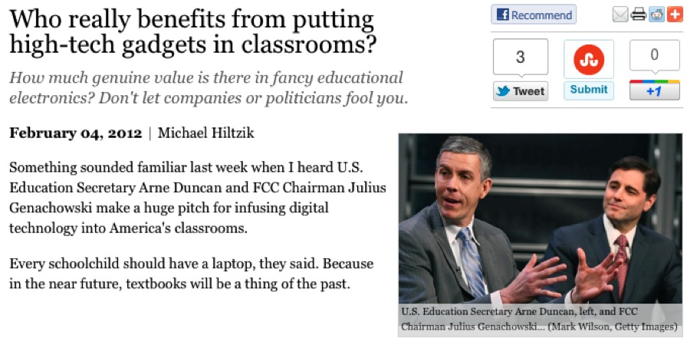

Slide 7
Goals
Clarify the rationale for educational design research (EDR).
Illustrate how even (especially) PhD students can pursue EDR.
Describe the important criteria of an EDR project.

Slide 8
Research Paradigm Arguments Persist

Slide 9
Paradigm

Slide 10
Positivist Paradigm
There are facts with an objective reality that exist regardless of our beliefs.
The goal of research is to detect the causes of changes in phenomena through measurement and quantitative analysis.
Experimental designs are best because they reduce “error” hiding “the truth.”
Detachment is the ideal state.

Slide 11
Interpretivist Paradigm
Reality is socially constructed through collective definitions of phenomena.
The goal of research is to interpret phenomena from multiple perspectives.
Ethnographic methods such as observation and interviews are best because they provide the basis for shared interpretations.
Immersion is the ideal state.

Slide 12
Critical Paradigm
Reality is individually constructed based upon experience, gender, culture, etc.
The goal of research is to improve the status of the under-privileged.
Critical theory deconstructing phenomena is best when it reveals the hidden power agendas in many educational technology interventions.
Political engagement is the ideal state.

Slide 13
Heuristic Paradigm
Reality is complex and learning phenomena are unpredictable.
The goal of research is to provide education practitioners with the information they need to make better decisions.
Methods and tools should be selected on the basis of their potential for enhancing the quality of decision-making.
Skepticism is the ideal state.

Slide 15
Design Paradigm
Educational phenomena are exceedingly complex.
The goal of research is to have a positive impact on education practice and to contribute to design knowledge.
Creative design efforts combined with rigorous evaluation using multiple methods are recommended.
Commitment is the ideal state.

Slide 16
Educational design research is driven by a desire for impact.

Slide 17
The Impact of educational technology research?

Slide 18
Where is the impact of our research?

Slide 19
Research Reality
Isolated researchers conduct individual studies rarely linked to a robust research agenda or concerned with practice.
Studies are presented at conferences attended by other researchers and published in journals few practitioners read.
Occasional literature reviews and meta-analyses are published.

Slide 21
Academic Research
Educational Practice

Slide 22
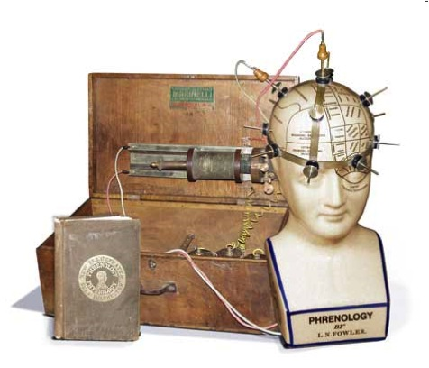
Educational technology “research” remains primarily pseudoscientific.

Slide 23
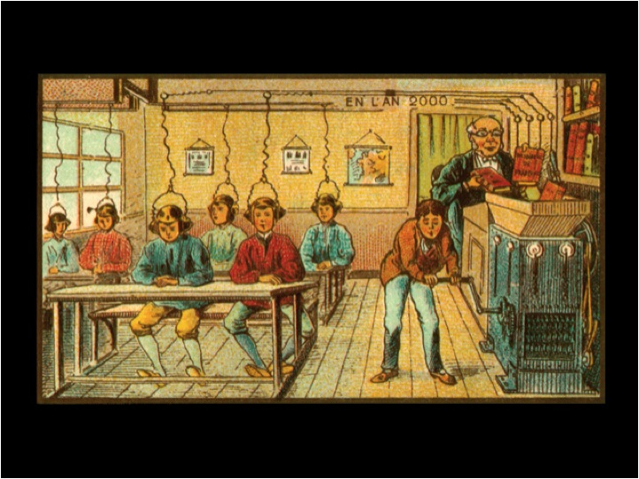

Slide 24
No
Significant
Difference

Slide 25
1928-2008
distance delivery modes from correspondence schools, radio, television, video, and now e-learning
when the course materials and teaching methodology are held constant, there are no significant differences (NSD) in learner outcomes
http://www.nosignificantdifference.org/

Slide 26
Educational technology researchers often fail to distinguish between research goals and methods.

Slide 27
Research Goals
Theoretical
Predictive
Descriptive
Postmodern
Design/Development
Action/Evaluation

Slide 28
Research Methods
Quantitative
Qualitative
Mixed
Historical
Literature Review
Critical Deconstruction

Slide 29
Design-Based Research Model
Phase 1
Phase 2
Phase 3
Phase 4
Analysis of Practical Problems by Research and Practitioners in Collaboration
Development of Solutions Informed by Existing Design Principles and Technological Innovations
Iterative Cycles of Testing and Refinement of Solutions in Practice
Reflection to Produce “Design Principles” and Enhance Solution Implementation
Refinement of Problems, Solutions, Methods, and Design Principles
(Reeves, 2006, p. 59)
Reeves, T. C. (2006). Design research from the technology perspective. In J. V. Akker, K. Gravemeijer, S. McKenney, & N. Nieveen (Eds.), Educational design research (pp. 86-109). London: Routledge.

Slide 31
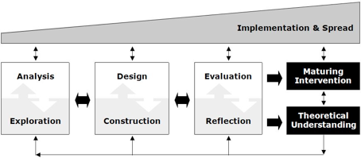
McKenney, S. E., & Reeves, T. C. (in press). Conducting educational design research. New York: Routledge.

Slide 32
Educational Design Research Steps
Identify a serious problem.
Work closely with practitioners to define the problem and desirable outcomes.
Create a prototype intervention informed by theory and the research literature.
Evaluate and refine the intervention in the real world.
Modify intervention until outcomes are reached.
Share findings with practitioners and researchers.

Slide 33
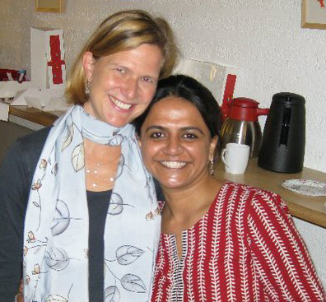
Susan McKenney & Harini Raval University of Twente, The Netherlands

Slide 34
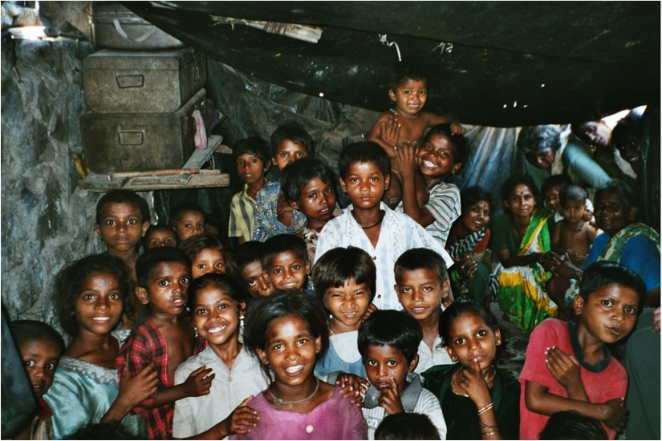

Slide 35
Raval, H. (2010). Supporting para-teachers in an Indian NGO: The plan–enact–reflect cycle. Doctoral dissertation. Enschede, NL: Twente University.
Type of Study: Educational design research study led by doctoral student and her supervisor.
Main Research Question: What kind of professional support can help para-teachers adopt teaching strategies with a learner-centered orientation?
Dual Outcomes:
Robust para-teacher professional development program
Design heuristics for creating similar programs in other contexts

Slide 36
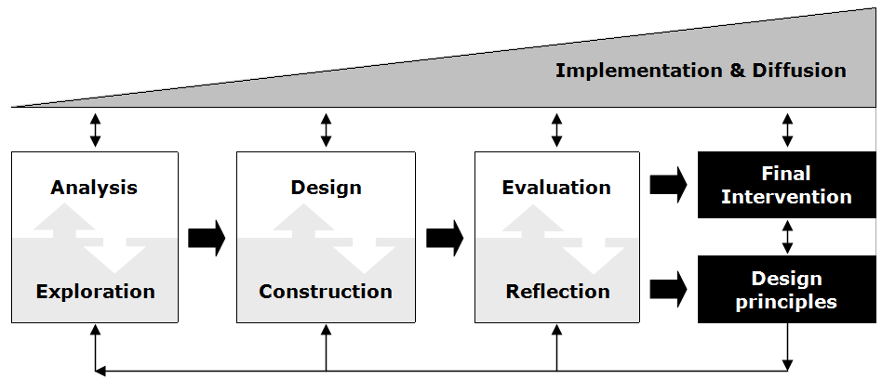
Para-teacher learning in an Indian NGO
Analysis
Literature review
Field portrait
Classroom observations
Teacher interviews
Management interviews
Exploration
Program inspiration
India
Long term interest in developing countries
SWOT (Strengths, Weaknesses, Opportunities, and Threats ) analysis to establish options and boundaries for a sustainable professional development program

Slide 37
Para-teacher learning in an Indian NGO
Design
Four major factors
the para-teacher
the instructional setting
the organizational setting
policy
Conceptual model
lesson planning
lesson enactment
reflection on the lessons
Construction
Workshop components
tailor-made templates for lesson planning and reflection
Opportunities to increase content knowledge
Pedagogical guidelines

Slide 38
Para-teacher learning in an Indian NGO
Evaluation
Three rounds of testing of professional development workshop
Researcher alone
Local managers with researcher present
Local managers alone
Reflection
Enhance PD program
Identify reusable design heuristics

Slide 39
Para-teacher learning in an Indian NGO
Implementation
First: Organizational conditions
Second: Basic teaching and classroom management skills
Third: Learner-centeredness
Diffusion
From start: Eye toward scale and sustainability
Program institutionalized (endures and grows without researchers)
Multiple publications

Slide 40
Article-Based Dissertation
Raval, H., McKenney, S., & Pieters, J. (2010). A conceptual model for supporting para-teacher learning in an Indian NGO. Studies in Continuing Education, 32(3), 217–234.
Raval, H., McKenney, S., & Pieters, J. (2011). Institutionalizing planning, enactment and reflection of daily lessons through appropriate organizational restructuring. The Asia-Pacific Educational Researcher, 20(3), 438=455.
Raval, H., McKenney, S., & Pieters, J. (In press). A needs and context analysis for teacher learning in an Indian NGO. International Journal of Training and Development.
Raval, H., McKenney, S., & Pieters, J. (under review). Supporting para-teachers by regularizing and strengthening planning, enactment and reflection of daily lessons.
Raval, H., McKenney, S., & Pieters, J. (under review). Summative evaluation of para-teacher support for remedial teaching in Indian slums.

Slide 41
Educational Design Research Characteristics:
Focused on broad-based, complex problems critical to education practice.
Intensive collaboration among researchers and practitioners.
Long-term engagement involving continual refinement of protocols and questions.
Commitment to innovative solutions and design principles.
Supervising faculty must have a robust research agenda.

Slide 42
Key Criteria for Design-Based Research
Collaborative
Utility-oriented
Theory-informed
Interventionist
Iterative
Rigorous
Relevant

Slide 43
Key Criteria for Design-Based Research
Collaborative
Utility-oriented
Theory-informed
Interventionist
Iterative
Rigorous
Relevant

Slide 44
Key Criteria for Design-Based Research
Collaborative
Utility-oriented
Theory-informed
Interventionist
Iterative
Rigorous
Relevant

Slide 45
Key Criteria for Design-Based Research
Collaborative
Utility-oriented
Theory-informed
Interventionist
Iterative
Rigorous
Relevant

Slide 46
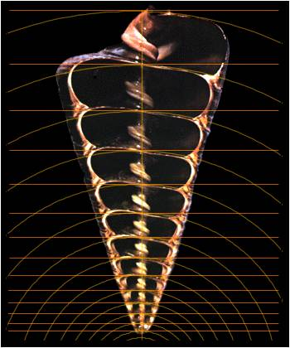
Key Criteria for Design-Based Research
Collaborative
Utility-oriented
Theory-informed
Interventionist
Iterative
Rigorous
Relevant

Slide 47
Key Criteria for Design-Based Research
Collaborative
Utility-oriented
Theory-informed
Interventionist
Iterative
Rigorous
Relevant

Slide 48
Key Criteria for Design-Based Research
Collaborative
Utility-oriented
Theory-informed
Interventionist
Iterative
Rigorous
Relevant

Slide 49
Should I engage in educational design research?

Slide 50
Resources
http://web.me.com/janherrington/EDR/

Slide 51
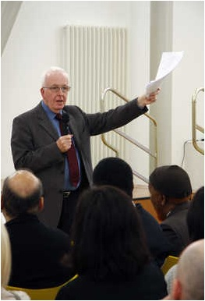
“The status of research deemed educational would have to be judged, first in terms of its disciplined quality and secondly in terms of its impact. Poor discipline is no discipline. And excellent research without impact is not educational.”
- Charles W. Desforges (2000)

Slide 52
Thank You!
Professor Emeritus Tom Reeves
The University of Georgia
Instructional Technology
604 Aderhold Hall
Athens, GA
30602-7144 USA
treeves@uga.edu
http://it.coe.uga.edu/~treeves

