Slide 1
MDDE Portfolio Defense
Glenn Groulx
March 2010
Athabasca University

Slide 2
MDDE601 – Article Critique

Slide 3
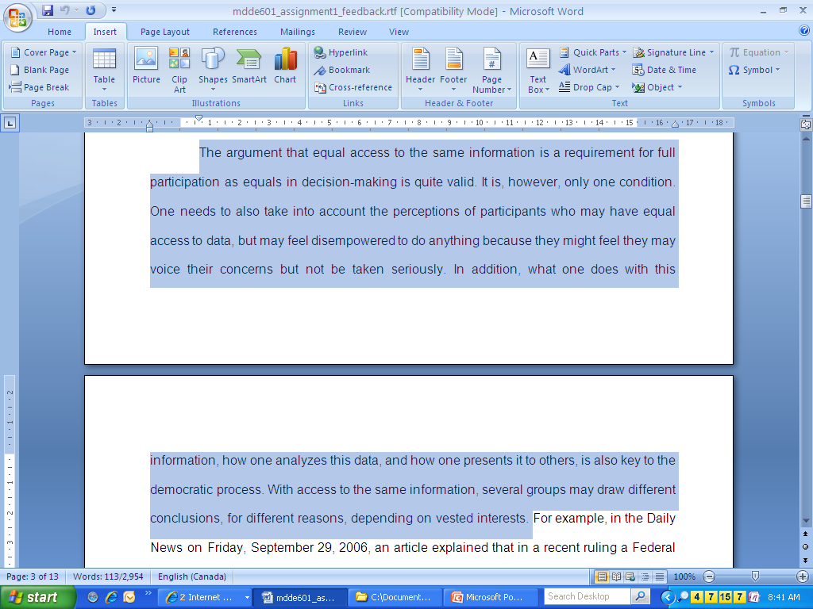
1.1,1.2 - Recognize and Define Aspects of Problems

Slide 4
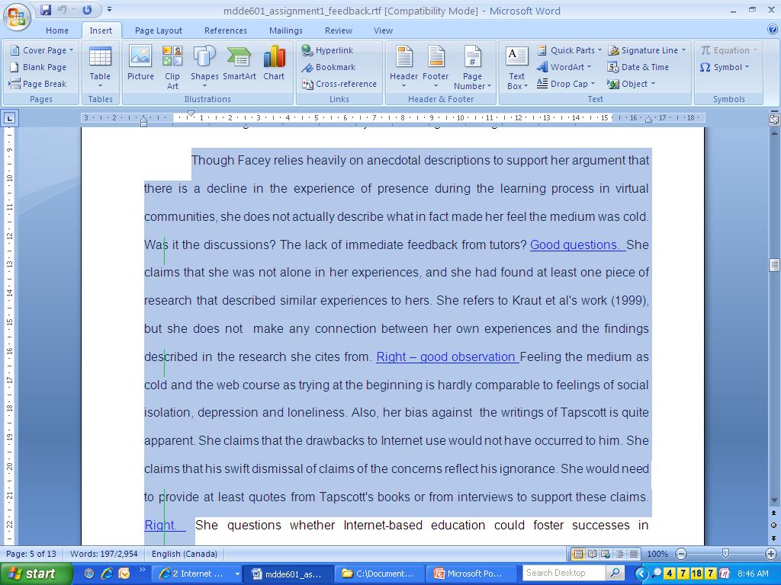
1.3, 1.5 – Formulating questions; evaluating relevance of information for a given situation

Slide 5
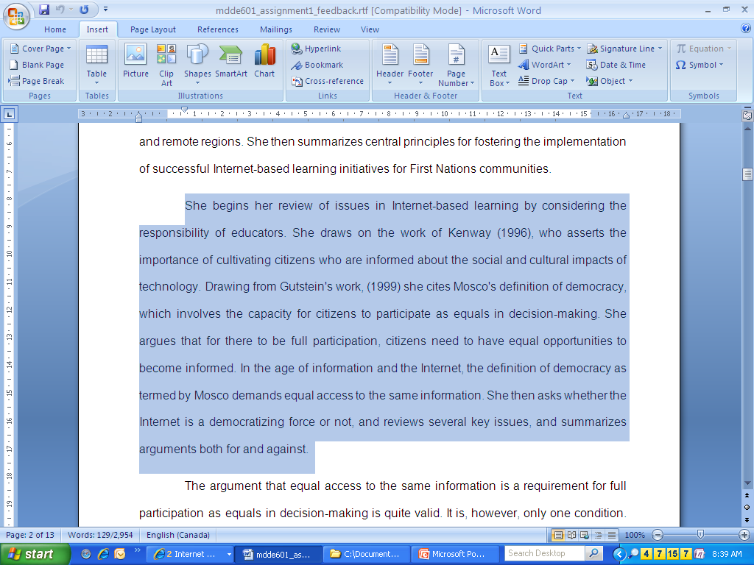
1.4 - Find and Access Information

Slide 6
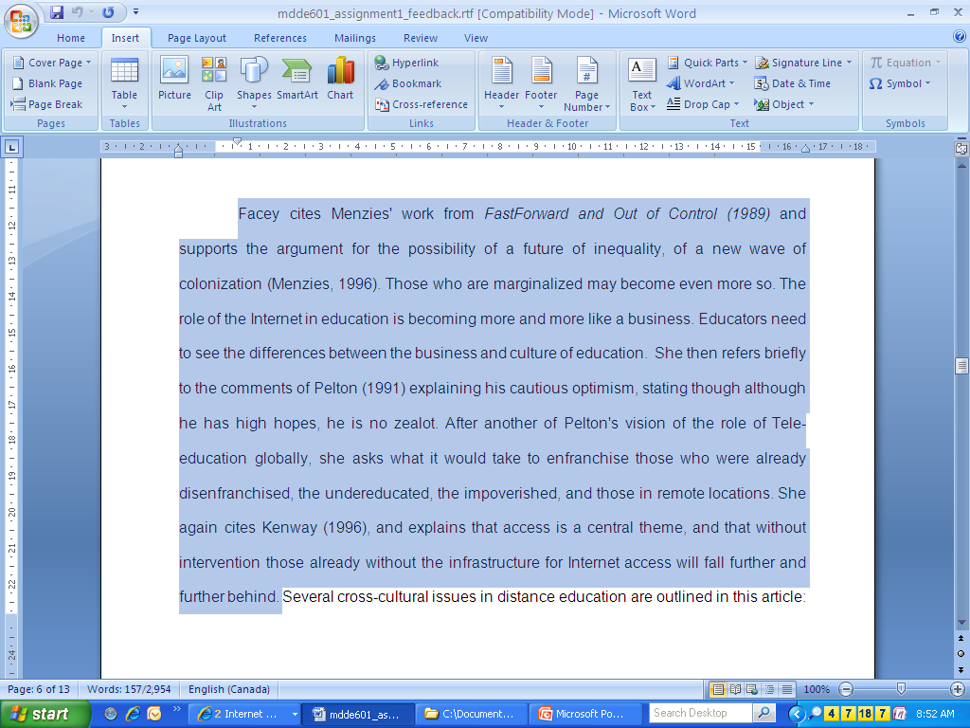
5.3 – Access and critically evaluate sources and content for quality, applicability and relevance

Slide 7
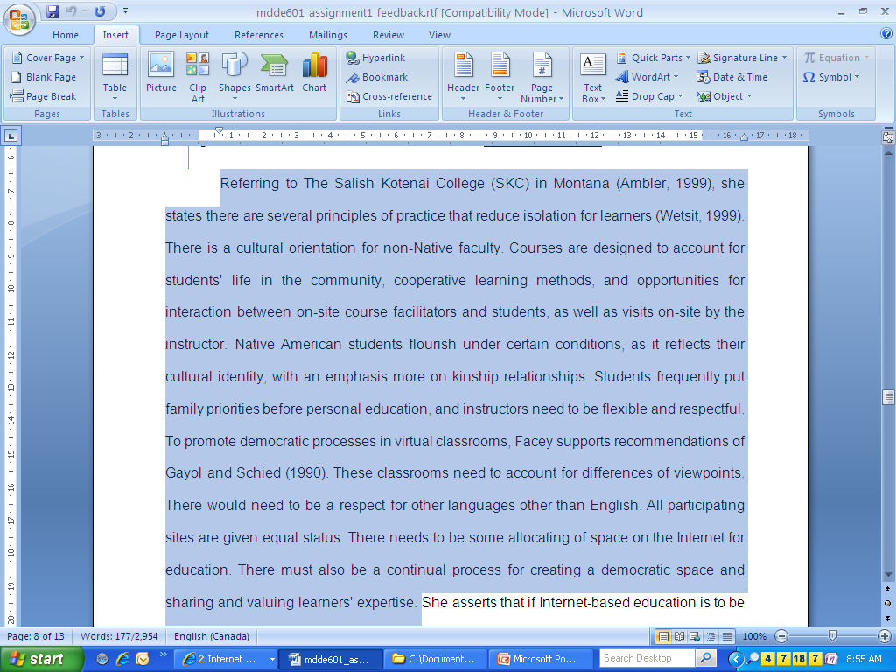
5.6 – Summarize and synthesize

