Slide 2
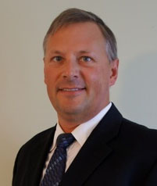
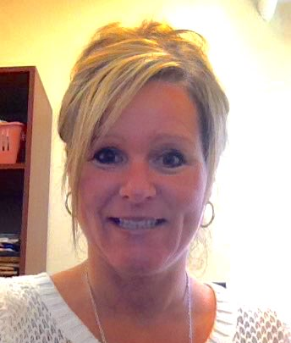
Presenters
M. Cleveland-Innes, PhD
Professor and Chair,
Centre for Distance Education
Athabasca University
Guest Professor, Department of Learning
KTH Royal Institute of Technology
Stockholm, Sweden
Dr. Nathaniel Ostashewski Assistant Professor
BSc Alberta, BEd Alberta, MEd Alberta, Academic Engagement Projects Developer at Curtin Teaching & Learning, Curtin University. He holds a teacher’s license in the province of Alberta, Canada
Joanne Murphy
Project Manager
PBDID Student • Athabasca University
Program Manager / Online Learning Specialist • Dalhousie University
Halifax, Nova Scotia, Canada

Slide 3
Today’s Agenda
A brief history of MOOC emergence
Athabasca University's response to MOOCs
The story of a new kind of MOOC: Learning to Learn Online

Slide 4
Key Dates & Developments
Original cMOOCs (2008) vs better known xMOOCs (2011)
xMOOCs took off in fall of 2011 with Intro AI Course at Stanford
Platform providers (Coursera, edX, Udacity, FutureLearn) vs content providers (Stanford, Harvard, MIT, Edinburgh, OU, ...)
This initiative is to support AU to be a learning provider
• Adapted from the work of Peter Sloep
http://preview.tinyurl.com/petersloep
© H Is for Home https://www.flickr.com

Slide 5
“….. the way forward lies in construing and enacting a pedagogy for human being. In other words, learning for an unknown future has to be a learning understood neither in terms of knowledge or skills but of human qualities and dispositions” (Barnett, 2012, p. 65).
Barnett, R. (2012). Learning for an unknown future. Higher Education Research & Development, 31(1), 65-77.

Slide 6
AU (M)OOC Advisory Group Co-leaders
Dr. Derek Briton
Dr. Marti Cleveland-Innes
Dr. Mike Gismondi
Dr. Cindy Ives
Dr. Nathaniel Ostashewski
Dr. Nancy Parker
Dr. George Siemens
Dr. Veronica Thompson

Slide 7
AU (M)OOC Advisory Group
Development Process
Create expert, evidence-based assessment of, and a critical academic and practical voice on (M)OOC issues
Determine process on assignment of credit
Support interest in MOOCs that continue social mandate to remove barriers to learning and engage new learners
Observe, document, measure, analyze and share our (M)OOC experience.

Slide 8
MOOC Research Initiative at AU
http://www.gatesfoundation.org/How-WeWork/Quick-Links/Grants-Database/Grants/2013/06/OPP1078781
Grant increased to $840,000
http://www.athabascau.ca/aboutau/news/index.php?new&id=139
266 submissions
78 second round review
28 successful submissions
2 projects in support of AU projects
http://www.moocresearch.com/
Site to report on MOOC research jointly sponsored by B&MGF and AU
http://www.slideshare.net/gsiemens/mooc-research-initiative
George’s report on MOOC initiative
Image courtesy Maastericht University

Slide 9
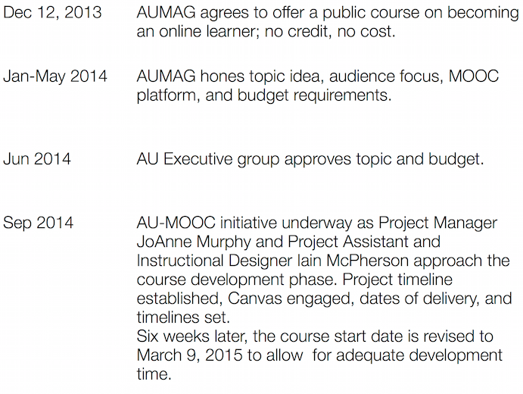
Approval and start-up

Slide 10
General Information
i
5 week MOOC
Launch date: March 9, 2015
Canvas LMS
Designed for both new and experienced learners (community-based education)
Learner-centred, engaging, high quality educational experience

Slide 11
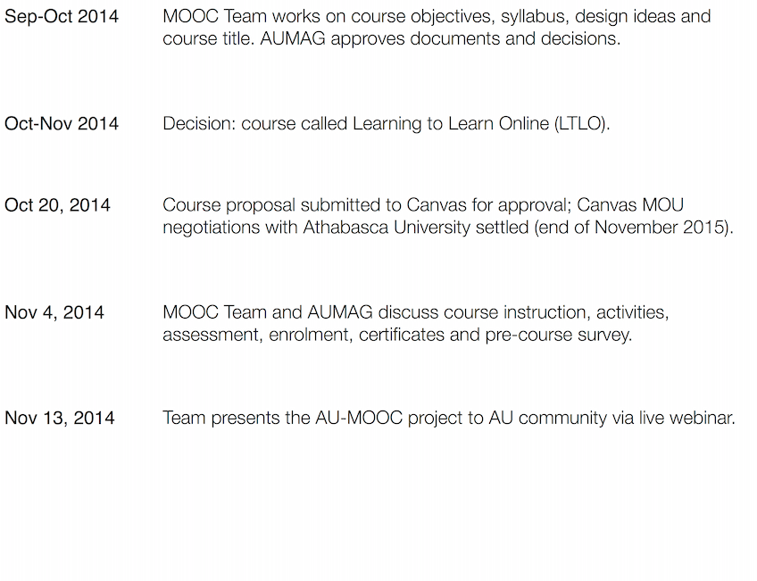
LTLO design timeline

Slide 12
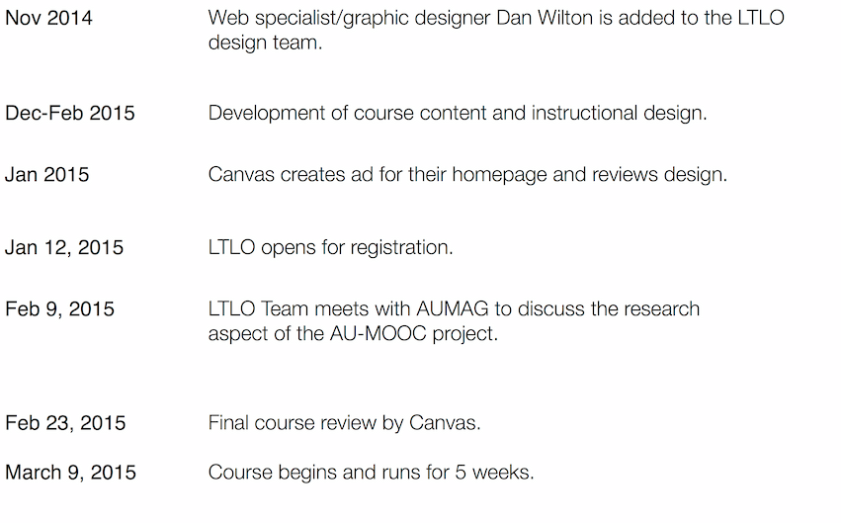
LTLO design timeline

Slide 13
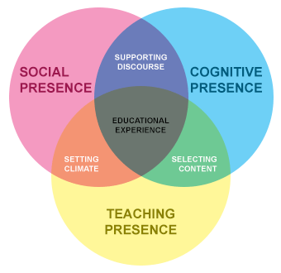
Goals & Design
Based on Community of Inquiry (CoI)
Garrison, Anderson & Archer, 2000

Slide 14
Goals and Design
Learn about course participants early in the course to enable us to enhance the learning experience and foster a learner-centered learning environment
Immediately engage learners and keep them engaged
Reach learners on an emotional level
Maintain the ‘open’ concept of a MOOC by providing learners with choice in their own learning experience; designing for learners of varying knowledge and computer experience
Design to feature cognitive, teaching, and social presences as posited by Garrison & Archer’s Community of Inquiry model
Multi-modal designing to appeal to various learning preferences

Slide 15
Learning Outcomes
Learners who successfully complete the AU MOOC will have demonstrated the ability to:
Describe what it means to learn.
Identify and analyze their personal learning preferences.
Describe areas of adjustment required for the online environment.
Analyze and compare the differences between the online learning and face-to-face learning experience (or ‘other types of learning’).
Identify and describe the common components of an online learning environment.
Employ effective online communication skills through an exploration of common online communication tools and strategies.
Analyze various types of online learning environments including the paradigm of the personal learning environment.
Formulate a personal strategy for successfully adapting to online learning

Slide 16
LTLO: Instruction
Three levels of instructor presence to: 1) support learners and 2) encourage a Community of Inquiry
Lead Instructor: AU Faculty Member
The Inspirer: AU MDE Graduate Student
Facilitators: 10 MDE Graduates/Students

Slide 17
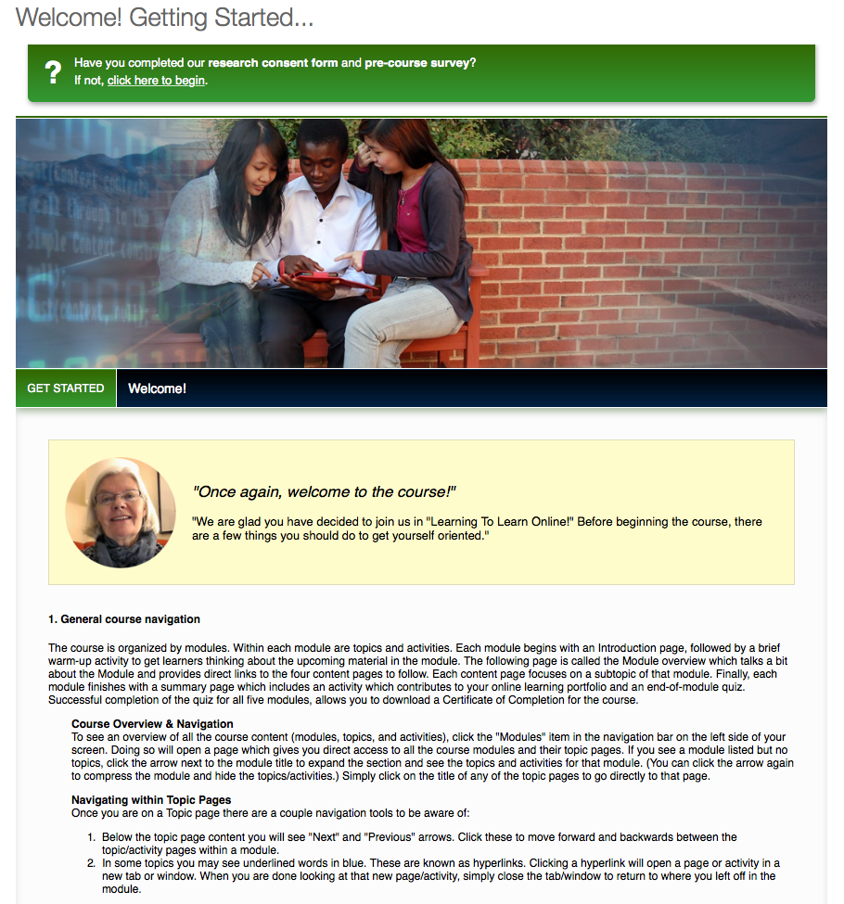

Slide 18
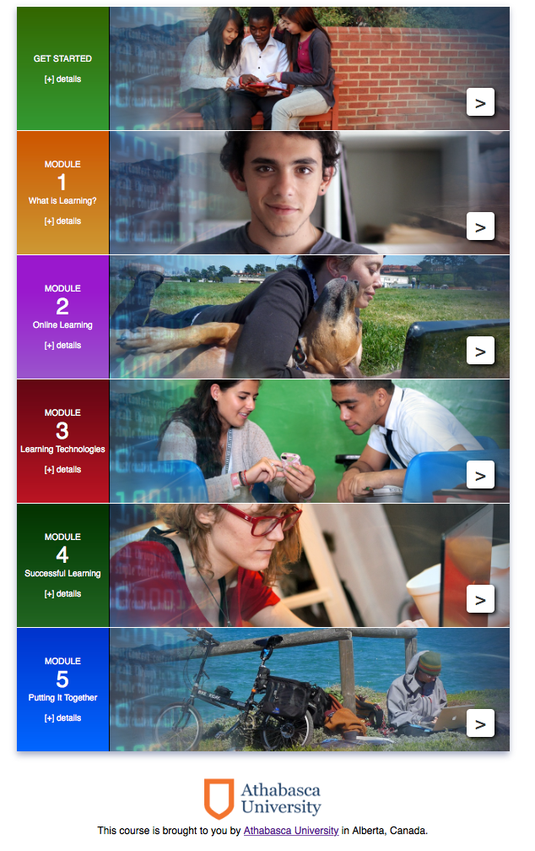

Slide 19
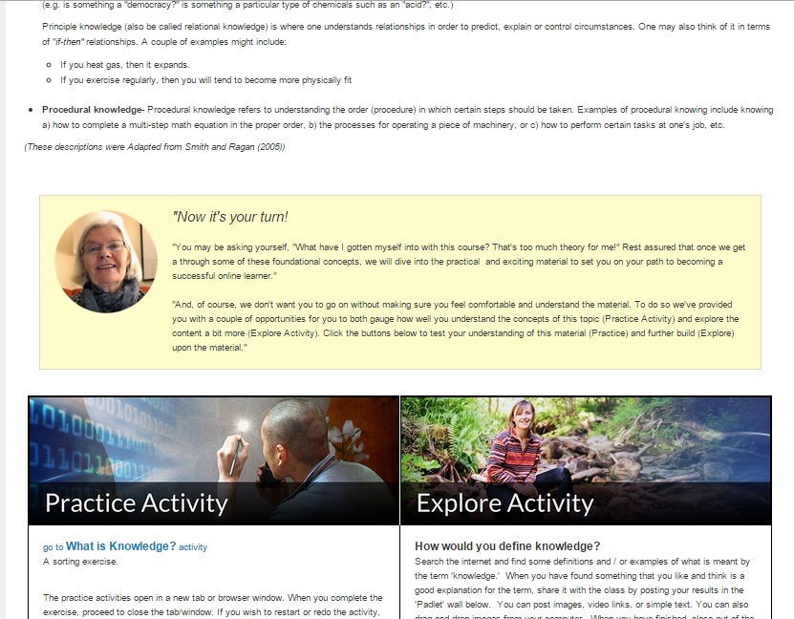

Slide 20
Research Questions
1. Identify the demographic profile of participants in LTLO;
2. Track the online activity of participants in LTLO;
3. Analyze discussion forum postings as artifacts of the amount and quality of text-based participation in LTLO;
4. Ask participants to tell us about their individual experience in LTLO through open and closed ended survey questions, pre and post LTLO;
5. Interview participants, instructors, designers, and advisors involved in LTLO to request these stakeholders describe their experience with and assessment of LTLO

Slide 21
Data Collected
Canvas Course Analytics & Enrolments
Pre-Course Survey
Course Discussions & Activity
YouTube Analytics
Post Course Survey
Semi-structured Participant Interviews (11)

Slide 22
Quick LTLO MOOC Statistics
Participants Enrolled 1825
Signed into the course 916
Completed (all 5 quizzes) 148
Downloaded a certificate 143
Discussion messages 3099
Messages by facilitators 1284
Messages by students 1815
Students who posted 310
Pre-course surveys completed 487
Post-Experience surveys completed 120
English first language, pre-course 63%
English first language, completed 65%
Holding no degree 28%
College/undergraduate degree 31%
Graduate student or above 41%

Slide 23
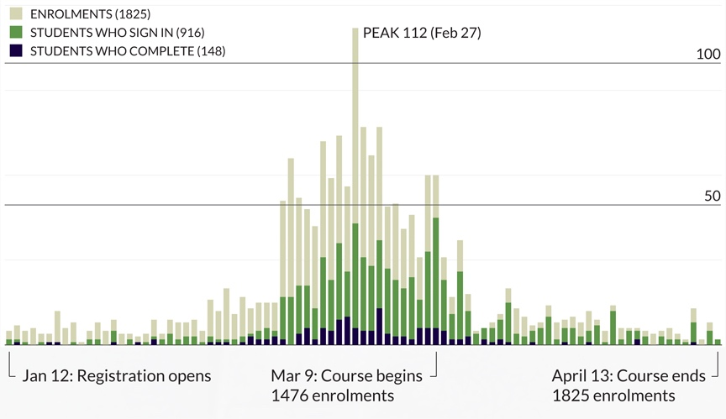
LTLO MOOC Enrolments

Slide 24
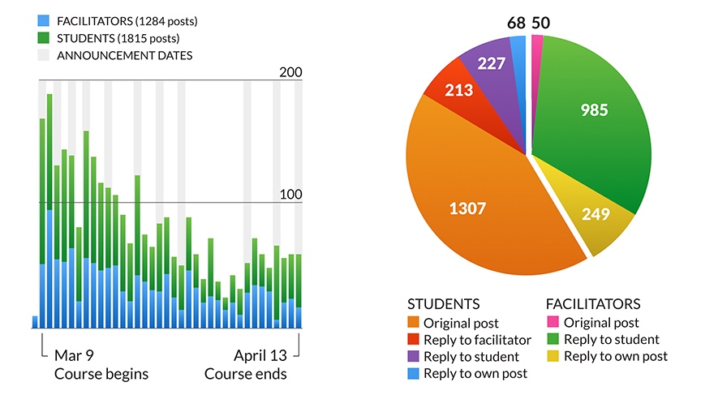
Discussion Activity

Slide 25
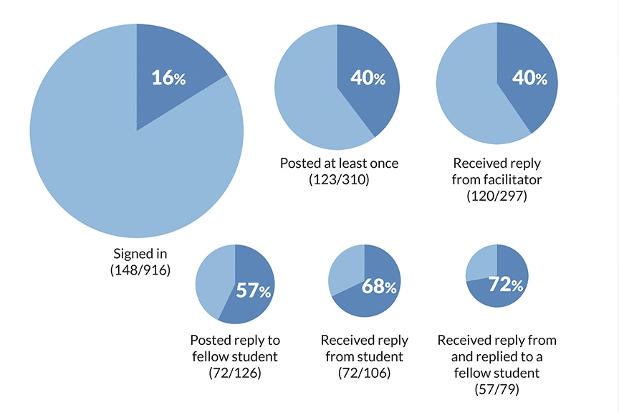
Interaction and Completion

Slide 26
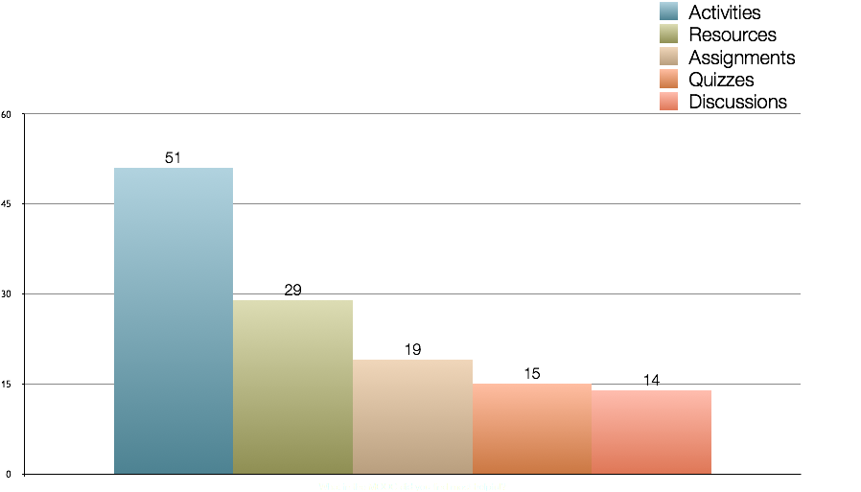
Which of the assignments/course activities did you find the most helpful?

Slide 27
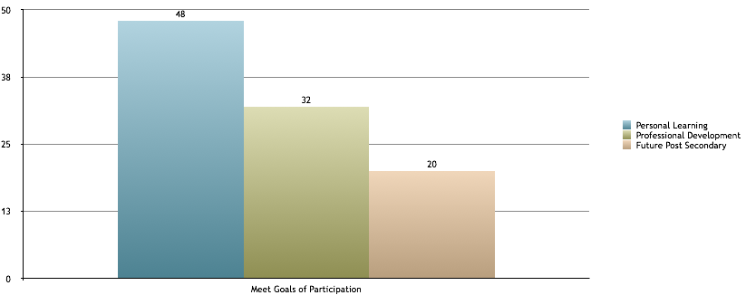
In what ways has the LTLO MOOC helped you meet your personal or professional goals?
Personal Learning Goals: Learn about online education.
Professional Development Goals: The course is valuable to me as it provides me with new knowledge and skills to enhance my teaching career.
Future Post secondary Education Goals: The course has helped me to decide to pursue a degree program using distance learning.

Slide 28
Participant Interviews
“The [AU] course was by far one of the best MOOCs courses that I have participated. The course design was very engaging and truly enjoyed the quizzes, as it was well designed and superbly challenging.”
The LTLO experience allowed another participant an opportunity to learn more about AU and online learning – As a result the participant plans to pursue an online Masters program, perhaps at AU.
A college curriculum designer( taking this as her first online course) wants to replicate the MOOC at her College – especially the introduction videos and the practice activities.
A semi-retired Professor thought that there was good practical application of knowledge in the activities and said that ‘it felt like a teacher was there’. He is now more knowledgeable and motivated to do things online.

Slide 29
Participant Interviews
A female participant liked connecting with people all over the world. Through people, she gained confidence and resources, and liked that there were videos and not just text.
A male participant is likely to use the course as a template in his online training for the Yukon government. He liked that it was open and felt that it was good advertising for AU – he even checked out the AU website as a result. He liked the course and felt that it presented AU in a ‘good light’.
Another female participant thought it was a great course and that all AU students should be mandated to take it to support their online learning.

Slide 30
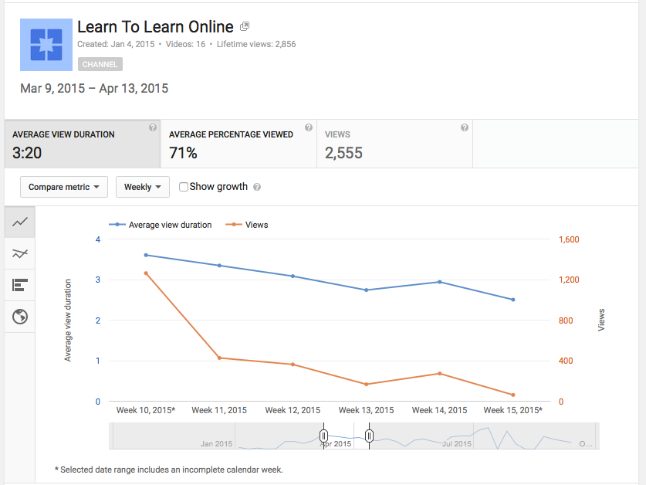
Video Playback Analytics
Videos were short in length (about 4.5 minutes) of which 71% was viewed.

Slide 31
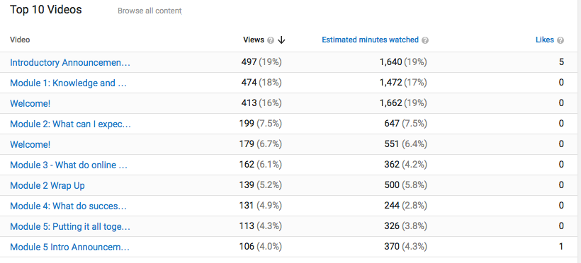
Weekly Video Playback Analytics
Viewers: 56% Female, 44% Male
View rates follow other interaction patterns reported in MOOCs: Highest rates of engagement in Week 1, dropping off gradually as the course progresses (regardless of course length)

Slide 32
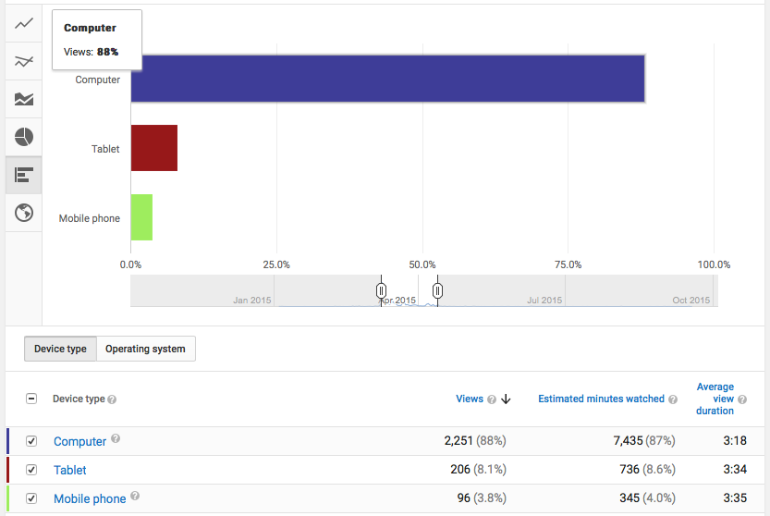
Video Playback By Device
Other MOOCs have reported higher numbers of Mobile device access for videos. Suggests that novice online learners are also novice mobile learners.

Slide 33
The Experience
Video: labour intensive rich, personal positive reception
high uptake
text versions ‘save time.’
Text:
Discussion boards promoted Most text-based communication was discussion board activity
Facilitators contacted supervisor via email Learner activity very high in the early days Dynamic videos (announcements) viewed more than static videos (module introductions).

Slide 34
Questions
All images courtesy www.gettyimages.ca
unless otherwise noted

Slide 35
AUMOOC Learning to Learn Online
M. Cleveland-Innes, PhD
martic@athabascau.ca
Dr. Nathaniel Ostashewski nostashewski@athabascau.ca
Joanne Murphy
jmurphy_au@yahoo.com

