Slide 1
Trans-Pacific Partnership (TPP):
IMPACT ON CANADA
Nadir Masood
COMP 607 Athabasca University
Dec 2015

Slide 2
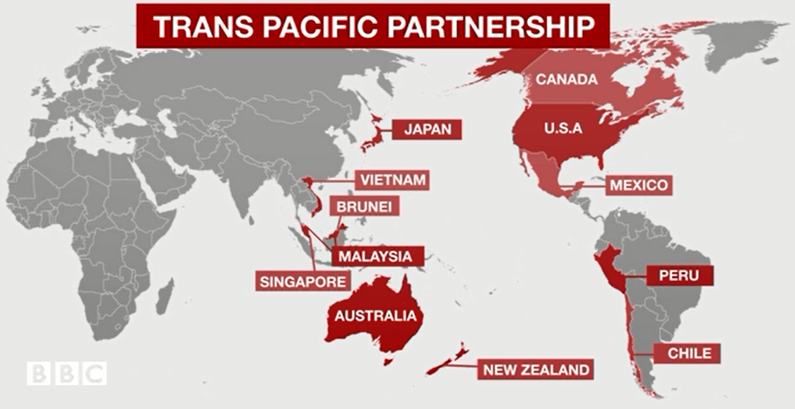
What is the TPP?
An international free trade agreement between Pacific Rim countries that represents 40% of the world’s economy.
Source: BBC News © 2015 BBC
Notes:
The TPP is a multilateral free trade agreement among twelve Pacific Rim nations that was reached on the 5th of October 2015 after seven years of negotiations. The TPP is an extension of the four nation Trans-Pacific Strategic Economic Partnership (TPSEP) agreement which was signed by New Zealand, Chile, Brunei and Singapore in 2005.
Canada entered negotiations in October of 2012 as a non party member. The TPP represents 40% of the world’s economy and includes the United States and Japan.
Nations of the TPP:
Canada Singapore
USA Australia
Japan New Zealand
Vietnam Chile
Brunei Peru
Malaysia Mexico

Slide 3
Key TPP resolutions
Promote economic integration;
Strengthen relationships;
Build upon rights and obligations under the WTO;
Strengthen competitiveness of businesses;
Support the growth of small businesses;
Establish a predictable legal and commercial framework;
Facilitate trade through transparent customs procedures;
Promote environmental protection and labour rights;
Recognize the right to adopt, maintain or modify healthcare systems.

Slide 4
Sounds great! What’s the problem?
Secret negotiations - no public consultation;
Negotiated by outgoing govt. during elections;
External pressure to ratify agreement;
Pressure to sign - even if not ratified;
Made in America – influenced by US interests;
Concerns regarding
Privacy Cybersecurity
Intellectual Property Patents
Notes:
Negotiated in secrecy - no public consultation;
Text not publicized until after the treaty was negotiated;
Negotiated by outgoing govt. during election campaign;
External pressure to ratify agreement;
Pressure to sign agreement (even if not ratified);
Made in America – heavily influenced by the US;
Concerns raised regarding privacy, intellectual property.

Slide 5
Privacy
Storage of personal sensitive information outside Canada;
No say in how or where data is stored;
Safeguards;
Surveillance.

Slide 6
Cybersecurity
Only two bullet points in the agreement:
Importance of building national cyber incident response capabilities;
Importance of collaboration.
Cannot request source code as a condition for sale of software.

Slide 7
Intellectual property
Modelled after DMCA;
International agreements;
Key issues:
Technological Protection Measures;
Patents.

Slide 8
Intellectual property - TPMs
Circumvention of TPMs contravenes Canadian copyright laws;
Treated as separate infringement under TPP, regardless of any illegal action associated with it;
Notes:
While the circumvention of digital locks or Technological Protection Measures contravenes Section 41 of the Canadian Copyright Act, the TPP stipulates that the it should be treated as a separate infringement – distinct from any illegal activity associated with the circumvention. This raises the question as to what happens when a TPM is broken on work that is not copyrightable or if the copyright has expired?

Slide 9
Intellectual property - Patents
Lead to accelerated increase in drug prices;
Curb competition from generic drug manufacturers.
Notes:
A major concern with regards to the host of patent provisions is the impact to pharmaceuticals. Humanitarian agencies rely heavily on generic drug manufacturers to provide low cost alternatives to support treatment programs in developing and conflict areas. However, the TPP mandates that extending pharmaceutical patents by at least five years and prohibiting national drug regulatory authorities from approving generic drugs until patent expiry.

Slide 10
Conclusion
Impact is more far reaching and is outside the scope of this discussion.
Canadians need to be informed of the impacts to their laws by an agreement negotiated in secret.
External pressure to ratify should be measured against long term effects.
Nadir Masood ● COMP 607 ● Athabasca University ● Dec 2015 All images copyright free or licensed under Creative Commons Public Domain Dedication (CCO)
Notes:
With the official text of the agreement only released within the last few months, the impact to Canada has yet to be fully analyzed. This research has only skimmed the surface but some major impacts to Canadian laws were revealed. What is most concerning to me personally is how Canadian laws are forced to be modified by a treaty negotiated behind closed doors. While there is pressure from the United States for Canada to ratify and sign on to the agreement, there needs to be a deliberate consideration of the long term effects.
Please feel free to send me your comments, feedback and questions on the Landing. Thank you for your time.

