Slide 2
A model for a successful Indigenous online high school: Perspectives of teachers, staff, students, and parents Presented by: Sophia Palahicky December 9, 2015
Dissertation Committee Members Dr. Dianne Conrad Dr. Cynthia Blodgett-Griffin Dr. Lloyd Robertson Dr. Michael Barbour

Slide 3
Presentation Overview
Introduction and Background
Research problem
Literature review
Research questions
Research methodology
Findings
Questions

Slide 4
Aboriginal Population Source: Statistics Canada 2011
Population - 4.3% of the total Canadian population
Population Growth - increased by 20.1% between 2006 and 2011
Population Density - largest shares of the population of Nunavut and the Northwest Territories & largest numbers lived in Ontario and the western provinces
Population Breakdown - 60.8% First Nations , 32.3% Métis & 4.2% Inuit

Slide 5
Aboriginal Population Continued Source: Statistics Canada 2011
Young population - 7% of all children, 5.9% of all youth, & the median age was 26
Diverse cultures - more than 600 First Nations/Indian bands & over 60 Aboriginal languages
Population of reserves - 49.3% lived on an Indian reserve or Indian settlement

Slide 6
High School Completion Rates
Total rate in Canada - 78.3% recorded in 2009-2010
Aboriginal rate - Nearly 40% of Aboriginal students did not complete high school (Friesen, 2013).
Manitoba rate - Manitoba had the lowest high-school graduation rate for First Nations (Canadian Press, 2014)

Slide 7
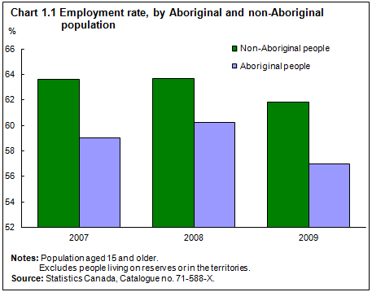
Employment Rate

Slide 8
Education and the Labour Market Source: Statistic Canada 2011
Completed postsecondary education – employment rate down 1.8%
Important point - non-Aboriginal people with a completed postsecondary education employment rate down 1.5%
With less than a high school diploma - employment rate down 5.5%
With a high school diploma and some postsecondary education - employment rate down 3.3%

Slide 9
Research Problem
High school completion rates are low for Aboriginal learners
High school completion rates are alarmingly low for First Nations students
High school completion rates affect labour market success

Slide 10
Complexity of The Issue
Cultural invasion
Marginalization
Aboriginal control over Aboriginal education
Reconnecting Aboriginal communities to cultures and languages
Funding inequalities

Slide 11
Addressing The Issue
Since the majority of Aboriginal peoples (more than 600 First Nations) reside in rural or remote areas, “distance education would seem in theory to offer considerable benefits to community members” (Simon, Burton, Lockhart, & O’Donnell, 2014, p. 2).

Slide 12
Research Purpose
Benefits
This research study uses a case study to describe a successful model of an Indigenous online high school by examining perceptions of teachers, staff, students, and parents.
Need
There is limited research on K-12 Aboriginal online education in Canada.

Slide 13
Definition of Success
Tunison’s (2007) definition of success states that:
“Success with respect to the Learning Spirit is typically seen through the lens of protecting and reclaiming language, culture, and tradition while focusing on long-term goals such as graduation and transitions to work and post-secondary institutions” (p. 13).

Slide 14
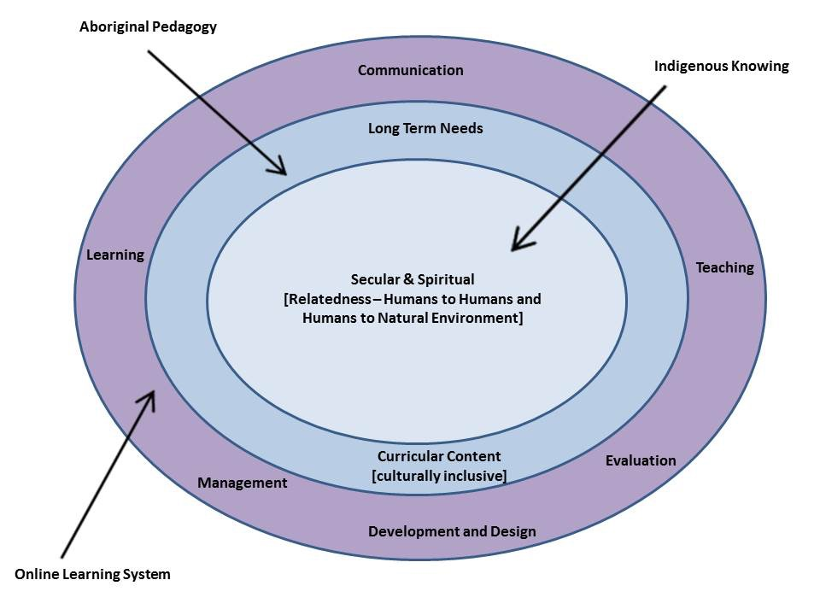
Conceptual Framework

Slide 15
Literature Review Topics
Historical review of Indigenous education
An investigation of successful models of distance education
The need for online learning in Aboriginal communities

Slide 16
Historical Review
Phase one – Residential schools
Phase two - Indian Act of 1951
Phase three - Indian Education Paper Phase One of 1973

Slide 17
Successful Models of Distance Education
Moore and Kearsley (2005) recommend distance education programs utilize a systems view in order to be successful.
Design & Development
Evaluation
Communication
Management
Teaching & Learning

Slide 18
Online Learning in Aboriginal Communities
There are four K-12 distance education programs under federal jurisdiction (Barbour, 2014).

Slide 19
Research Questions
What are the essential components of a successful Indigenous online high school?
What role does Indigenous culture play in shaping a successful model?

Slide 20
Research Methodology
According to Yin (2003), case study is appropriate when:
the researcher is not able to manipulate the behavior of the research participants
the casework covers contextual conditions that are relevant to the topic of study
the researcher cannot manipulate the behavior of the participants
the answers to the research questions will be derived from participants’ meaning

Slide 21
Data Collection and Analysis
Subtopic | Description
Methods | Mixed (qualitative and quantitative)
Instruments | 16 interviews online survey (17 participants)
Participants | administrators, teachers, staff, students, parents
Data analysis | Inductive approach (open coding, axial coding, selective coding)
Considerations | ethical consideration, access and permissions, informed consent, role as researcher

Slide 22
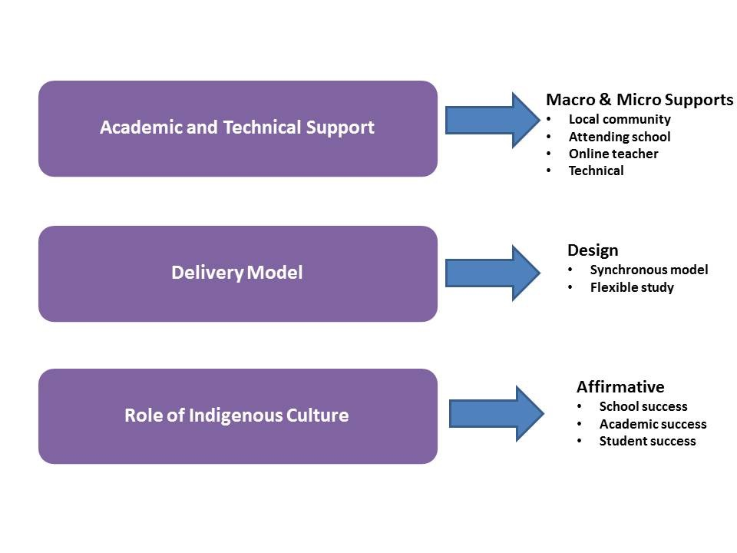
Findings

Slide 23
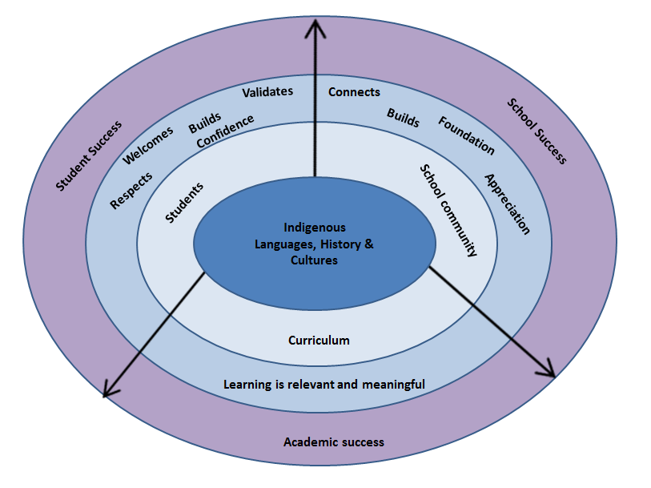

Slide 24
References
Barbour, M. K. (2013). State of the nation: K –12 online learning in Canada. Victoria, BC: Open School BC/Vienna, VA: International Council for K –12 Online Learning. Retrieved from http://www.openschool.bc.ca/pdfs/state_of_nation-2013.pdf
Clark, R. C., & Mayer, R. E. (2011). E-learning and the science of instruction: Proven guidelines for consumers and designers of multimedia learning (3rd Edition). Hoboken, NJ, USA: Pfeiffer. Retrieved from http://www.ebrary.com
Moore, M., & Kearsley, G. (2005). Distance education: A systems view. Belmont, CA.:Wadsworth.
Puxley, C. (2015). Grinding poverty faced by Manitoba First Nations worst in country: Aboriginal Affairs documents. Canadian Press. Retrieved from http://aptn.ca/news/2015/01/29/grinding-poverty-faced-manitoba-first-nations-worst-country-aboriginal-affairs-documents/
Report of The Standing Senate Committee on Aboriginal peoples. (2012). Reforming First Nations education [electronic resource]: From crisis to hope. Ottawa, Ont.: Standing Committee on Aboriginal peoples, 2011 (Saint-Lazare, Quebec: Canadian Electronic Library, 2012).
Simon, J., Burton, K., Lockhart, E., & O'Donnell, S. (2014). Post-secondary distance education in a contemporary colonial context: Experiences of students in a rural First Nation in Canada. The International Review Of Research In Open And Distance Learning, 15(1). Retrieved from http://www.irrodl.org/index.php/irrodl/article/view/1357/2770
Statistics Canada. (2011). Aboriginal Peoples in Canada: First Nations People, Métis and Inuit. Retrieved from http://www12.statcan.gc.ca/nhs-enm/2011/as-sa/99-011-x/99-011-x2011001-eng.cfm
Statistics Canada. (2011). Aboriginal Peoples. Retrieved from http://www.statcan.gc.ca/pub/11-402-x/2011000/chap/ap-pa/ap-pa-eng.htm
Strauss, A. L. & Corbin, J. (1990). Basics of Qualitative Research. Newbury Park, CA: Sage.
Tunison, S. (2007). Aboriginal learning: A review of current metrics of success. Saskatoon, SK, CAN: Canadian Council on Learning, Aboriginal Learning Knowledge Centre. Retrieved from http://www.ebrary.com
Yin, R. K. (2003). Case study research: Design and methods (3rd ed.). Thousand Oaks, CA: Sage.

Slide 25
FACTORS INFLUENCING PERSISTENCE IN HIGHER EDUCATION DISTANCE EDUCATION CONSORTIA
Research project in partial fulfillment of an
Ed.D. at Athabasca University
by
Gord Preston, B.Ed., M.B.A., Dip.C.S.
CIDER Presentation December 9, 2015

Slide 26
Agenda
Introduction
The Topic
The Methodology
The Analysis
Preliminary Findings

Slide 27
Introduction
Background
work history
education
Interest in Consortia
faith based business education in Canada
consortia potential

Slide 28
The Topic
Primary research question, “What factors influence persistence in four Canadian higher education, distance education consortia?”
Secondary research question, “To what extent, if any, does consortium operational alignment, or misalignment, with cultural logics influence its persistence? “
Why this topic?
Why Canada?
Why the external environment?

Slide 29
Reflections on Methodology
Four case studies
scale too big for an Ed.D. dissertation, but learning lots
Case selection
convenience has benefits
contrast has benefits
Methodological changes on the fly: switch from two to one phase of data collection

Slide 30
The Analysis
Narrative Analysis
15 interviews
90+ documents
10% second coded; 88% agreement (Cohen’s kappa .872)
Meta-triangulation between three models
again, scale too ambitious but learning lots

Slide 31
Preliminary Findings
Incomplete, but…
Early indications confirm the importance of alignment with cultural logics
Similarities between jurisdictions
consortium highly valued by operational personnel
inter-organizational models confirmed
Differences between jurisdictions
Functional differences to achieve similar goals (access, efficiency, excellence, accountability)

Slide 32
Heather Scarlett-Ferguson BSP, M.ED. (DE), Edd(c), RPh Athabasca University
Professional Development Education use by Pharmacists:
Exploring Organizational Context in Knowledge Translation to Practice

Slide 33
Research Problem
It takes an average of 17 years for health research evidence to reach patients.
How can this be improved?
What factors influence this?
Why does this even matter?
How could I measure organizational
factors and their perceived influence
on knowledge use?

Slide 34
Methodology
Sampling
Alberta Context Tool (ACT) + qualitative questions
Data analysis
Descriptive statistics
Factor analysis
Multiple regression

Slide 35
Quantitative Results
N = 569
Over 90% non-management pharmacists
Mostly female; majority age range 30-55 yrs
58% community Rx & 42% hospital Rx
There was a statistically significant (p<0.05) difference of ACT scores between community and hospital pharmacists on all concepts except for ACT Space and ACT Time
The PCA indicated a 15-factor solution (Eigenvalue >1) accounting for 67.37% of the variance in organizational context -similar finding to previously published research using a nursing sample population

Slide 36
Quantitative Results
Multiple regression examined dependent (10 areas of ACT) and independent variables (years worked in role & years worked in location; type of practice)
Preliminary analysis showed some correlations (both positive and negative)
Formal & information interactions showed less than 22% of explained variance (R²)

Slide 37
Qualitative Results
Q #1 – most significant factors? (n=422)
In order of frequency, the most prevalent themes were: time, staff, confidence, workload, resistance, and leadership.
Q # 2 – any others not listed? (n=168)
In order of frequency, the most prevalent themes were: communication/networking, technology, collaboration, system inefficiencies, and availability of professional development opportunities.

Slide 38
Significance –What does this really mean?
Hospital and community pharmacists differed in perceptions regarding most aspects of the ACT
Factor analysis showed that the ACT may be a valid instrument for use in pharmacists
There were some disparities between quantitative and qualitative results and some additional insights:
Resistance to change & confidence were additional factors listed by pharmacists and deemed important even though not part of the ACT
Technology, system inefficiencies & communication were listed as ‘other’ items not addressed in the ACT
These results provide a baseline for future research

