Slide 1
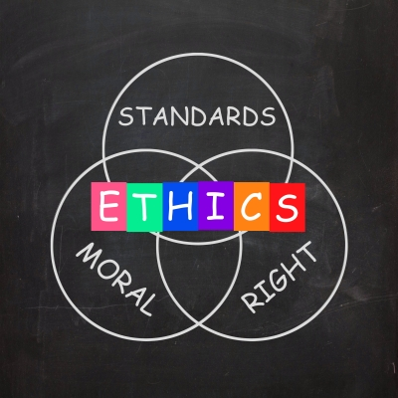
Ethical Behavior of IS Professionals and Unified Code of Conduct
Merdan Hojanepesov
Ethical, Legal, and Social Issues in Information Technology (COMP 607)
Fall 2015
Athabasca University
Image, courtesy of FreeDigitalPhotos.net by Stuart Miles

Slide 2
Information Systems (IS) Professional
Evolution of Information Technology Hardware and Software
User and business demands for Information Technology
IS Professionals, examples:
Programmers, QA/QC Testers
System and Database Administrators
Network and Security Analysts
Project Managers, IT Managers, and many others…
Image, courtesy of FreeDigitalPhotos.net by watcharakun

Slide 3
IS Affiliation
IT Professional Organizations
Canada’s Association of IT Professionals http://www.cips.ca/
Project Management Institute http://www.pmi.org/
International Information System Security Certification Consortium, Inc., (ISC)² https://www.isc2.org/
Association of Information Technology Professionals (AITP) https://www.aitp.org/
Institute for Certification of Computing Professionals http://iccp.org/
Association for Computing Machinery http://www.acm.org/
Institute of Electrical and Electronics Engineers https://www.ieee.org

Slide 4
Ethical Behavior
Actions describe ethical behavior and organizational commitment
Business Ethics:
How an individual decides to interact with external and internal environment
Norms an individual follows
How an individual behaves within an organization
Image, courtesy of FreeDigitalPhotos.net by Stuart Miles

Slide 5
What influences ethical behavior?
Length of organizational existence and Institutionalization of Ethical Standards similar to ones that exists with Doctors, Lawyers, or Engineers
Outcome of the research showed no significant influence on professional’s behaviors and that ethical behaviors are common to all professions
Image, courtesy of FreeDigitalPhotos.net by Stuart Miles

Slide 6
What influences ethical behavior?
Organizational structure: organic versus mechanistic?
Mechanistic – more unethical, possibly due to high degree of formalization and depends on repetitive behaviors
Organic – less unethical, possible due to more flexibility and adaptability to dynamically change
Image, courtesy of FreeDigitalPhotos.net by Stuart Miles

Slide 7
What influences ethical behavior?
Awareness of the existence of organization’s code of ethics:
Hypothesized relationship
Ethics Code Awareness > Corporate Ethical Values > Organizational Commitment
Just awareness is not sufficient for IS professionals to behave more ethically
Communication technologies and emerging technological innovations
IDEGOV project – many shortcomings, but positive contribution from future oriented research
Image, courtesy of FreeDigitalPhotos.net by Stuart Miles

Slide 8
Code of Ethics
Purpose of code of ethics, application within organization
Are specialists in IS field considered professionals such as doctors, lawyers and engineers?
Need for a code of conduct?
7 conceptual values as base for code of ethics
Consistency, respect individuals, autonomy, integrity, justice, utility and competence
Affiliation of IS professionals with various organizations
Conflict of interest between code of ethics within organization they work for and professional organizations they are affiliated with
Image, courtesy of FreeDigitalPhotos.net by David Castillo Dominici

Slide 9
Unified Code of Conduct for IS Professionals
5 major IS organizations were surveyed for similarities in moral requirements:
Society
Employer
Clients
Colleagues and professional organizations
Commonalities exists, as well as some differences
Should there be comparison between IS organizations and non-IS?

Slide 10
CONCLUSION
Many researches have been undertaken on behavioral ethics and effect of the code of ethics on professional behavior
While Canada becoming more culturally diverse and welcoming more people from all over the world, there is a little research on impact of diverse cultural values on ethical behavior within organization
Strong relationship between ethical behavior and existence of code of conduct exists, however, there is no agreement if unified and comprehensive code of ethics is a solution for IS professionals
Further research should be conducted
Image, courtesy of FreeDigitalPhotos.net by Nutdanai Apikhomboonwaroot

