Slide 1
Do employees have the right to privacy in the workplace?
Ethical, Legal and Social Issues in Information Technology
Prepared by:
Bozena Tkaczyk
Notes:
Hi Everyone, My name is Bozena Tkaczyk and I will be discussing the topic of privacy in the workplace. Do employees have this right?

Slide 2
Where is the line?
“Public bodies have a responsibility to secure and protect their computers and networked systems against internal and external threats, however they must also respect an employee’s legal right to privacy,” said Commissioner Denham.
Notes:
While a certain level of monitoring is necessary in order to ensure that employees are not wasting their time and the resources of their employers, there need to be strict guidelines as to how much monitoring is to be allowed and what exactly is ethical vs. not ethical.
The question is, when does monitoring become too much and what is the best way to ensure that both parties remain fair without violating the rights of the other.

Slide 3
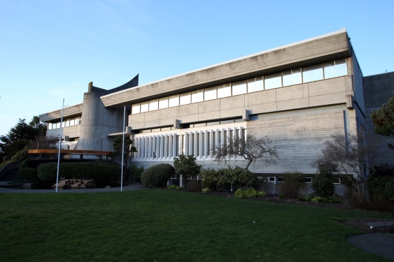
Times Colonist
The new mayor of Saanich, B.C. alleges that municipal staff want to bug his computer … BUSINESS > B1
_______________________________________________________
TC PUBLICATION LIMITED PARTNERSHIP
Tuesday, January 28, 2014
Victoria, British Columbia
High 12, Low 8. Details C12
timescolonist.com
Privacy watchdog to probe use of spyware at Saanich municipal hall
B.C.’s information and privacy commissioner is launching an investigation into Saanich’s use of spyware on municipal computers.
The municipality has said that software called Spector 360, which can record every keystroke and monitor online activity, was installed in response to a May 2014 cyber-security review. The program was purchased Nov. 21, less than a week after the municipal election, It was put on Atwell’s computer on Dec. 2, a day after he was sworn into office.
A few weeks later, the plan had been revealed by an unnamed whistleblower and it came to light that the software that had been chosen did nothing to secure the system from outside threats, but rather, was implemented in order to monitor the incoming Mayor. IT technicians who were responsible for installing the software were given explicit instructions to enable the most privacy-intrusive features of the software.
_________________________
"I was never informed of this action and it was done without my knowledge. Someone was planning to spy on everything I did on my computer," Atwell said
“I have decided to act on my own motion and initiate an investigation into whether the district’s use of employee-monitoring software complies with the Freedom of Information and Protection of Privacy Act,” BC’s Privacy Commissioner said.
Notes:
Recently, controversy broke out in the District of Saanich regarding their implementation of Spector 360 to monitor the incoming mayor, Richard Atwell.
“I have decided to act on my own motion and initiate an investigation into whether the district’s use of employee-monitoring software complies with the Freedom of Information and Protection of Privacy Act,” BC’s Privacy Commissioner said.

Slide 4
TIMES COLONIST, VICTORIA, BC
TUESDAY, April 1 2014 B1
PRIVACY
Editor: Bozena Tkaczyk > Email: boztka@rogers.com timescolonist.com/business
UPDATE: BC privacy commissioner to issue report on Saanich mayor’s spyware allegations
BC’s Privacy Commissioner has found that Saanich’s use of spyware to track on-line activity of its newly elected mayor and other staff violates employee rights. Commissioner Elizabeth Denham initiated an investigation in January, following public statements by Saanich Mayor Richard Atwell and persistent unanswered questions about the use of employee monitoring software by the district.
In her report, Denham is recommending the District of Saanich disable key features of the Spector 360 software including keystroke logging, automated screen shots and continuous tracking of computer program activity. The Commissioner is also advising Saanich to destroy all data collected by the software.
““One of the most disappointing findings in my investigation is the District’s near complete lack of awareness and understanding of the privacy provisions of B.C.’s Freedom of Information and Protection of Privacy Act. The law has been in place for more than 20 years, yet the District appears to not understand its most basic privacy provisions.
The Commissioner’s full report at: http://www.oipc.bc.ca/report/investigation-reports
Notes:
BC’s Privacy Commissioner has found that Saanich’s use of spyware to track on-line activity of its newly elected mayor and other staff violates employee rights.

Slide 5
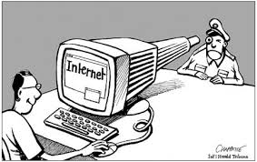
Spector 360
I am not here to protect your information! I am here to spy on you!
“Decisions were made by the senior management in the best interests of protecting Saanich’s information and technology system,” Laidlaw said.
Notes:
While the District claims that the purchase of Spector 360 software was the response to recommendations based on the IT audit, BC’s Information and Privacy Commissioner, Elizabeth Denham, remains sceptical. Additionally, as a senior IT analyst at the District of Saanich has confirmed, none of the major recommendations made by the Wordsworth & Associates, had been acted upon.
Spector 360 not only provided zero protection against malware and virus attacks, but the installation of the software required for other existing anti-virus features to be disabled. Ironically, the implementation of Spector 360 made the District of Saanich’s computer network more vulnerable to attack than before.
Denham went on to say that, “Security measures taken by the District may have resulted in a net reduction to IT security by concentrating the personal information of key employees and officers in one location, creating a ‘honeypot’ for external attackers.”

Slide 6
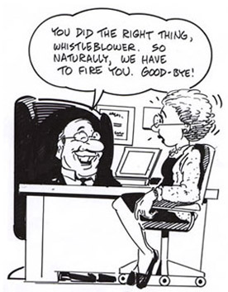
Notes:
The Whistle-blower was accused of breaking two of the District of Saanich’s confidentiality requirements; one being that he “will not release or discuss non-routine municipal or departmental business without prior authorization.”
He was also accused of breaking the Code of Ethics, which states that, “a minicipal employee shall not use information which is not available to the general public for his or her own personal profit or advantage and shall not provide such information to others unless it is in the course of the employee’s duties to do so.”

Slide 7
TIMES COLONIST, VICTORIA, BC
TUESDAY, December 8, 2015 B3
LAW & ETHICS
Editor: Bozena Tkaczyk > Email: boztka@rogers.com timescolonist.com/business
Ethical decision-making and leadership are the basis of ethical organizations, corporate social responsibility. How does the District of Saanich fit in?
Privacy Commissioner Elizabeth Denham released a scathing report into the District’s improper use of Spector 360 on March 30, in which she said senior staff failed to consider privacy standards before approving its use. Denham also found senior staff failed to notify Atwell about the software’s installation on his computer, and noted “the District’s submissions to my office demonstrate a deep lack of understanding about the most basic tenets of the (Freedom of Information and Protection of Privacy) Act, such as what constitutes the collection of personal information.”
Denham also concluded that Director of Corporate Services, Laura Ciarniello, gave the express approval to install the spyware.
An in-house report released Wednesday on the use of spyware at the District of Saanich admits senior staff failed to consider privacy concerns, but stops short of blaming any individual staff member for its improper use.
Wrongful use of spyware was a 'corporate decision' says Saanich CAO
_________________________
“Finding no evidence of malfeasance, I find no cause to terminate or discipline any employee” Internal investigation
This case presented grave implications not only on law and justice, but also on the democratic system itself, which with this case, as well as many others like it, has been greatly eroded. In the end, the only person that had been punished was the whistle-blower who brought the matter into light - a truly sad outcome in a so-called Democracy.
Notes:
So who was responsible for the decisions and for ordering the implementation of Spector 360 at the District of Saanich? According to documents obtained through the Freedom of Information Act, it was the Director of Corporate Services, Laura Ciarniello who gave the Manager of IT, Forrest Kvemshagen the approval to purchase, install and enable the software. With such information, it would be clear to any logical thinker, that it would be Ciarniello and perhaps even her accomplice, Kvemshagen who would have to bear the consequences of violating BC Privacy Law.
Saanich resident and retired Chief Information Officer of BC Pension Corporation, Karen Harper, was a vocal critic of the way in which the issue had been handled by the District of Saanich; “I can state with utter certainty that had I authorized the installation of spyware on our system, I would have been fired for cause. It would not have mattered whether I did so out of incompetence or if I had some other motivation. I would have been gone.
Why? I would have brought disrepute onto the organization to a degree that cannot be ignored.”
This case presented grave implications not only on law and justice, but also on the democratic system itself, which with this case, as well as many others like it, has been greatly eroded. In the end, the only person that had been punished was the whistle-blower who brought the matter into light - a truly sad outcome in a so-called Democracy.

Slide 8
References
Focus on line: The whistle blower’s tale: part 1 http://focusonline.ca/?q=node/874
Focus on line: The whistle blower's tale: part 2 http://focusonline.ca/?q=node/889
Focus on line: Investigations into investigations http://focusonline.ca/?q=node/901
The Times Colonist's coverage of Richard Atwell http://focusonline.ca/?q=node/834
https://www.oipc.bc.ca/media/16671/ir_f15-01-districtofsaanich-30mar2015-posted.pdf
http://www.timescolonist.com/opinion/columnists/les-leyne-investigation-could-favour-saanich-mayor-richard-atwell-1.1744327
http://saanichvoiceonline.ca/2015/02/01/saanich-under-investigation-for-spying/
http://www.cbc.ca/news/canada/british-columbia/saanich-spyware-report-highlights-systemic-disconnect-between-privacy-and-security-1.3126805
http://www.saanichnews.com/news/309675001.html

