Slide 1
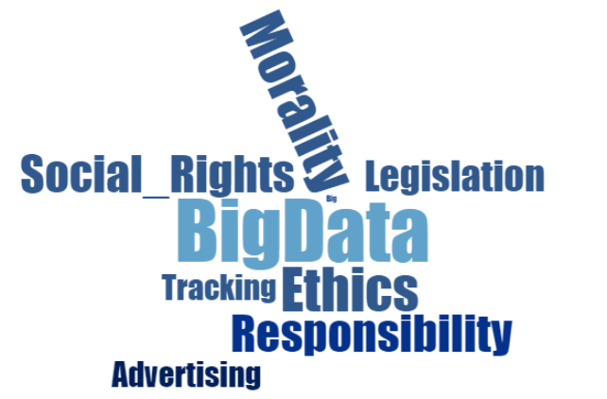
Big Data Analytics: An Ethical Question
Leah Korganowski
3108793
COMP 607 – Fall 2015

Slide 2
Overview
Big Data has been brought on with the rapid improvement and use of the internet, social media, and technology tracking methods.
As companies use, share, and sell this data questions of privacy rights and ethics is called into question.
With this governments have been creating data protection laws but often there are ways around this information, to which consumers can still be targets.

Slide 3
An Ethical Approach
Traditionally ethics were based on a more normative approach
Involved following the right and wrong behaviour expectations based on a societies moral standards [1].
Questions To Ask In Data:
How does ethics play a role in a modern world with modern technology. The context between modern and traditional ethical thinking has changed.
How can ethics be applied when Big Data spans globally across cultures.

Slide 4
An Ethical Approach, Cont.
Velasquez et. al details on five main approaches to ethics that are used today. [2]
Approach | Description
Utilitarian | Determines that the most ethical action should be the one that provides the largest good for the largest number.
Rights | This approach is more open ended but includes that humans have dignity and have the right to truth, privacy, etc.
Fairness of Justice | Sees favouritism and discrimination as not right and that individuals should be treated equally.
Common-Good | Social policies, systems, and environments are good to all.
Virtue | Individuals should strive towards certain ideals.

Slide 5
Big Data – Why it is used
Firms use big data for a number of primary reasons.
Cost reduction
Faster and accurate decision making
Predictive analytics
Create new products and services
Surveillance and consumer behaviour tracking
Purchasing Behaviour tracking
Ability to create real-time custom tailored advertisements
[5] [6]

Slide 6
Big Data in Use – Case Studies
Verizon
Wireless operator that has access to millions of data trails perfect for analytics.
Shares data with outside of firm
NetFlix
Uses its Big Data for predictive analytics
Uses customer viewing data and determines their behavioural patterns
Google
Sells customer information about mobile customers
Locations, activities, background and almost all other data is shared
Creates new shows based on this information
One of the largest Big Data users
Search keywords are collected, analyzed, and google algorithms applied
Result is customized tailored advertising that follows the user in Google and other sites
[3] [6] [7] [8]

Slide 7
Misuses of Data
Currently many infringements on personal information and rights are occurring. Some of the main misuses of data are sourced from:
Company And Government Data Policies
Data Brokers
Data Policy Issues
Often policies they do not transcend international borders
Are not written well thorough enough to encompass all aspects of data use.
Include legal loopholes which allows private data to be shared.
Over convoluted and not understood by the average consumer.
[9]

Slide 8
Misuses of Data
Data Policy Issue Examples:
The Fair Credit Reporting Act (FCRA) protects individuals from data being provided to parties. However the act does not apply to groups, allowing information and credit scores to be made in bulk and then used [9].
Policies often allow low sensitivity data to be collected and shared Data can be used maliciously through reidentification. User is under the impression that they are anonymous.
Interesting Fact: 87% of the US’s citizens that are in public databases can be identified using three anonymous data points: birthday, gender and postal code. This is known as the triple identifier [10].

Slide 9
Misuses of Data
Data Brokers
Primary concern in the big data field.
Are the companies that collect and manage consumer data.
For a price sell it to other companies.
Method of obtaining and selling data is ethically questionable.
[11]
Issue Examples:
Often web browser option for declining data to be tracked is ignored by the tracking company
Data broker industry does not operate with transparency
Data that is collected is shifted across many entities
[9].
How can the original user’s data be protected if there is no governing organization or law against these brokers?

Slide 10
Corporate Ethics Importance
http://www.ibmbigdatahub.com/sites/default/files/whitepapers_reports_file/TCG%20Study%20Report%20-%20Ethics%20for%20BD%26A.pdf
Ethics are important demonstrate as a company, as they instill trust, integrity and risk reduction to the firm.
Be Aware Of The Data Source | Know and keep track of where data is coming from Have a regulated screening process that ensure the data collected was through legitimate means, via notice and choice.
Classify The Data | Don’t just keep all data in one bucket of accessibility. Separate sensitive and financial information from innocuous data Set higher standards of care and security for the more sensitive data
Transparency Is Key | Keep records of data keeping and collection methods Show consumers their data. The majority of consumers don’t opt out of their data collection even though many companies allow them to.
Education | Companies dealing with the data need to define ethics within the organization and follow it. Public must become data conscious aware citizens.
[9] [12]

Slide 11
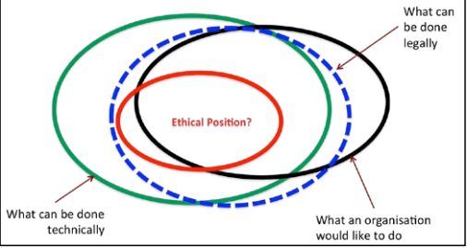
Conclusion
Ethics lie right in the middle of: What can be done technically, legally, and the wants of the organization.
[13]
There is a fine line between acceptable business conduct and unethical conduct.
Although Big Data is a well known topic there still are infringements on personal privacy happening.
Better policy and governance from both the government and individual corporations is needed.
Public needs to be educated, as better informed citizens are safer ones.

Slide 12
References
[1] Fieser, J. “Ethics.” Internet: http://www.iep.utm.edu/ethics/#H2, 2015 [Dec. 8, 2015].
[2] Valasquez, M. et al. “Thinking Ethically:
A Framework for Moral Decision Making.” Internet: http://www.scu.edu/ethics/practicing/decision/thinking.html, 1996 [Dec. 8, 2015].
[3] Davenport, T. “Three big benefits of big data analytics.” Internet: http://www.sas.com/en_sa/news/sascom/2014q3/Big-data-davenport.html, 2014 [Dec. 8, 2015].
[4] McAfee, A. “Big Data: The Management Revolution.” Internet: https://hbr.org/2012/10/big-data-the-management-revolution/ar, 2012 [Dec. 8, 2015].
[5] Chouffani, R. “Big Data Analytics a Big Benefit for Marketing Departments.” Internet: http://www.cio.com/article/2392067/data-management/big-data-analytics-a-big-benefit-for-marketing-departments.html, Sept. 24, 2012 [Dec. 8, 2015].
[6] Lange, L. “Big Benefits from Big Data.” Internet: http://www.sap.com/bin/sapcom/lt_lt/downloadasset.2014-09-sep-11-15.big-benefits-from-big-data-pdf.html, 2014 [Dec. 9, 2015].
[7] Leber, J. “How Wireless Carriers Are Monetizing Your Movements.” Internet: http://www.technologyreview.com/news/513016/how-wireless-carriers-are-monetizing-your-movements/, Apr. 12, 2013 [Dec. 9, 2015].
[8] Rijmenam, M. V. “How Google Applies Big Data To Know You – Infographic.” Internet: https://datafloq.com/read/google-applies-big-data-infographic/385, 2015 [Dec. 9, 2015].
[9] Carson, A. “Data Brokers Demystified: A Call for Ethics.” Internet: https://iapp.org/news/a/data-brokers-demystified-a-call-for-ethics/, Sept. 18, 2014 [Dec. 10, 2015].
[10] Buytendijk, F. and Heiser, J. "Confronting the privacy and ethical risks of Big Data.” Internet: http://www.ft.com/cms/s/0/105e30a4-2549-11e3-b349-00144feab7de.html#axzz3uF75u7Sf, Sept. 24, 2013 [Dec. 10, 2015].
[11] Riglian, A. “'Big data' collection efforts spark an information ethics debate.” Internet: http://searchcloudapplications.techtarget.com/feature/Big-data-collection-efforts-spark-an-information-ethics-debate, [Dec. 10, 2015].
[12] Morgan, L. “Big Data Ethics: 8 Key Facts To Ponder.” Internet: http://www.informationweek.com/big-data/big-data-analytics/big-data-ethics-8-key-facts-to-ponder/d/d-id/1322143?image_number=9, Sept. 25, 2015 [Dec. 10, 2015].
[13] Chessell, M. “Ethics for big data and analytics.” Internet: http://www.ibmbigdatahub.com/sites/default/files/whitepapers_reports_file/TCG%20Study%20Report%20-%20Ethics%20for%20BD%26A.pdf, 2014, [Dec. 10, 2015].
[14] SAS. “Big Data.” Internet: http://www.sas.com/en_us/insights/big-data/what-is-big-data.html, 2015 [Dec. 10, 2015].

