Slide 1
Funded with support from the European Commission, within project Grading soft skills: GRASS, No. 543029-LLP-1-RS-KA3-KA3MP
Research Team:
Niall Seery, Donal Canty, Adrian O`Connor & Jeffrey Buckley
Technology Education Research Group
University of Limerick
This communication reflects the views only of authors, and the commission cannot be held responsible for any use, which may be made of the information contained therein.

Slide 2
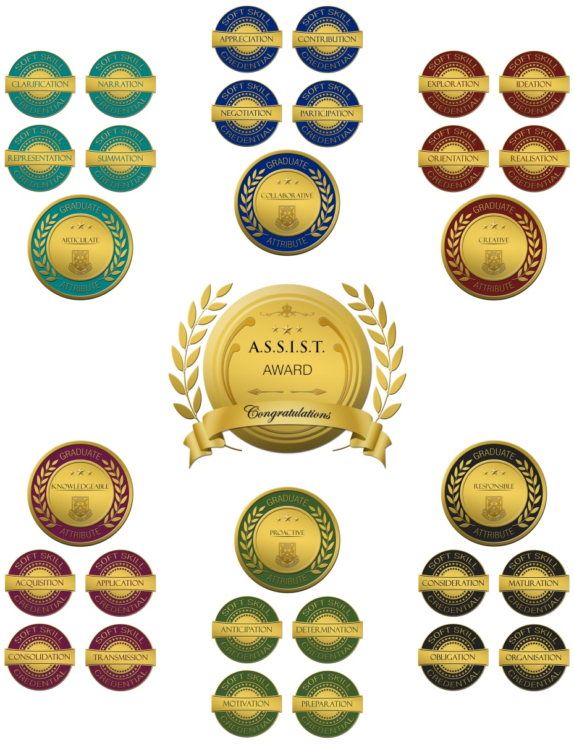
ASSIST Initiative
University of Limerick, Limerick, Ireland
Technology Education Research Group (TERG)
Dept. Design & Manufacturing Technology
Initial Technology Teacher Education (ITTE)
B. Tech (Ed) - NFQ Level 8 Honours Degree
Focus of Research Investigation
Pedagogical & Technological Approaches
Validation & Recognition of Soft Skills
The ASSIST Digital Badges
Graduate Attributes
Soft Skills

Slide 3
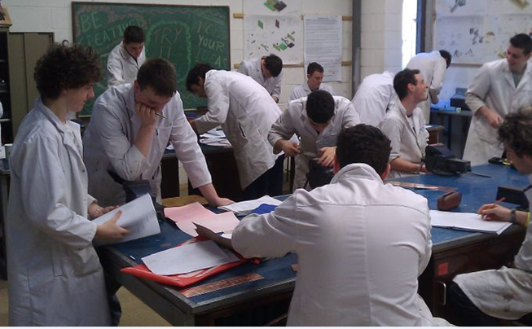
UL Application Case
B. Tech (Ed) - NFQ Level 8 Honours Degree
EY4003 - Subject Pedagogics 1 (Wood Tech. & Graphics)
EY4013 - Subject Pedagogics 1 (Engineering Tech. & Graphics)
12 Weeks (Autumn Semester 2015)
I Hour Subject Pedagogy Lecture p/w
2 Hour Graphical Pedagogy Lab p/w
2 Hour Practical Pedagogy Lab p/w
Second Year ITTE Students
5 Female
95 Male

Slide 4
Articulation
Clarification
This badge will be awarded to people who display evidence of the capacity to make something more comprehensible and free from ambiguity.
Narration
This badge will be awarded to people who display evidence of the capacity to provide a descriptive account or tell a story about something.
Representation
This badge will be awarded to people who display evidence of the capacity to effectively use something (e.g. metaphor, symbol) that stands for something else.
Summation
This badge will be awarded to people who display evidence of the capacity to add the most important pieces of something together in a concise form.

Slide 5
Collaboration
Appreciation
This badge will be awarded to people who display evidence of the capacity to recognise the worth, quality, or importance of something or someone.
Contribution
This badge will be awarded to people who display evidence of the capacity to give something to someone in order to help achieve or provide something.
Negotiation
This badge will be awarded to people who display evidence of the capacity to discuss something formally with someone in order to reach an agreement.
Participation
This badge will be awarded to people who display evidence of the capacity to be involved in an activity or event with someone in doing something.

Slide 6
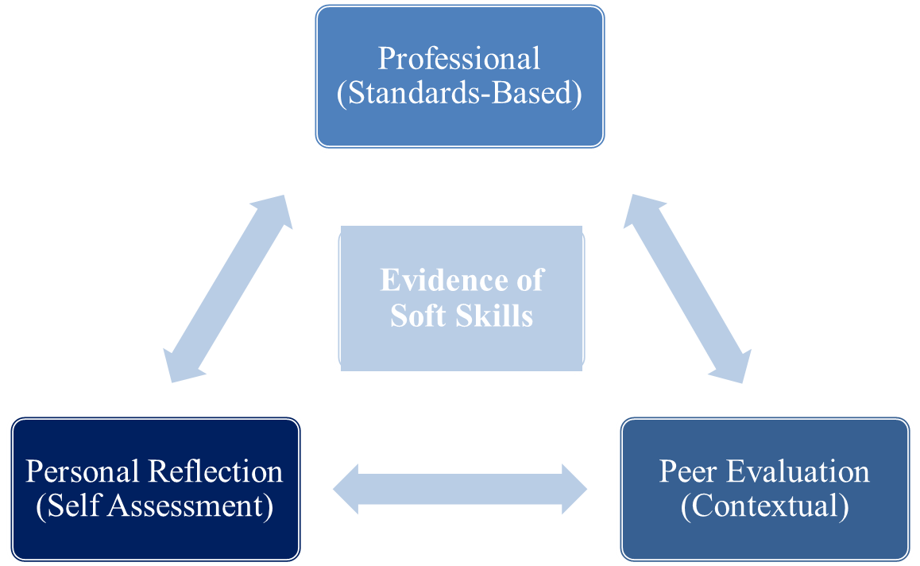
Assessment Architecture
Authentic Evidence of Student Performance
Multi-Modal Capacity
Situational Context of Skill Demonstration
Construct of Capability
Relative Progression of Initial Attainment
Targeting Specific Benchmarks
Value Judgements of Educational Stakeholders
Self Assessment
Peer Observation
Teacher Evaluation

Slide 7
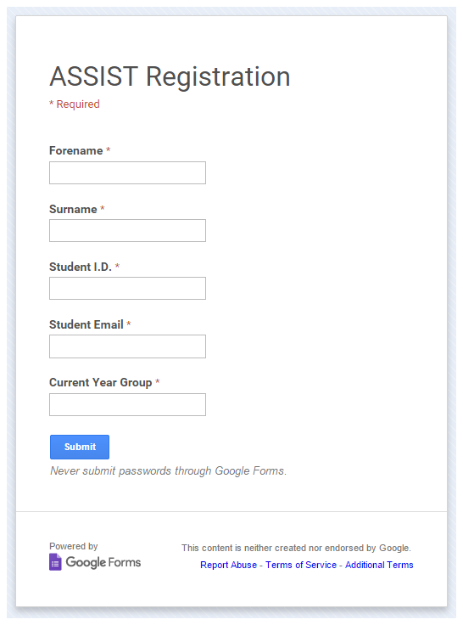
Technological Infrastructure
Private Web Hosting - www.terg.ie
Dynamic Web Space
Full User Confidentiality
Online Registration Forms
Facilitating Soft Skill Evidence
Supporting Multimodal Data Files
Managing Submissions & Accreditation
Assessing Soft Skill Evidence
Benchmarks of Soft Skill Attainment
Badge Earners
Individual User Profiles
Linked to Professional Networks

Slide 8
Badge Nominations
Self-Critique Peer-Critique Peer Name: ______________
What are the factors that influenced the nature and quality of participation?
1. | Level of Participation Excellent Very Good Good Did Not Participate | Evidence:
2. | Impact of Participation

Slide 9
Badge Accreditations
Attribute | Soft Skill | Student Activity | Awarded
 | Clarification | Pair Work: Verbal Demonstration | 53
 | Narration | Pair Work: Verbal Discussion | 65
 | Representation | Group Work: Video Presentation | 67
 | Summation | Autonomous Student Evidence | 59
 | Appreciation | Autonomous Student Evidence | 81
 | Contribution | Group Work: Project Feedback | 67
 | Negotiation | Class Activity: Walking Debate | 68
 | Participation | Group Work: Critiquing Drawings | 65

Slide 10
Ways of Working
With Others
Ways of Thinking
Intra -Personal
Inter -Personal
Soft Skills
Summary
Motivational - Digital Credentials
Credible - Badge Currency
Sustainable - Technological Capacity

Slide 11
Application case: Math coach
KTH Royal Institute of Technology

Slide 12
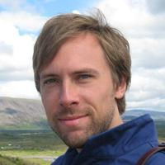
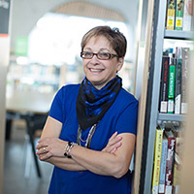
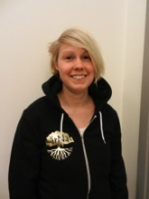
Stefan Hrastinski
Stefan Stenbom
Martha Cleveland-Innes
Simon Benjaminsson
Anna-Maria Martinsson

Slide 13
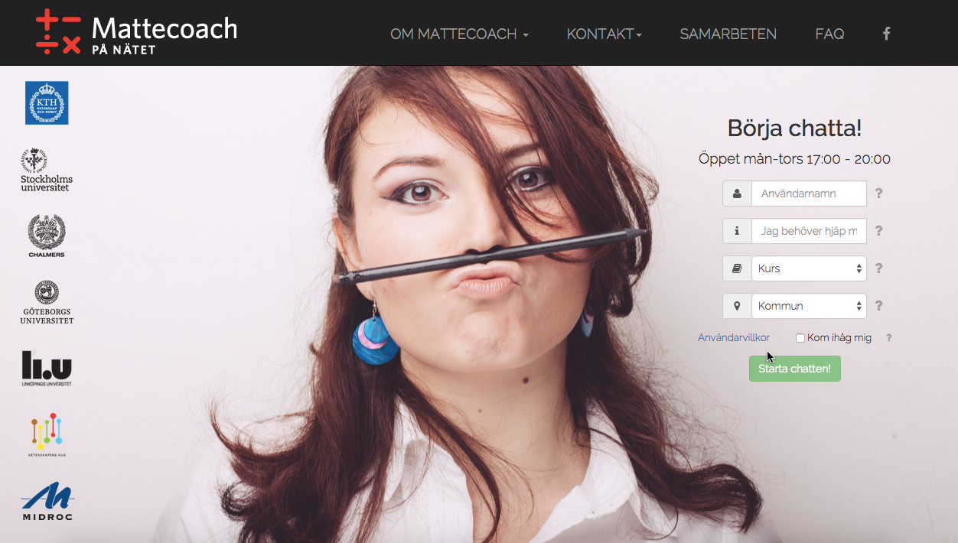

Slide 15
Tutoring online tutors: using digital badges to encourage the development of online tutoring skills

Slide 16
Three challenges/badges
Encourage discussion
Encourage reflection
Provide emotional support

Slide 17
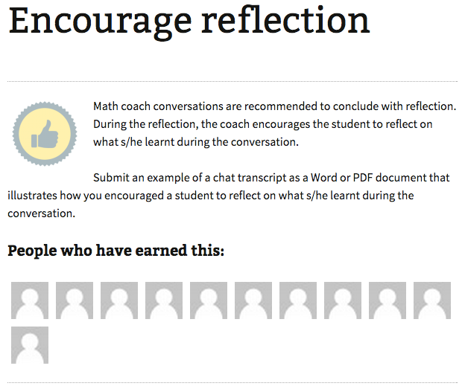

Slide 18
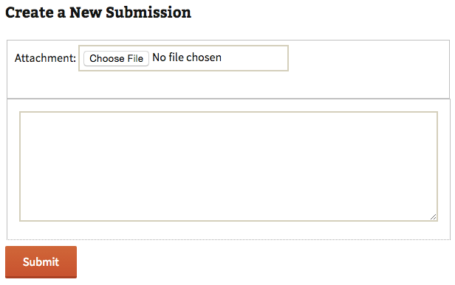

Slide 19
Findings
Digital badges can be used to encourage reflection and the development of online tutoring skills.
Identification of the challenge to balance the private activity, reflection on tutoring skills, and the social activity, communication with the students.
Encourage discussion was the most applied online tutoring skills, while encourage reflection and provide emotional support were more challenging to apply in practice.

Slide 20
Six challenges/badges
Encourage discussion
Encourage reflection
Provide emotional support
Elicit coachee’s level of understanding
Use goal-oriented communication
Build trust

Slide 21
Six+ sub-badges = Math coach badge/certificate

