Slide 1
Using Big Data and Analytics to Improve Learning and Education
George Siemens
CIDER
February 10, 2016

Slide 2
The history of learning analytics

Slide 3
“The world is one big data problem”
Gilad Elbaz

Slide 4
Learning analytics is the measurement, collection, analysis, and reporting of data about learners and their contexts, for the purposes of understanding and optimizing learning and the environments in which it occurs.
LAK11 Conference
Notes:
https://tekri.athabascau.ca/analytics/

Slide 5
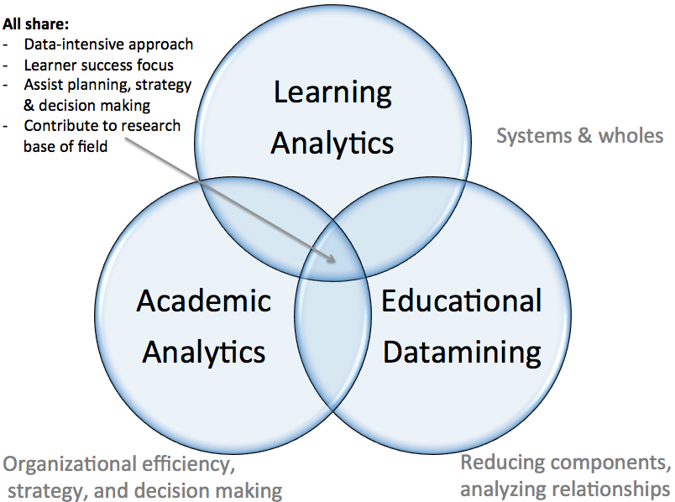

Slide 6
Technique: Baker and Yacef (2009) five primary areas of analysis:
Prediction
Clustering
Relationship mining
Distillation of data for human judgment
Discovery with models
Notes:
Baker, R. S. J.d., & Yacef, K. (2009). The state of educational data mining in 2009: A review and future visions. Journal of Educational Data Mining, 1(1). http://www.educationaldatamining.org/JEDM/images/articles/vol1/issue1/JEDMVol1Issue1_BakerYacef.pdf

Slide 7
Current state and future trends: A citation network analysis of the learning analytics field.
Dawson, S., Gašević, D., Siemens, G., & Joksimovic, S. (2014, March). In Proceedings of the Fourth International Conference on Learning Analytics And Knowledge (pp. 231-240). ACM.

Slide 8
Paper classification
Schema from Info Systems (6 categories)
1. Evaluation research
(e.g. case study empirical)
2. Validation research
(e.g. testing theory/ method/ solution empirical)
Glass, R.L., et.al, 2002. Research in software engineering: an analysis of the literature. Information and Software Technology 44, 8, 491-506

Slide 9
Paper classification
3. Solution proposal
(solution/ technique to address an issue)
4. Conceptual proposal
(e.g. frameworks)
5. Opinion
(well its my opinion/argument)
6. Experience
(Let me tell you a story)
7. Panel/workshop

Slide 10
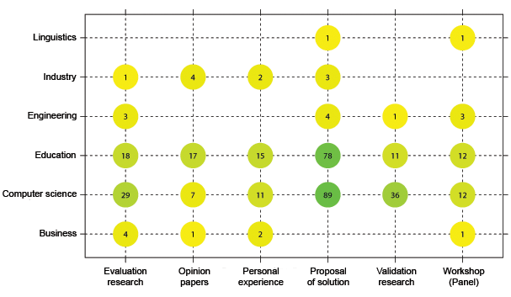
Paper classification (LAK)
Dominated by evaluations of research (journals)
Proposal of solution dominates conference

Slide 11
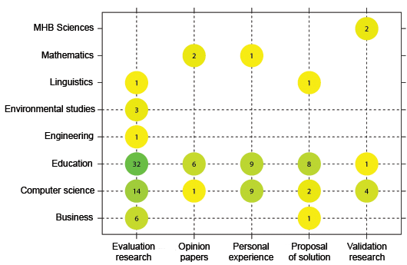
Paper classification (Journal)
Dominated by evaluations of research (journals)
Proposal of solution dominates conference

Slide 12
Paper classification
Dominated by computer science (LAK)
Greater number of education researchers in journals
Reflection of special issues
Reflection of priority sites for publications
Largely conceptual and opinion publications

Slide 13
Methods classification
Qualitative
Quantitative
Mixed methods
Other

Slide 14
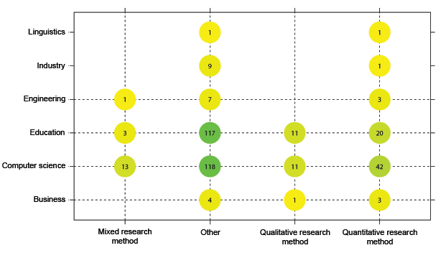
Methods classification (LAK)
Other dominates – reflects high number of opinion and conceptual papers

Slide 15
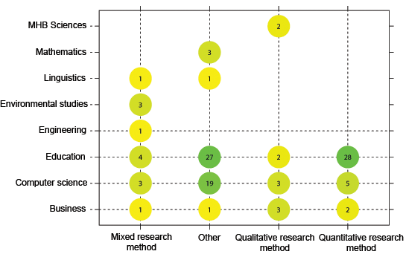
Methods classification (Journals)

Slide 16
What will LA do for learning science & education
Add a new research layer
Personalization
Optimization (move from negative orientation)
Organizational insight
Improved decision making
New models of learning
Increase competitiveness
Improve marketing/promotion/recruitment

Slide 17
Learning analytics is about learning
Gašević, D., Dawson, S., Siemens, G. (2015). Let’s not forget: Learning analytics are about learning. TechTrends, 59(1), 64-71.

Slide 18
Once size fits all does not work in learning analytics
Gašević, D., Dawson, S., Rogers, T., Gašević, D. (2016). Learning analytics should not promote one size fits all: The effects of course-specific technology use in predicting academic success. The Internet and Higher Education, 26, 68–84.

Slide 19
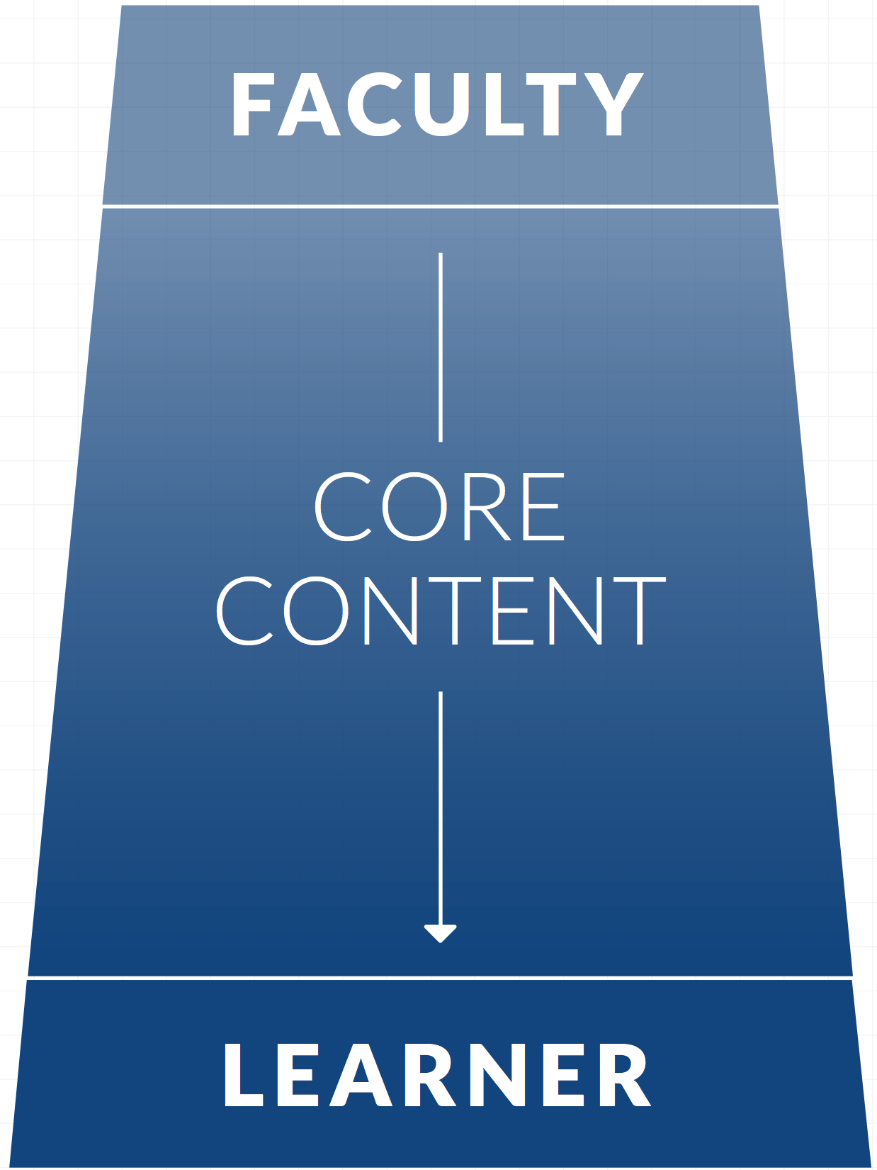

Slide 20
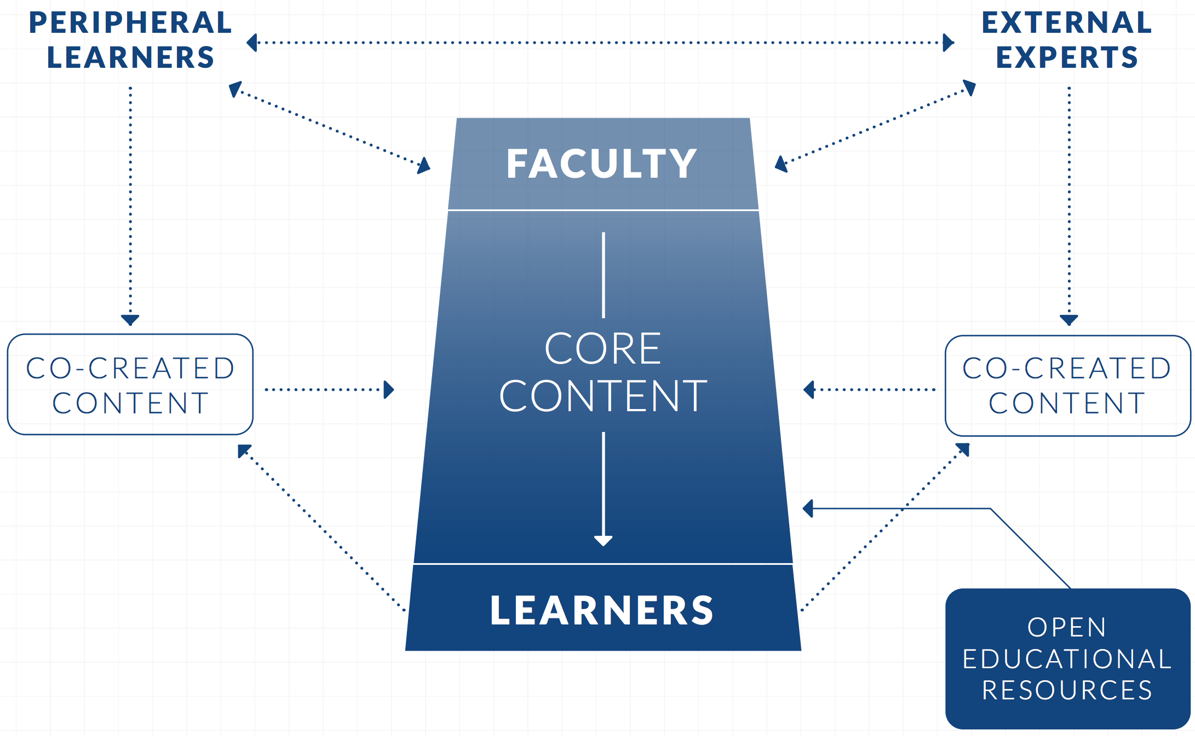

Slide 21
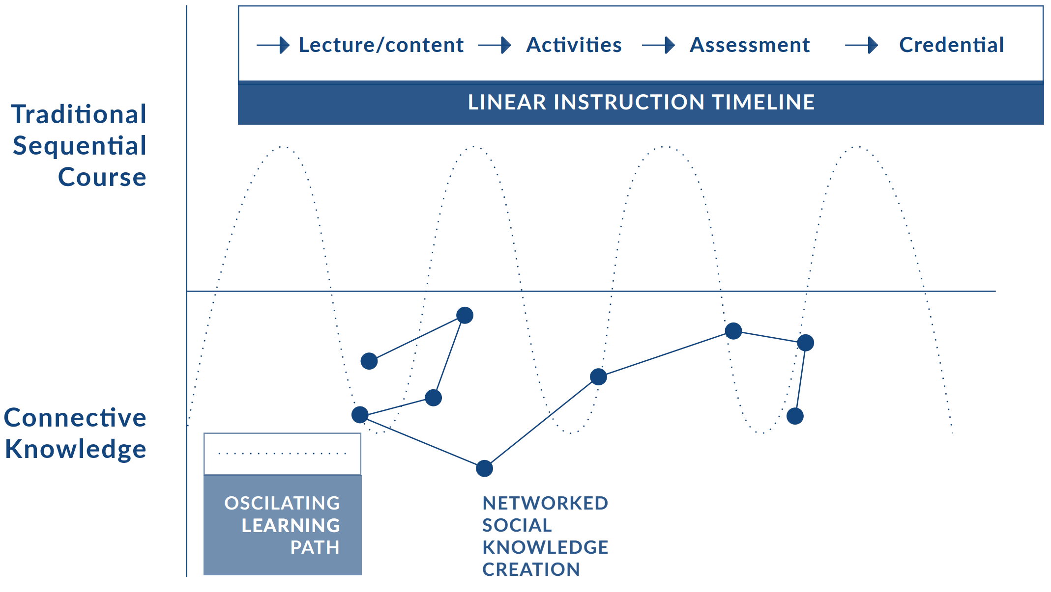

Slide 23
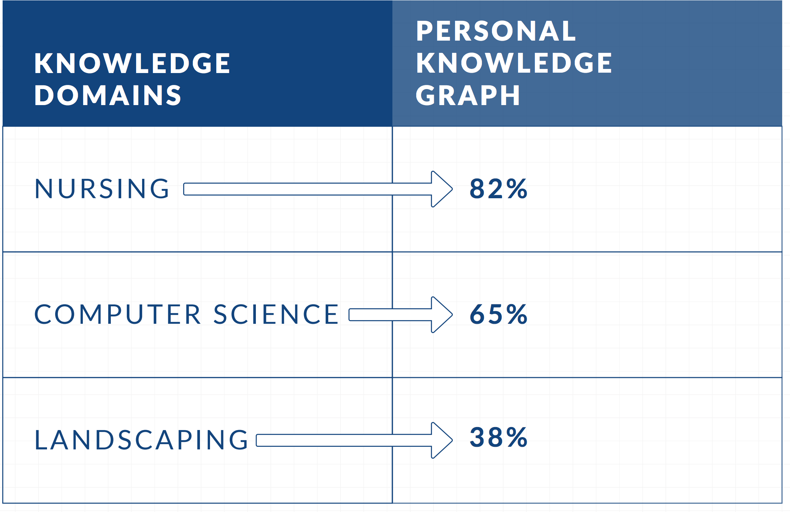

Slide 24
Parallel developing partners: Adaptive and personalized learning
Platform | Publisher
Knewton | Pearson
Smart Sparrow | McGraw-Hill
Desire2Learn | adaptcourseware
LoudCloud | CMU OLI
Intel One-to-One | Intel content ecosystem

Slide 25
Knowledge development, learning, is (should be) concerned with learners understanding relationships, not simply memorizing facts.
i.e. naming nodes is “low level” knowledge activity, understanding node connectivity, and implications of changes in network structure, consists of deeper, coherent, learning

Slide 26
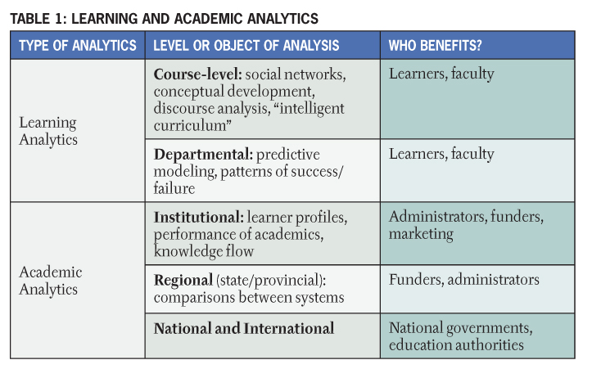
Siemens, Long, 2011. EDUCUASE Review

Slide 27
Learner success
Use of school resources/services
At-risk learners (predictive capacity)
Help-seeking behavior
Alerts
Intervention
Learner dashboard
Path of concept development
Real-time analytics

Slide 28
http://www.itap.purdue.edu/learning/tools/signals/

Slide 29
http://oli.cmu.edu/

Slide 30
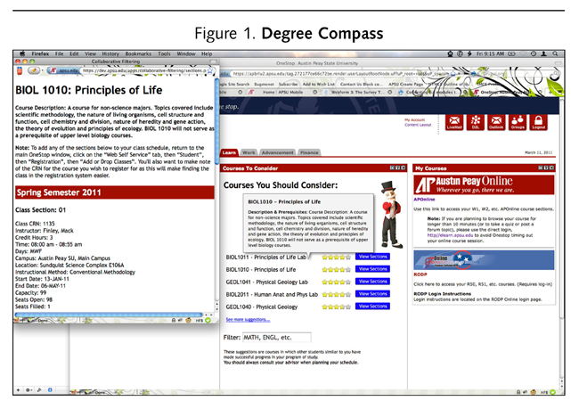
Denley, 2012
Notes:
http://www.educause.edu/ero/article/austin-peay-state-university-degree-compass

Slide 31
Check my activity
Predictive Analytics Reporting

Slide 32
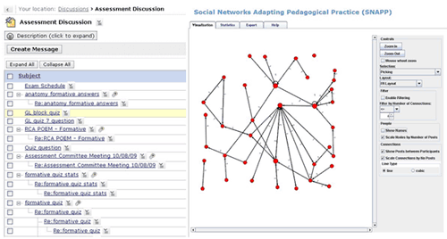
http://research.uow.edu.au/learningnetworks/seeing/snapp/index.html

Slide 33
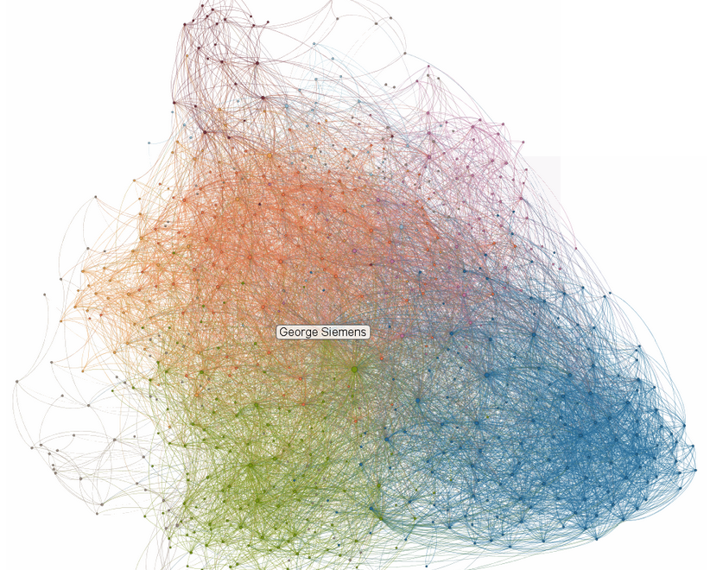

Slide 34
The WHAT of learning analytics

Slide 35
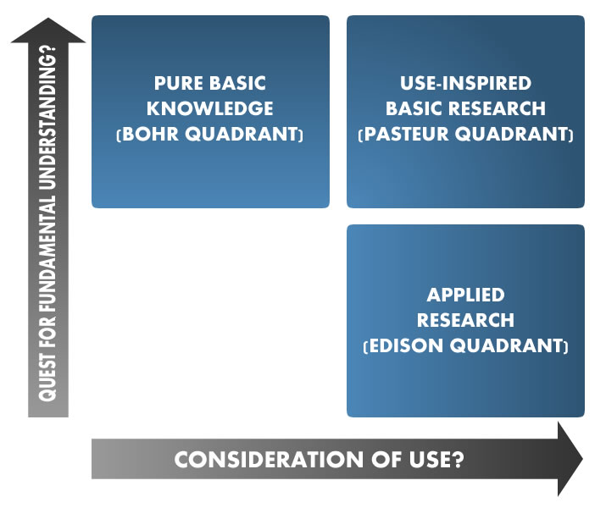

Slide 36
Lack of data-informed decision making culture
Macfadyen, L., & Dawson, S. (2012). Numbers Are Not Enough. Why e-Learning Analytics Failed to Inform an Institutional Strategic Plan. Educational Technology & Society, 15(3), 149-163.

Slide 39
The HOW of learning analytics

Slide 40
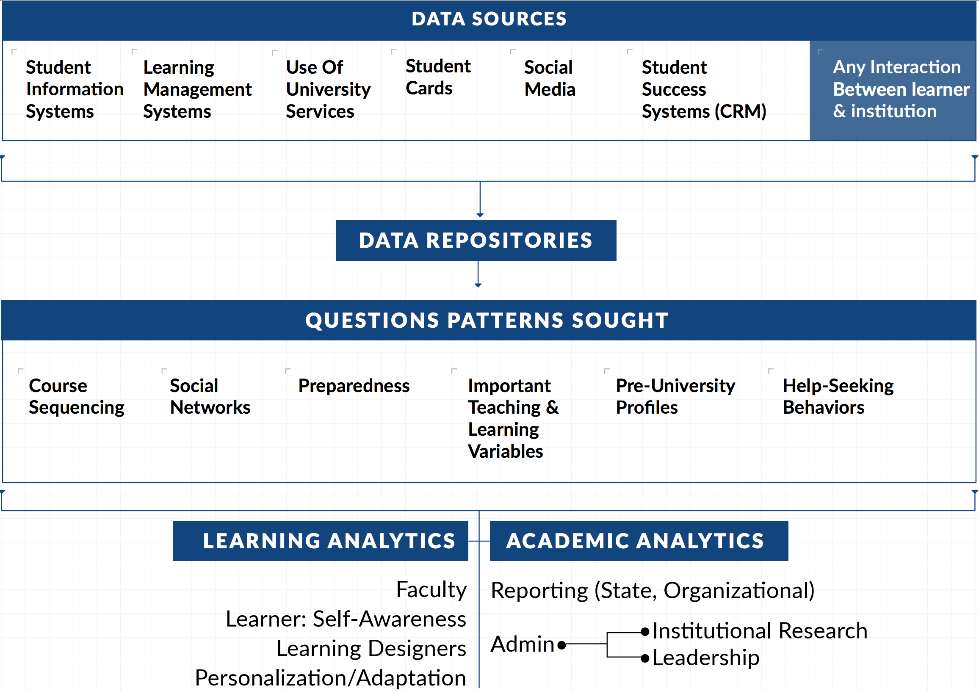

Slide 43
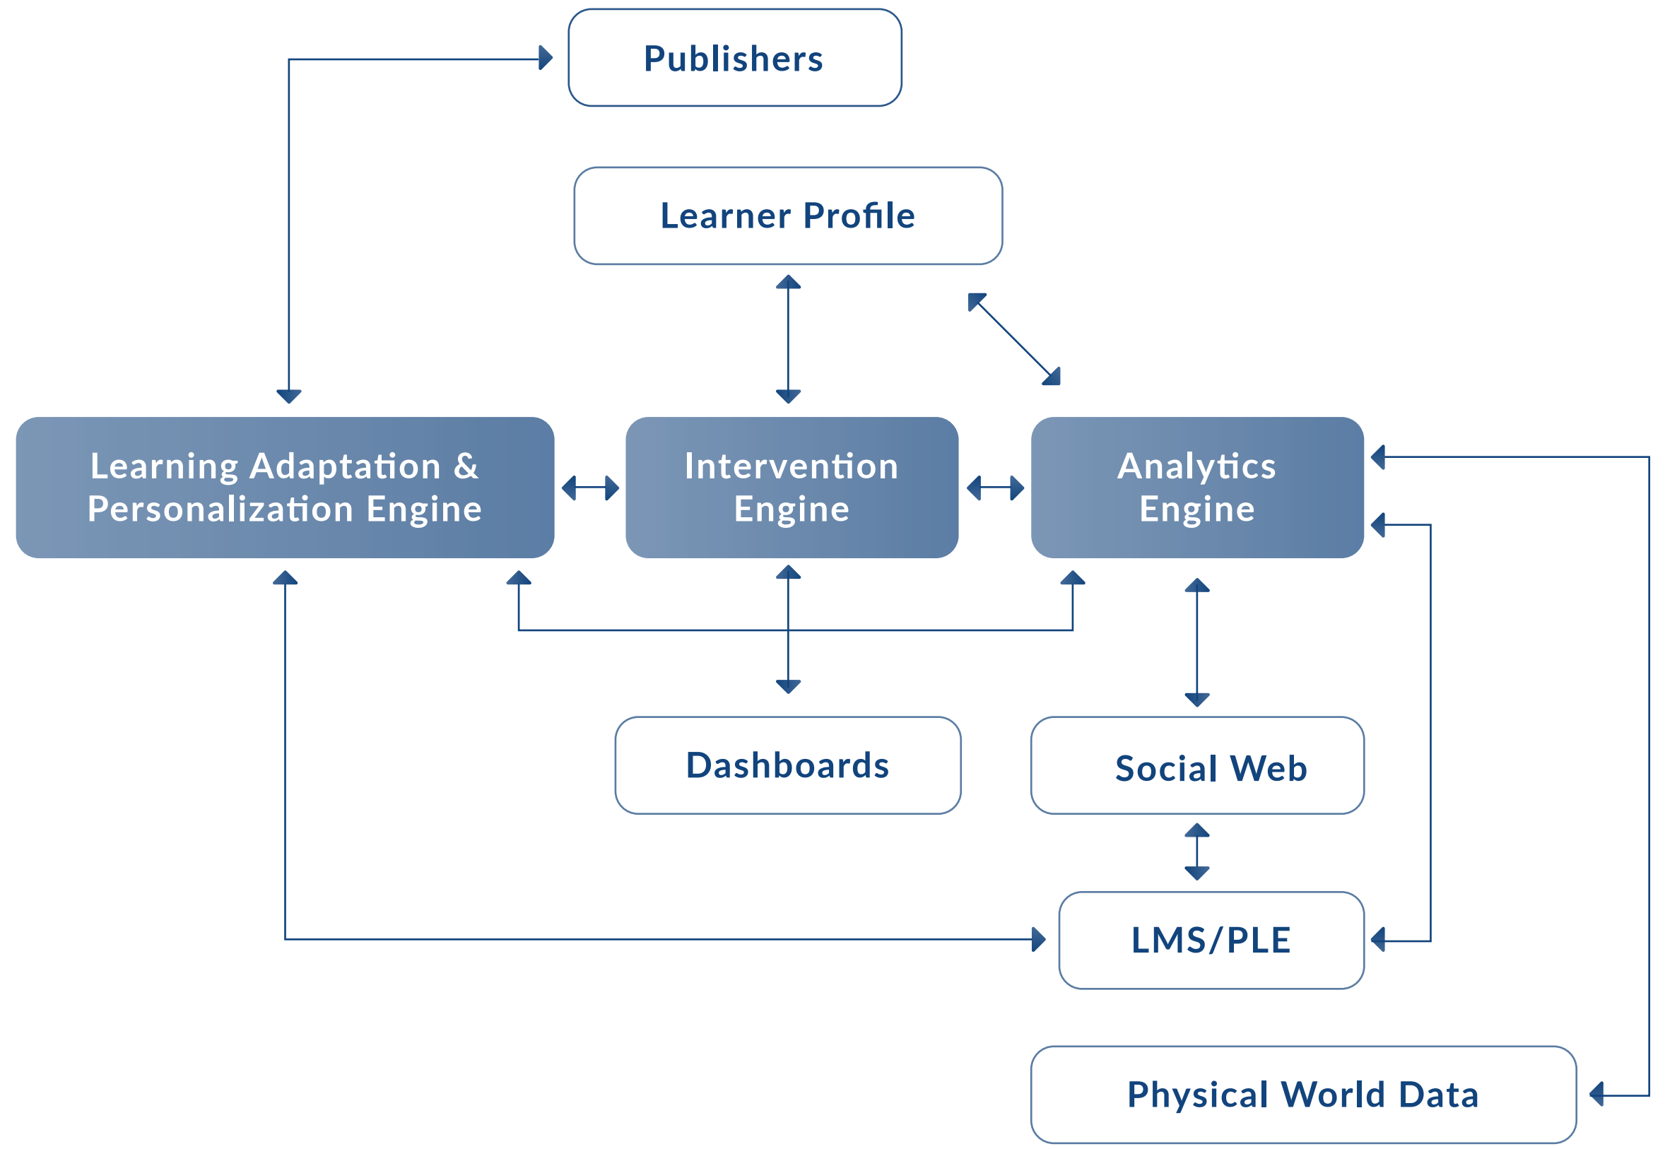

Slide 44
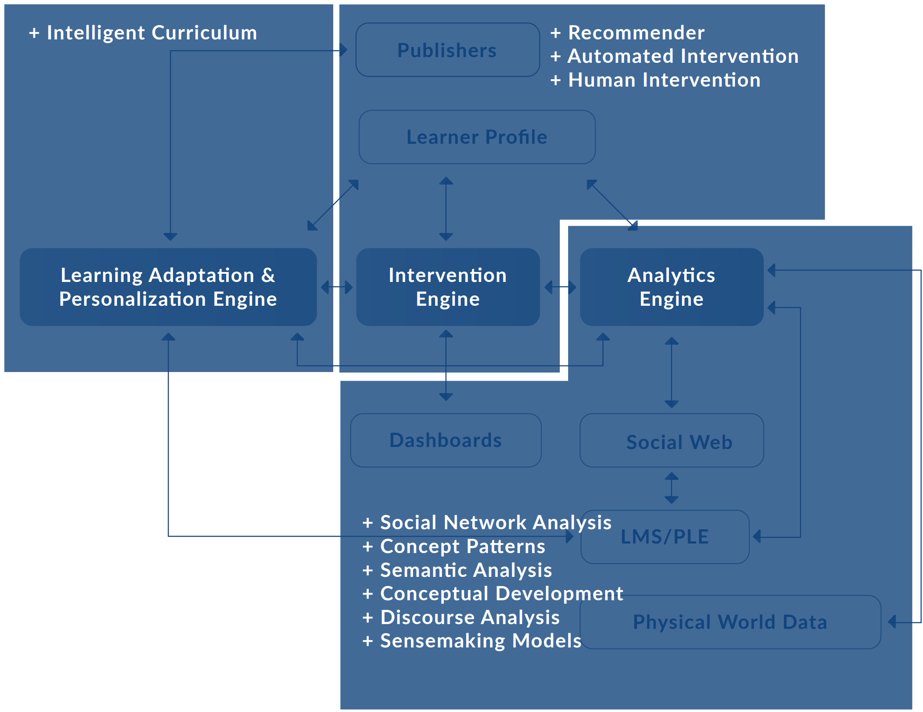

Slide 45
UTA UA
iMotions
Ambient computing/Wearables
Mindfulness
Integrated university-wide analytics (all data under one department’s control)

