Slide 1
Phenomenology
“Consciousness is known through the world, and at the same time, the world is known through consciousness” (Kung, 1980, p. 145).

Slide 2
Philosophical Origin
Husserl: “a way of returning to and exploring the reality of life and living” (Tuohy, et al., 2013).

Slide 3
Descriptive Phenomenolgy
“The objective of descriptive phenomenology is to describe a phenomenon’s general characteristics rather than the individual’s experiences to determine the meaning or essence of the phenomenon” (Giorgi, 2008; Crotty, 1996)
“The objective of descriptive phenomenology is to ‘describe things as they appear to consciousness.’ Consciousness is the medium between people and world” (Moran, 2000; Giorgi, 2005)

Slide 4
Bracketing
“is the suspension of the researcher’s own preconceptions, beliefs or prejudices so that they do not influence the interpretation of the respondents’ experience” (Parahoo, 2006).
Question to consider: Is this “suspension” actually possible?

Slide 5
Interpretive Phenomenology
Hermeneutics is to describe, understand, and interpret participants’ experiences.
Dasein: “being-in-the-world” – we are already embedded in a world of meaning. “Being human is a situated activity, a situation in which things are encountered and managed.” (Reed & Ground, 1997)

Slide 6
Co-constitutionality
Meanings are a blend of participants’ and researchers’ meaning (Flood, 2010)
Do you see any problems/benefits with this?

Slide 7
Interpretive Phenomenological Analysis (IPA)
“IPA’s focus on gaining a more in-depth and richer understanding of the participants’ experiences makes it a versatile tool. While the participant is trying to make sense of the world around them, the researcher is trying to make sense of the participant trying to make sense of the world around them” (Roberts, 2013).

Slide 8
Life-world existential themes
Lived space – “felt space” – the space in which we are located (spatiality)
Lived time – subjective time, as opposed to clock time (temporality)
Lived body – we are always in our body (corporeality)
Lived human relation – how we communally experience the world (communality)

Slide 9
Hermeneutic circle
“the circular process of continuous re-examination of propositions” (Rapport & Wainwright, 2006)

Slide 10
Example of methodology
Question: How does a woman’s sense of identity change during motherhood?
Small sample size “a large sample size can overwhelm the researcher with data” (Roberts, 2013)
A purposive homogenous sample is necessary so that themes can be realized from certain groups of people who have shared particular experiences.

Slide 11
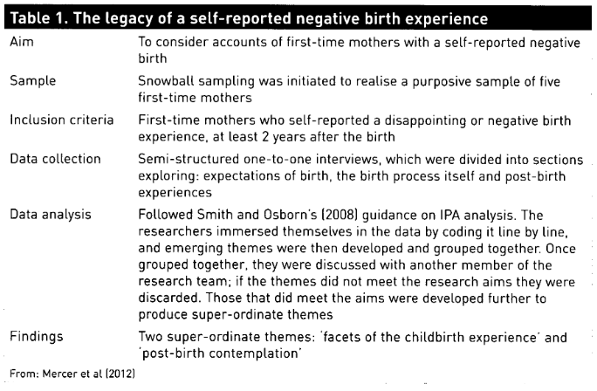
Data collection & analysis

Slide 12
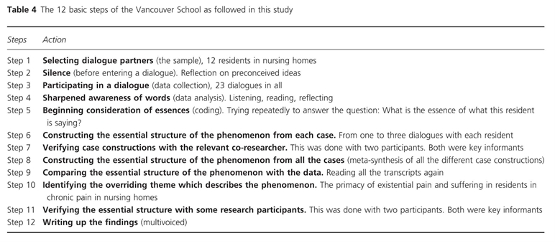
Gudmannsdottir, G., & Halldorsdottir, S. (2009). Primacy of existential pain and suffering in residents in chronic pain in nursing homes: a phenomenological study. Scandinavian Journal Of Caring Sciences, 23(2), 317-327 11p. doi:10.1111/j.1471-6712.2008.00625.x

Slide 13
rigour
Can be achieved in a research study by demonstrating transparency in the research process and be open to external audit, confirming credibility (Smith, et al., 2009)
“To ensure the trustworthiness of the study, that ‘qualitative research represents truth, researchers should engage in ‘reflexivity,’ which entails adopting self-awareness to potential biases” (Kingdon, 2005)

Slide 14
PHenomenography
“The empirical study of the limited number of qualitatively different ways in which we experience, conceptualise, understand, perceive, apprehend various phenomena in and aspects of the world around us” (Marton, 1994).

Slide 15
A final note on generalizability
“A phenomenological description is always one interpretation, and no single interpretation of human experience will ever exhaust the possibility of yet another complementary, or even potentially richer, description” (van Manen, 1984, p. 40)

Slide 16
Provocative Questions
Do you think bracketing is possible? Have you ever experienced the ability to suspend your beliefs/preconceptions?
Do you see any problems/benefits with the idea of co-constitutionality – that researchers help build meaning for research participants?
How does “being” online shift, expand, transform the concepts of lived space, time, body and human relationships?
What issues arise from the use of small, homogenous sample sizes?

Slide 17
The dilemma of false consciousness
“there is also the possibility that those actors might be falsely conscious and that sociologists have an obligation to see an objective perspective which is not necessarily that of any of the participating actors at all” (Cohen, Manion & Morrison, 2011, pp. 20-21).
What are the implications – good and bad – that people may have a false consciousness? If people do have a false consciousness, what are some of the extreme research implications of this? If we say it is impossible for people to have a false consciousness, what are some of the research implications?

Slide 18
References
Adams, C. & Yin, Y. (2014). Undergraduate students’ experiences of time in MOOC: A term of Dino 101. 11th International Conference on Cognition and Exploratory Learning in a Digital Age (CELDA 2014). 225-230.
Crotty, M. (1996). Phenomenology and Nursing Research. Melbourne: Churchill Livingstone.
Gudmannsdottir, G., & Halldorsdottir, S. (2009). Primacy of existential pain and suffering in residents in chronic pain in nursing homes: a phenomenological study. Scandinavian Journal Of Caring Sciences, 23(2), 317-327 11p. doi:10.1111/j.1471-6712.2008.00625.x
Rapport, F., & Wainwright, P. (2006). Phenomenology as a paradigm of movement. Nursing Inquiry, 13(3), 228-236. doi:10.1111/j.1440-1800.2006.00325.x
Reed, J. & Ground, I. (1996). Philosophy for Nursing. London: Arnold.
Roberts, T. (2013). Understanding the research methodology of interpretative phenomenological analysis. British Journal Of Midwifery, 21(3), 215-218.
Tuohy, D., Cooney, A., Dowling, M., Murphy, K., & Sixsmith, J. (2013). An overview of interpretive phenomenology as a research methodology. Nurse Researcher, 20(6), 17-20.
Trigwell, K., & Prosser, M. (2004). Development and Use of the Approaches to Teaching Inventory. Educational Psychology Review, 16(4), 409-424. doi:10.1007/s10648-004-0007-9
Van Manen, M. (1984). Practicing phenomenological writing. Phenomenology and pedagogy. 2(1), 36-69. Retrieved from https://ejournals.library.ualberta.ca/index.php/pandp/issue/view/1044

