Slide 1
Academic Blogging in Practice:
A Case Study
CeLC 2010 Presentation
Edmonton, AB
June 2010

Slide 2
Introduction
Address blogging from my own perspective as a learner and student researcher
Use perspective of analyzing blogging practices in terms of what was significant, valuable and challenging
Share my passion for blogging
Identify differences of learning using blogging in different contexts

Slide 3
Background
Completed 4 courses of 11 course MDE program at Athabasca University using blogging
1 regular course, 1 seminar format, 2 independent study
Between September 2008 to December 2009
Blogged within Me2U community at Athabasca University
2 significant differences from other case studies:
Maintained contact with one professor as mentor during four consecutive semesters
16 months of uninterrupted blogging practice

Slide 4
Selection and Collection of Data
No log files available
Used a Tag Cloud
Commonly Used Tags: Edublogging, MDDE663, MDDE690, MDDE691, MODEL POST, and Reflections
29 connections were established with other peers within the Me2U community;
I blogged a total of 159 posts and classified these posts with 330 tags

Slide 5
Four Blogging Contexts
Cohort
Seminar
Blogging Circle
Practice Network

Slide 6
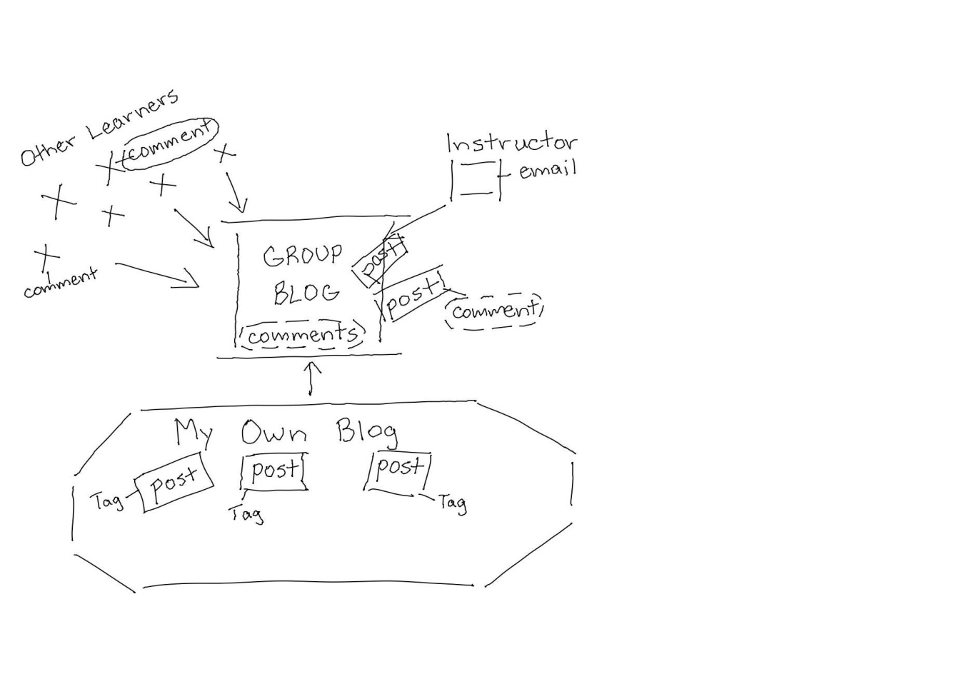
Cohort Blogging

Slide 7
Blogging Within a Cohort
Began blogging to review content specific to course
Considered Group blog central focus
Interacted mainly with instructor
Engaged in commenting between instructor and a few other learners
Used tagging sporadically to categorize posts

Slide 8
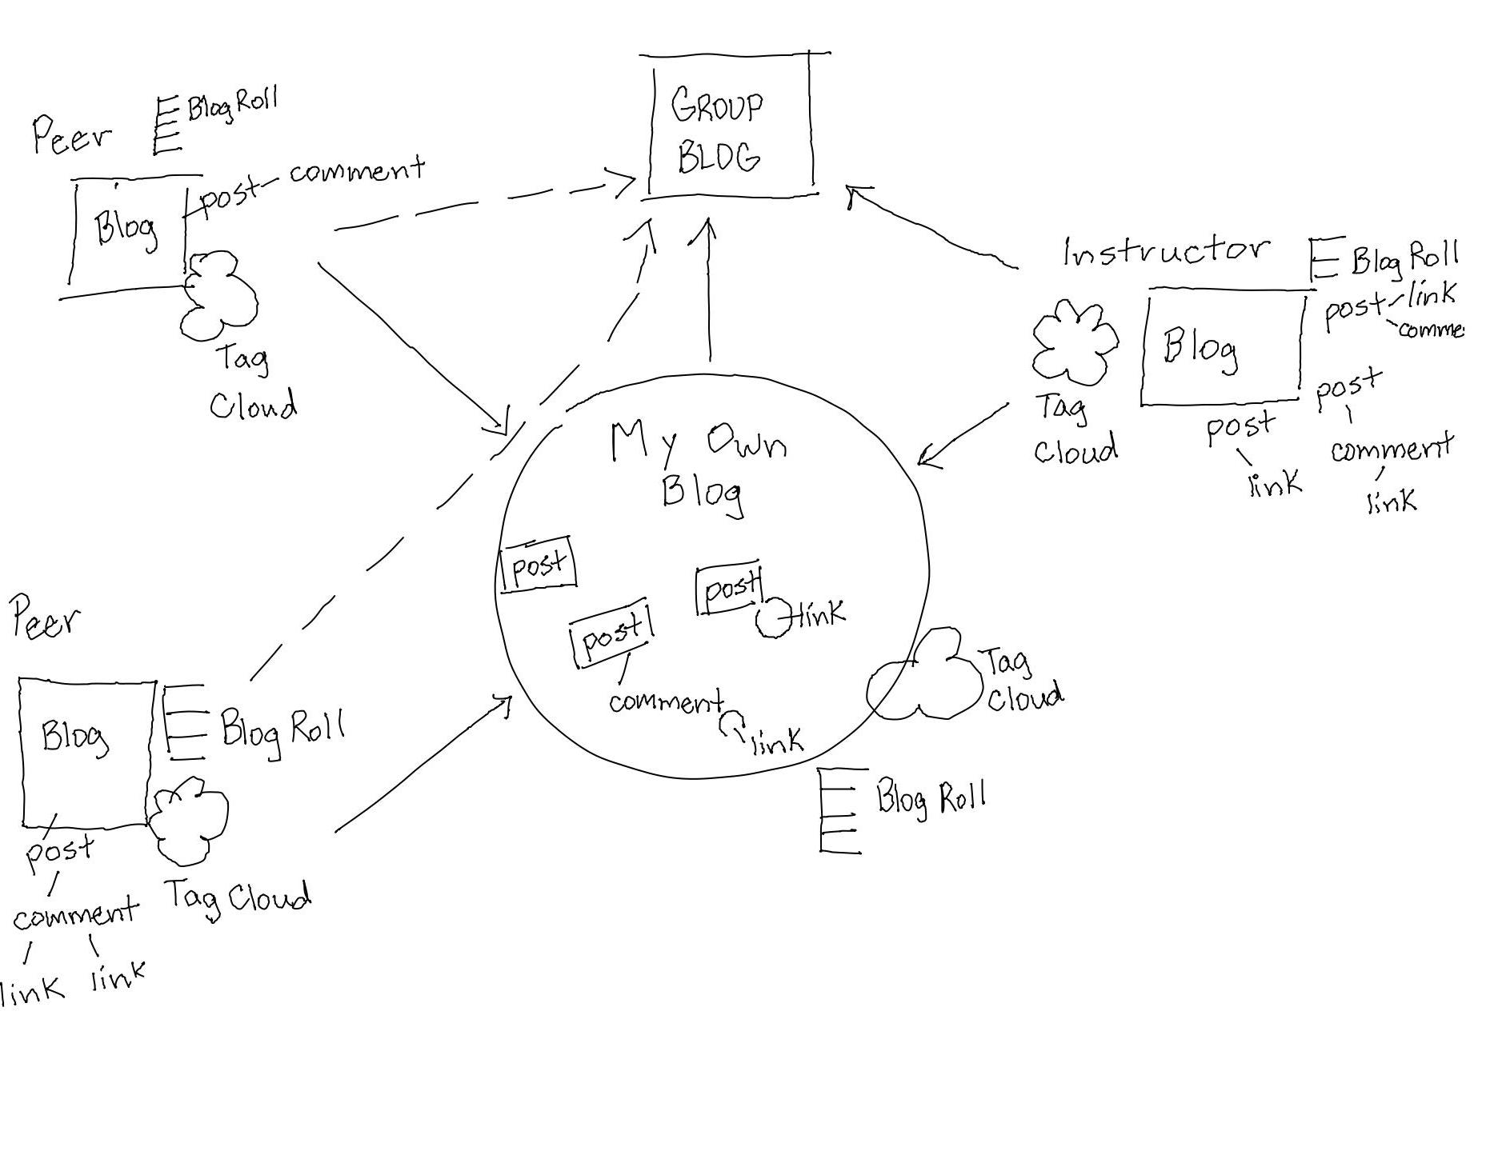
Seminar Blogging

Slide 9
Seminar Blogging Activity
  Began to more systematically organize posts for easier retrieval and re-use (piling)
  Completed more posts as Pause-points (self-monitoring of progress made)
  Spent more time intentionally weaving ideas from articles, web sites, blog posts
  Participated in greater sharing of online resources and experiences

Slide 10
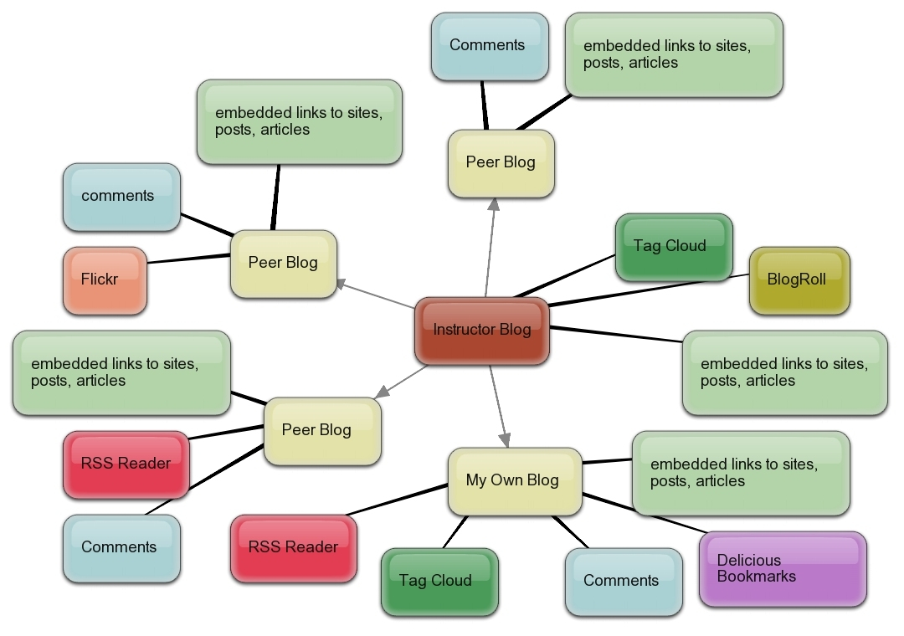
“Blogging Circle”

Slide 11
Blogging in a Blogging Circle
  Began to more systematically organize posts for easier retrieval and re-use (piling)
  Completed more posts as Pause-points (self-monitoring of progress made)
  Spent more time intentionally weaving and sharing ideas from articles, web sites, blog posts
  Facilitated and participated in extended conversation first as comment thread, then moved conversations to own blogs as blog posts linked to each others’ posts

Slide 12
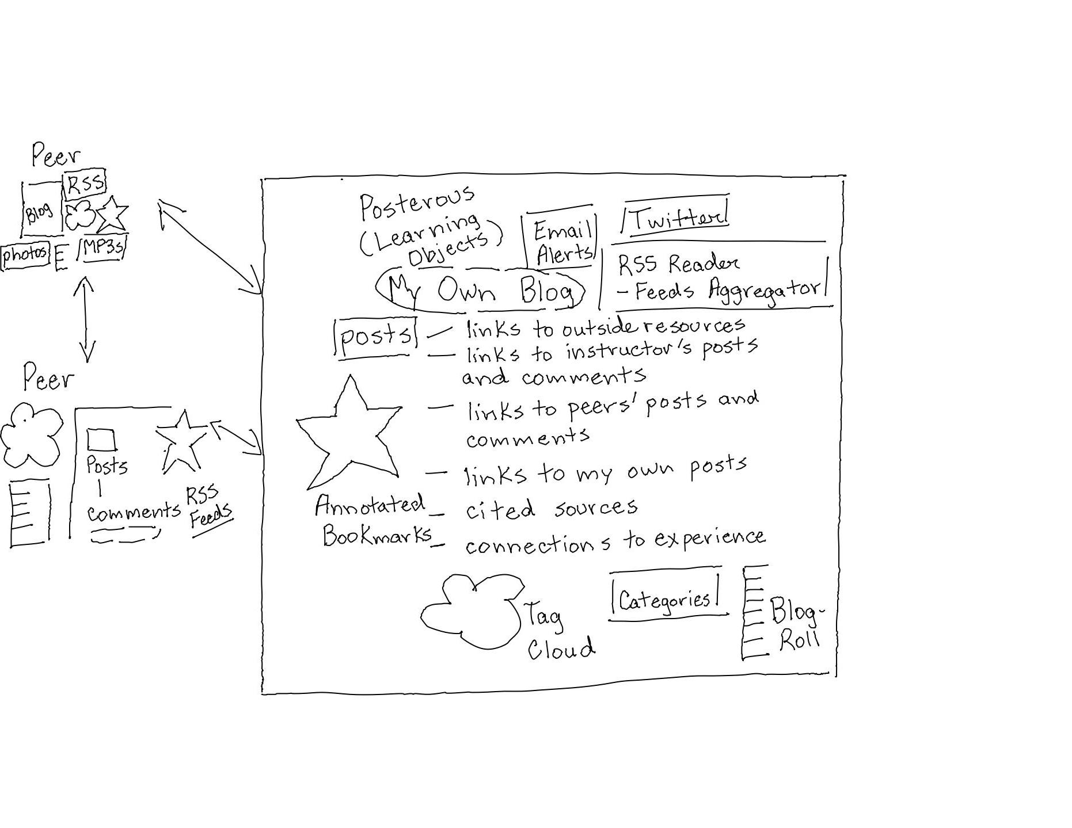
Blogging in a Practice Network

Slide 13
About Learning in a Blogging Circle
  Fundamental shifts of perspective:
  Ideas/process capture is more proactive and more engaged with purposeful posting
  “Not just about me – other students like myself have need for mentor’s expertise”
  “I need to blog for oneself, so it is time to fly solo”
  I began viewing blogging context of my own larger role as peer mentor in supporting other learners like myself
  Engaged with other learners as guest blogger (as a former student of the course)

Slide 14
Suggestions for Using Blogs for Instruction with Learners
Provide models for posting (exemplars)
Actively blog alongside learners – share own blogging experiences
Provide activities that require reflective pause-points for learners to assess their learning
Encourage students to share ideas with one another cooperatively and collaboratively
Discuss with students how to deep-weave, and use activities that go beyond surface commenting on others’ posts
Model how to blog from different perspectives, roles, and voices

Slide 15
Strategies for Minimizing Learner Frustrations and Ambivalence
Use student names and refer to posts and comments made by learners on regular presence
Offer resources to students that might be of use/interest
Use informal, conversational tone to describe one’s own authentic blogging practice
Make sub-text within your blog posts, to comment on what/how you are blogging
Use tags and links as you would like your students to use them

Slide 16
Personal Best Practices
Engage in conversations with oneself (as future reader) and others
Participate in self-regulated learning one’s learning mindful of instructor/mentor’s broader teaching context with others like oneself
Tag meaningfully and proactively in anticipation of reviewing Tag Cloud later
Balance post types to practice the different skills of knowledge construction process
Use idea capture (voice recordings, scanned notes, graphic organizers) as much as possible to track progress of ideas

Slide 17
Conclusions
The case study supports central role of peers in supporting learners.
The case study also provides strong support for the essential, central role of instructors.
Student bloggers require sustained opportunities to practice over several semesters in differing contexts, ideally with only one instructor.
Students need to be offered opportunity to practice blogging apprenticeship to engage others in wider circles but within secure practice network

Slide 18
Selected Resources
Bates, Marcia J. "The Design of Browsing and Berrypicking Techniques for the Online Search Interface." Online Review 13 (October 1989): 407-424.Kerawaala (2009)
Downes, S. (2009). New Tools for Personal Learning. Retrieved December 7, 2009, from URL: http://www.slideshare.net/Downes/new-tools-for-personal-learning
Siemens, G. (2009). What is Connectivism? Week 1: CCK09 Course, Date: September 2009
Retrieved October 26, 2009 from http://docs.google.com/Doc?id=anw8wkk6fjc_14gpbqc2dt
Weick, Sutcliffe, and Obstfeld: Organizing and the Process of Sensemaking. Organization Science 16(4), pp. 409–421, ©2005 INFORMS
Du, H., & Wagner, C. (2007). Learning With Weblogs: Enhancing Cognitive and Social Knowledge Construction. IEEE Transactions on Professional Communication, 50(1), 1-16. Retrieved from Academic Search Premier database.
Efimova, L. (2009). Weblog as a personal thinking space. HT’09: Proceedings of the twentieth ACM conference on hypertext and hypermedia, June 2009. New York: ACM. doi:10.1145/1557914.1557963 [.pdf]

Slide 19
Thank you for listening
For questions and comments, please contact me:
Glenn Groulx
ggroulx@nwcc.bc.ca
Twitter: @ggroulx
https://landing.athabascau.ca/pg/blog/glenngr4
http://edublogging4literacy.edublogs.org

