Slide 1




Arena Blended Connected (ABC)
curriculum design
Clive Young and Nataša Perović
Digital Education, UCL

Slide 2
ABC curriculum design
The ABC curriculum design method
student centered
activity based
collaborative
rapid
(re)design programmes and modules
non-prescriptive
ABC is built from
curriculum design research from the JISC* (Viewpoints)
UCL IoE** (learning types) and adapted for UCL
* Viewpoints project (2008-2013),
**Laurillard, D. (2012). Teaching as a Design Science: Building Pedagogical Patterns for Learning and Technology. New York and London: Routledge.

Slide 3
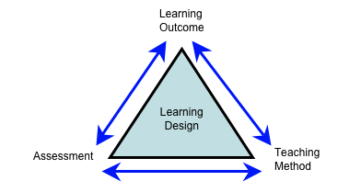
ABC curriculum design
Helps
  develop richer learning designs for blended learning
  integrate strategic initiatives e.g. digital skills, employability
  join ‘formal’ (learning outcomes + assessment) to practice
  cross-team communication and sharing
http://www.open.edu/openlearnworks/pluginfile.php/54507/mod_page/content/2/WP3_new_unit_image.png

Slide 4
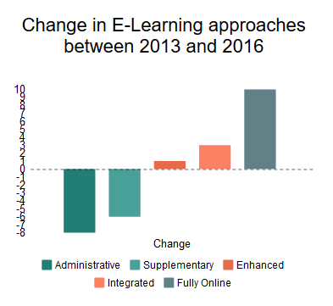
ABC curriculum design
Blended learning
1 - a combination of face-to-face and online teaching
2 - a combination of technologies
3 - a combination of methodologies
Sharma P (2010)
UCL is getting more blended
(according to our students)
Notes:
Mention flipping

Slide 5

ABC curriculum design
Meet Your Researcher
Personal Tutor
Connected Curriculum
UCL framework for diverse &
good curriculum design
Vertical modules
Capstone
Being part of a community
Peer mentoring
Articles, blogs, exhibitions, presentations, videos
Making Cities, London
Explicit
links to career
Enterprise
Notes:
CENTRE - Every year of study, every programme
Inspire program teams to enhance connections across years of study, between staff and students, and between disciplines
Think about nature of ‘research’ in and beyond one’s own discipline
Framework for good curriculum design: Diversity & Department-specific
01 - Students make connections & conversations
‘Meet your researcher’
Revisiting personal tutor’s role
02 -Sequence of research learning
Engaging in research process and thinking at every stage
‘capstone’ research opportunity
‘Vertical’ modules
03 - Clear opportunities to connect subject learning with other disciplines
Linking out to the wider world, global citizenship
04 - Opportunities to connect with wider learning and skills
Teamwork, project mgmt, creativity, leadership
Ability to articulate relevance of learning and skills to future career
05 - Assessment as research ‘output’
Articles, blogs, exhibitions, presentations, videos
Impact beyond university
Relevance to career
06 - Sense of belonging, being part of a community
Connecting with each other
Group projects
Peer mentoring

Slide 6
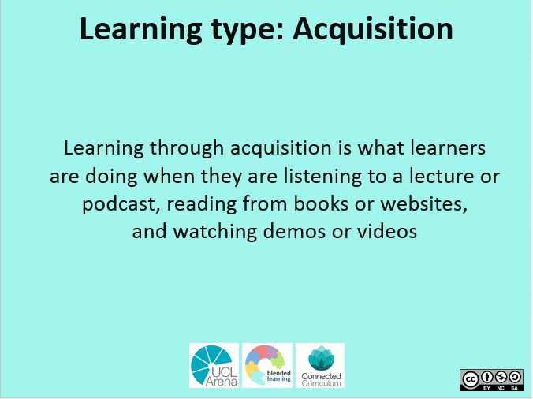
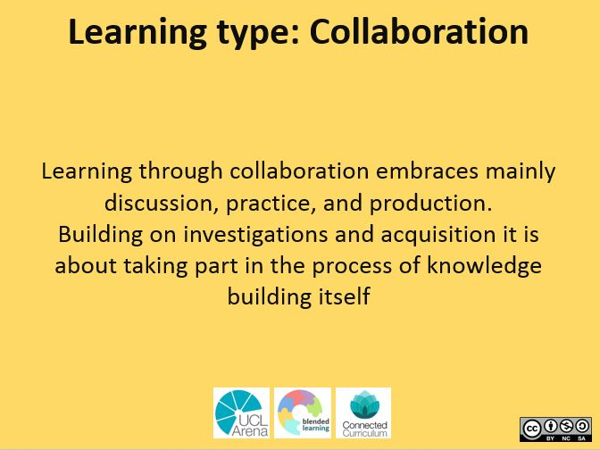
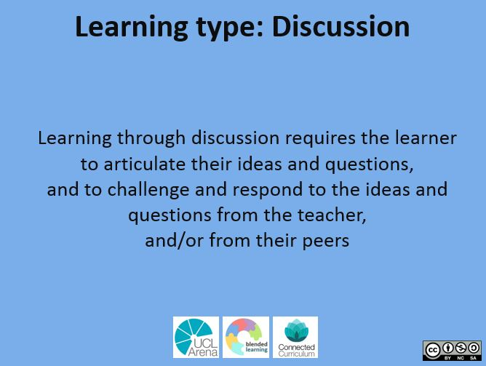
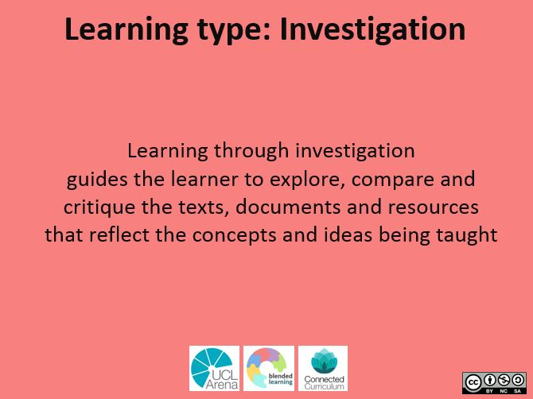
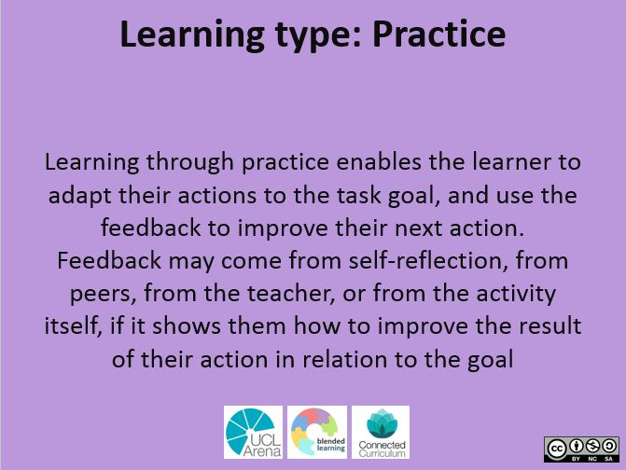
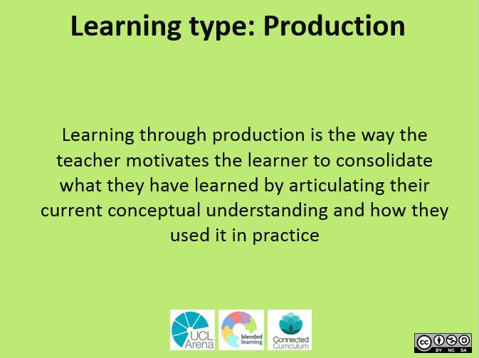
ABC curriculum design
Learning types cards (front)
learning activity types on one side and examples of activities on the other

Slide 7
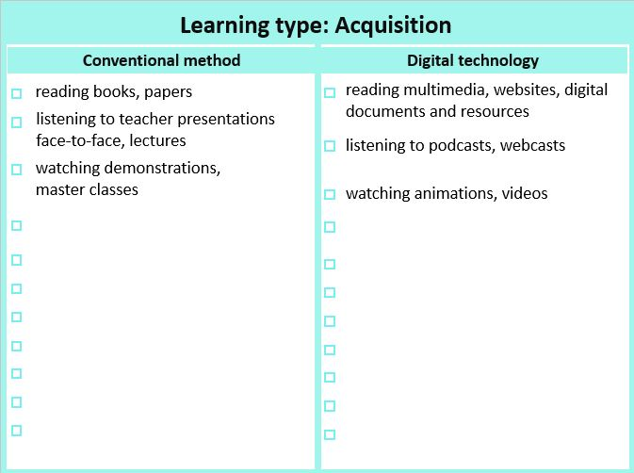
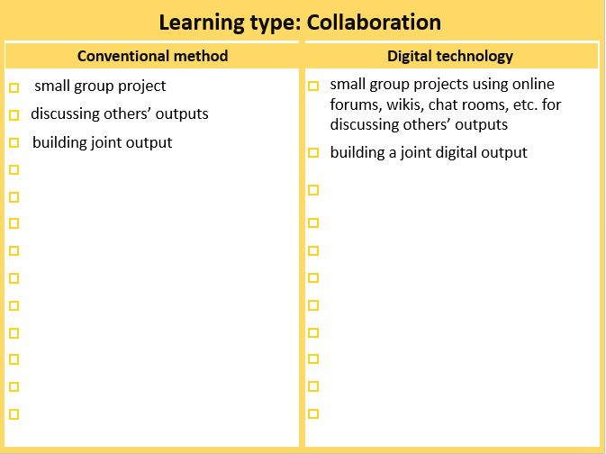
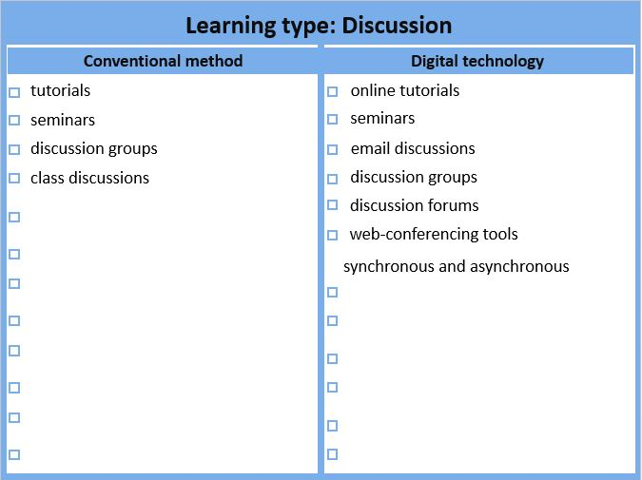
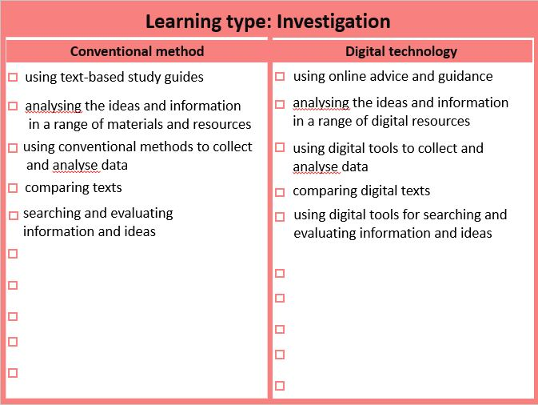
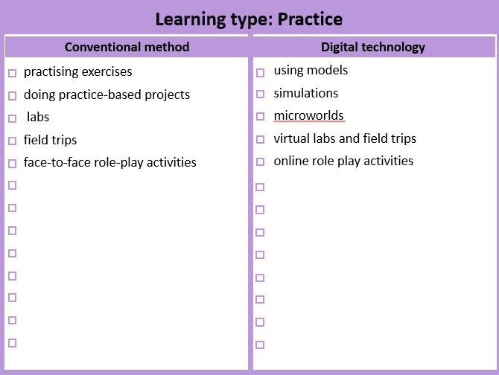
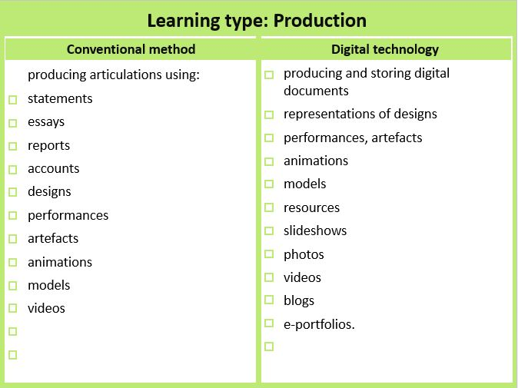
ABC curriculum design
Learning types cards (back)
learning activity types on one side and examples of activities on the other

Slide 8
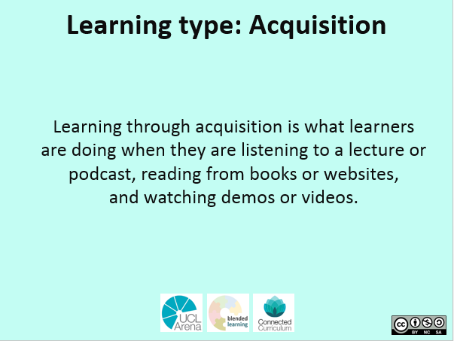
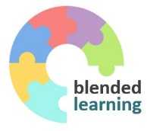
ABC curriculum design
Learning types cards (front and back)

Slide 9
ABC curriculum design
Learning types cards (front and back)

Slide 10
ABC curriculum design
Learning types cards (front and back)

Slide 11
ABC curriculum design
Learning types cards (front and back)

Slide 12
ABC curriculum design
Learning types cards (front and back)

Slide 13
ABC curriculum design
Learning types cards (front and back)

Slide 14

Learning types activities , V- Visible learning A - can be assessed (F or S)
Investigation
Practice
Production
Web search (forum, wiki) V
OER resources (external)
Literature reviews and critiques (forum/blog/wiki/RSS) V
Field/lab observations (media/blog/wiki) V
Action research V
Authentic research / data analysis – write a paper V
Lead a group project V
MCQs - formative with automatic feedback V/A
Online role play (forum, virtual classroom)
Reflective tasks – group or individual (forum) V/A
Case studies (forum, lesson) V/A
Rapid-fire exam questions (forum) V/A
Advanced role play – you are the consultant etc. V
Interview an expert (video/forum/chat) V
Literature reviews and critiques (forum/blog/wiki/RSS) V/A
MCQs - formative with automatic feedback V/A
Develop a shared resource library (database/glossary/wiki) V/A
Shows/demonstrates learning (displays, posters, presentations) V/A
Portfolios (MyPortfolio) V/A
Case studies (forum, lesson) V/A
Summarisation tasks (upload texts – individual or group) V/A
Rapid-fire exam questions (forum) V/A
Concept mapping (external) V
Create video of performance (media) V/A
Audio commentary of performance (media) V/A
Skype or virtual classroom 'viva' V/A
Make and give a presentation (external) V/A
Video blog (external) V/A
Write a report (external) V/A
Make an analysis (external) V/A
Case studies V/A
Advanced role play – you are the consultant etc. V
Action plan for workplace V/A
Action plan for further study V/A
Authentic research / data analysis – write a paper V/A
Prepare professional briefing V/A
Create, make a case (study) V/A
Create podcast (media) V/A
Work assignment (blog/report) V/A
Interview professional colleagues V/A
Lead a group project V/A
Collaboration
Collaborative wiki - what do we know about ...? V/A
Develop a shared resource library (database/glossary/wiki) V
Social networking – participate (external) V
Special interest groups - share on a topic (forum) V
Mentor other learners V
;
Acquisition
Guided readings (library resources)
OER resources (external)
Podcast (media) V if students do it
Webinars (virtual classroom) V
Q&A forum (forum, where teachers answer student questions) V
Video lectures (webcast),
YouTube videos (external)
Field/lab observations (media/blog/wiki) V
MCQs - formative with automatic feedback V
Portfolios (MyPortfolio) V
Discussion
Interview an expert (forum/chat) V
Webinars (virtual classroom) V
Model answers/examples of previous work (forum)
Analyse chat text (in course or uploaded) V
Job/professional reflections (blog) V/A
Group discussions on the topic, problem, reading (chat/blog/wiki) V/A
Social networking – participate (external) V
Reflective tasks – group or individual (forum) V/A
Special interest groups - share on a topic (forum) V
Lead a group project V/A

Slide 15

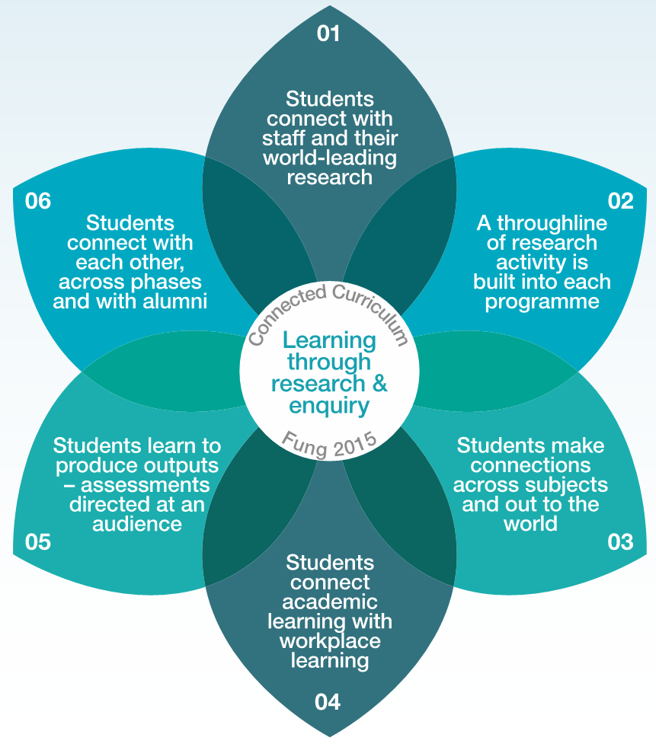
Connected curriculum dimensions of connectivity and learning process modelling (the Conversational framework) connections
collaboration
discussion
discussion
investigation
collaboration
aquisition
discussion
collaboration
production
discussion
aquisition
Learning types
Acquisition
Collaboration
Discussion
Investigation
Practice
Production
collaboration
practice

Slide 16

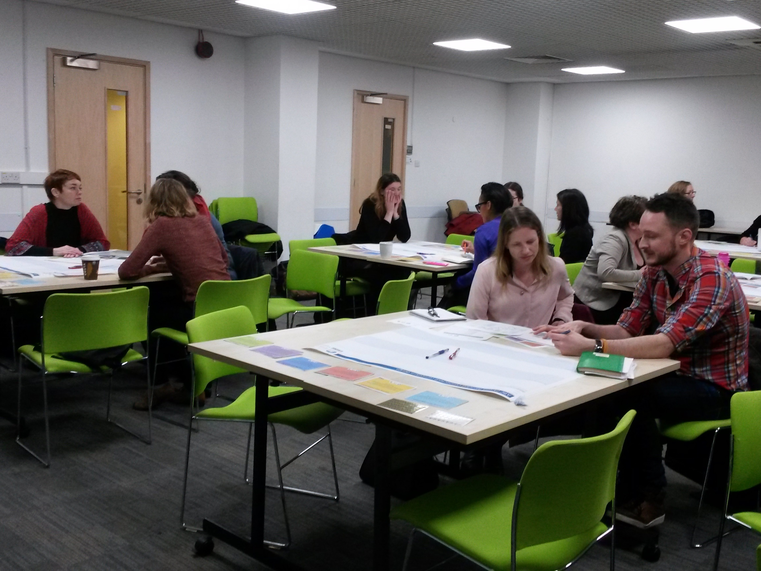
ABC curriculum design workshop

Slide 17
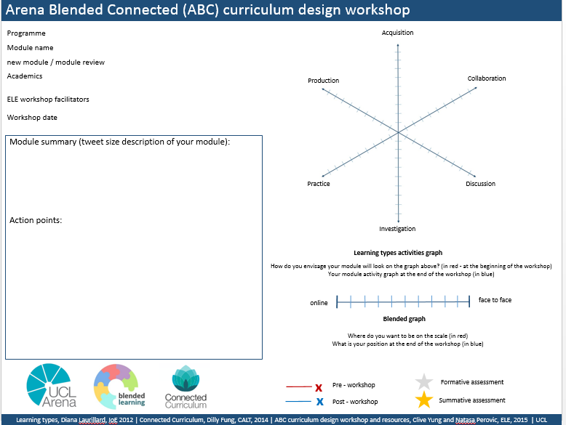
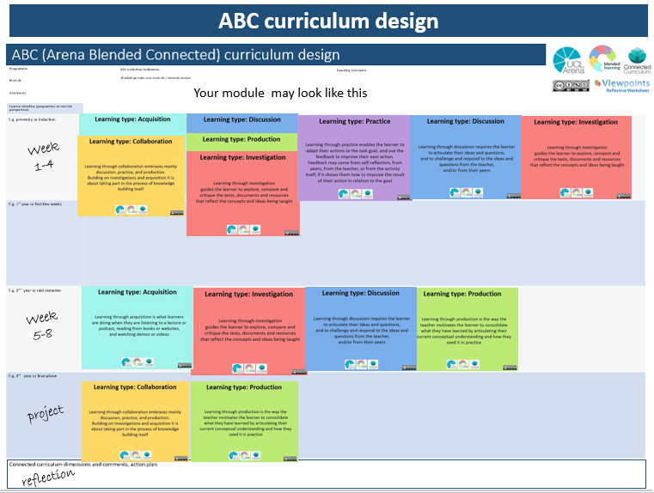
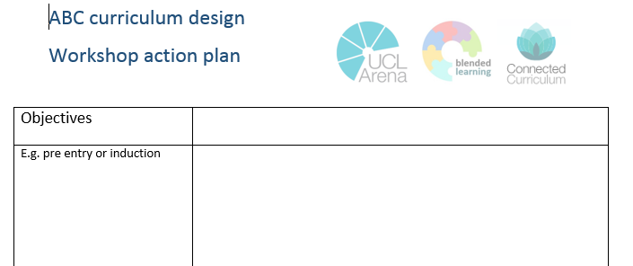
ABC curriculum design
Workshop schedule:
Module info and graphs sheet
  Tweet your module – tweet size description of your module
  Module shape (Learning types activities graph) distribution of learning types
  Blend – (blended graph)
Storyboard sheet
  Storyboard – learning types sequences and activities
  Assessment – align activities and assessment
Module info and graphs sheet
  Review the graphs – what has changed? Why?
Actions – what next for team?

Slide 18
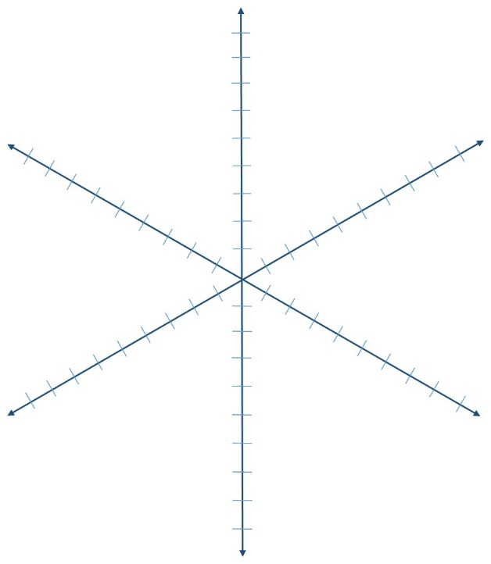


Arena Blended Connected (ABC) curriculum design workshop
Arena digital
Programme
Module name
new module / module review
Academics
Acquisition
Use of videos in teaching
Anna Moore, Jon Grabol
Production
Collaboration
CY, NP
ELE workshop facilitators
Workshop date
Pre - workshop
5th June 2015
Module summary (tweet size description of your module):
All you need to know about use of videos in 21st century teaching
Practice
Discussion
Investigation
Learning types activities graph
@ABC_LD
How do you envisage your module will look on the graph above? (in red - at the beginning of the workshop)
Your module activity graph at the end of the workshop (in blue)
online
x
face to face
Blended graph
Where do you want to be on the scale (in red)
What is your position at the end of the workshop (in blue)
Learning types, Diana Laurillard, IoE 2012 | Connected Curriculum, Dilly Fung, CALT, 2014 | ABC curriculum design workshop and resources, Clive Yung and Natasa Perovic, ELE, 2015 | UCL

Slide 19
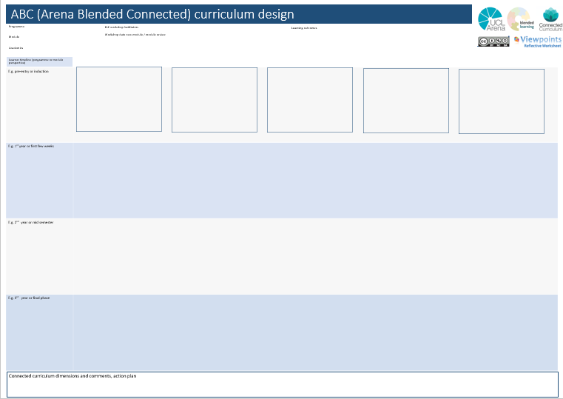

ABC curriculum design
Week
1-4
Week
5-8
project

Slide 20
ABC curriculum design
Induction
Topic 1
Topic 2
Topic 3

Slide 21
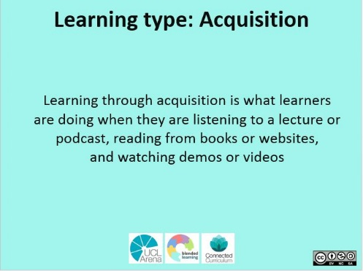
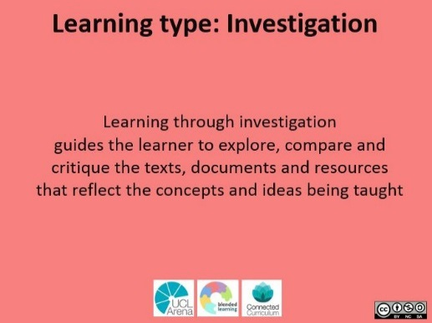
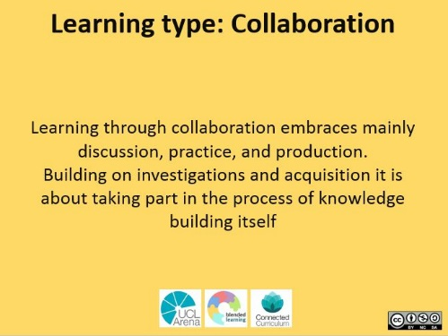


ABC curriculum design
Your module may look like this
Week
1-4
Week
5-8
project
reflection

Slide 22

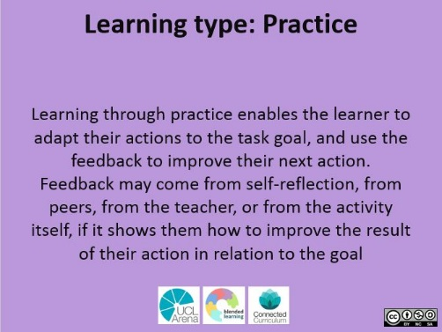
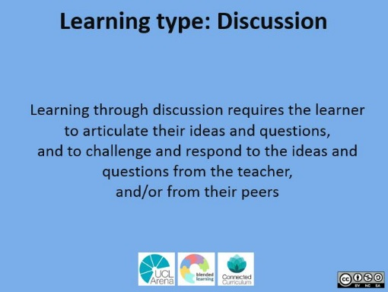
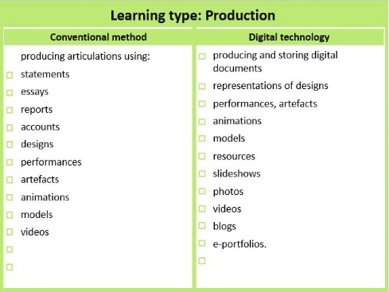
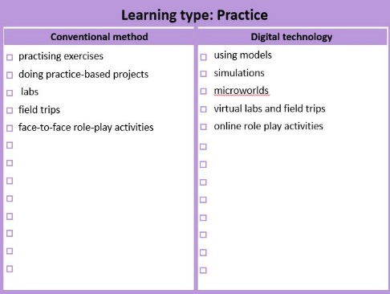
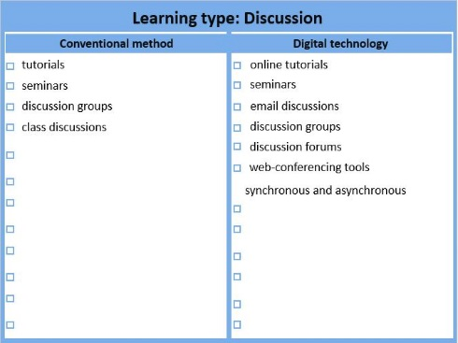
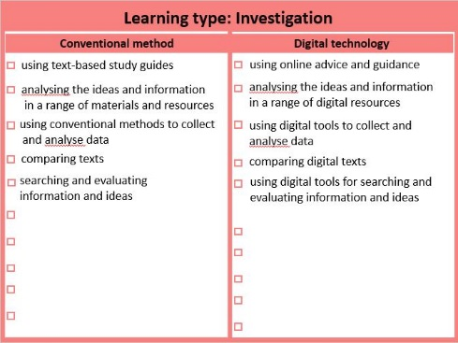

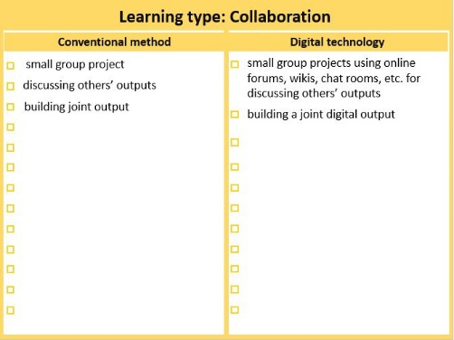
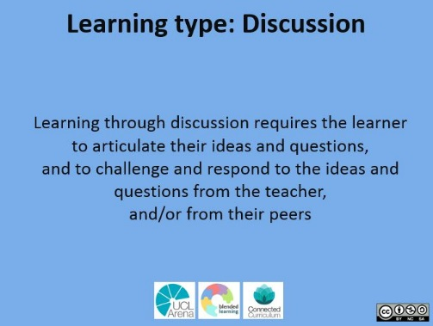
ABC curriculum design
Week
1-6
Week
1-6
Week
6-10
Once happy with your module design, turn the cards to the other side and select learning activities
Select learning activities
✓

Slide 23
ABC curriculum design
Selecting activities and assessment
✓
Select formative ( ) and summative assessment ( )

Slide 24
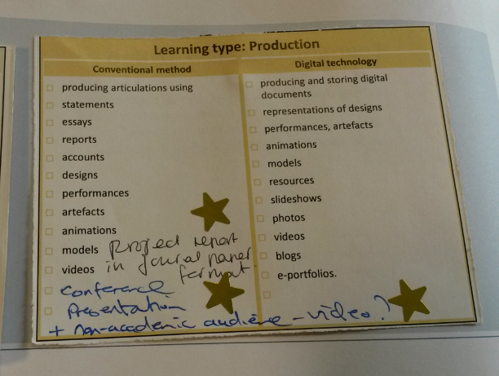
ABC curriculum design
Selecting activities and assessment
✓
✓
(script)
✓
Select formative ( ) and summative assessment ( )

Slide 25
ABC curriculum design
Selecting activities and assessment
✓
✓
Select formative ( ) and summative assessment ( )

Slide 26
Arena Blended Connected (ABC) curriculum design workshop
Arena digital
Programme
Module name
new module / module review
Academics
Acquisition
Use of videos in teaching
Anna Moore, Jon Grabol
Production
Collaboration
CY, NP
ELE workshop facilitators
Workshop date
Post - workshop
5th June 2015
Module summary (tweet size description of your module):
All you need to know about use of videos in 21st century teaching
Practice
Discussion
Investigation
Learning types activities graph
@ABC_LD
How do you envisage your module will look on the graph above? (in red - at the beginning of the workshop)
Your module activity graph at the end of the workshop (in blue)
online
x
x
face to face
Blended graph
Where do you want to be on the scale (in red)
What is your position at the end of the workshop (in blue)
Learning types, Diana Laurillard, IoE 2012 | Connected Curriculum, Dilly Fung, CALT, 2014 | ABC curriculum design workshop and resources, Clive Yung and Natasa Perovic, ELE, 2015 | UCL

Slide 27
Arena Blended Connected (ABC) curriculum design workshop
Arena digital
Programme
Module name
new module / module review
Academics
Acquisition
Use of videos in teaching
Anna Moore, Jon Grabol
Production
Collaboration
CY, NP
ELE workshop facilitators
Workshop date
5th June 2015
Module summary (tweet size description of your module):
All you need to know about use of videos in 21st century teaching
Practice
Discussion
Investigation
Learning types activities graph
@ABC_LD
How do you envisage your module will look on the graph above? (in red - at the beginning of the workshop)
Your module activity graph at the end of the workshop (in blue)
online
x
x
face to face
Blended graph
Where do you want to be on the scale (in red)
What is your position at the end of the workshop (in blue)
Learning types, Diana Laurillard, IoE 2012 | Connected Curriculum, Dilly Fung, CALT, 2014 | ABC curriculum design workshop and resources, Clive Yung and Natasa Perovic, ELE, 2015 | UCL

Slide 28
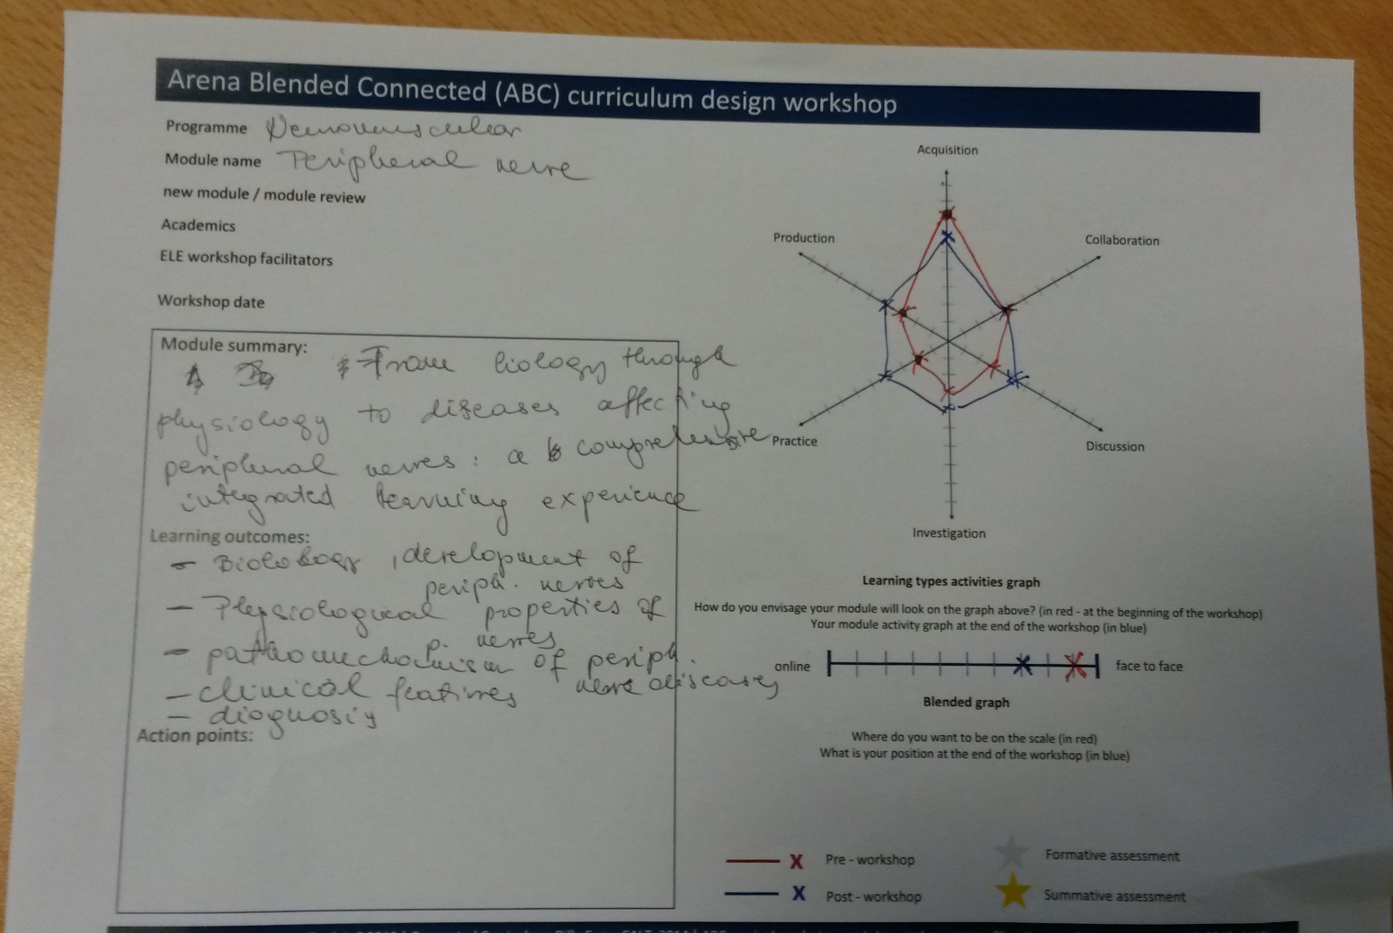

Slide 29
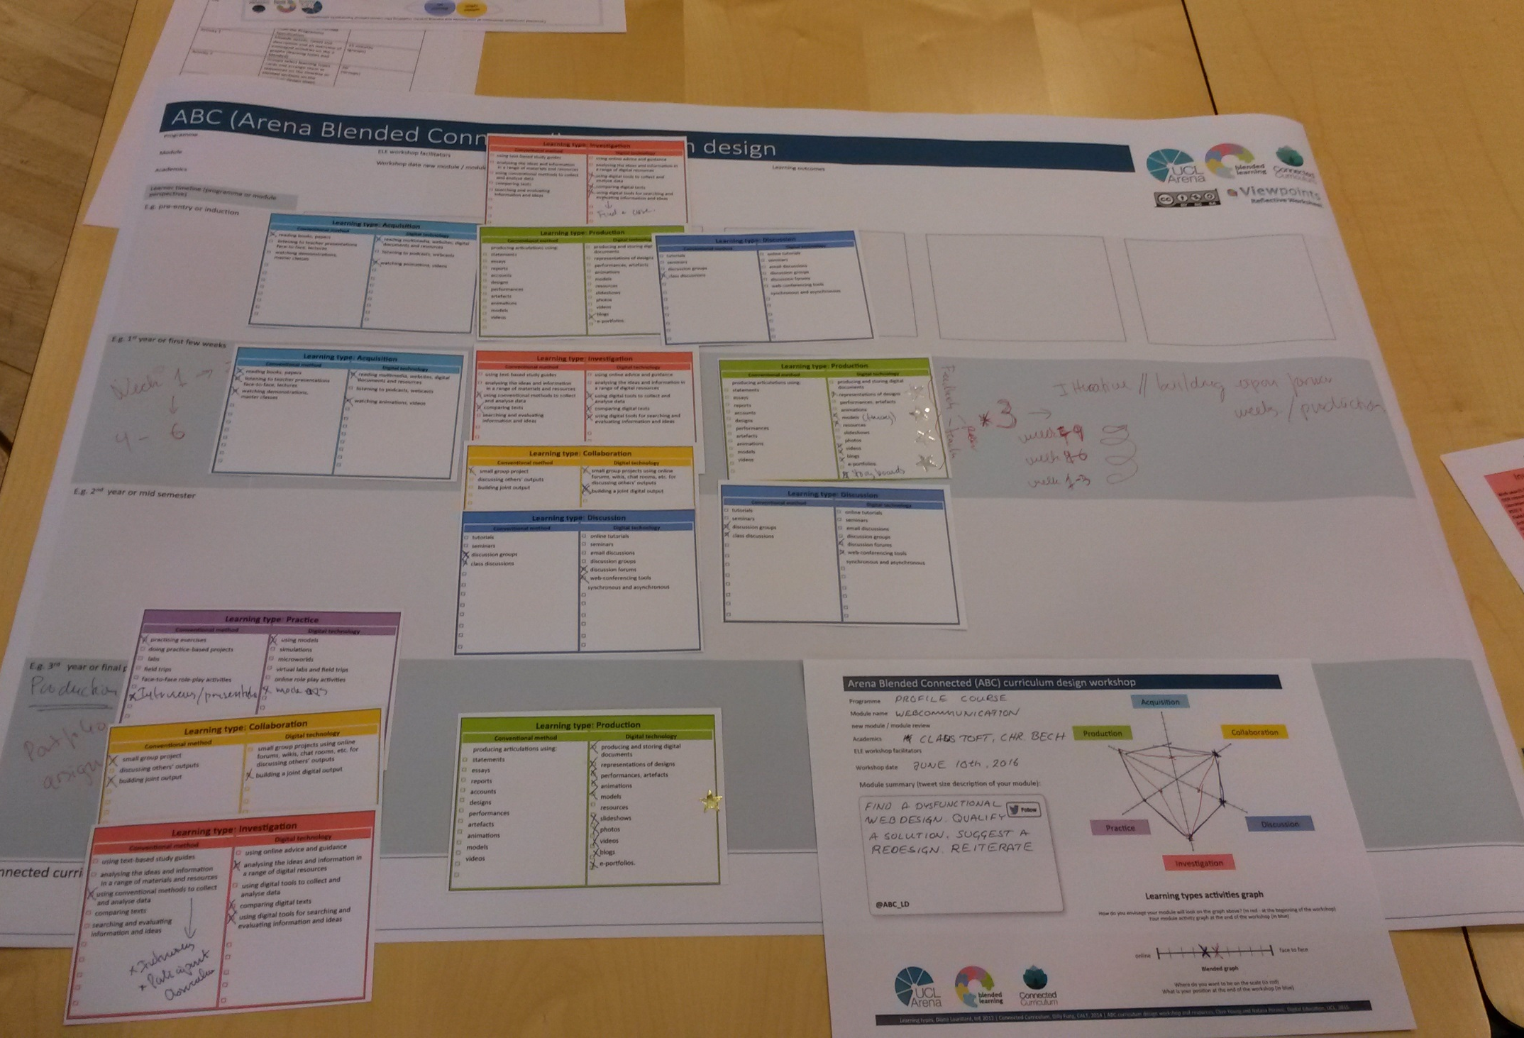
ABC curriculum design

Slide 30
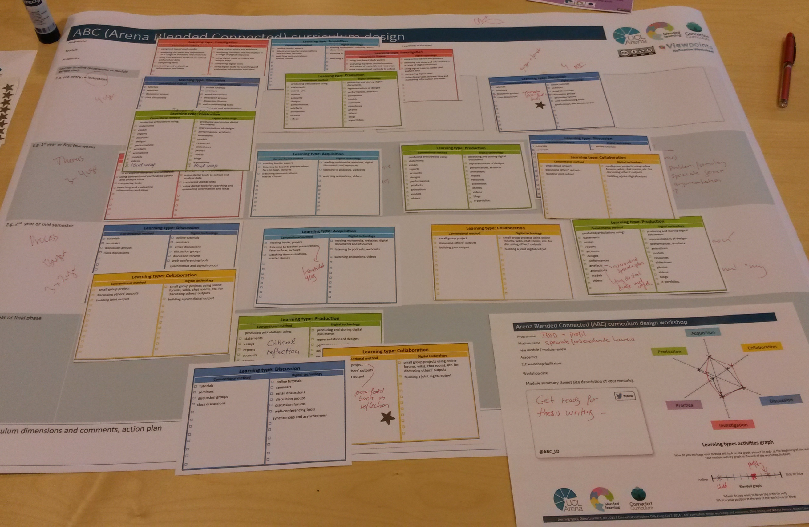
ABC curriculum design

Slide 31
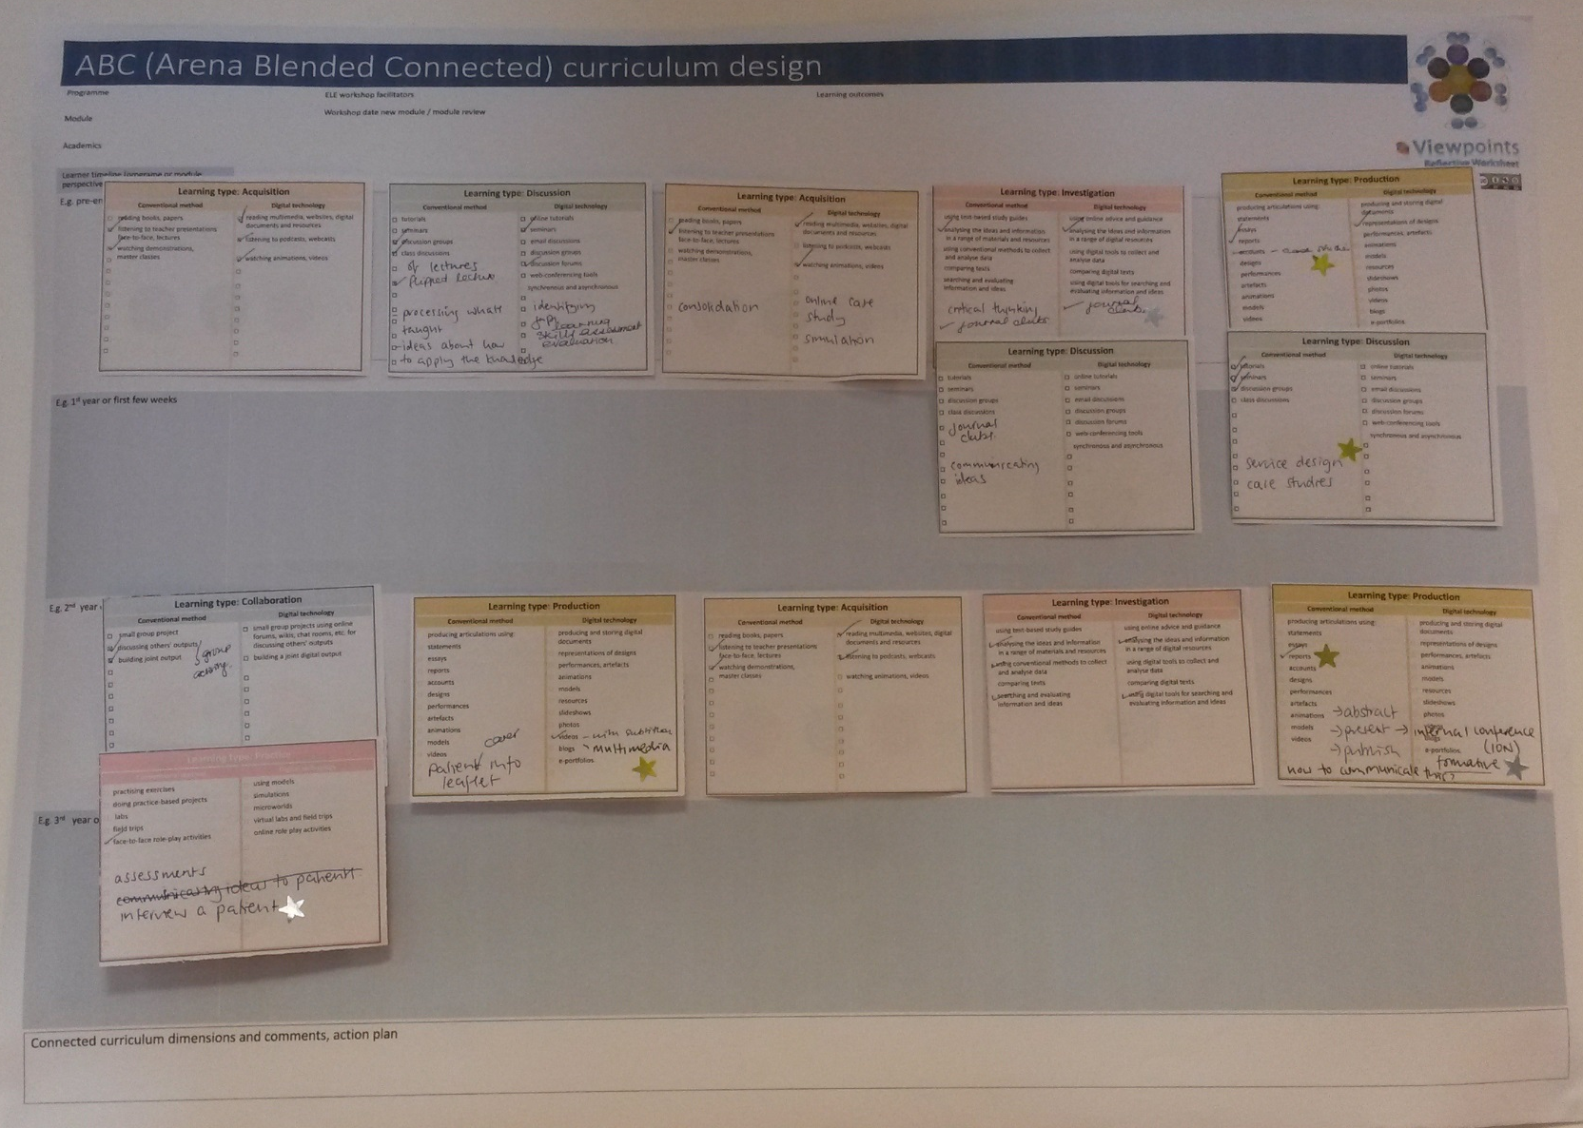

Slide 32
ABC curriculum design
Action plan

Slide 33
ABC curriculum design
Next steps for participants
Action plan
Development schedule (activities and assessment)
Storyboard
Moodle site plan (Moodle benchmark)
Student journey
Connected curriculum
Digital literacies
QA
Publicity etc

Slide 34
ABC curriculum design
What next?
Do you want to run the ABC workshop in your institution?
Do you want to join our international development group?
Do you want to get involved in a project?

Slide 35
ABC curriculum design
Contact
Clive Young c.p.l.young@ucl.ac.uk
and
Nataša Perović n.perovic@ucl.ac.uk
@ABC_LD

