Slide 1
"Open and Closed" Getting the mix right. Who gets to Decide??
Jon Dron Terry Anderson George Siemens
TEKRI
Athabasca University
This work is licensed under a Creative Commons Attribution 2.0 Generic License.
Notes:
Despite the desirability of "Making Open the Default" as the theme of this year’s open access week, there are many reasons that can and should influence a person and an organization to restrict access to content. In this session we explore these reasons from theoretical, practical and pedagogical positions, noting that these decisions all revolve around issues of control. From a practical perspective, we note the need for more nuanced ways to control information than a simple choice of open or closed. We look two examples, the differentiated sharing allowed through permissions of networking systems such as Elgg, and the capacity to research rights as delineated in the various Creative Commons licences. From a theoretical perspective we note that capacity to make control decisions requires skill and authority, but helps build responsibility and ownership. From a pedagogical perspective we note value and challenges of opening works in computer forums, e-portfolios and resource sharing within and beyond the course.

Slide 2
Nurturing openness in the classroom

Slide 3
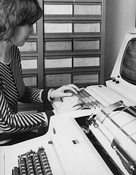
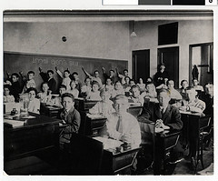
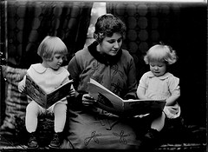
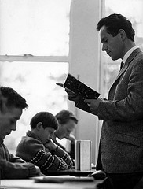
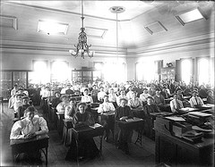
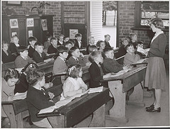
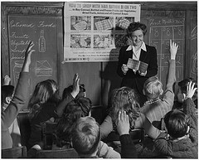
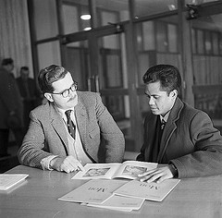
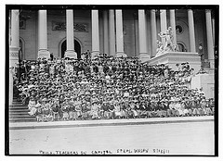
Who decides?

Slide 4
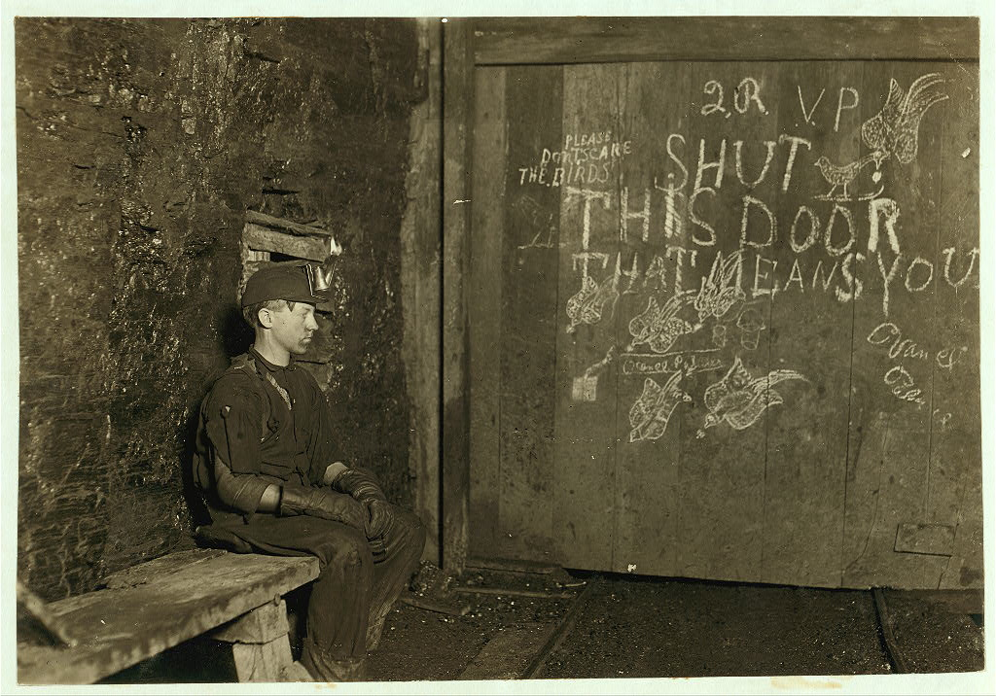
Forced closure

Slide 5
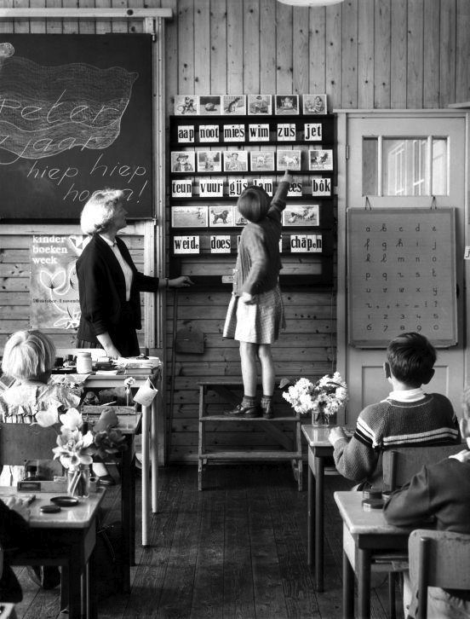
Forced disclosure
Notes:
Issues of forced disclosure
Problems of traditional classrooms (open to those in them, no hiding, closed to those outside)
Problems of hierarchical role-based LMSs – either open or closed, nothing between

Slide 6
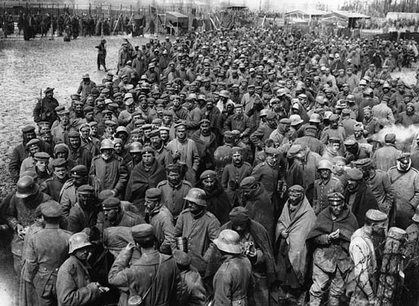
preconditions for intrinsic motivation
Control
Competence
Connectedness
(Ryan & Deci Self-determination Theory)
Notes:
learner control
competence support
relatedness
See Ryan & Deci SDT work - instrinsic motivation needs

Slide 7
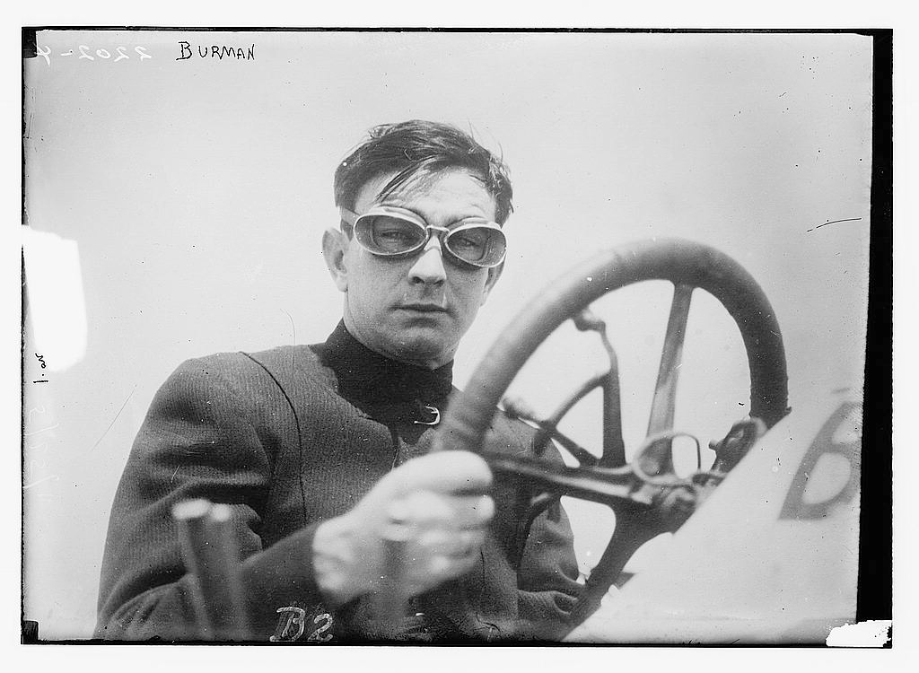
control

Slide 8
closed
open
private
disclosed
hidden
exposed
protected
unprotected
safe
insecure

Slide 9
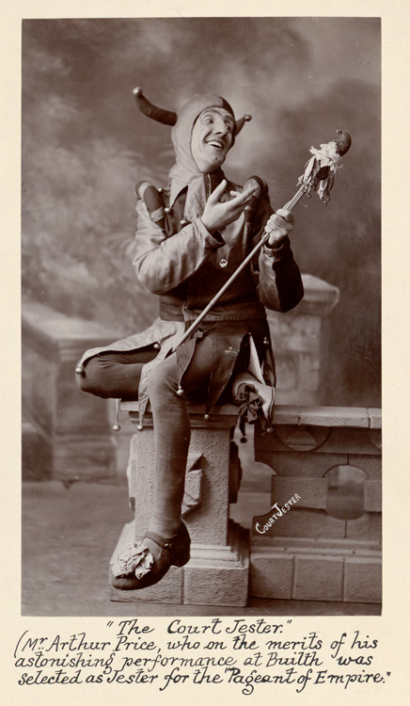
competence

Slide 10
closed
open
Learning management systems
Networked learning
environments
MOOCs
Public forums

Slide 11
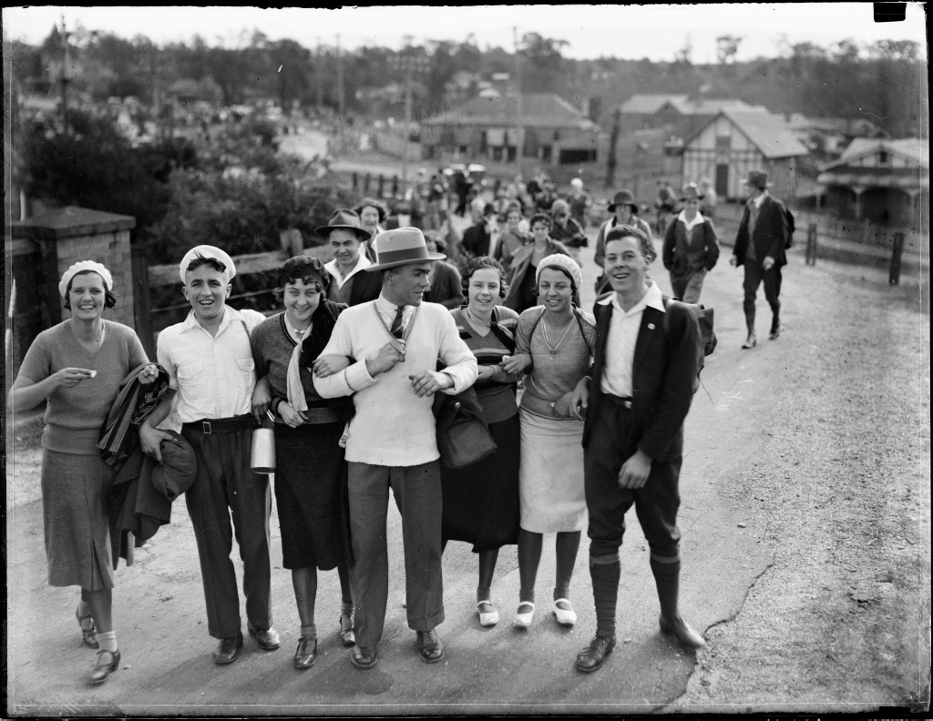
connectedness

Slide 12
closed
open
collaboration
individual
group
network
strangers
cooperation

Slide 13
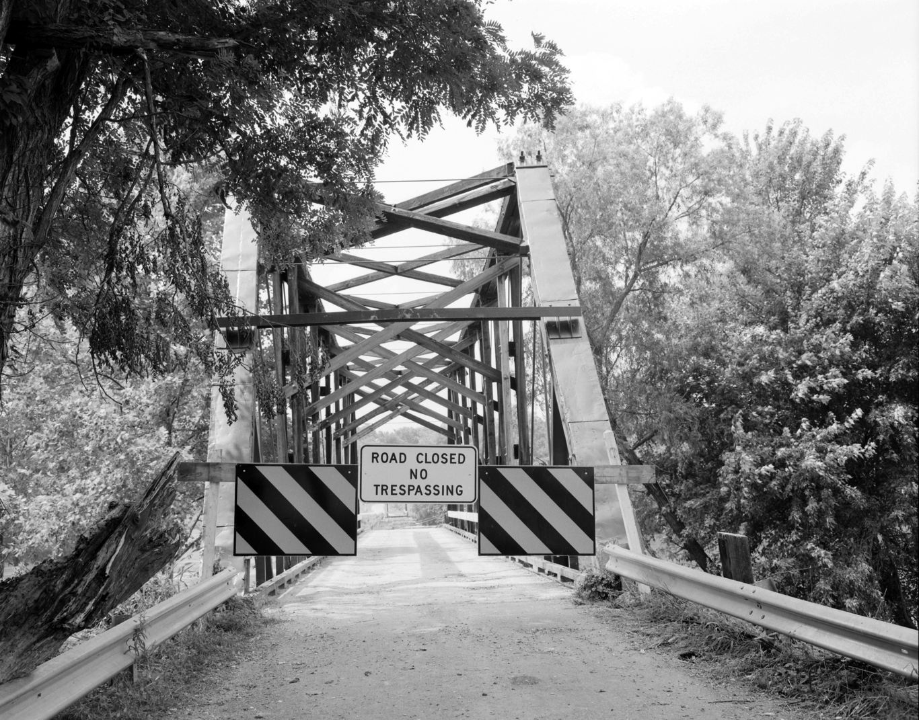
coherence

Slide 14
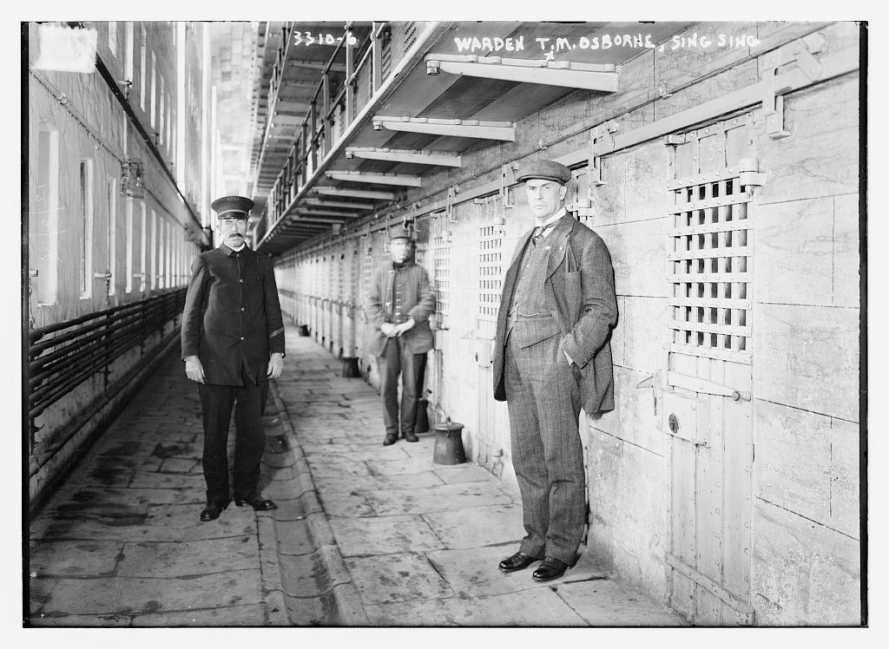
6 cooperative freedoms
Time
Place
Pace
Content
Access
Medium
http://www.slideshare.net/moutta/cooperative-freedom-simple-approach
Notes:
Hexagon of cooperative freedom (after Morten Paulsen)
the early 90s - context of closed courses, lack of public engagement, boundaries of system clear, adjacent possible limited

Slide 15
10 cooperative freedoms
Place
Disclosure
Content
Delegation
Pace
Time
Method
Medium
Relationship
Technology
15
Notes:
added method, technology, relationship, delegation (choosing when to choose) and disclosure. Lost ‘access’ because that is a freedom for the institution/network/whatever, not the learner
removed access - that’s not a learner freedom, it’s a prerequisite

Slide 16
10 cooperative freedoms
Place
Disclosure
Content
Delegation
Pace
Time
Method
Medium
Relationship
Technology
16
Notes:
added method, technology, relationship, delegation (choosing when to choose) and disclosure. Lost ‘access’ because that is a freedom for the institution/network/whatever, not the learner
removed access - that’s not a learner freedom, it’s a prerequisite

Slide 17
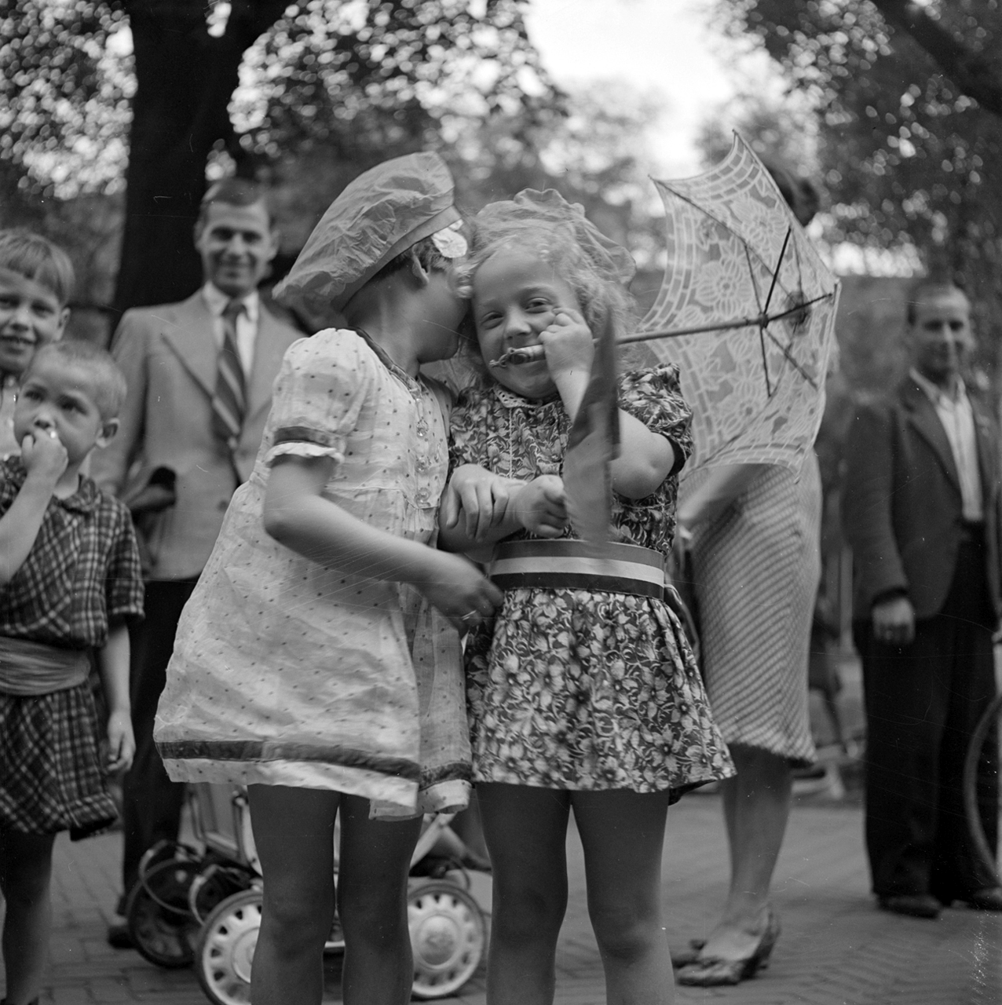
Controlled disclosure

Slide 18
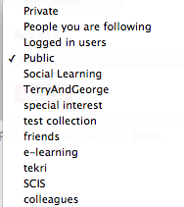
The Landing
Default
Groups

Slide 19
Enduring Course Archives
Why is all student work and comments, lost at the end of each term?
Students’ comments (MDDE 605)
“the archive was terrific, I didn’t know how to approach this assignment until I had seen other students’ work”
“using the archive is cheating, I enrolled to learn how to do these assignments myself.”
Should the default be open or up to each student?

Slide 20
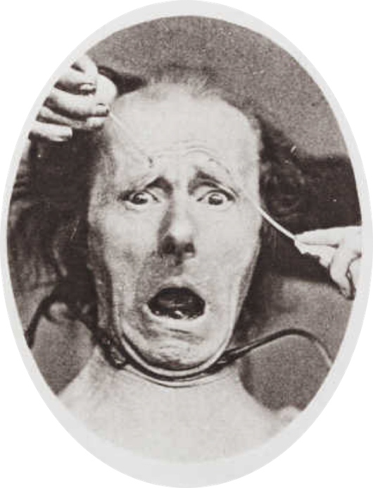
Blech, just the kind of stuff an introvert would hate! If this was a classroom I'd be the guy in the back that never puts his hand up.
This is not comfortable for me to blog. I have learned so much in my media classes about the fact that we put too much information on the web about ourselves and once said, you can't take it back. But..., I am also learning that I learn faster in group learning than by myself.

Slide 21
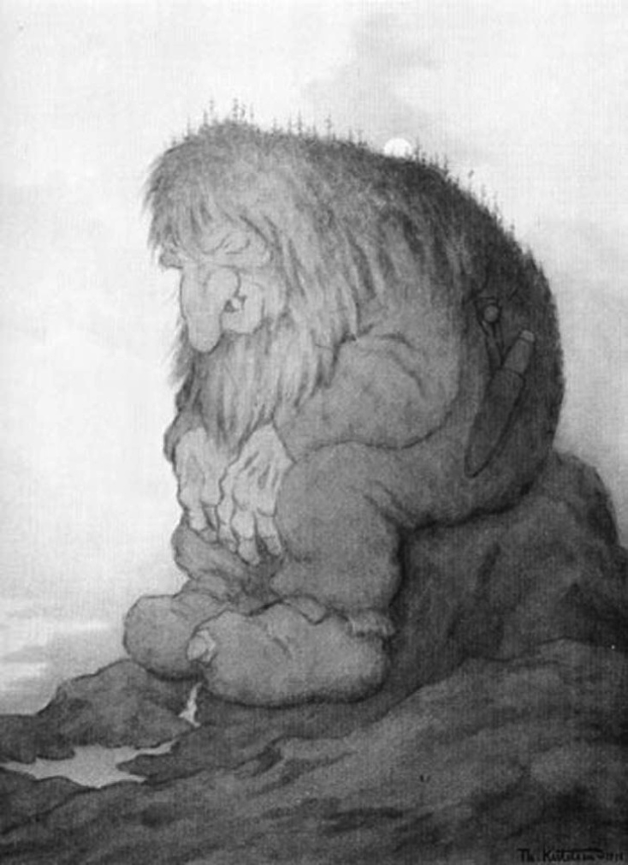
Trolls and other monsters

Slide 22
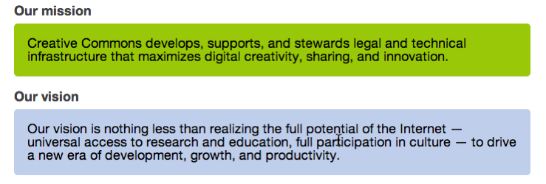
It Isn’t Open until it is licensed for use.
http://www.slideshare.net/greg.g/publishing-publishers-and-authors-what-you-need-to-know-about-creative-commons

Slide 23
http://www.slideshare.net/greg.g/publishing-publishers-and-authors-what-you-need-to-know-about-creative-commons

Slide 24
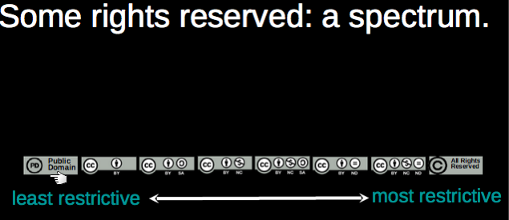
open
closed

Slide 25
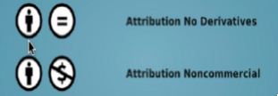
IRRODL setting the default to Open
From:
To:

Slide 26
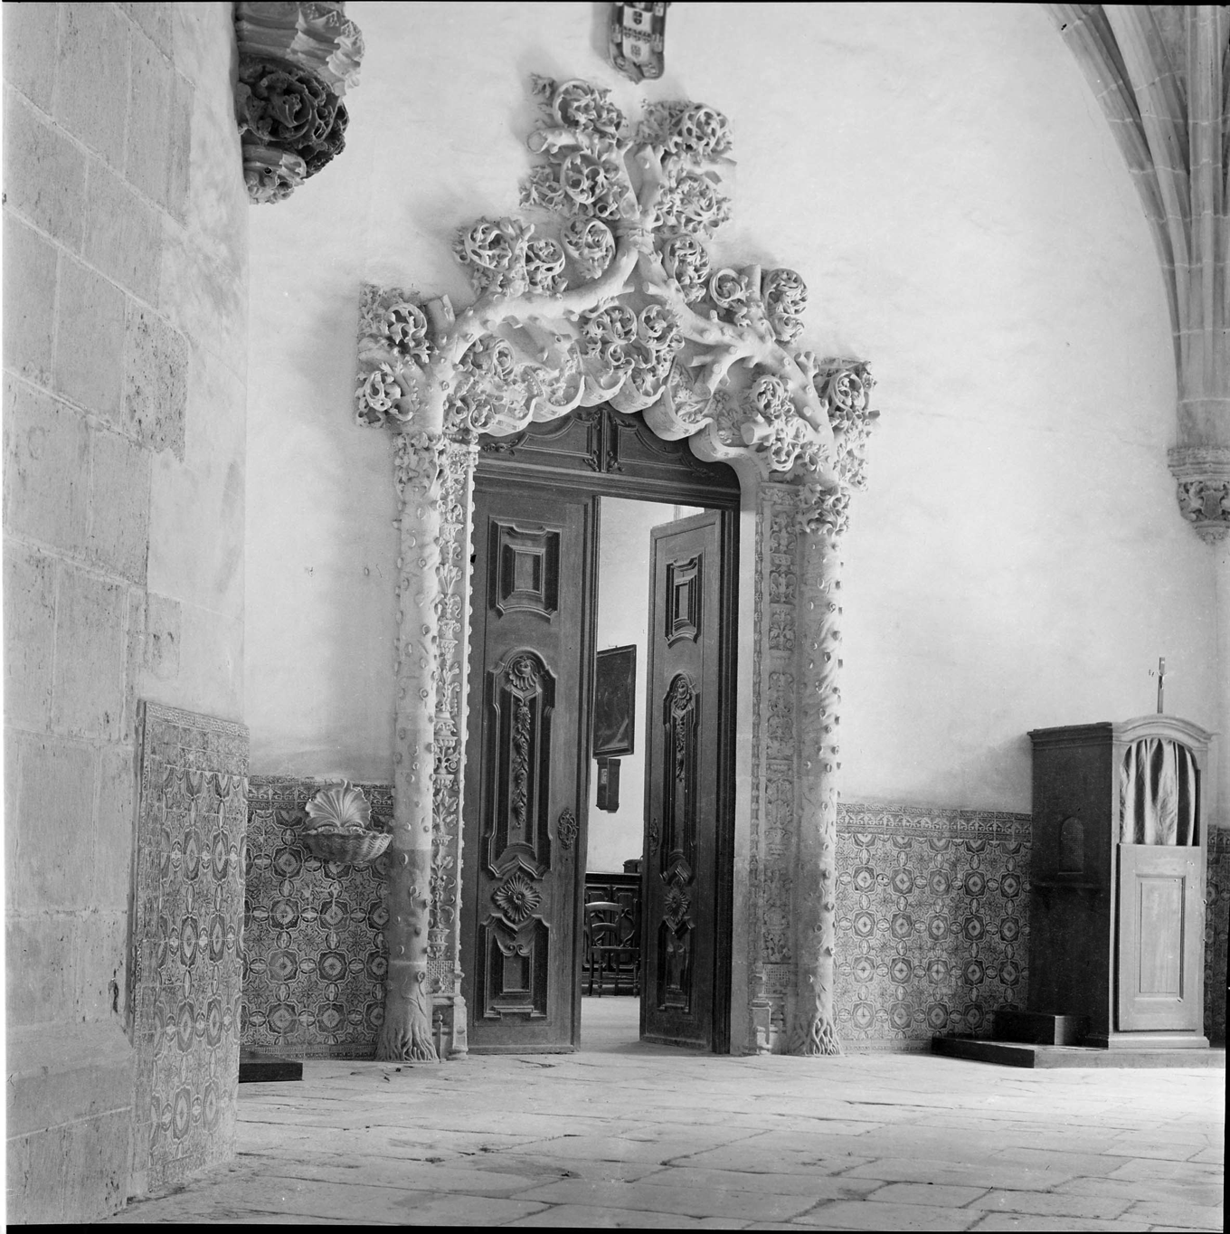
Opening and closing doors

Slide 27
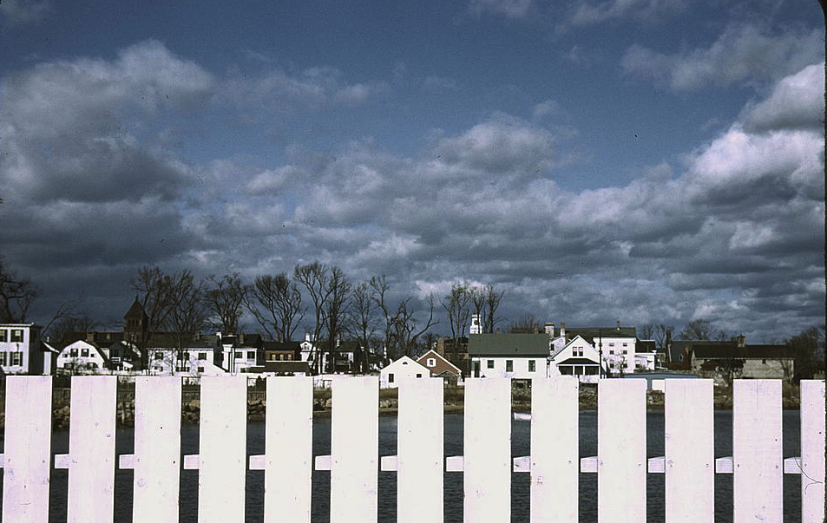
Fences with holes

Slide 28
Thank you
https://landing.athabascau.ca

