Slide 1
Online, Blended and Distance Education: Building Successful Programs in Schools
Tom Clark & Michael K. Barbour, Co-Editors, Stylus, 2015
Stylus Online, Blended & Distance Ed Series Michael G. Moore, Editor
Book Wiki Portal: bit.do/obdewiki
(onlineblendedschooling.wikispaces.com)

Slide 2
About the Book
We asked: What can North American educators learn from international K–12 educators, and vice versa, about building successful programs?
Then went about finding the people & programs who could help them answer these questions.

Slide 3
About the Book
Current status of global online & blended learning
Expert chapters on key components (teaching, curriculum, technology) and issues (equity, choice)
Case studies from the U. S. and five other nations
Eight key trends that can guide future practice, based on a synthesis of chapter findings

Slide 4
Key Case Study Questions
1) | What lessons did you learn in building your program?
2) | What practices have you found to be important for program effectiveness?
3) | How does policy impact your program?
Special practices focus for this session: How does your program personalize learning in your unique context?

Slide 5
Wiki
http://bit.do/obdewiki
http://onlineblendedschooling.wikispaces.com

Slide 6
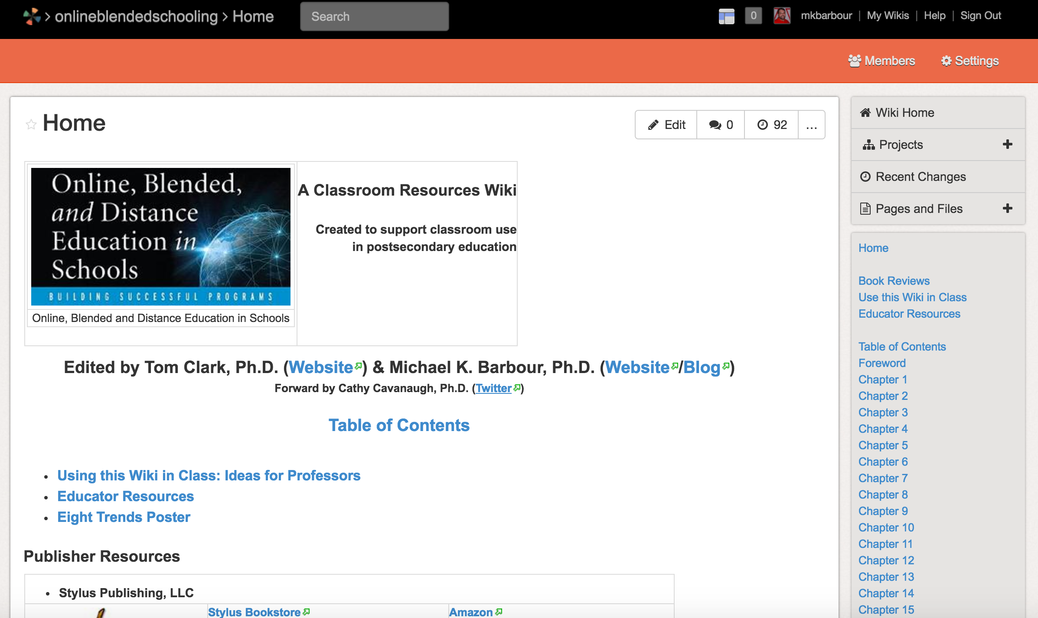

Slide 7
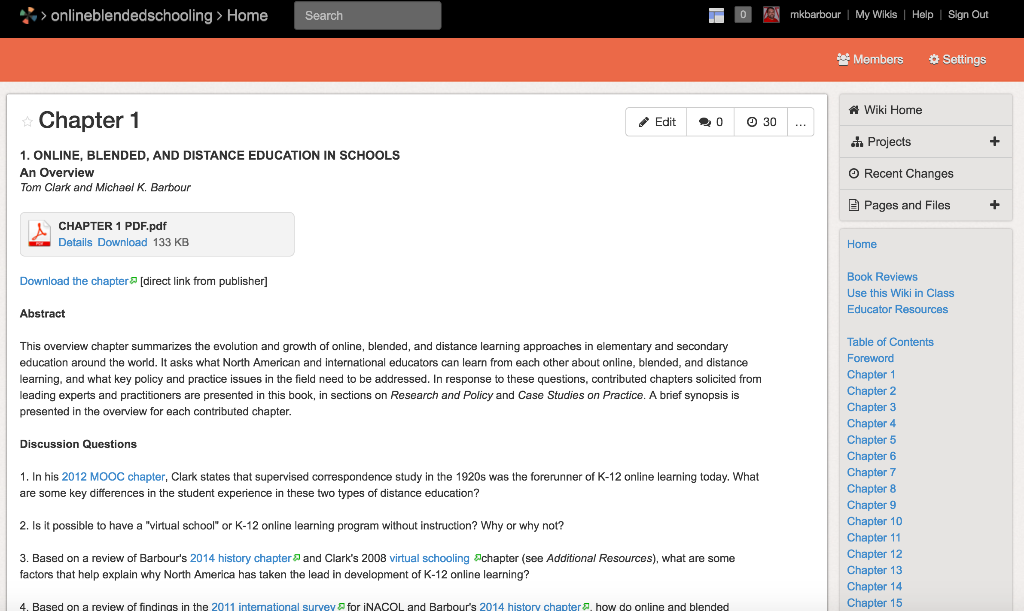

Slide 8
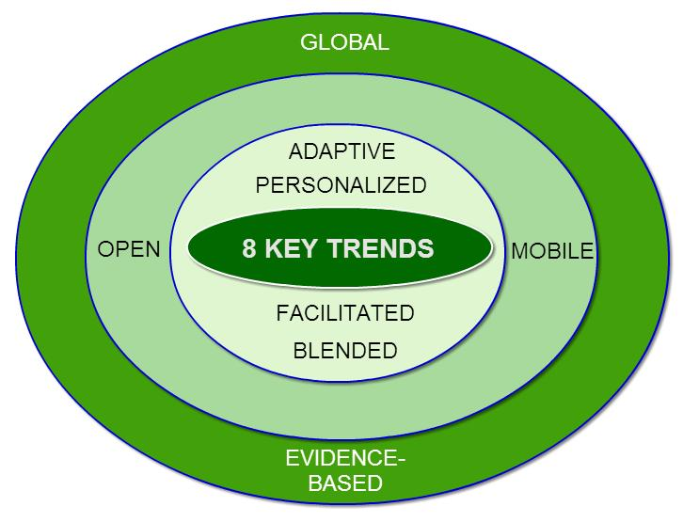
Book: Key Trends
The book concludes with eight key trends based on a synthesis of chapter findings and scanning
Notes:
Evidence presented by our chapter authors and other sources suggests that, in the future, online, blended, and distance learning in schools will be global and evidence- based, mobile and open, blended and facilitated, and personalized and adaptive.
Global and evidence-based underlie the other trends. Open and mobile are worldwide trends that apply to teaching and learning. Decisions about facilitated and blended instruction and personalized and adaptive learning must be made at the program level.

Slide 9
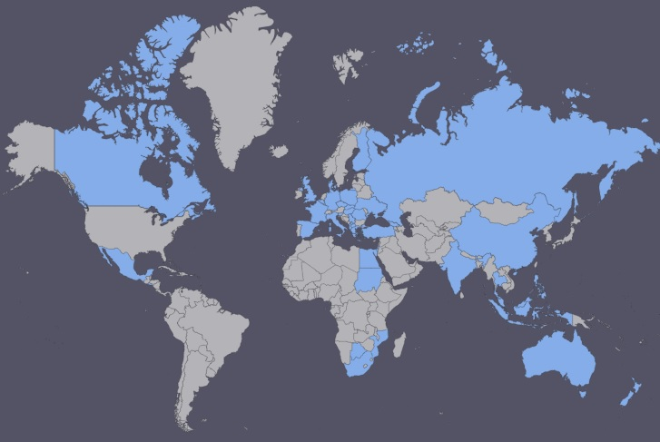
Global
50-nation iNACOL survey (2011)
North America
(4)
45 NATIONS PROFILED
Europe
(21)
Asia &
Middle East
(11)
Oceania
(2)
Africa
(7)
Every continent
except South America represented
Notes:
The survey report did not include an index or count of nations …. so we made one
45 NATIONS PROFILED
AFRICA 7
Botswana Burkino Faso Egypt Mozambique Nigeria South Africa Sudan ASIA AND THE MIDDLE EAST 11
China Gaza Strip/Palestine Georgia Indonesia Israel Malaysia Philippines Singapore Thailand Turkey Uzbekistan
EUROPE 21
Albania Belgium Bulgaria Czech Republic Denmark Finland France Greece Hungary Italy Kosovo Poland Republic of Macedonia Romania Russian Federation Serbia Slovak Republic Slovenia Spain Ukraine United Kingdom
OCEANIA 2
Australia New Zealand
NORTH AMERICA 4
Canada: BC El Salvador Mexico United States

Slide 10
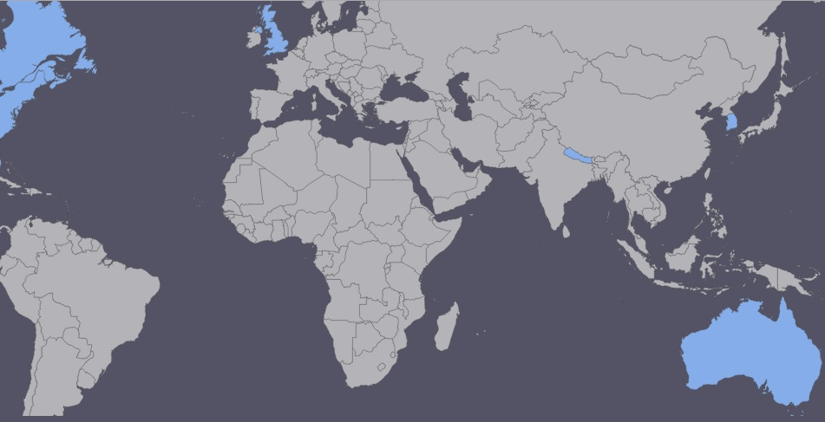
Global
Case studies for book (2015)
Canada
(Smallwood , Reaburn &
Baker, Ch 12)
UK
(Boulton &
Hasler Waters,
Ch 15)
Nepal
(Cavanaugh, Ch 13)
USA
(Oliver & Weeks,
Ch 8; Yang & Rice, Ch9; Revenaugh, Ch 10; Ebert & Powell, Ch 11)
South Korea (Kim & Seo,
Ch 16)
Australia (Harris, Ch 14)
Notes:
In our new book, we have case study chapters in the book from the U. S. and five other nations -- Canada, Australia, the UK, South Korea, and Nepal -- that help illustrate the diversity of ways in which digital learning is happening around the world.

Slide 11
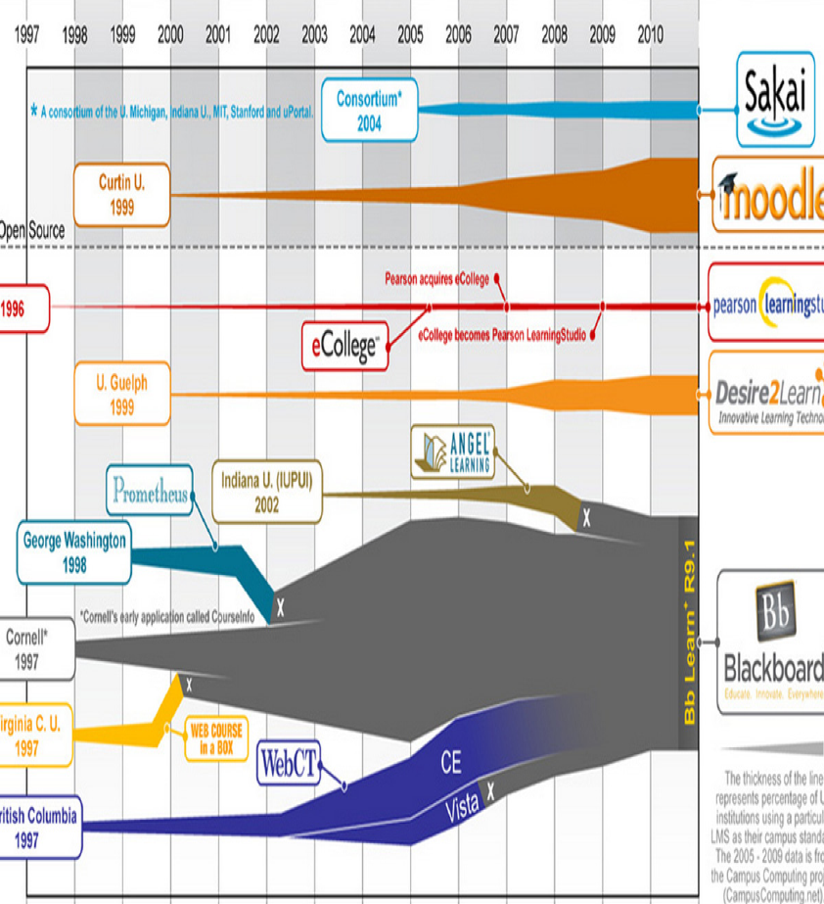
Open
Growing use of open education resources & LMS
(Darrow, Ch 3)
Notes:
Open educational resources. Open content. Open learning management and content development systems. Open courses such as MOOCs A huge trend.

Slide 12
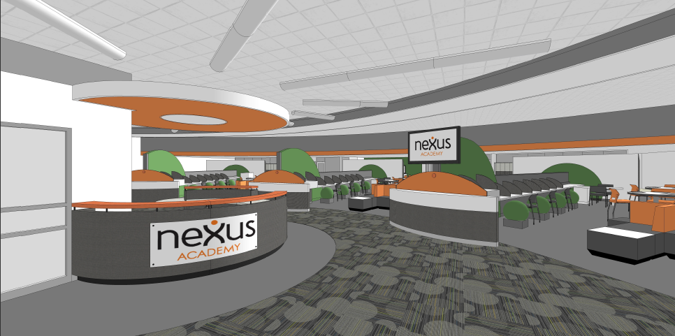
Open
Growing use of open learning environments
(Revanaugh, Ch 10)
Source: Connections Education
Notes:
Open learning environments.
NZ example from Michael & Niki

Slide 13
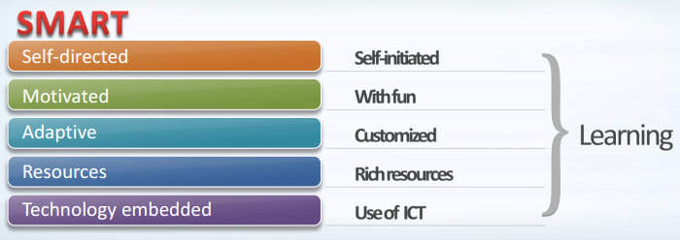
Mobile
Robust broadband & wifi needed for mobile learning; connectivity gaps in schools (Rose et al, Ch 7; Cavanaugh, Ch 13)
National curriculum and assessment initiatives may drive increased connectivity
Smart Learning (S. Korea)

Slide 14
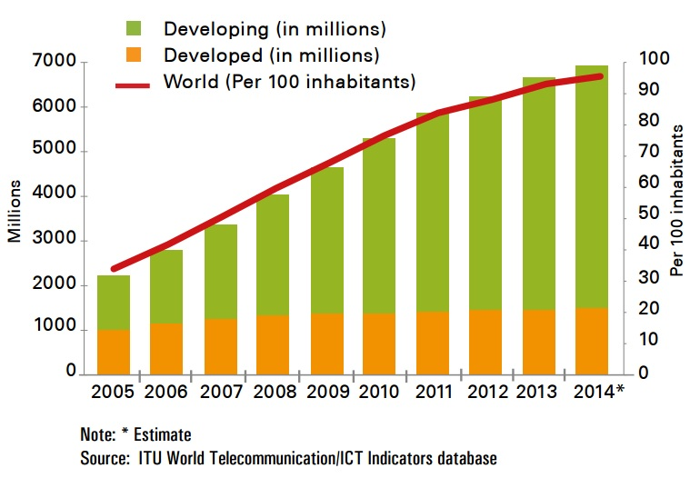
Mobile
Developing nations catching up in mobile access; may “leapfrog” educational technologies
(Cavanaugh, Ch 13)
Mobile
Subscriptions
by Economic
Development
Level
Notes:
According to ITU surveys, ALMOST 3 BILLION PEOPLE — 40% OF THE WORLD’S
POPULATION — ARE USING THE INTERNET mostly via mobile technologies
By end 2014, 44% of the world’s households will have Internet access at home. Close to one third (31%) of households in developing countries will be connected to the Internet, compared with 78% in developed countries.
In Africa, only one out of ten households is connected. But Mobile-broadband penetration in Africa was close to 20% in 2014, up from 2% in 2010
By end 2014, the number of mobile-broadband subscriptions reached 2.3 billion globally, almost 5 times as many as just six years earlier (in 2008).
By end 2014, 55% of all mobile-broadband subscriptions are expected to be in the developing world, compared with only 20% in 2008.

Slide 15
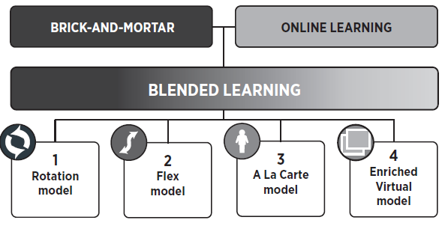
Blended
Emergence of K–12 blended learning has brought online learning into mainstream (Revanaugh, Ch 13. Ebert & Powell, Ch 11)
Adapted with permission from "Classifying K–12 blended learning," by Heather Stakerand Michael B. Horn, © 2012, Innosight Institute.
Notes:
Blended rotation & flex models most common in U. S. (Revenaugh, Ch 10)

Slide 16
Blended
Outside the U.S., many nations have different paradigms for digital learning
Little full-time K-12 online learning
Online learning used when F2F unavailable
Any digital tech use may be considered “e-learning” (Smallwood, Reaburn & Baker, Ch 12; Cavanaugh, Ch 13; Harris, Ch 14; Boulton & Hasler-Waters, Ch 15; Kim & Seo, Ch 16)
DIGITAL WORLDWIDE…
LEARNING ENVIRON-MENTS | CURRIC-ULUM | RESOUR- CES | REPOSI- TIORIES | LITERACY
Notes:
Other nations have different paradigms for digital learning that may not meet the strict Staker & Horn blended learning definitions.
Full-time K-12 online learning is primarily a U. S. phenomenon. It is rarely used overseas except when a student cannot attend a face-to-face school due to geographic isolation, illness, or other issues.
VLEs
Digital

Slide 17
Facilitated
Important new roles for K-12 teachers as facilitators, guiding and shaping learning
Primarily provide scaffolding, support and intervention.
Effective practices (Kennedy & Archambault, Ch. 2); Certifications and Endorsements (Yang & Rice, Ch. 9)
Notes:
Facilitated. We have examples in the book of high quality teacher-led online learning in the U. S. and other nations. NCBS in Sydney. VHS in Ontario. Strong instructional models in North Carolina’s state-led school and Clark County Nevada’s district –led school. We’ve found out in the U. S. that teacher-less or low teacher contact yields lower quality learning. Online learning does not mean teacher-less learning!

Slide 18
Personalized
Trend toward increasing personalization via technology
Personalized learning (Revenaugh, Ch 10)
Individualized learning (Smallwood, Reaburn & Baker, Ch 12; Harris, Ch14)
Authentic collaborative activities (Boulton & Hasler Waters, Ch 15)
Notes:
A wide variety of ways that programs are personalizing learning. Data-driven personalized learning in a small high school setting via Nexus Academies. High-touch, student-centric personalized approaches in our Canadian VHS and Australian NBCS case study schools. Different ways of using LMS to personalize learning in five different UK schools, including individualization and authentic collaboration.

Slide 19
Adaptive
Online learner interactions increasingly used to adapt teaching and learning
Example: Nexus Academy
dynamic F2F grouping of students to learn a specific objective based on CC-aligned embedded testing
use of adaptive testing to personalize learning program, track progress (Revenaugh, Ch 10)
Notes:
Adaptive can be seen as another form of personalization—but deserves separate mention. As Watson said in KP 2012, any definition of blended learning should include “a way in which students’ online work generates data that are used by the instructional system—teacher, technology, or both—to personalize and improve instruction for each student” (p. 17). On a daily basis in blended schools like Mickey Revenaugh’s Nexus Academy, small group face-to-face instruction is organized on the fly to help learners with a common need gain mastery of specific learning objectives.

Slide 20
Evidence-Based
Ask the right questions to build evidence-based practice, such as:
Under what conditions does K-12 online and blended learning work best?
Rather than asking:
Does it work better than face-to-face? (Ferdig, Cavanaugh, & Freidhoff, Ch 5)
Notes:
Evidence-based. We need to know what works so that effective digital learning can be scaled up. That’s why some of the top researchers in K-12 online and blended learning contributed to our book. For example, Chapter 5 on what the research says about K-12 online learning, by Rick Ferdig, Cathy Cavanaugh, and Joe Freidhoff. They say to ask the right question: under what conditions does K-12 online and blended learning work best? That’s essential to gathering evidence to inform practice.

Slide 21
Evidence-Based
Online is complex; blended even more so
(Ferdig, Cavanaugh & Freidhoff, Ch 5)
Notes:
The distributed nature of online learning is seen as raising new complexities in terms of influences on the treatment for researchers, and blended raises even more complexities. There are so many variables beyond the teacher, the student and the content to consider.

Slide 22
Insert Kimberley’s slides (VHS-Ontario)

Slide 23
Your Questions and Comments

Slide 24
Associate Professor, Instructional Design
Touro University, California
mkbarbour@gmail.com
http://www.michaelbarbour.com
http://virtualschooling.wordpress.com

