Slide 1

State of the Nation:
K-12 E-Learning in Canada
Michael K. Barbour
Touro University, California
Randy LaBonte
Canadian eLearning Network

Slide 2




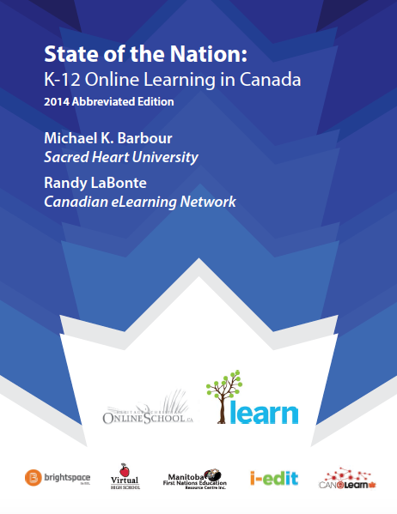
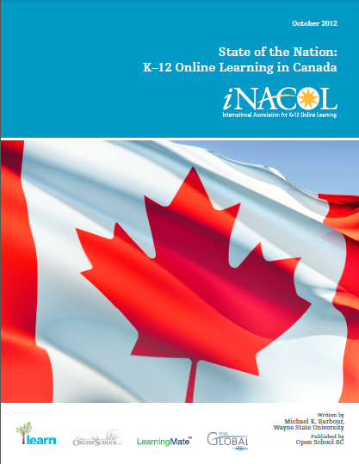



Slide 3







Slide 4
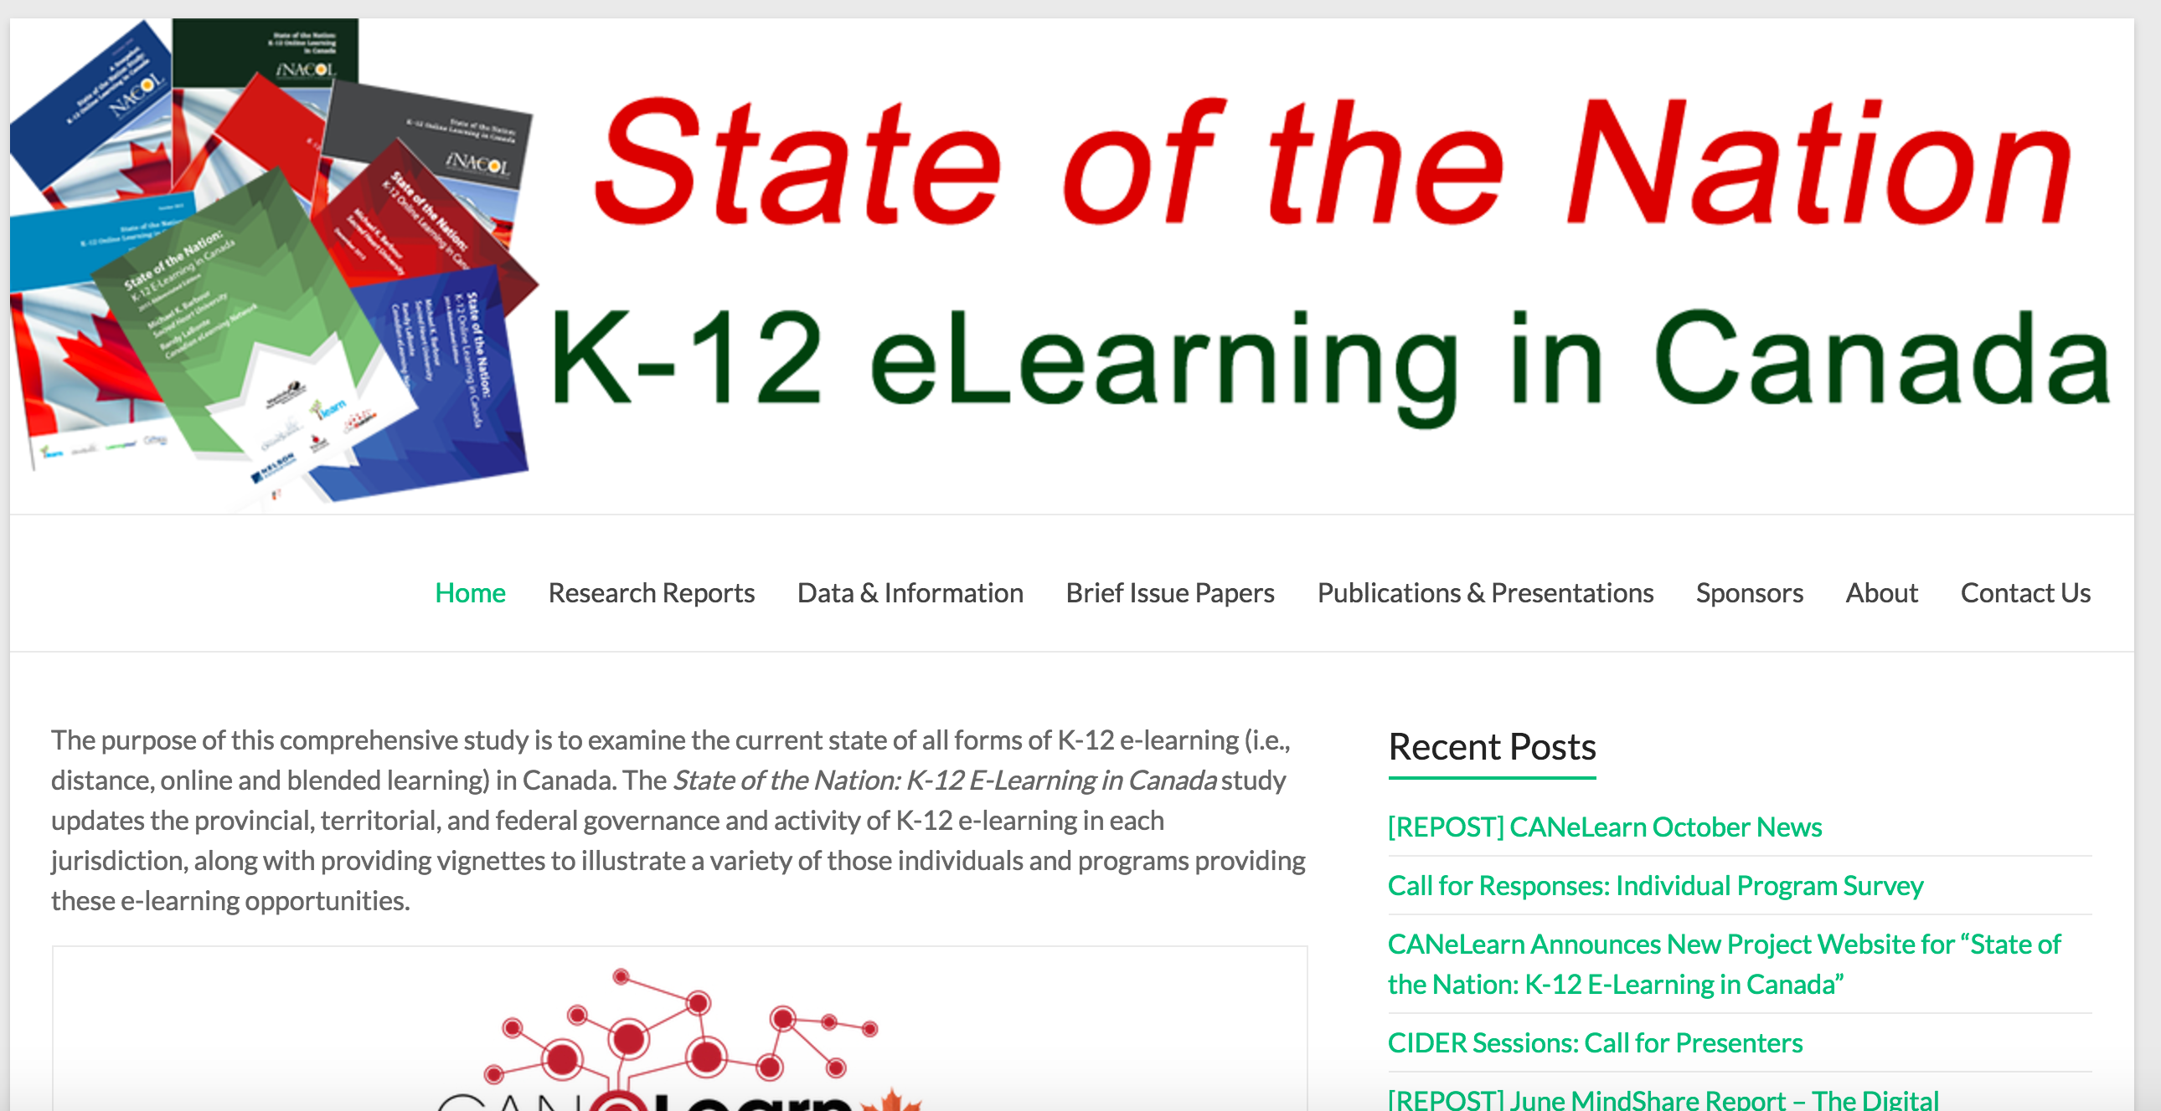
http://k12sotn.ca

Slide 5
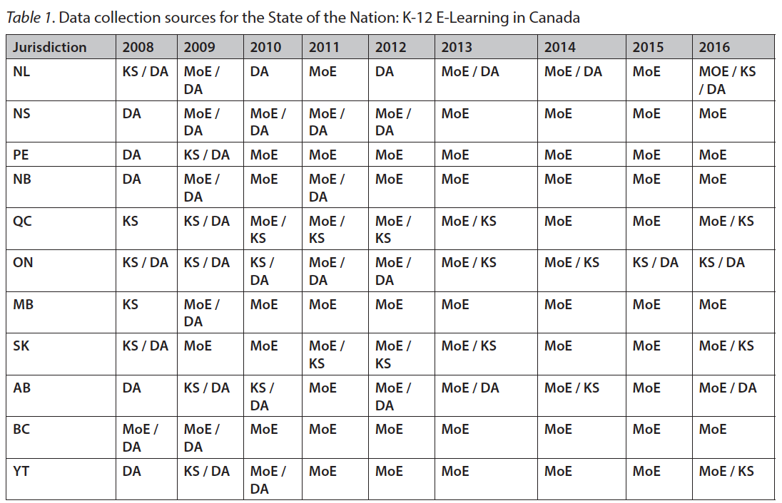
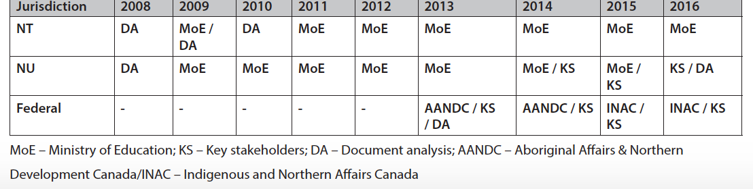
Methodology

Slide 6
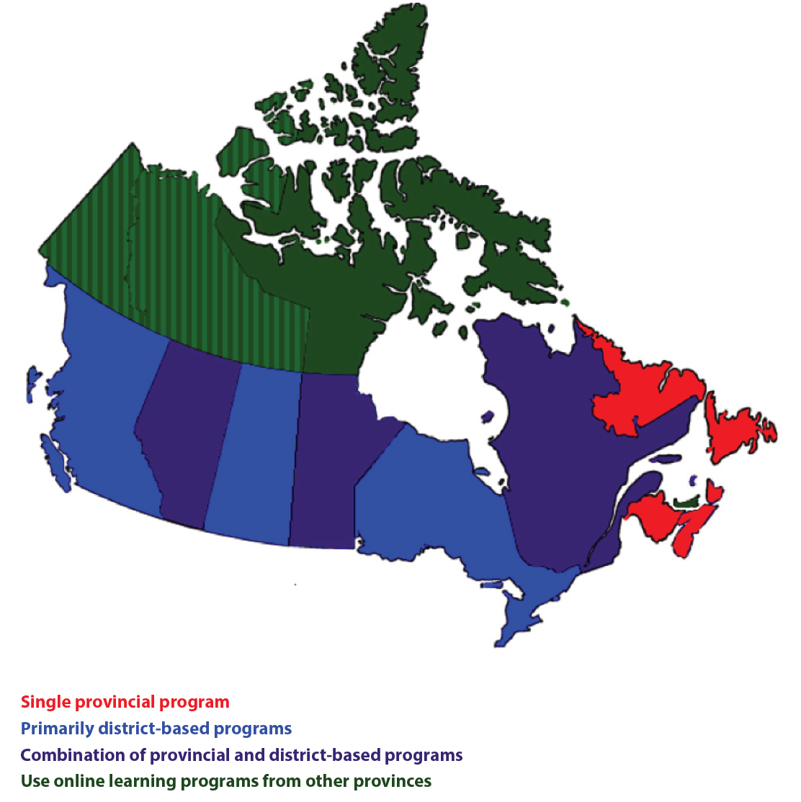
National Overview

Slide 7
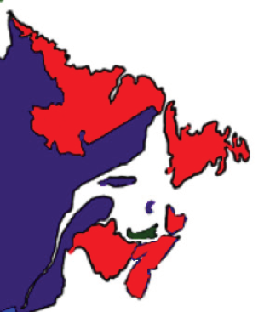
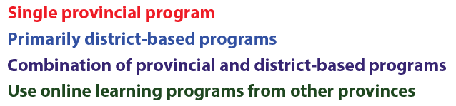
Atlantic Canada

Slide 8
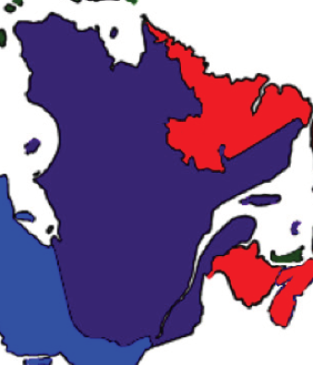
Quebec

Slide 9
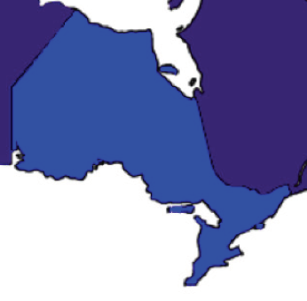
Ontario

Slide 10
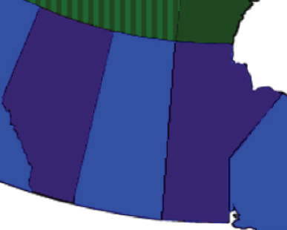
Prairies

Slide 11
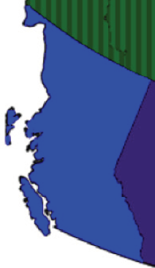
British Columbia

Slide 12
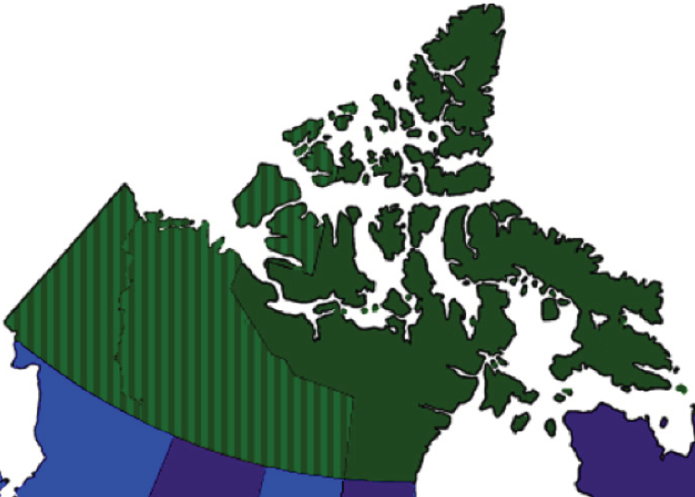
Northern Canada

Slide 13
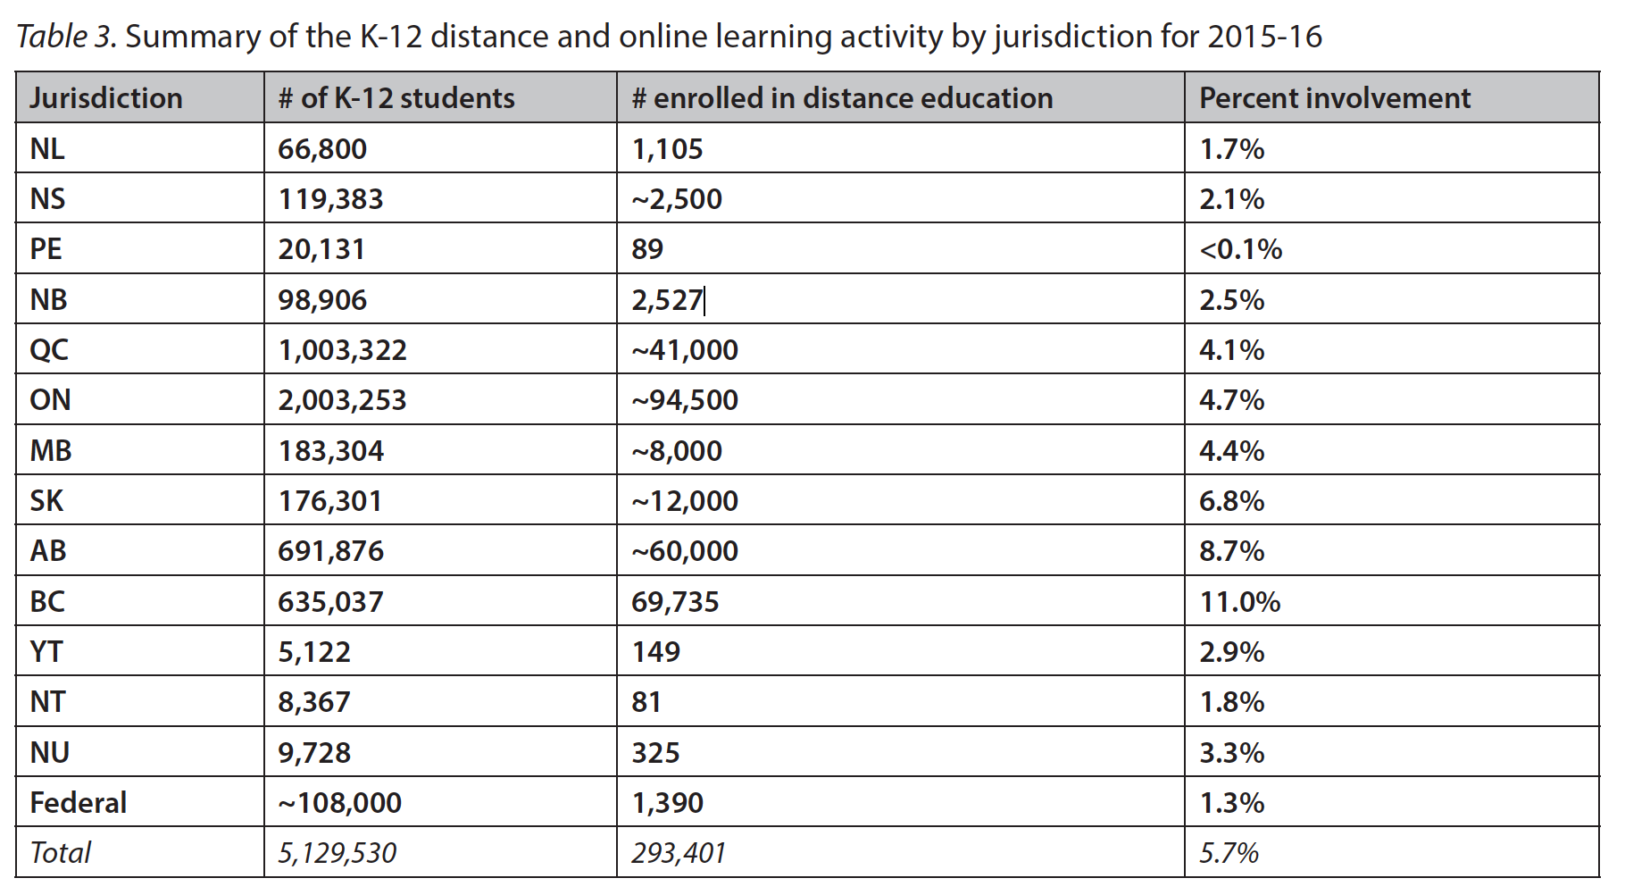
Distance & Online Learning

Slide 14
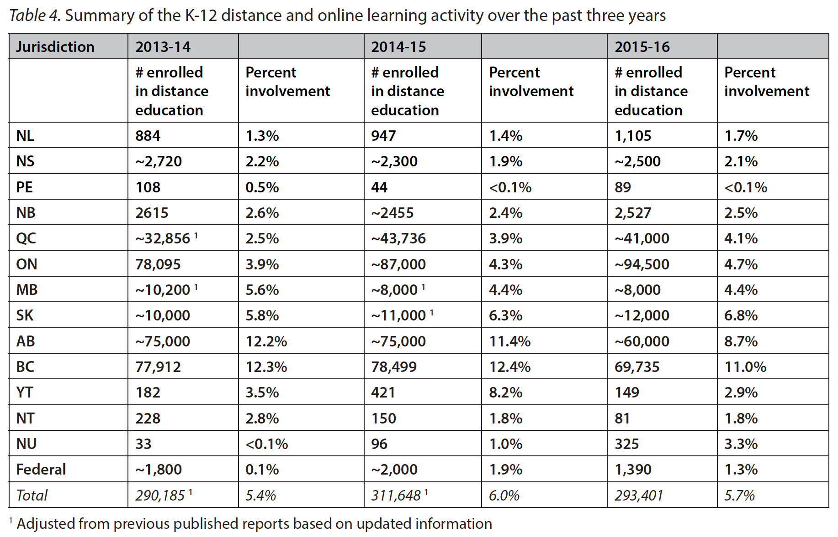
Distance & Online Learning

Slide 15
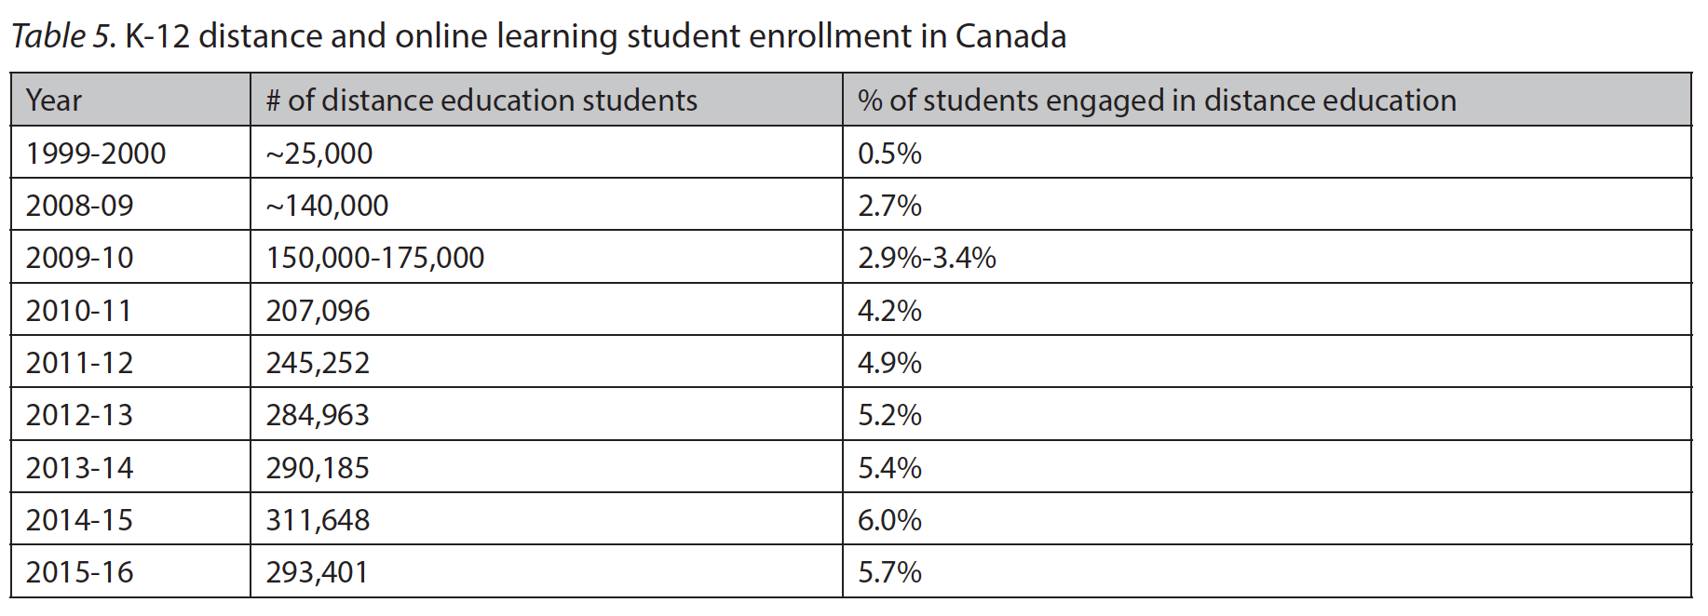
Distance & Online Learning

Slide 16
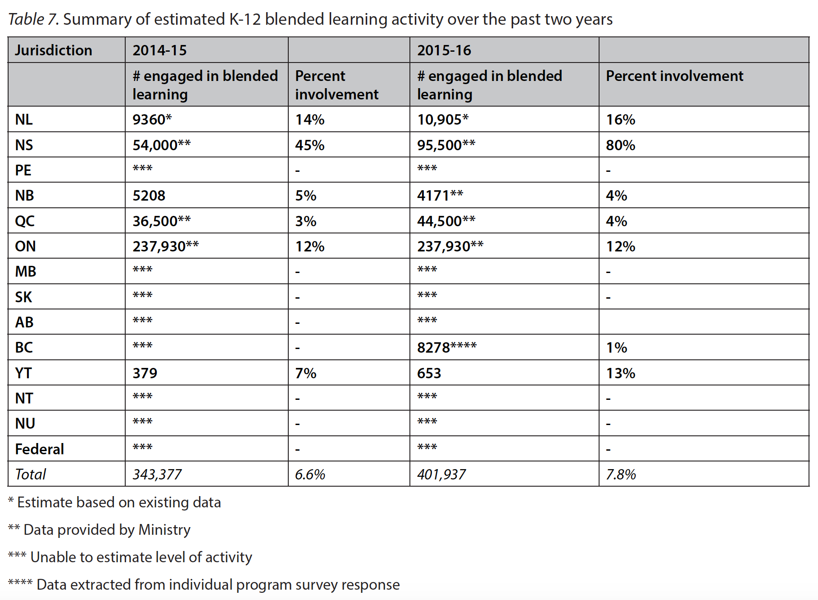
Blended Learning

Slide 17
Better Data

Slide 18
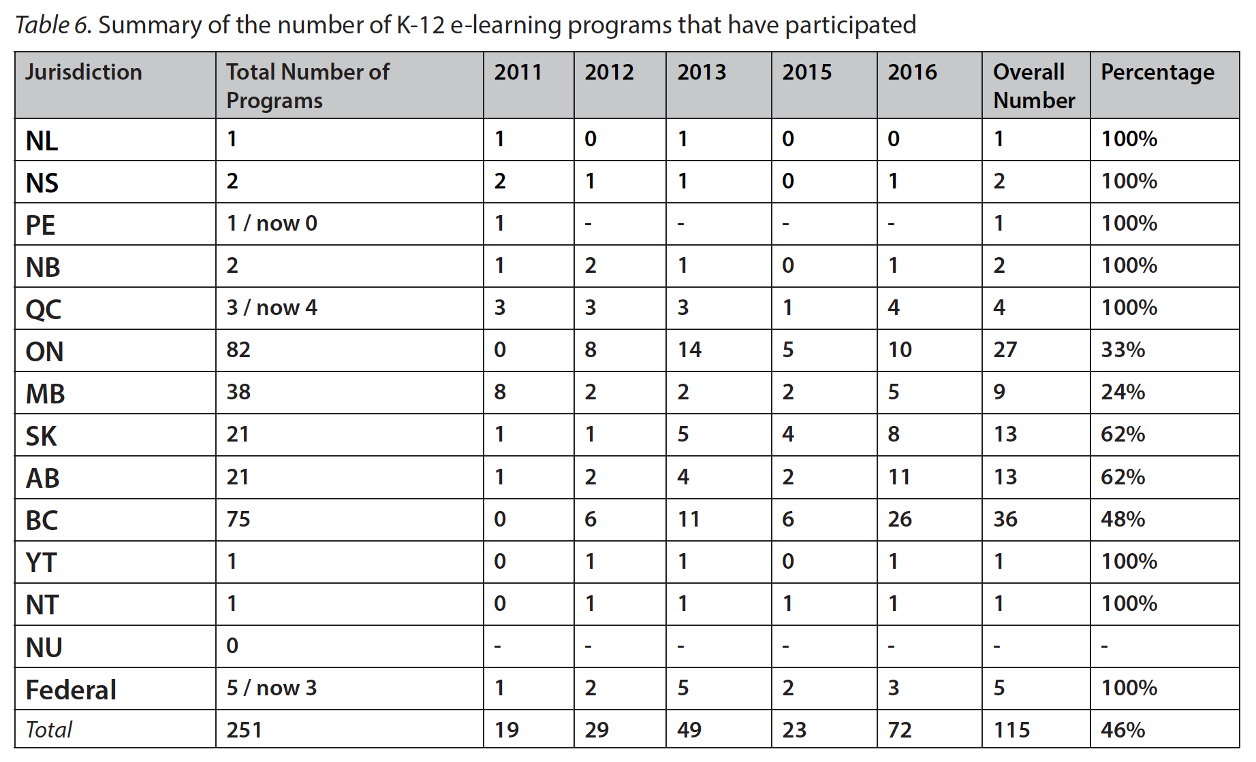
Better Data

Slide 19
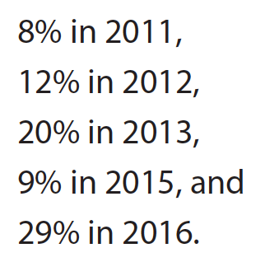
Better Data

Slide 20
http://k12sotn.ca

Slide 21

Your Questions and Comments

Slide 22

Associate Professor of Instructional Design
Touro University, California
  mkbarbour@gmail.com
  http://www.michaelbarbour.com

