Slide 1
Building Student Networks: Towards a Connectivist Analysis of Classroom Learning Environments
Dr. Gerald Ardito
Pace University School of Education
CIDER Session
April 19, 2017
Photo by Flip 42 on Flickr

Slide 2
Contents
1. Introduction – Connectivism Changed/Ruined My Life
2. Conceptual Framework
2.1 Cooperative Freedoms
2.2 Connectivism
3. Method
3.1 Curricular (re) design
3.2 Data collection and analysis
4. Findings
4.1 Student Achievement
4.2 Student Learning Networks
5. Discussion
6. Implications
Questions

Slide 3
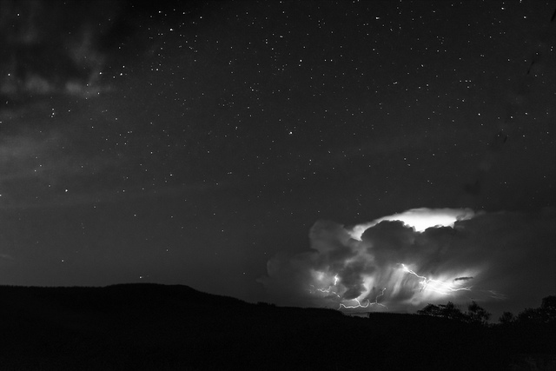
Research Questions
Do K-12 students form connectivist learning networks?
Under what conditions do these types of student learning networks form and thrive?
Photo by Flip 42 on Flickr

Slide 4
Conceptual Framework
Connectivism
Paulsen’s Cooperative Freedoms

Slide 5
Connectivism
“Connectivism is the thesis that knowledge is distributed across a network of connections, and therefore that learning consists of the ability to construct and traverse those networks.”
Khatabi & Fouladchang, 2015
Image from Education 2020

Slide 6
Cooperative Freedoms
Paulsen’s Model of Cooperative Freedoms (from Dron & Anderson, 2014 – used with permission)

Slide 7
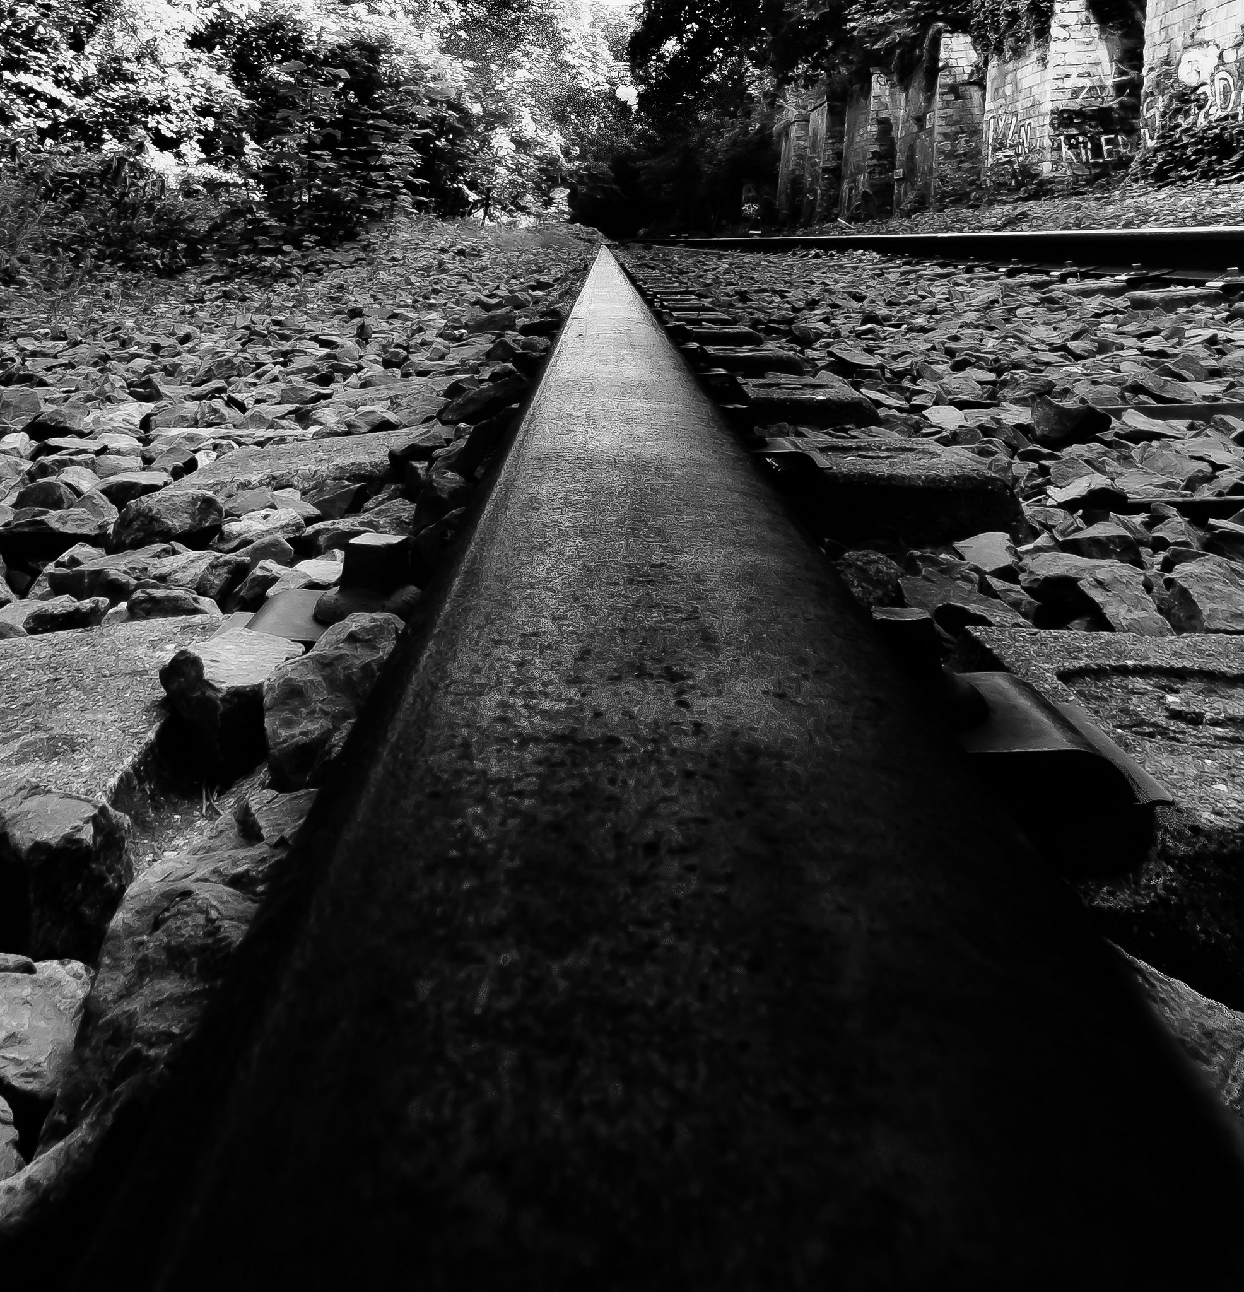
Method
Photo by Flip 42 on Flickr

Slide 8
Context
Participants
50 8th grade Life Science Students
Two sections (based on math placement) 20, 30
None had experience with self-directed learning
Learning Environment
Redesigned as set of 5 self-directed units
Students were free to choose their own path through the five units
Students were free to choose with whom to work (or not)
Moodle used as LMS; Edmodo used as discussion tool
Duration – an entire school year

Slide 9
Instructional (Re)Design

Slide 10
Physical Layout

Slide 11
Findings
Photo by Flip 42 on Flickr

Slide 12
Final Exam Results

Slide 13
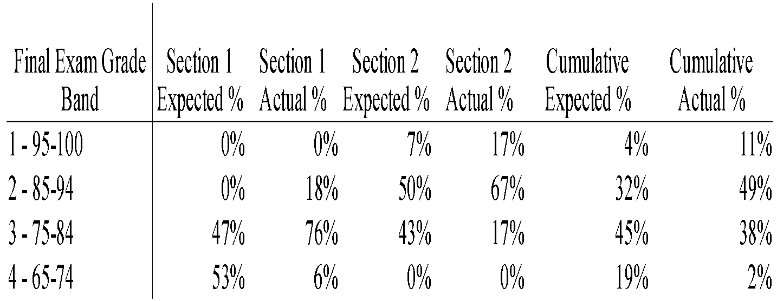
Predicted vs Actual Performance

Slide 14
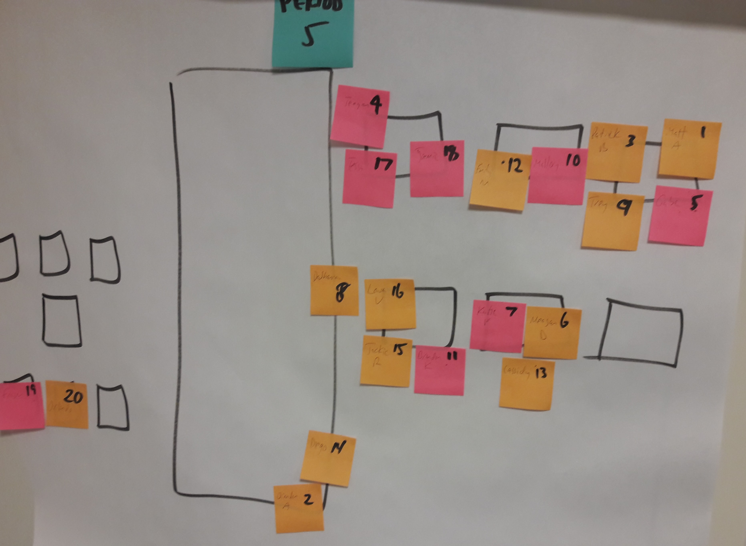
Student Groupings #1

Slide 15
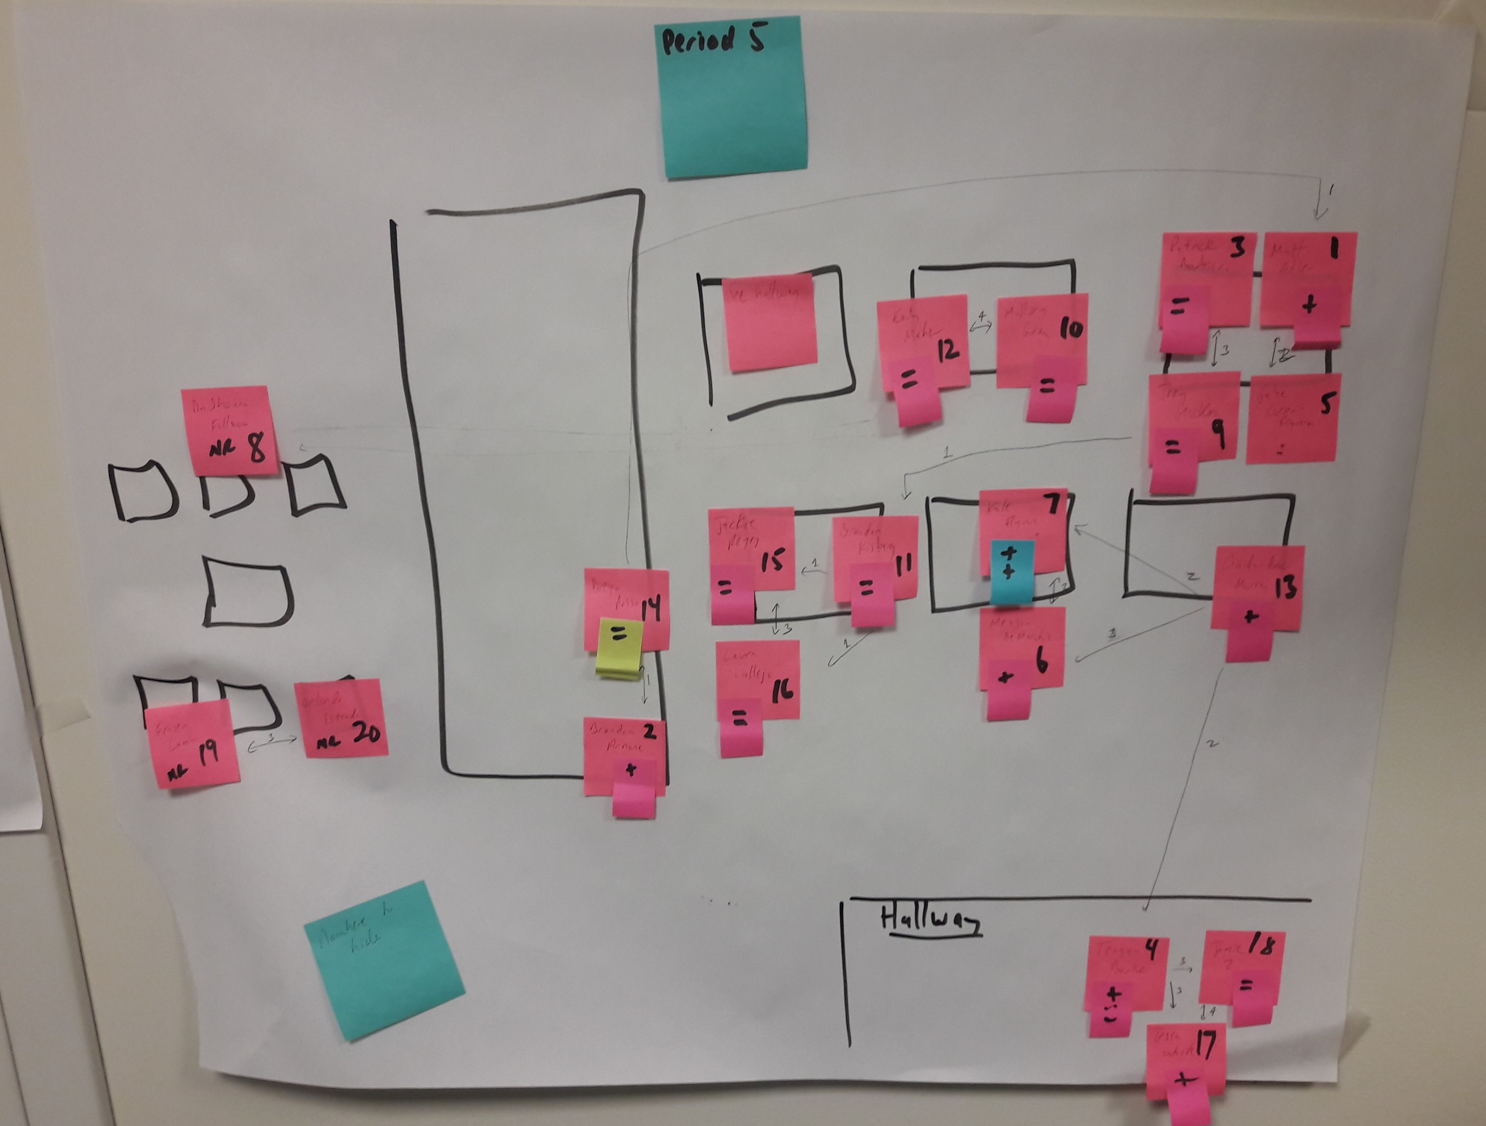
Student Groupings #2

Slide 16
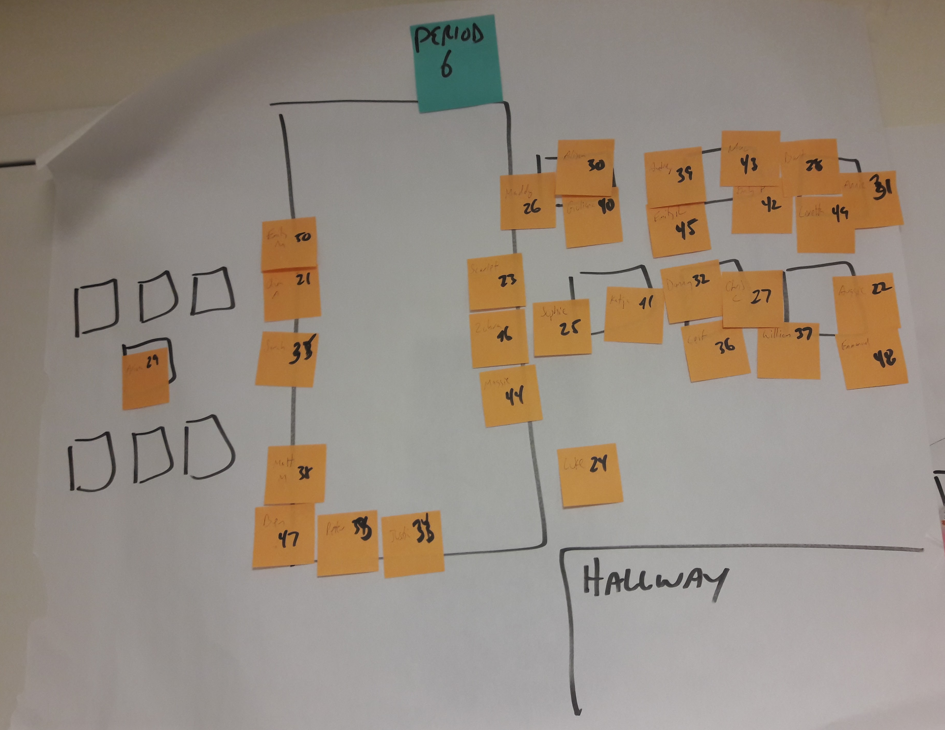
Student Groupings #3

Slide 17
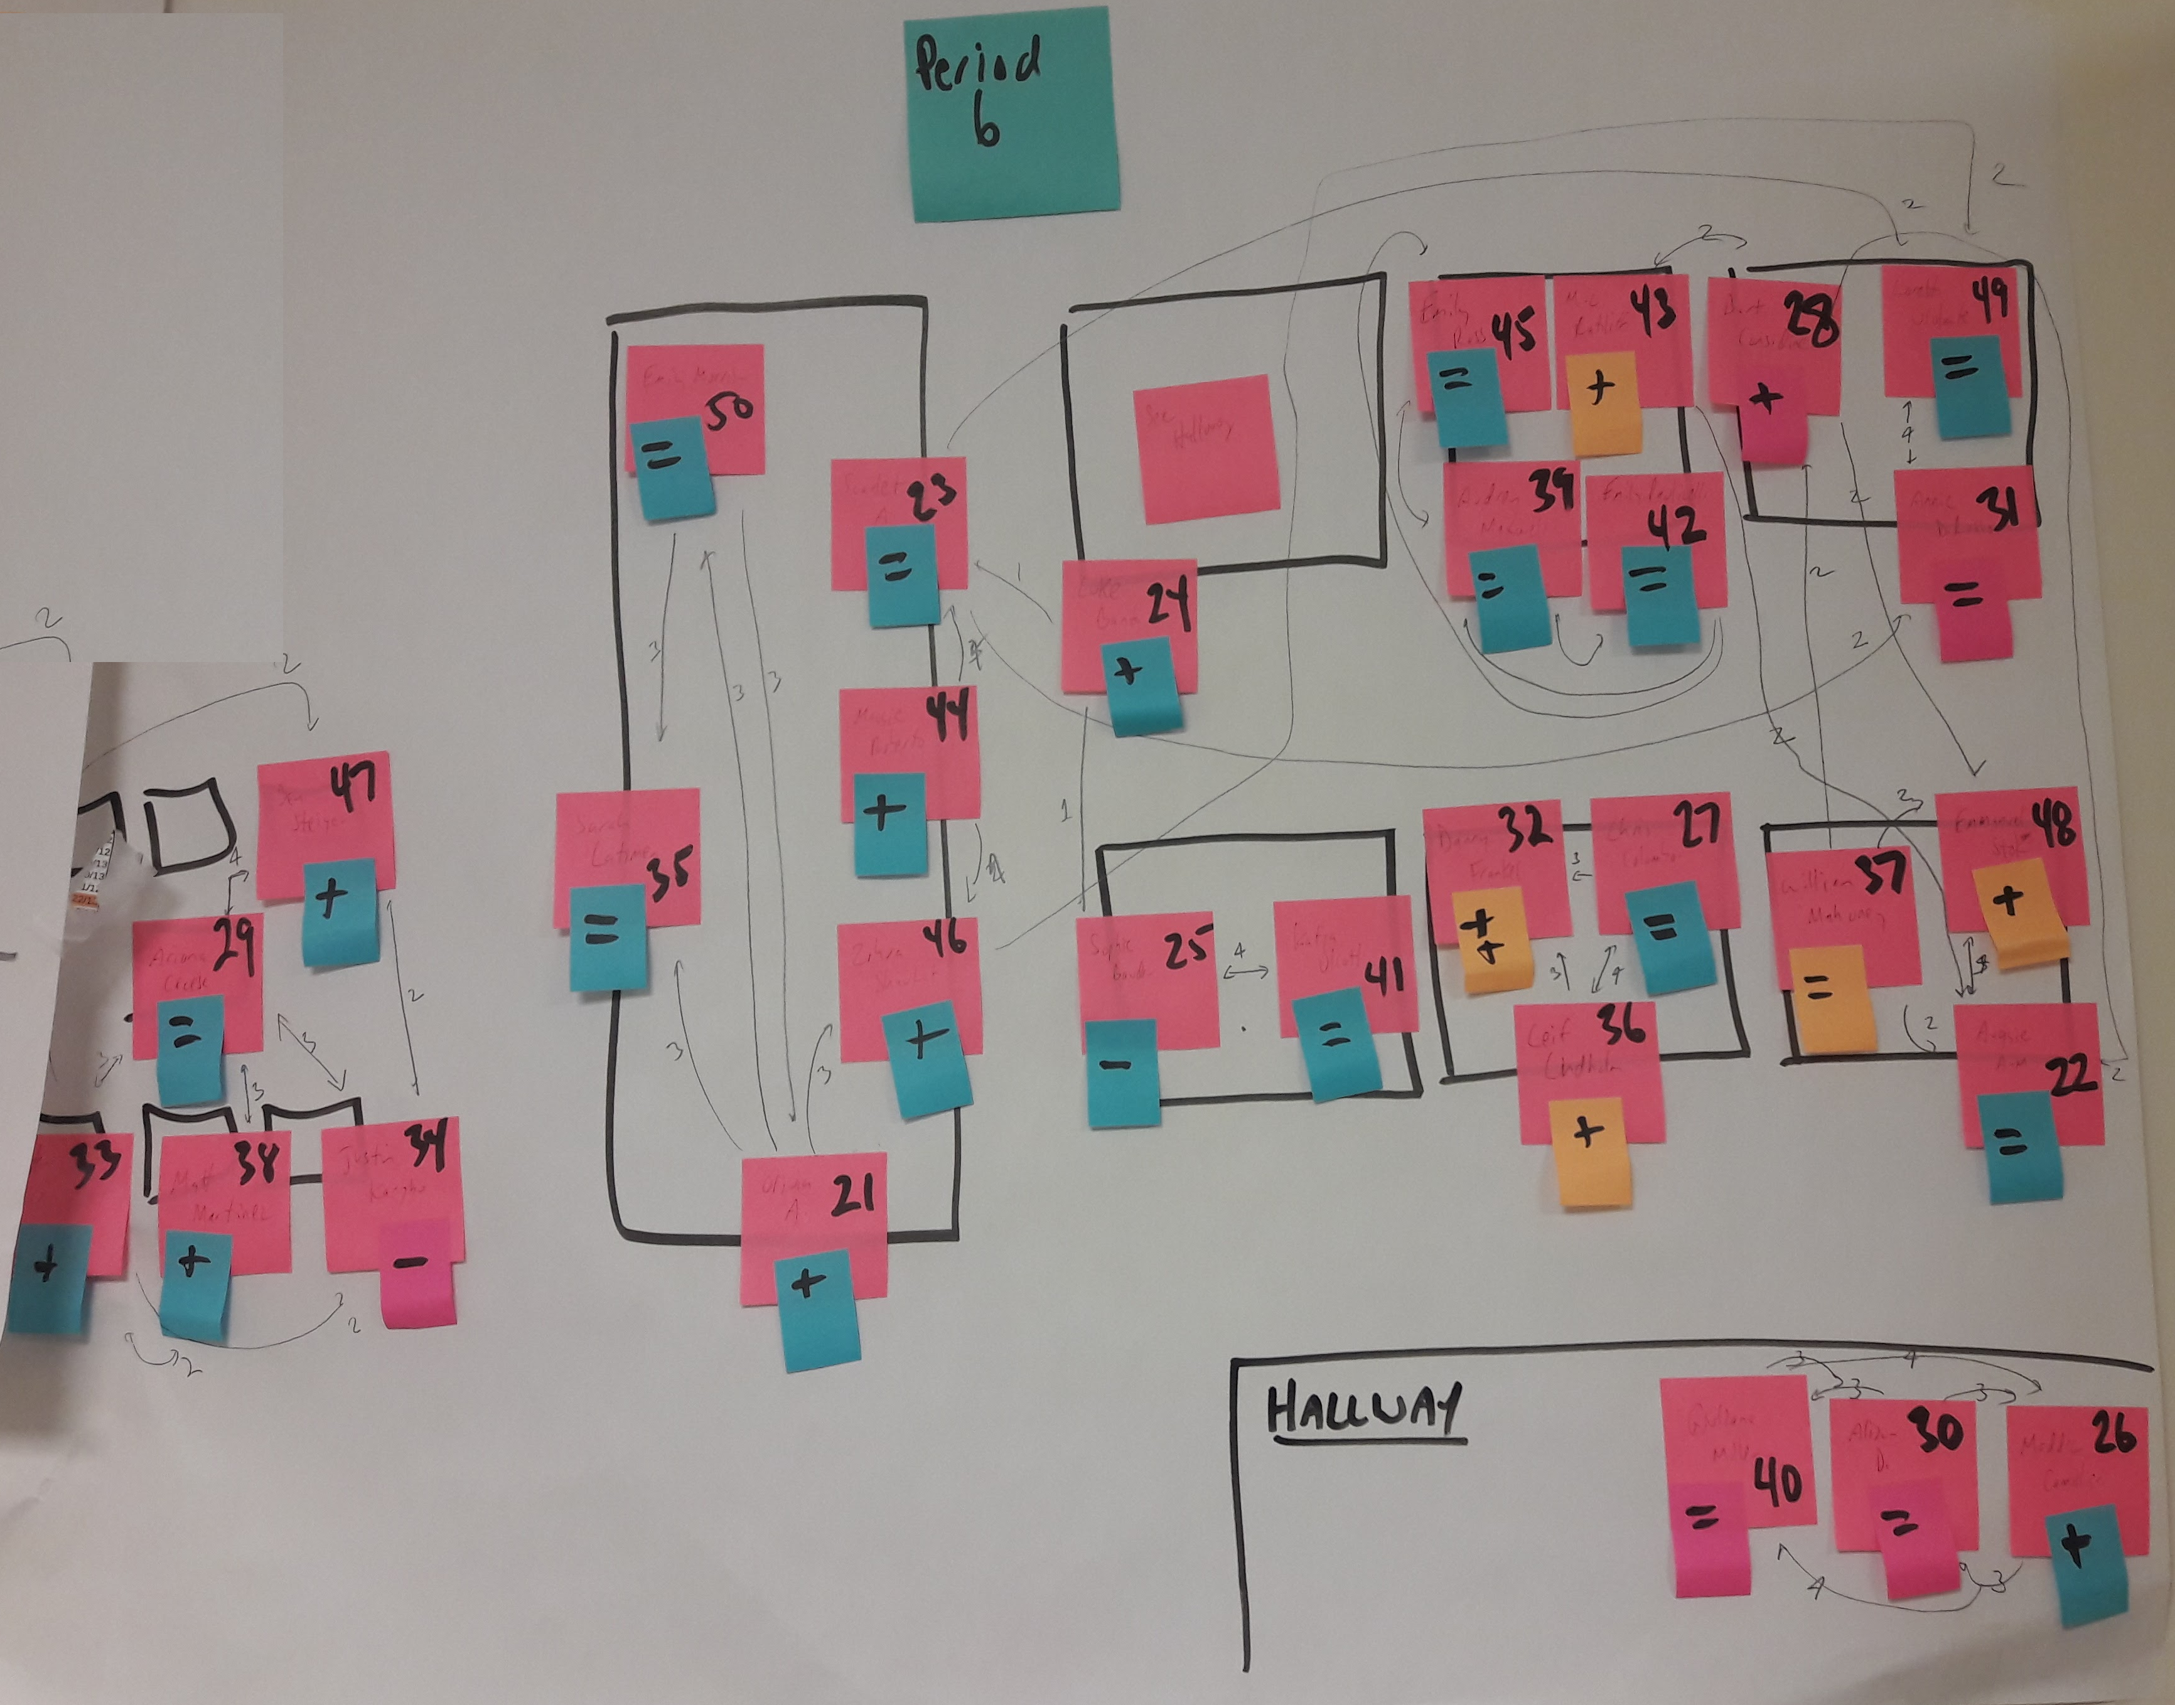
Student Groupings #4

Slide 18
Social Network Analysis

Slide 19
Discussion
Photo by Flip 42 on Flickr

Slide 20
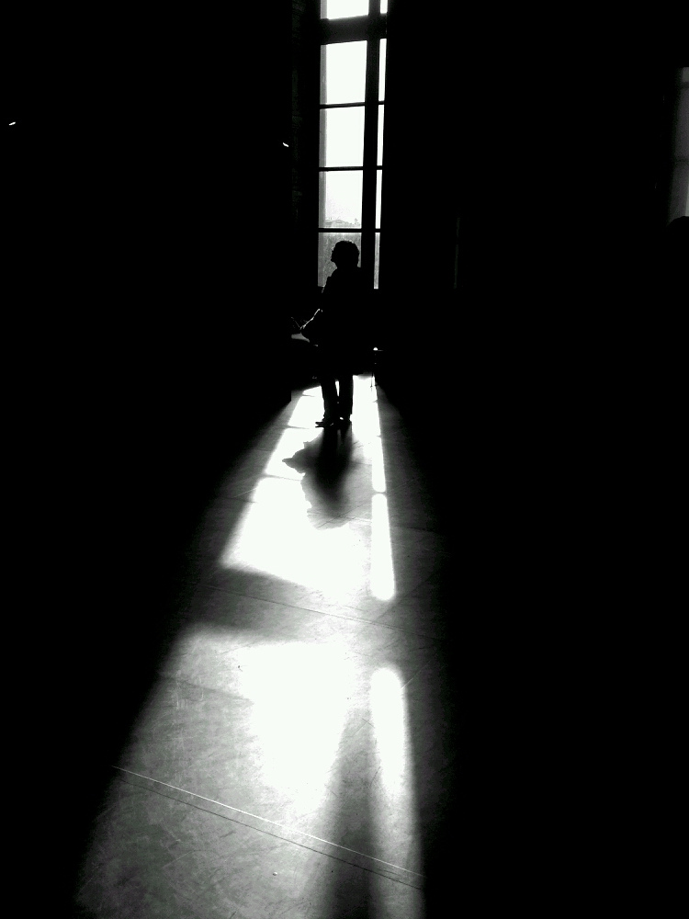
Implications
Photo by Flip 42 on Flickr

Slide 21
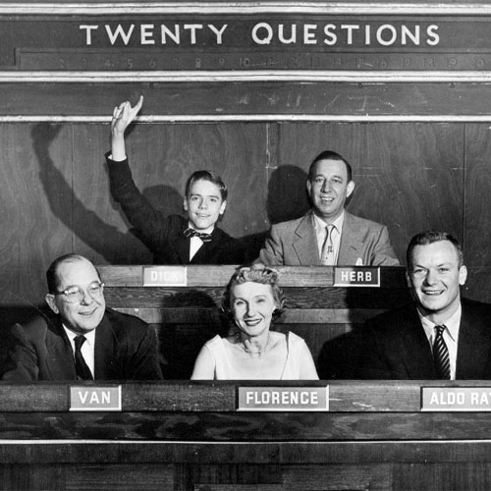
Questions?

Slide 22
Thanks
gardito@pace.edu
Twitter: geraldardito
Linked In: https://www.linkedin.com/in/geraldardito/

