Slide 1
Open and Shut Case: Tracking Down Open Access Resources
Peggy Lynn MacIsaac
Reference Services Librarian
Jennifer Rempel
Information Literacy and Resource Access Librarian
Notes:
Good afternoon.
My name is Peggy Lynn and my colleague is Jen. We’re both librarians at AU Library. But for the next hour, we are … JP Private Investigators, here to serve you.

Slide 2
Case File: 20170511
Clients’ Need:
To make a presentation at home institution about the experiences at this conference.
To make it visually exciting.
To find and use other people’s creative work, without breaking the law.
JP Private Investigators’ Service:
To teach clients how to lawfully find and use openly accessible resources to accomplish their task.
Notes:
Today’s fictional scenario is that you are our clients.
Your need is:
To make a presentation at home institution about the experiences at this conference.
To make it visually exciting.
To find and use other people’s creative work, without breaking the law.
[Remember this is fictional, we will not be asking you to make a presentation in the next hour.]
So, as your private investigators, we will teach you how to lawfully find and use openly accessible resources to accomplish this task.

Slide 3
Lingo: Open Access
DEFINITION: That one can freely access the resource (e.g. tool or content).
Tools
search tools
software
Our Service: Teach you to recognize what you can use and modify, lawfully.
Content
E-text
Image
Audio/ Video
Our Service: Teach you to recognize what you can use and modify, lawfully.
Notes:
We’ll be teaching the lingo around solving your case, and keeping you out of court.
Open access are resources that you can freely access. But we know you want to be able to find resources that you can use and modify. We’re going to take you through some steps for finding tools that you can use and modify and content that you can use and modify.

Slide 4
Lingo: Licensing
DEFINITION: The legal permission to use something.
Case Evidence:
The license information for each resource will tell us if it is open access, and what limitations there are to its use and modification.
Notes:
Licensing is how you know if you can use and modify tools or content for your presentation. We’ll be right beside you through all the steps so you don’t have to feel overwhelmed by the legalese. I’ll pass it over to Jen.

Slide 5
Tools: tracking skills
To use:
This means that you can use the software for free, but you cannot access or modify the source code.
Jing
LightShot
To modify:
This means the source code is open for individuals or communities of users to modify and share, usually under an appropriate license such as GNU GPL.
CamStudio
Greenshot
Notes:
Software that is freely available to use means that you can use the software for free, but you cannot access or modify the source code; this software is free, but is not open source. Examples of this kind of software include video-building software Jing, and screen capture tool LightShot. Software that is freely available to modify refers to software that is under a license that allows you to access and modify the software's source code. Examples of free and open source software include CamStudio and Greenshot. The most important characteristic of a software for our purposes in today's session is free use, as your current task is to design a presentation using freely available tools and content.

Slide 6
Gnu general public license
https://www.gnu.org/licenses/gpl-3.0.en.html
Can distribute copies of free software
Source code is freely (openly) available
Can share and change all versions of a program
Must make altered code freely (openly) available as well
Must mark new code as changed from source code
Patents on code must comply with GNU GPL license
GNU logo by Aurélio A. Heckert, Wikimedia Commons
Notes:
GNU GPL is one of the most widely used open source software licenses, and so I will discuss it in some detail here, as it is a license you're likely to come across when searching for open source tools.
The GNU General Public Licence was launched by software programmer Richard Stallman in 1983; it is supported by the Free Software Foundation. G-N-U stands for GNU's Not Unix, referring to Stallman’s use of Unix in developing free software. The important thing is that the creation of the GNU operating system led to the creation of the GNU GPL – general public license. You can read the entirety of the GNU GPL on gnu.org; I will summarize the main points here.

Slide 7
Tracking skills: Open Source tools
Free Software Foundation’s Free Software Directory
http://directory.fsf.org/wiki/Main_Page
GitHub
https://github.com
GNU Free Software Directory
https://directory.fsf.org/wiki/GNU
Open Source Software Directory
https://opensourcesoftwaredirectory.com/
SourceForge
https://opensourcesoftwaredirectory.com/
Wikipedia’s “List of free and open-source software packages”
https://en.wikipedia.org/wiki/List_of_free_and_open-source_software_packages
Notes:
There are a number of open source software collections or directories available online. Here are a few of the most commonly used collections. Both software that is "open to use only” and “open to modify" can be found in these collections; however, these collections are geared towards software that is open source.

Slide 8
Tracking skills: Within a collection
Search for your software in an open-source software collection
Notes:
A good place to begin searching for the tool you need is within one of the collections mentioned in the previous slide. There are various ways to search each collection, by a word or phrase describing what the software does, for example, “screen capture”, or by its license.

Slide 9
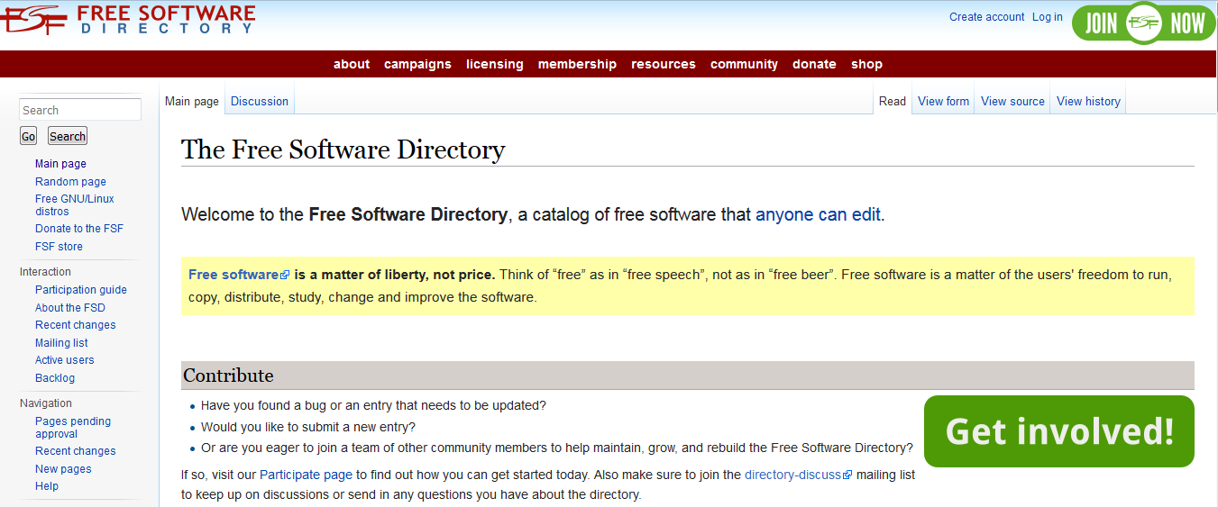
Notes:
The Free Software Directory is a good place to start. [go live]

Slide 10
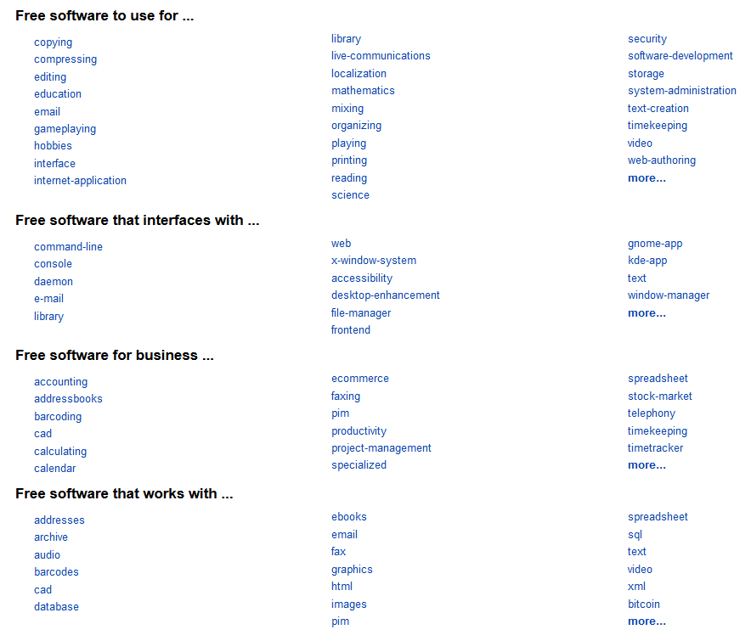
Notes:
You can begin by browsing by software use, type, etc.

Slide 11
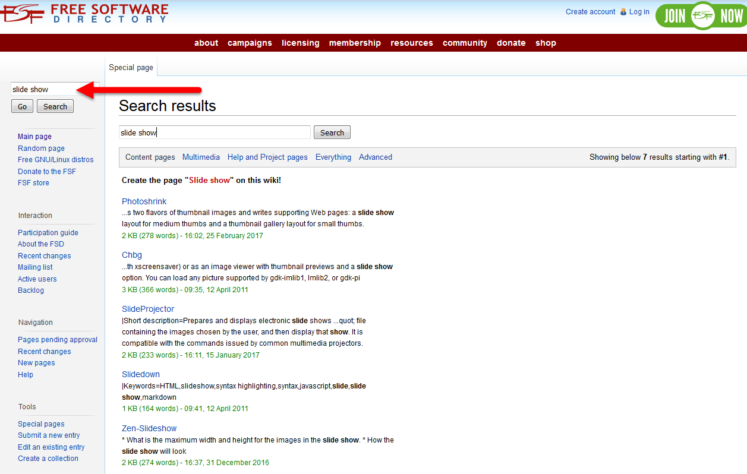
Notes:
You can also search by the type of software you're looking for; for example, slideshow, screencapture, voice capture, etc.

Slide 12
Tracking skills: Within a collection
Search for your software in an open-source software collection
The Free Software Directory allows you to search by license
Notes:
The Free Software Directory also allows you to search by license.

Slide 13
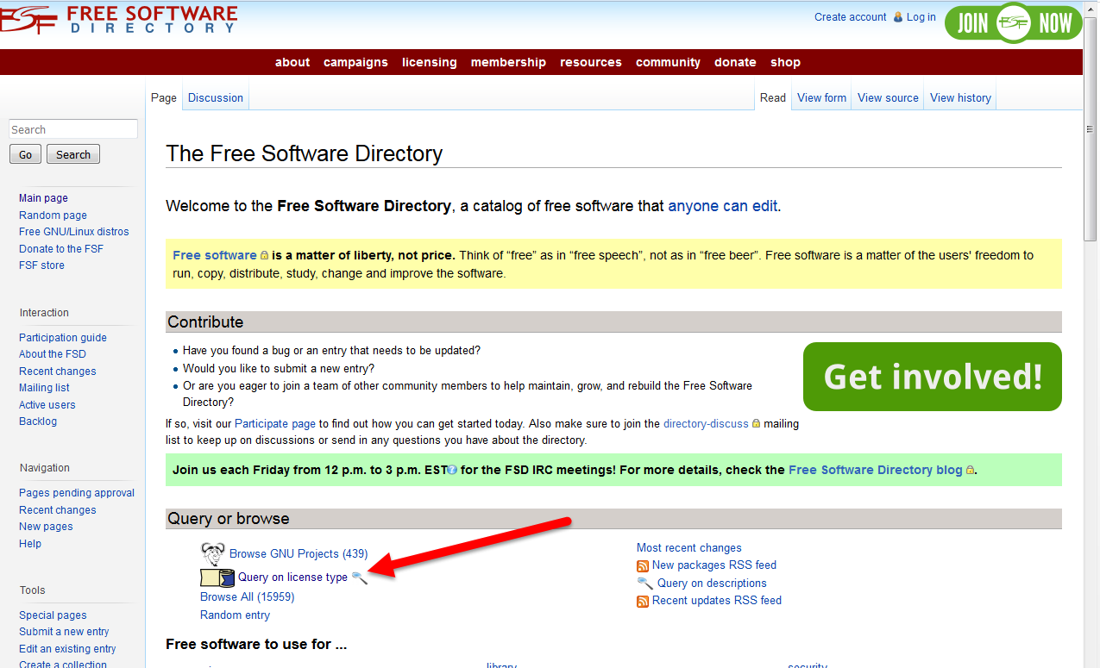
Notes:
Click on “Query on license type”.

Slide 14
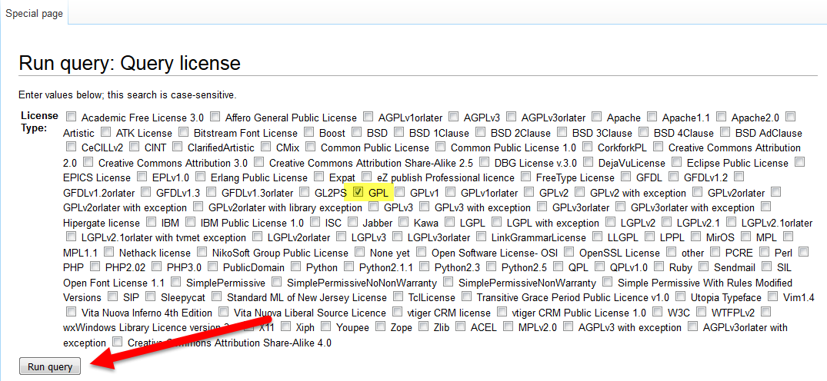
Notes:
Select which license type or types you are looking for, and click “Run query”.

Slide 15
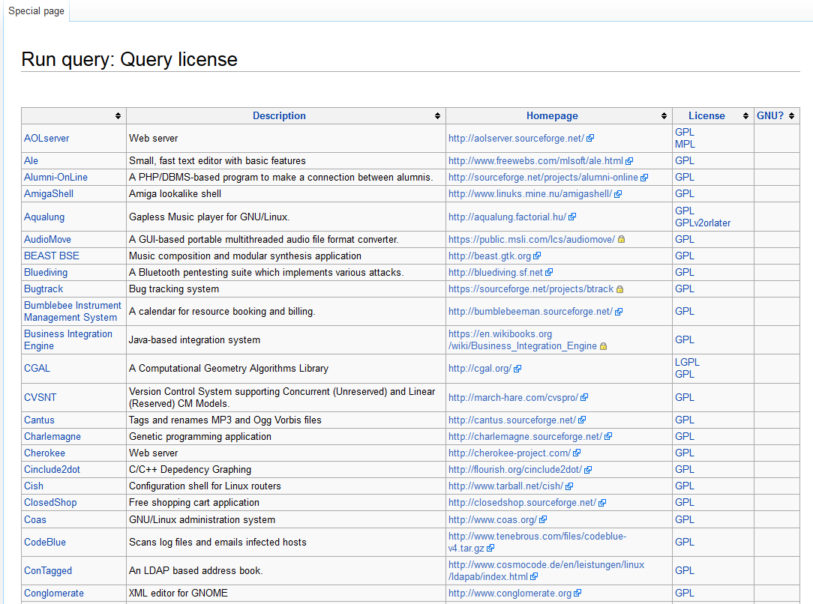
Notes:
Your results will include all software under that license that is listed in the FSD.

Slide 16
TRACKING Skills: web searching
Tips:
Begin a web search phrase with the type of software you want to find; e.g. “screen capture GNU”, NOT “GNU screen capture”
Search phrases:
screen capture GNU
video capture GNU
screencasting GNU
"screen capture" "open source“
"video capture" "open source"
Notes:
It’s relatively easy to carry out a web search – I’ve used Google – to find GNU GPL licensed / open source software. Generally, you should begin a web search phrase with the type of software you want to find; e.g. “screen capture GNU”, NOT “GNU screen capture”. You may also want to use different terms for the type of software you’re looking for, for example, screencasting software or video capture software.

Slide 17
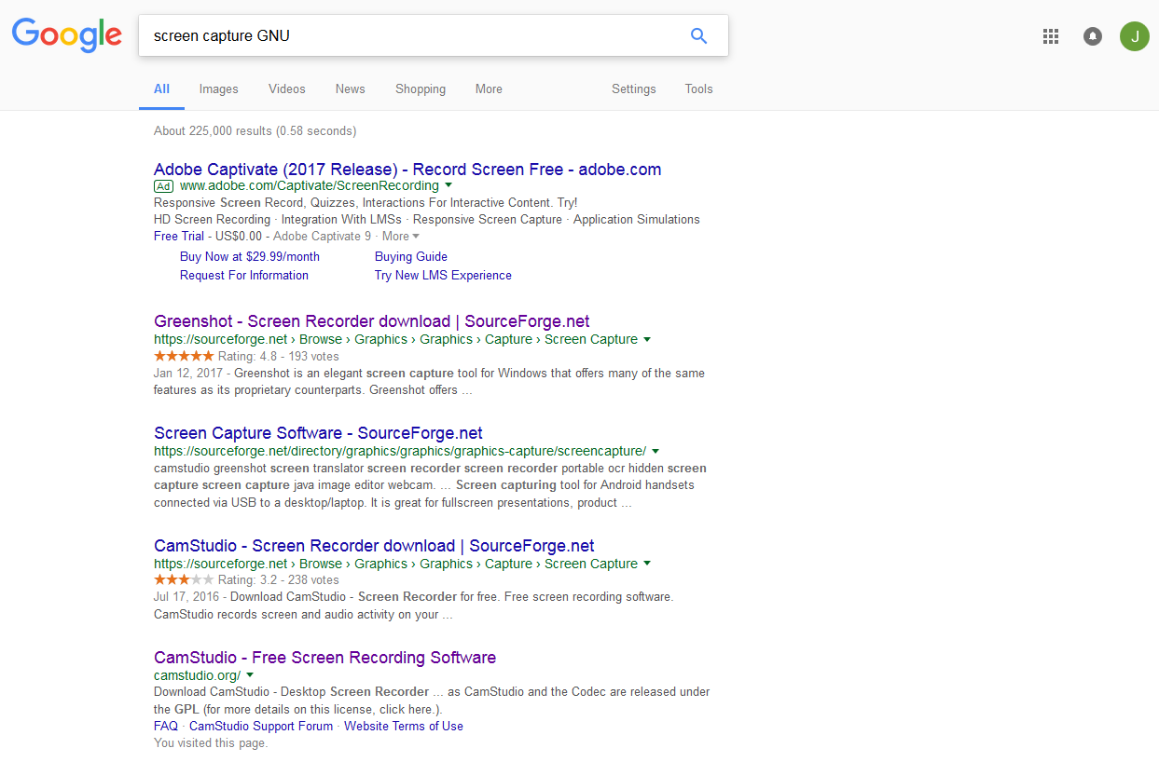
Notes:
You can usually find what you're looking for with a Google search. The top results will be the most popular open source software.

Slide 18
Can I use what I found? : step one
Search for your software in an free / open-source software collection
Notes:
If you find a free software that you would like to use, it’s a good idea to check what license it was released under. There are a few ways to do this. The quickest is to search for your software in an open-source software collection; for example, in the Free Software Directory.

Slide 19
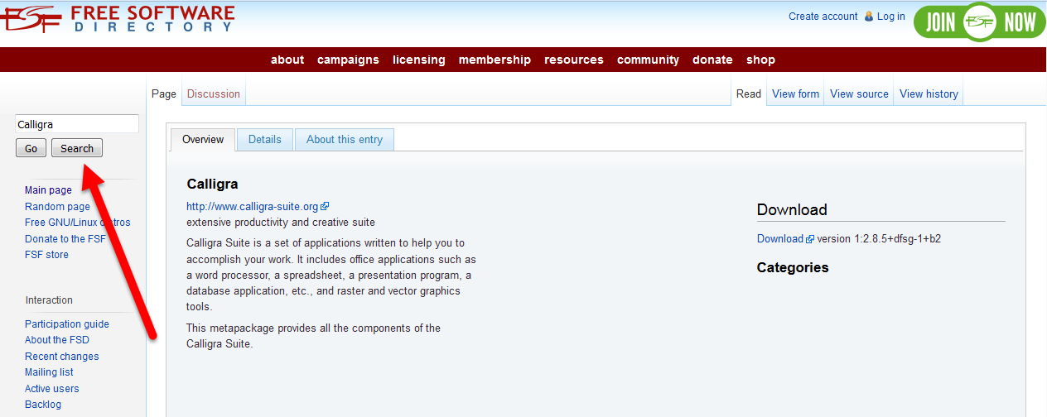
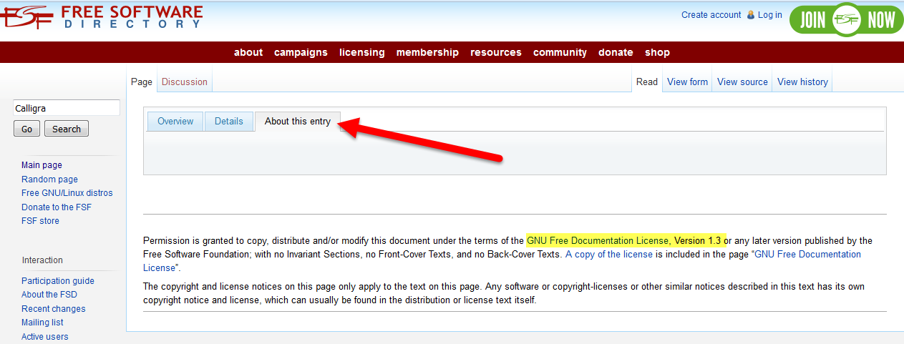
Notes:
The Free Software Directory usually provides licensing information. Search for your software. If it is listed in FSD, you will find licensing information in the “About this entry” or “Details” tabs.

Slide 20
Can I use what I found? : step two
Search for your software in an open-source software collection
Go to the software’s homepage, if it has one, and look for licensing information
Notes:
You can usually find information about a software's license on that software's homepage, if it has one.

Slide 21
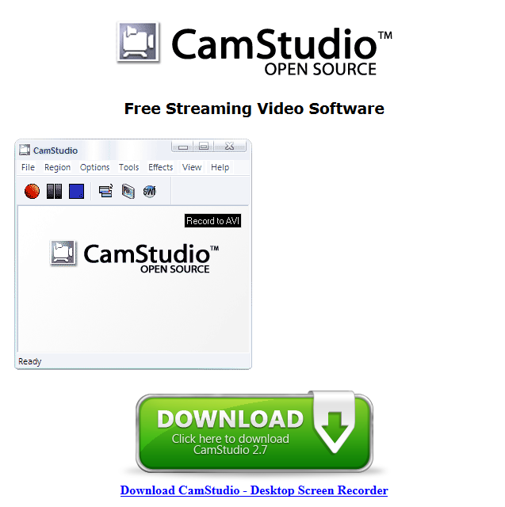
Notes:
This information is usually found on the bottom of the software’s homepage.
We suggest having a look but not spending too much time, as sometimes this information can be rather hidden.

Slide 22
Screen / video capture software | Screen shot | Video capture | Free | Open source | GNU GPL
“Check mark” and “X” icons used in this table by Freepik and Elegant Themes, flaticon.com.
Notes:
Many free and / or open source video and screen capture options are available. Some of the most popular include CamStudio, Greenshot, Jing, LightShot, ScreenPresso, SareX, and TinyTake. Most of these tools offer both screen and video capture, except for Greenshot. These software are all free; CamStudio, and Greenshot are also open source.
We've posted up on our Landing page some of the most popular screen and video capture software that you may want to use to build your presentation. Your task now is to either carry out a search for a software that is not listed here and to add it to the chart, or, to fill in the missing information for some of the software listed in the chart, including Jing, LightShot, and TinyTake. You need to find out if the software is for screen shot, video capture, or both; if it is free, if it is open source, and if it is under a GNU GPL license.

Slide 23
Tracking skill: Your Practice time
We’d like you to search for Open Access Tools. Post your findings at: https://tinyurl.com/JP-open
We’d like the following information: Example:
Name of tool Greenshot
URL greenshot.org
Screenshot Y/N screenshot Y
Video capture Y/N video capture N
Free Y/N free Y
Open Source Y/N open source Y
GNU GPL Y/N GNU GPL Y
Notes:
We’d like you to do some searching, if you find anything you’d like to share, we’re going to suggest you post them to our page on the AU Landing site. We’ll take a moment to share our screen and show you where we’d like you to post. This is also where all our supporting documents can be found including this powerpoint. The information is freely available to the public, without having to set up an account. If you’d like to contribute files, and use this space to collaborate with others you’re welcome to do so. You’ll just need to create a free account with AU Landing.

Slide 24
Tracking skills: Open Access tools
Other useful tools
Presentation-building software
Web-conferencing software
Accessibility tools
Notes:
This presentation was focused on helping you find the tools you need to complete your task, which is to make a visually exciting and interesting presentation at your home institution about the experiences you have had at this conference. Your task was to find tools and content that you can use under a license that allows you do use other peoples' work legally. But there are other tools out there that you may find useful as well, including web conferencing software and accessibility tools.

Slide 25
Presentation builders | Free | Open source | GNU GPL
“Check mark” and “X” icons used in this table by Freepik and Elegant Themes, flaticon.com.
Notes:
You can also search for these presentation builder software. Are PowToon and SlideDog, or the other presentation builders you find, free? Open source? Under a GNU GPL license?

Slide 26
Webconferencing Software | Free | Open source | GNU GPL
“Check mark” and “X” icons used in this table by Freepik and Elegant Themes, flaticon.com.
Notes:
There are many free and open source web conferencing software available. Some of the most popular include BigBlueButton, MConf, OpenMeetings, and WebHuddle. Again, you can use your newly-acquired search skills to track down, within a directory or online, the free and open source web conferencing tool that is suitable to your needs.

Slide 27
Accessibility tools | Free | Open source | GNU GPL
“Check mark” and “X” icons used in this table by Freepik and Elegant Themes, flaticon.com.
Notes:
It is probably a part of your institutions' mandates – as it is a part of AU's mandate – to make sure that materials, resources, and information are accessible to all students. Some useful free and open source tools for creating closed-captioned videos and web conferences are also available; a few examples of closed-captioning tools include Aegisub, eWorks, OverStream, and YouTube.

Slide 28
Tracking skills: finding content
Licensing
Copyright
Creative Commons Licensing
Collections
Find collections
Search for content
License of found content
Web Searching
Search terms
License of found content
Notes:
Having found the software tools you want to use, we’ll now talk about finding content. This will follow the same story as Jen described, talk about licensing, collections, and web searching.

Slide 29
Tracking skills: licensing
A bit about the law.
Know enough to know what to search.
Notes:
Remembering … Jen and Peg are your private investigators, not your lawyers. We’re going to talk a bit about the law. So in order to help you not break it.

Slide 30
Tracking skills: licensing
Copyright
Automatic
Creative Commons Licensing
voluntary
Notes:
Copyright is a legal right defined by law.
In Canada, it is a federal law. An original work is automatically protected by copyright at the moment of creation and for 50 years following the death of the copyright holder.
Internationally, there are treaties in place between countries WIPO (World Intellectual Property Organization and Berne convention to name two of many).
Some countries don’t have copyright laws.
There are several public copyright licensing initiatives.
They are all voluntary.
We’re going to discuss one. The Creative Commons Licensing.

Slide 31
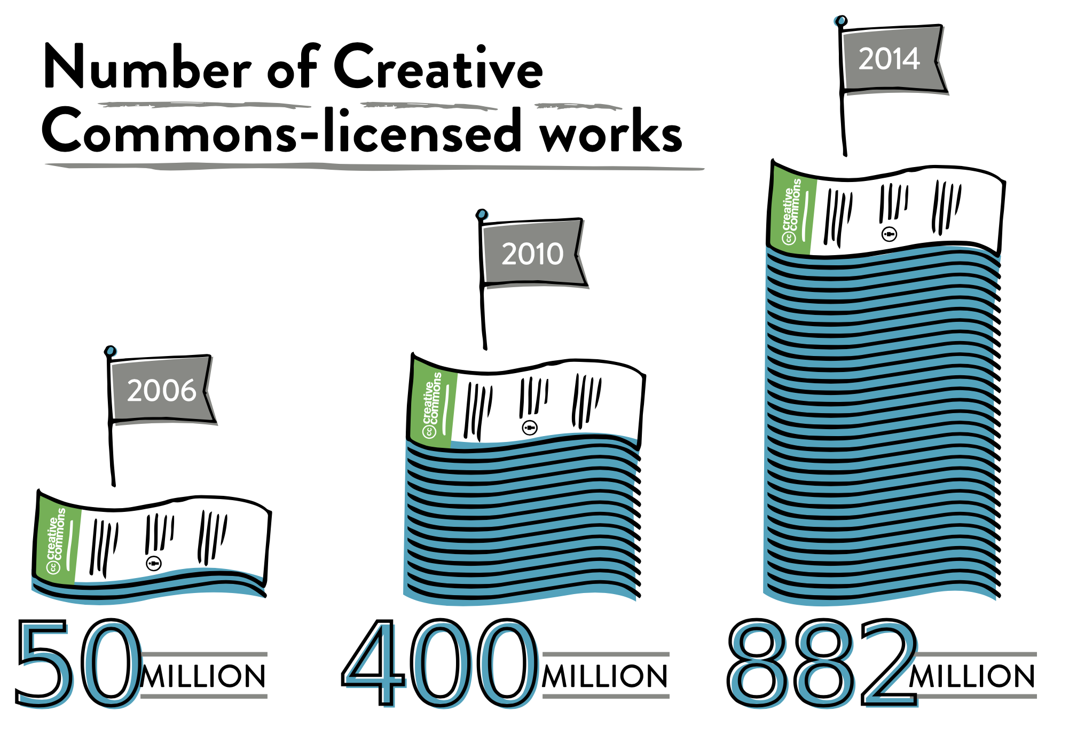
Tracking skills: licensing
Source:
State of the Creative Commons 2015
Notes:
We choose to work with Creative Commons Licensing because it’s widely adopted around the world.

Slide 32
Tracking skills: licensing
What does “Open” mean?
Creative Commons Licensing uses the
Open Knowledge Foundation’s definition:
Open data and content can be freely used, modified, and shared by anyone for any purpose.
Notes:
Creative Commons Licensing is built off this definition.

Slide 33
Tracking skills: licensing
Rights holders can reassign rights protected by copyright.
Attribution (BY)
NonCommercial (NC)
ShareAlike (SA)
NoDerivatives (ND)
Notes:
Creative Commons Licensing
Allows rights holders to reassign four rights protected by copyright law.
These are their icons, and definitions.
Mathematically, there are many combinations of these four.

Slide 34
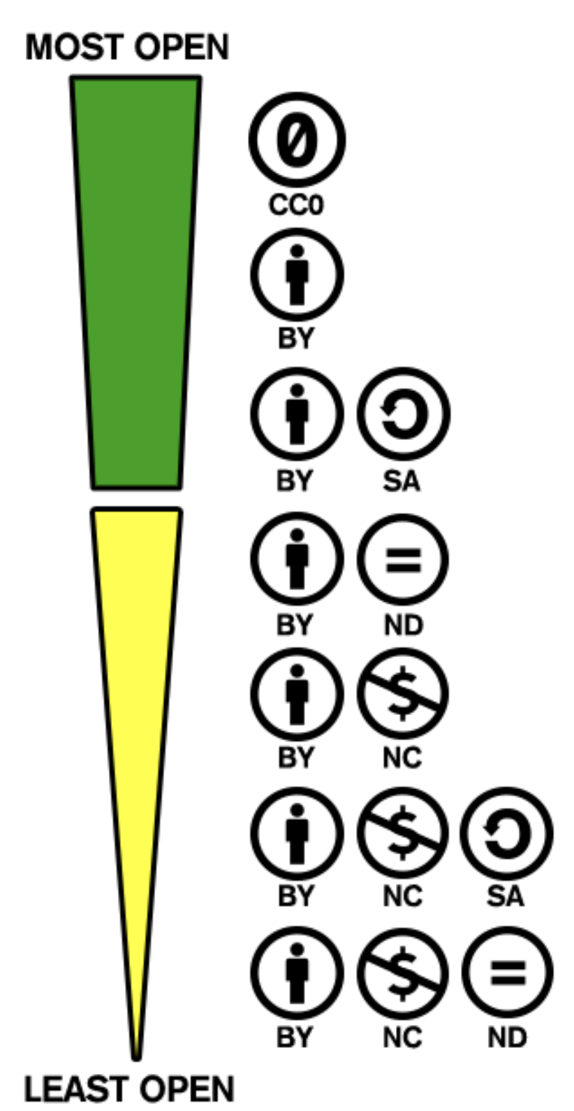
Tracking skills: licensing
Notes:
Of the many possibilities, these are the most common combinations of the many possible.

Slide 35
Tracking skills: licensing
Notes:
These are the only that fit the “Open” definition stated earlier. We’ll go through each in detail.

Slide 36
Tracking skills: licensing
Notes:
This is the most open, with the item being put into the public domain. Copyright holder wishes to waive all interests that may exist in the work worldwide.

Slide 37
Tracking skills: licensing
Attribution (BY)
One can use the work in any way must give you credit in the manner that the creator requests,
but not in a way that suggests endorsement.
Notes:
All that’s required is that the original creator be credited (This is called attribution).

Slide 38
Tracking skills: licensing
ShareAlike (SA)
Anyone can copy, distribute, display, perform, and modify the work, as long as one distributes any modified work on the same terms.
Notes:
Requires attribution and sharing in the same manner that was originally shared.

Slide 39
Tracking skills: Collections
Articles and Books
Dissertations and Theses
Legal and Data
Images and Sounds
Multiple formats
Notes:
Here are some of our favorites.

Slide 40
Tracking skills: Collections
Articles
PubMed Central Canada http://pubmedcentralcanada.ca/
PLOS http://www.plos.org/publications/journals/
Wiley Open Access http://www.wileyopenaccess.com/view/journals.html
multiple databases listed by AU Library at: http://library.athabascau.ca/resource/browse?type=FreelyAvailable
Notes:
Here are some of sites.

Slide 41
Tracking skills: Collections
Books
Project Gutenberg– Canada https://www.gutenberg.ca
Project Gutenberg https://www.gutenberg.org
InTechOpen www.intechopen.com
Lonely planet travel guides http://lonelyplanet.com/
OAPEN Library www.oapen.org
Directory of Open Access Books www.doabooks.org
Notes:
Here are some of our favorites.

Slide 42
Tracking skills: Collections
Dissertations and Theses
Open PQDT http://pqdtopen.proquest.com/search.html
Open Access Theses and Dissertations https://oatd.org
Notes:
Here are some of sites.

Slide 43
Tracking skills: Collections
Legal
CANLII http://www.canlii.org/
WORLDLII http://www.worldlii.org/
Notes:
Here are some of sites.

Slide 44
Tracking skills: Collections
Data
Statistics Canada http://www.statcan.gc.ca/
United Nations Statistical Division http://unstats.un.org/unsd/default.htm
OECD http://www.oecd.org/
Notes:
Here are some of sites.

Slide 45
Tracking skills: Collections
Images
Pexel – stock photos www.pexels.com
Flickr – The Commons www.flickr.com/creativecommons
Xkcd – comic https://xkcd.com
Notes:
Here are some sites.

Slide 46
Tracking skills: Collections
Sounds
Ambient-Mixer http://www.ambient-mixer.com/
ccMixter http://ccmixter.org
Freesound www.freesound.org
Sound Cloud https://soundcloud.com/creativecommonsmusicfree
JewelBeat www.jewelbeat.com/free/free-library-music.htm
Librivox audio-books https://librivox.org/
Notes:
Here are some of sites.

Slide 47
Tracking skills: Collections
Warm Summer Forest http://forest.ambient-mixer.com/summer-forest
Notes:
We thought we’d share one resource with you. Ambient-Mixer is so cool! They present sound recordings with the various sounds separated on different tracks so that the listener can control. In this particular screenshot, we’ve muted the deer call.

Slide 48
Tracking skills: Collections
Multiple Formats
Library and Archives Canada www.bac-lac.gc.ca/eng/discover/Pages/browse-product-type.aspx
OERcommons www.oercommons.org/curated-collections
Toporama (Interactive Canadian maps) http://atlas.gc.ca/toporama/en/index.html
Wikimedia Commons https://commons.wikimedia.org
Khan Academy www.khanacademy.org
MOOC providers www.mooc.ca/providers.htm
OAIster http://oaister.worldcat.org
Notes:
Here are some of our favorites.

Slide 49
Tracking skills: Web searching
Notes:
There are many collections on line that make it easy for users to discover and collaborate on images, video, music, research, and educational texts.
Source: creativecommons.org

Slide 50
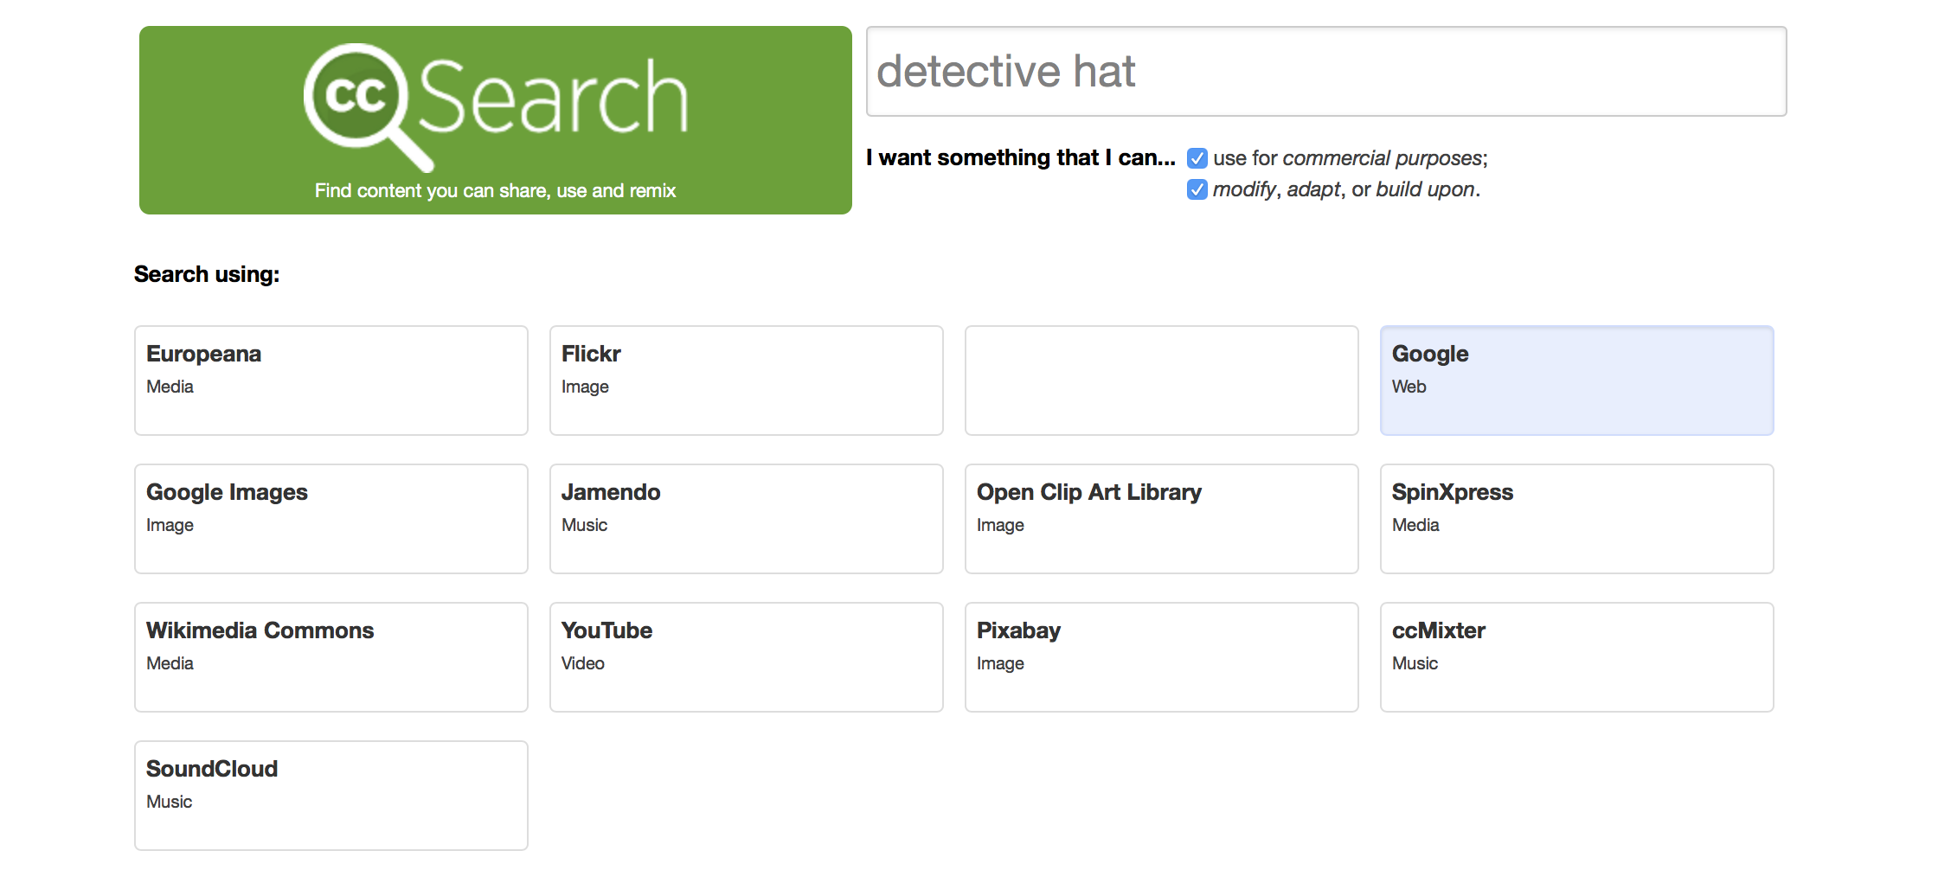
Tracking skills: Web searching
Notes:
https://search.creativecommons.org
Has built an interface to set limits, for our purposes check both boxes to limit to the most open licenses.
There is a disclaimer that that one can’t assume the results will comply with the CC license.

Slide 51
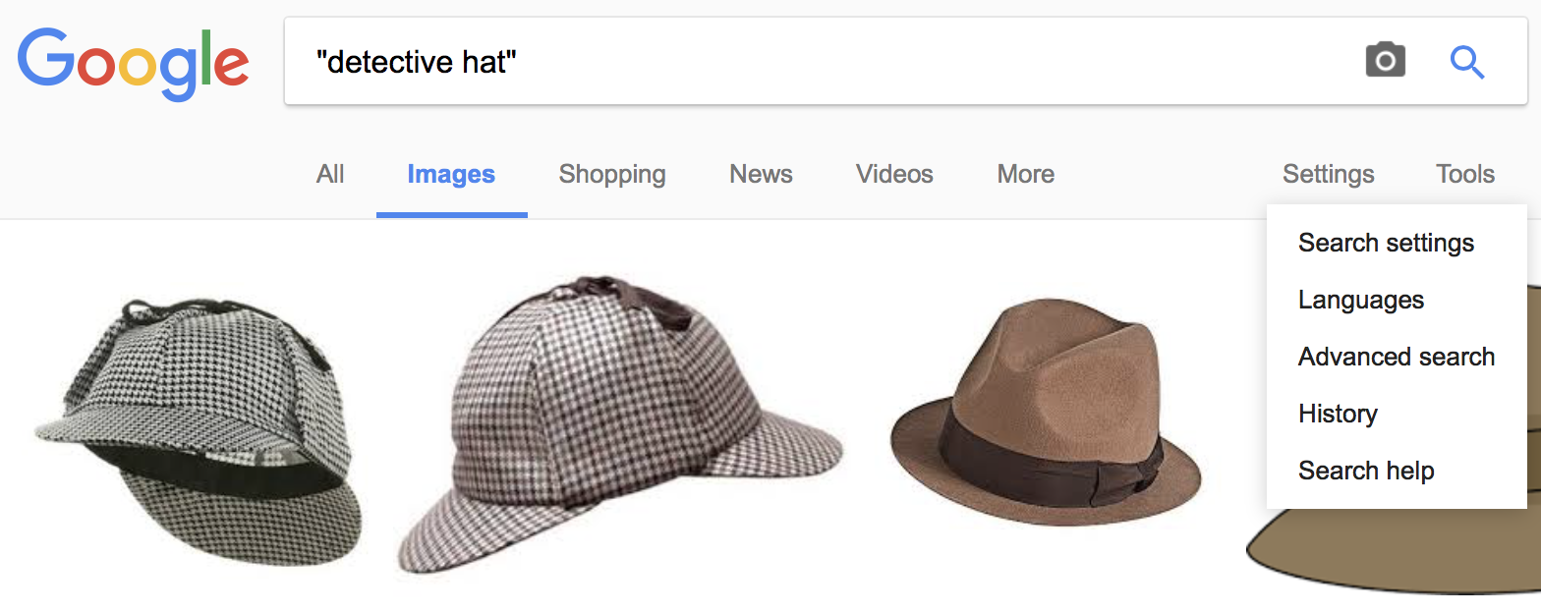
Tracking skills: Web searching
Do a search in Google.
Select image or video.
Click Settings.
Click Advanced Search.
Notes:
Let’s work within the Google Search engine itself.
Enter a search in Google

Slide 52
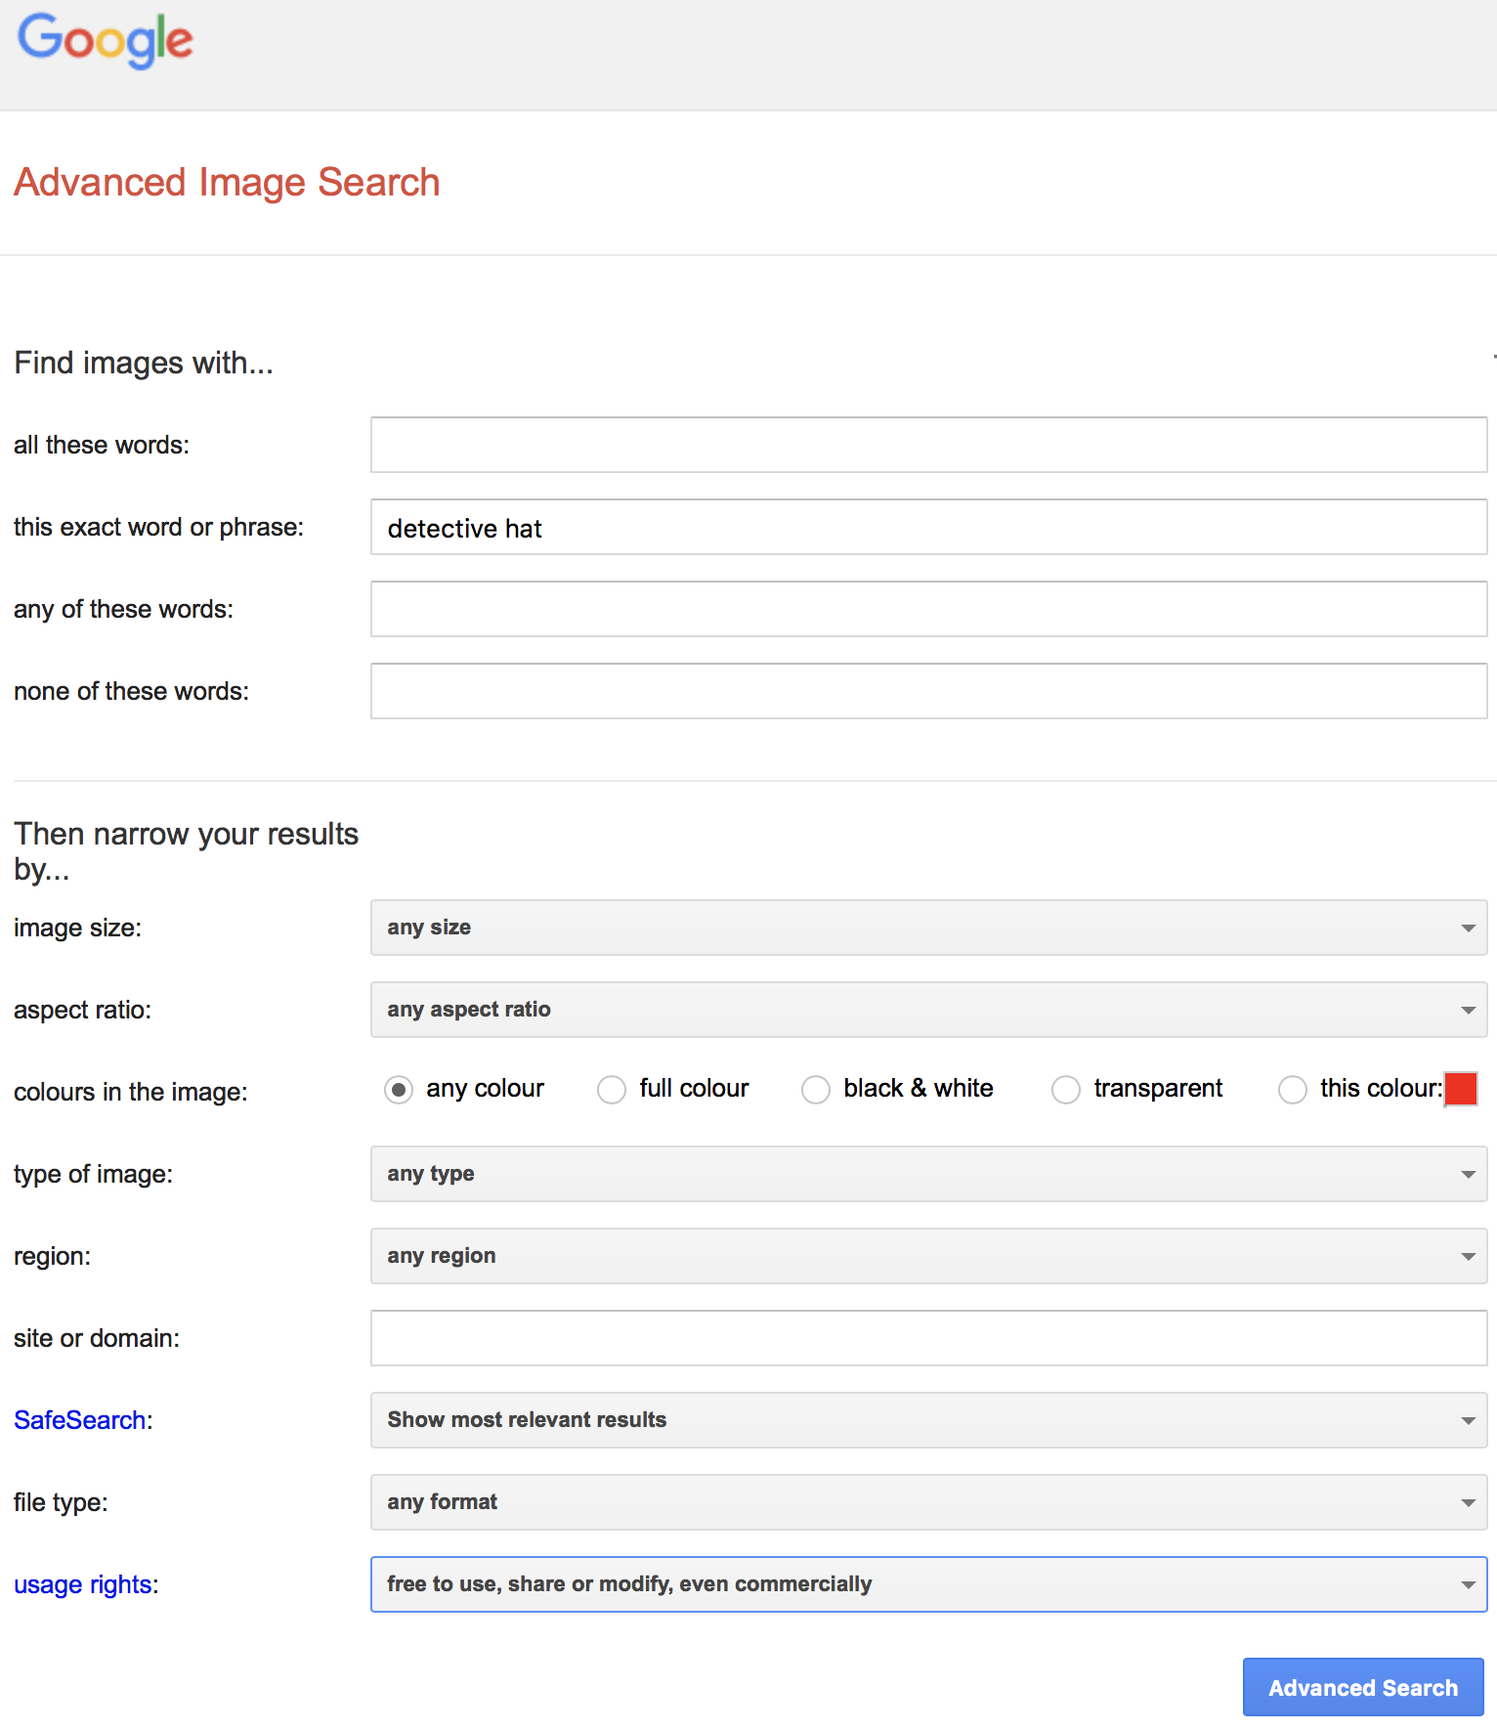
Tracking skills: Web searching
Google: Advanced Search
Select the usage right:
“Free to use, share or modify, even commercially”
Notes:
Because we chose “images” before clicking on the advanced search, we’re able to narrow the results based on qualities relevant to images,
such as
format,
colour,
image size,
aspect ratio.
As always, going to the search tool itself can provide greater options than collaborative tools found else where. There are more choices for usage rights options than the tool link from the Creative Commons site.
Sidenote: Google dvanced searching limiters do help in narrowing a search for Open Source softwares. This is why Jen showed you general web searches and directory searches.

Slide 53
Tracking Skills: Web Searching
Notes:
As a wrap up regardless of the manner in which you found an item you want to use, you’ll always need to confirm the licensing information. Here’s an example the pixabay which is an image collection. In this screen shot we see the item is in the public domain as a Creative Commons Zero.

Slide 54
Thank you for your attendance!
Questions?
Notes:
Thank you for attending our workshop today! After this session, we will format your contributions and add them to the site.

Slide 55
Open And Shut Case: Please start here
https://tinyurl.com/JP-open
Notes:
You can have open the Freely available website of the AU Library and if you find good resources that aren’t listed there, then we encourage you to post it to our presentation’s webpage.

