Slide 1
SILO-BUSTING 2.0
Frazer Andrews, Senior Program Advisor, Faculty of Business
Peggy Lynn MacIsaac, Reference Services Librarian
Mike MacLean, Senior Program Advisor, Faculty of Business
Jennifer Rempel, Information Literacy and Resource Access Librarian
Alberta Services for Students Conference 2017

Slide 2
Ideally, members of discrete organizational units work together as a team to accomplish their tasks, while at the same time working in coordination with other units in order to help the organization as a whole achieve its wider goals.
– Peter Schütz & Brian Bloch

Slide 3
“Silofication” occurs when there is a breakdown in the flow of data, knowledge, and information across these units. Silofication is a series of “breakdowns that occur within and between organizations because of the failure to partner effectively” with each other.
– David Willcock

Slide 4
Alan Neebe, in 1987, “made the first reference to silos as a metaphor in organisational behaviour, with reference to grain silos as an example of how parts of organizations function in a manner disconnected from the others”.
- Frans Cilliers & Henk Greyvenstein

Slide 5
Organizational silos...
Grow inward
Isolate talent
Hoard resources
Slow progress
Dampen enthusiasm
Create paranoia
Act in self-protective ways that damage others
Don’t network
Focus on individual good rather than organizational good
Win when others lose
- Dan Rockwell

Slide 6
"The negative outcomes [of silofication within an organization] can include lack of shared learning and innovation, delays in getting work done, unproductive conflict, stress, and significant reputational and financial costs due to program failures".
– David Willcock

Slide 8
How do silos affect me and my work?
With your group, please identify specific examples of silofication in the workplace.
What happens, or fails to happen?
What is the impact on your performance, job satisfaction, and/or sense of identity within your institution?
Does this affect service to students?

Slide 9
Concrete Strategies
Recognize
Imagine
Act

Slide 10
Recognize
“How are people changed by the work we do?” “How do we do what we do?”
Siloed Organizations:
Focus on the organization not the customers, create paranoia, dampen enthusiasm, and normalize protective language, e.g. “It’s not my problem.”
Define success as individuals out-doing colleagues, act in self-protective ways that damage others, and only win when others lose.
Isolate talent, redundant work is duplicated out of institutional ignorance.
Resources are stockpiled, rather than leveraged by those who need them most.
Are slow to progress and only grow inward.
Silo Busting:
Recognizes the customer-centred purpose of your work and cultivate it as a motivator for action.
Acknowledges individual and organizational weaknesses and strengths.
Leverages the diverse deep expertise in specific areas of organization.
Identify stakeholders who can champion collaboration. Don’t focus on skeptics.

Slide 11
Imagine
“What am I doing to help people realize they matter?”
“What am I doing to make people feel like they belong in a collaborative working environment?”
The organization can be agile and resilient through cross-boundary collaboration.
Action for change coming from within each siloed group.
Focusing on the work, not the silos.
Sources:
Publications in our bibliography by Ron Ashkenas, Mehrdad Baghai, and Dan Rockwell
Silo Busters (Frazer Andrews, Peggy Lynn MacIsaac, Mike MacLean, & Jennifer Rempel)

Slide 12
Act
“What am I doing to help people work together?”
Amplify:
Do not make enemies of the people you are trying to connect.
Foster maximum transparency and information sharing.
Develop leadership skills and attitudes that enhance collaboration.
Measure and reward performance in terms of teams.
Communicate:
Start a positive whisper campaign amongst champions by employing boundaryless language.
Establish inclusive rather than exclusive systems.
Tell stories that honor collaboration and illustrate silo-busting.
Build:
Hold cross-department planning meetings, to breakdown seeing the other as the enemy.
Seek best solutions regardless of the source.
Build consensus.
Ensure cross-functional teams have power with a final decision-maker in order to eliminate the need to run decisions up the chain.

Slide 13
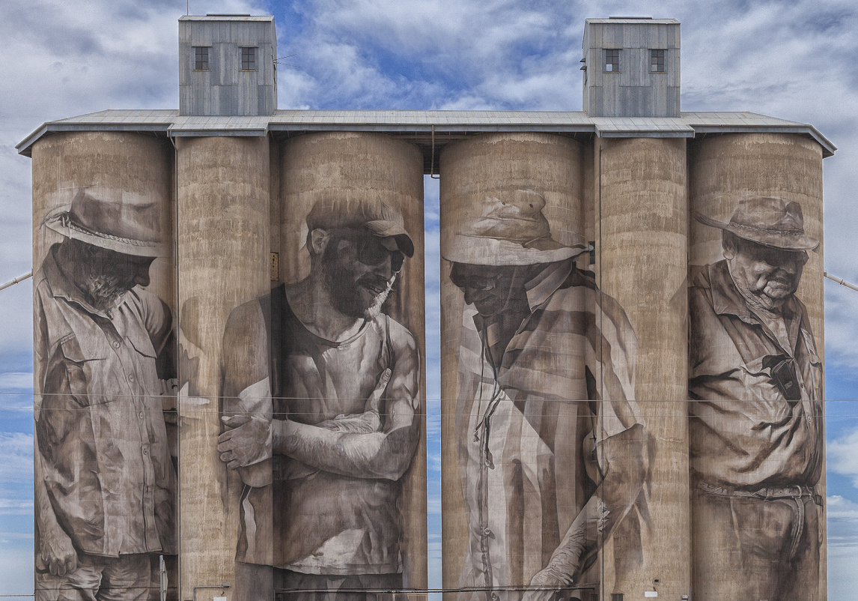
Look beyond your boundaries...
tinyurl.com/lufacta
Image credit: Brucephython, Wikimedia Commons

Slide 14
References
Ashkenas, R. (Sept. 9, 2015). Jack Welch’s approach to breaking down silos still works. Harvard Business Review Digital Articles.
Baghai, M. (2011-2016) Alchemy Growth Partners’ [website]. http://www.alchemygrowth.com
Cilliers, F., & Greyvenstein, H. (2012). The impact of silo mentality on team identity: An organisational case study. SA Journal of Industrial Psychology, 38(2), 75-84. http://dx.doi.org/10.4102/sajip.v38i2.993
Rockwell, D. (2011, April 28). Mehrdad comes of age [Blog post]. Retrieved from https://leadershipfreak.blog/2011/04/28/4808/
Rockwell, D. (2012, May 9). Destroy silos before they destroy you [Blog post]. Retrieved from https://leadershipfreak.blog/2012/05/09/destroy-silos-before-they-destroy-you/
Dan Rockwell (2016, July 19) Breaking silos – Connecting people. [Blog post]. Retrieved from https://leadershipfreak.blog/2016/07/19/breaking-silos-creating-connected-organizations/
Schütz, P., & Bloch, B. (2006). The “silo-virus”: Diagnosing and curing departmental groupthink. Team Performance Management: An International Journal, 12(1/2), 31-43.
Willcock, D. (2014). Inside-out collaboration: An integrated approach to working beyond silos. Reflections, 14(3).

