Slide 1
Social Presence within Two Massive Open Online Courses (MOOCs)
Werklund School of Education
A Multiple Case Study
Dr. Matthew Stranach October 4, 2017

Slide 2
Why MOOCs?
Intersection of instructional design, online course development, program development, higher education teaching and learning
MOOCs are popular, emergent course format
Strong interest in OERs, improving access to HE
Strong interest in enhancing quality in HE online courses
Public-facing PD and/or continuing education courses
MOOCs can be scaled to suit local projects and applications→ Matt has designed “mini-MOOC” for 2017 Futures Forum; developing another for Oshawa / UOIT “Teaching City” initiative

Slide 4
Why MOOCs?
2008: First MOOC→ University of Manitoba→ 25 paid students + 2000+ free enrollment students
Since 2008, up to 20 million students from over 200 countries having registered as MOOC participants (Karsenti, 2013)
As many as 300,000 students have enrolled in a single MOOC (Karsenti, 2013)

Slide 5
Discussion Questions
Have you participated in these kinds of courses (MOOCs)? In what capacity?
What was your experience like?
What did you enjoy, not enjoy about the experience?
What aspects of the course were most conducive to your learning? Less conducive?

Slide 6
Focus and Purpose
By looking at both individuals’ and groups’ experiences of social presence, I have learned about individuals’ reasons for participating in MOOCs, and the extent to which social presence affects their learning. This study has also provided the opportunity to learn about how institutions of higher learning can design and facilitate MOOCs to enhance social presence, as well as cognitive and teaching presences.

Slide 7
Research Questions
How does social presence affect teaching and learning within MOOCs?
What factors contribute to participants’ establishing a social presence in MOOCs?
How does social presence affect participants’ perceptions of a sense of belonging to a learning community?

Slide 8
Community of Inquiry (CoI)
CoI model. Communities of Inquiry website (2013). Retrieved from
https://coi.athabascau.ca/ Used with permission.

Slide 9
Discussion Questions
Does anyone have instructional design or educational development within professional or academic responsibility?
To what extent to theoretical frameworks help or inform your educational / professional work?
Do you / have you used CoI within your work? Other e-learning frameworks?

Slide 10
MOOC Formats
xMOOCs
Aligned with cognitive-behaviorist pedagogy (Anderson, 2013)
Focused primarily on the teacher or instructional designer
Characterized by low amounts of social presence (Anderson & Dron, 2011)
cMOOCs
Aligned with connectivism (Daniel, 2012)
Learners are encouraged to use social media and other Web 2.0 tools to explore a given topic or theme (Rodriguez, 2013)
Teaching role taken on largely by participants (Kop, 2011)

Slide 11
Discussion Questions
To what extent does pedagogical perspective inform your practice as an educator?
Does your perspective, practice as an educator tend to align with behaviourism, cognitivism, constructivism, connectivism? Other?

Slide 12
Overview of the Study
Case study methodology→ initially single, became multiple
Speaks to courses “as a whole” as well as individual participant experiences
Two American HE institutions, two course providers, two differing subject / content areas
Both aligned with “xMOOC” format— proprietary learning software, behaviorist / cognitivist approaches to teaching and learning (Anderson, 2013)

Slide 14
Overview of the Study
MOOC #1
American college
Language instruction / learning disabilities
515 registered participants
Canvas learning software
Videos, readings
Emphasis on discussions
No formal evaluation
Certificate of completion available
MOOC #2
American “ivy league” university
Energy science
16,023 registered participants
Ed.X learning software
Videos, readings
Emphasis on quizzes, tests
Discussions to help evaluation
Certificate of completion available

Slide 16
Key Findings
Social presence appeared in both courses
Personal interest a strong motivator for MOOC participation
Similar levels of teaching presence and cognitive presence reported between courses
Social presence reported as experienced least among three CoI presences in both courses
Participants, generally, did not view themselves as part of a “learning community”
Social presence helped participants further individual learning goals

Slide 17
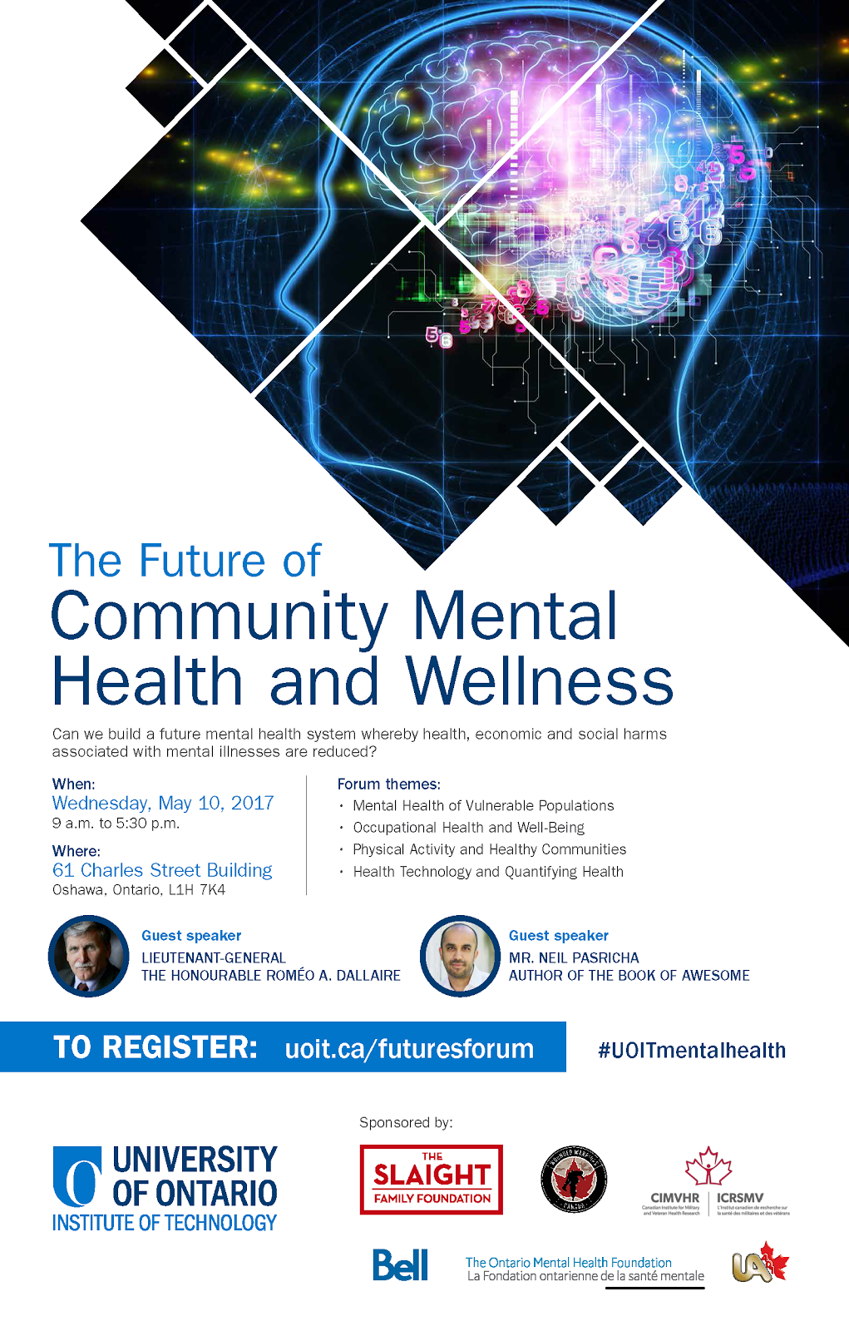

Slide 18
Implications
Personal interest
Leverage personal interest in courses to create further opportunities for CP, SP
Suggest wider range of learning activities
Support for learning
Enhanced SP may lead to enhanced CP
Wider range of teaching strategies, use of digital media may help enhance SP, CP
Enhance discussions through guidelines, facilitation
Opportunities to collaborate
Leverage technology for synchronous meetings, collaboration
Recognize multiple, personalized pathways through courses

Slide 20
Future Directions
Further MOOC format research (i.e., types of MOOCs)
Increase number of MOOCs in a case study
Additional research methodologies: grounded theory, narrative inquiry, action research, others
Focus on instructor, facilitator, designer perspectives
Areas of overlap between CoI elements within context of MOOCs

Slide 22
Discussion Questions
What questions would you like answered regarding MOOCs?
What questions would you like regarding CoI?
What further research would be valuable with regards to CoI and MOOCs?

