Slide 1
MOOC Activity and Design Dr. Kathlyn Bradshaw
A study of instructional designers’ perceptions supports the notion of cultural historical activity theory (CHAT) as a relevant framework for mapping the crossover between formal and informal e-learning in massive open online course (MOOC) design. As Hall (2009) stated, to optimize learning, formal and informal learning should be connected, and learning is most effective when learners engage in both formal and informal learning activities.
CIDER
November 1, 2017

Slide 2
The Frankenstein Bicentennial Project – Arizona State University
MOOCenstein: Frankenstein Goes Global
This working group will discuss the development of a Massive Open Online Course (MOOC) to be produced by an interdisciplinary group of scholars across a range of institutions, and to be offered during the 2016-2018 bicentennial celebration and beyond. The MOOC will use the novel Frankenstein as a gateway for connecting STEM content with humanities, social sciences and arts, and it is designed to will create an international community of thinkers critically engaged with the ethical, legal and societal issues raised by Frankenstein beyond traditional college and university environments. The group will also advance efforts to establish Frankenstein as a “One Book” that is simultaneously enjoyed and discussed around the world during the two-year bicentennial celebration. This collective reading experiment will invite a diverse public into a dialogue that models the freewheeling intellectual discourse of Shelley’s day, mixing chemistry, poetry, biology and other subjects with the urgent ethical concerns of a world where artificial life is not a dream but, increasingly, a reality. (ASU, 2014)

Slide 3
The Research Setting
Types | Focus | Level of Formality
cMOOCs | Students to choose what to learn & how: create connections make connections between concepts build networks to keep current in a field (Downes, 2012) | Primarily informal learning opportunities
xMOOCs | Mass access to the lectures, readings, discussions, assignments, and assessments a student would find in a traditional college class (Haber, 2014) | Primarily formal learning opportunities
From Frankenstein to Post Humanism designed as a MOOC with a bit of both

Slide 4
Research Question, Methods, and Methodology
How do instructional designers perceive learners’ opportunities for boundary crossing between formal and informal learning within a MOOC design?
Where do instructional designers perceive opportunities for formal learning in designed activities?
Where do instructional designers perceive opportunities for informal learning in designed activities?
Where do instructional designers perceive opportunities for learners to cross boundaries between formal and informal learning within designed activities?
Case Study: Bound by time and context; multiple data sources
Participants: 8 instructional designers (Canada & US, post-secondary)
Survey
Focus Groups
Interviews

Slide 5
Theoretical Framework
cMOOCs as primarily informal learning activity systems | From Frankenstein to Post Humanism MOOC – Designed to be in between | xMOOCs as primarily formal learning activity systems

Slide 6
Tensions and CHAT Elements
primary involves tensions arising anywhere within any of the CHAT elements
secondary involves tensions arising between CHAT elements;
tertiary involves tensions arising between an old and a new activity system
quaternary involves tensions arising between activity systems
(Engeström, 1987, p. 189).

Slide 7
CHAT and Tensions
Object(ive)s tension arose between the certain purpose of formal learning contrasted with potential choices in informal.
Mediating artifacts were identified as those most often associated with formal learning, typically an LMS, while for informal learning social media (YouTube, Twitter, and so on) were identified.
Community formal learning involved teachers and instructors, while informal learning had a community of peers and life-long learners. D
Division of labour involved the teachers and instructors planning and facilitating formal learning, in contrast to non-facilitated self-directed informal learning.
Comparison of CHAT elements across the two activity systems pointed to quatenary tensions. These tensions in turn may indicate the potential for contradictions “historically accumulating structural tensions within and between activity systems” (Engeström, 2001, p. 137), or boundary crossings.

Slide 8
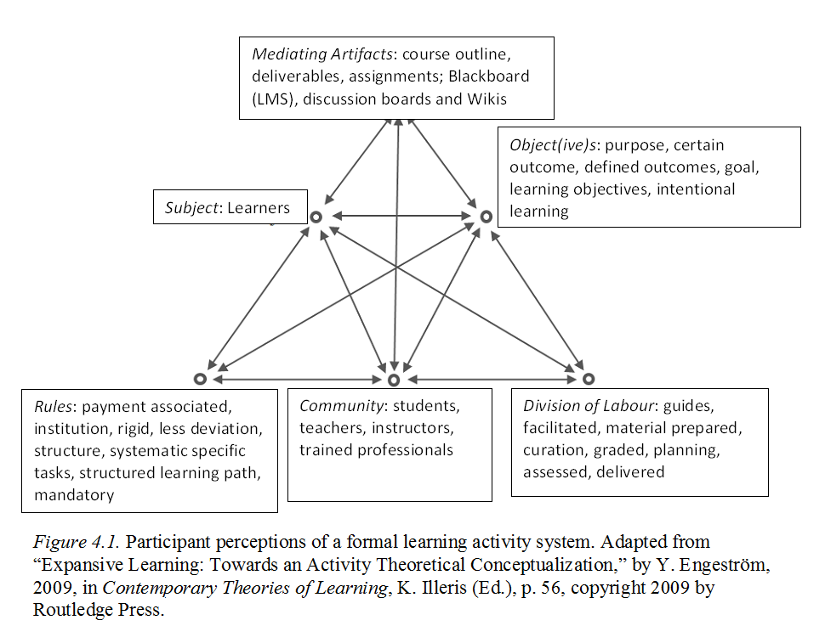
FINDINGS:
Clarity on “Formal Learning”

Slide 9
Findings: Ambiguity about “Informal Learning”
Participant | Definition | Literature | Definition
ID7 | “not.. Facilitated” | Tusting (2003) | “unplanned” (p. 8)
ID6 | “not an intended learning outcome or product” |  | “often implicitly taken to mean simply the opposite of formal learning” (p. 6)
 | “not packaged” |  | “unpremeditated” (p. 5)
ID5 | “very unstructured” | Crowley, et al. (2014) | “non-standardized” (p. 466)
ID4 | “no limitation” | Schwier & Seaton (2013) | “independent” (p. 2)
ID3 | “aren’t instructions” | Wright et al. (2013) | “incidental” (p.54)
Notes:
Quickly highlight similarities between participants’ use of language and definitions from the literature. Then make your two points (From a slide that I have removed) as per below.
Informal learning may not factor as a component in participants’ (formal learning) course design work and training as instructional designers
Reconsider the nature of informal learning discourse

Slide 10
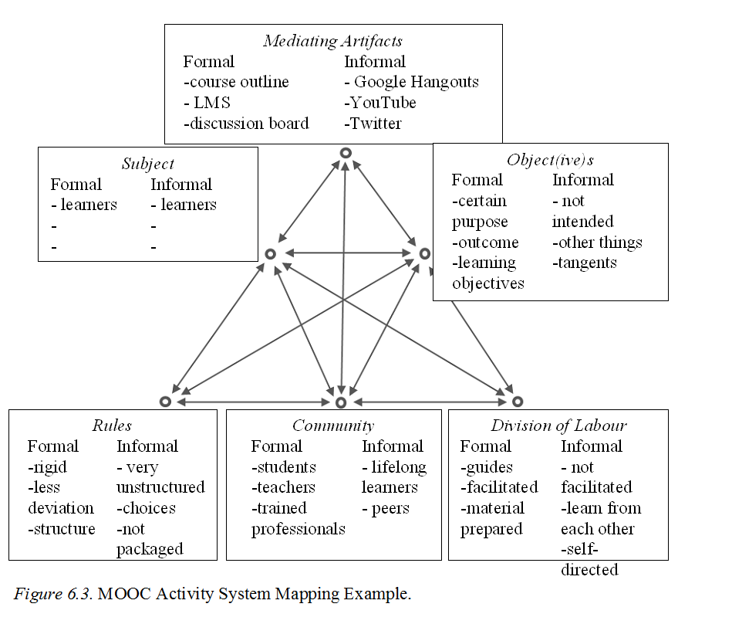
OUTCOME:
Design Tool for a MOOC
FUTURE DIRECTIONS:
Future research: MOOC implementation
Allow insights into the subject (learners)
Instructional designers’ perceptions compared with those of learners participating in the MOOC
Examine findings to identify similarities and differences and consider why

Slide 11
References
Crowley, K., Pierroux, P., & Knutson, K. (2014). Informal learning in museums. In R. K. Sawyer (Ed.) The Learning Sciences, 2nd Edition, pp. 19 - 34. Cambridge, UK: Cambridge University Press.
Downes, S. (2012, October 28). MOOCs and connectivist design [Web Blog post]. Retrieved from http://www.downes.ca/post/59359
Engeström, Y. (1987). Learning by expanding: An activity-theoretical approach to developmental research (p. 189). Helsinki: Orienta: Konsultit.
Engeström, Y. (2009a). Expansive learning: Towards an activity-theoretical reconceptualization. In K. Illeris (Ed.) Contemporary theories of learning (pp. 53-73). New York, NY: Routledge.
Haber, J. (2014). MOOCs. Cambridge, MA: MIT Press.
Hall, R. (2009). Towards a fusion of formal and informal learning environments: the impact of the read/write web. Electronic Journal of e-Learning, 7(1), pp. 29 – 40.
Schwier, R. A., & Seaton, J. X. (2013). A comparison of participation patterns in selected formal, non-formal, and informal learning environments. Canadian Journal of Learning and Technology, 39(1), pp. 1 – 15. Retrieved from: http://cjlt.csj.ualberta.ca/index.php/cjlt/article/view/709
Tusting, K. (2003). A review of theories of informal learning (Literacy Research Centre Working Paper No. 2). Lancaster, UK: Lancaster University.
Wright, S., Short, B., & Parchoma, G. (2013). Supporting creativity in craft brewing: A case study in iPhone use in the transition from novice towards mastery. International Journal of Mobile and Blended Learning, 5(3), 52 - 67.

