Slide 1
LOOCs: Sustainable open education for a small university
Dr. M. Tanya Brann-Barrett
Dean; Research, Teaching and Graduate Studies
&
Dr. Kathy Snow
CBU Teaching and Learning Chair in Open, Online and Blended Learning

Slide 2
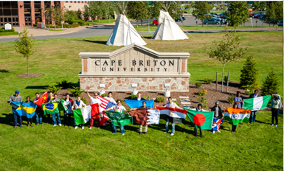
Intention Aim
To establish CBU’s position as an institution of excellence in teaching and learning world-wide.
To increase our annual student enrolment (and equivalent).
To develop relationships with people world-wide who may not otherwise have been introduced to CBU—people who could potentially choose to engage in further study at CBU.
To serve our mandate to Cape Breton Island by providing all citizens with the opportunity to learn in their communities in ways meaningful to them.

Slide 3
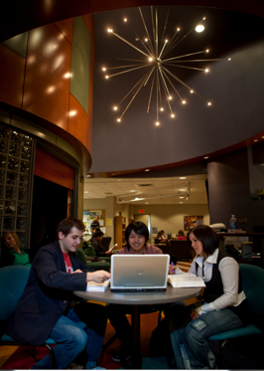
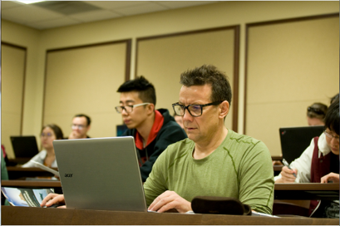
Strategy
Development of Open Digital Learning Opportunities at CBU

Slide 4
Building of the Success of MIKM 2701
Building from the Knowledge Keepers of Mi’kma’ki
An open dual mode course offered in the winter term of 2016, facilitated by Stephen Augustine and Ashlee Cunsolo
Public engagement
40-60 weekly in person participants
5326 registered participants
220 completed a participant certificate option

Slide 5
Organization of MIKM 2701
Structure
Blended, dual mode
Mi’kmaw Mondays with a 3 hour face-to-face “lecture” weekly
Live streamed by Bell Media who also archived content up until recently
Content is now hosted at CBU on our VIMEO library
Participants engaged through
Twitter #taliaqCBU
Facebook
In class questions

Slide 6
What we learned
There was a need for a dedicated space- simply setting up for livestream and deconstructing took 2-3 hours weekly
There was an appetite for certificate credit, but enrollment was problematic- a formalized system was needed that ran in parallel to degree credit registration
Supporting the learners was beyond the capacity of the two facilitators given the viral nature of the course- they were overwhelmed with email, tweets and FB posts
The pre/post production of materials for the course could be completed by people in non-traditional areas of the university

Slide 7
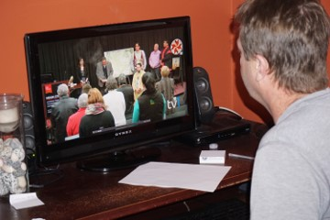
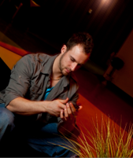
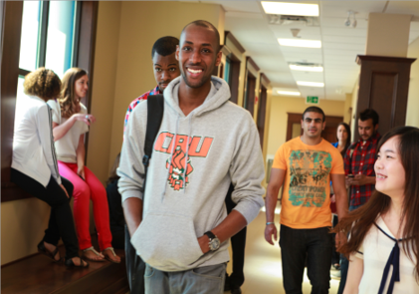
Implementation of a new model
Develop a system by which participants can choose to take particular CBU courses one of three ways:
3C Options:
For Credit
For Certificate of Participation
For Curiosity

Slide 8
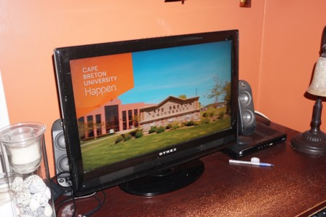
Ways to participate:
Online
Live Stream
Recording and Archiving
Skype for students

Slide 9
Implementation
Work with faculty and schools/college to adapt existing courses taught on-line, in-class or in-community to be accessible to participants locally and globally by incorporating new technologies, pedagogical practices and open-access elements.

Slide 10
Support
Community of Practice
3C Options:
Centre for Teaching & Learning Team
Student Peer Facilitators
Multiple Support Units including:
IT Services
Marketing & Communications
Schools
Facilities Management
Athletics
Finance
Library
Enrolment Services
Registrar

Slide 11
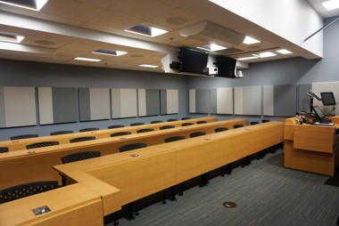
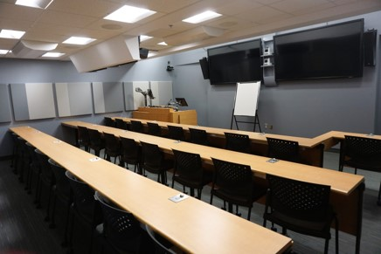
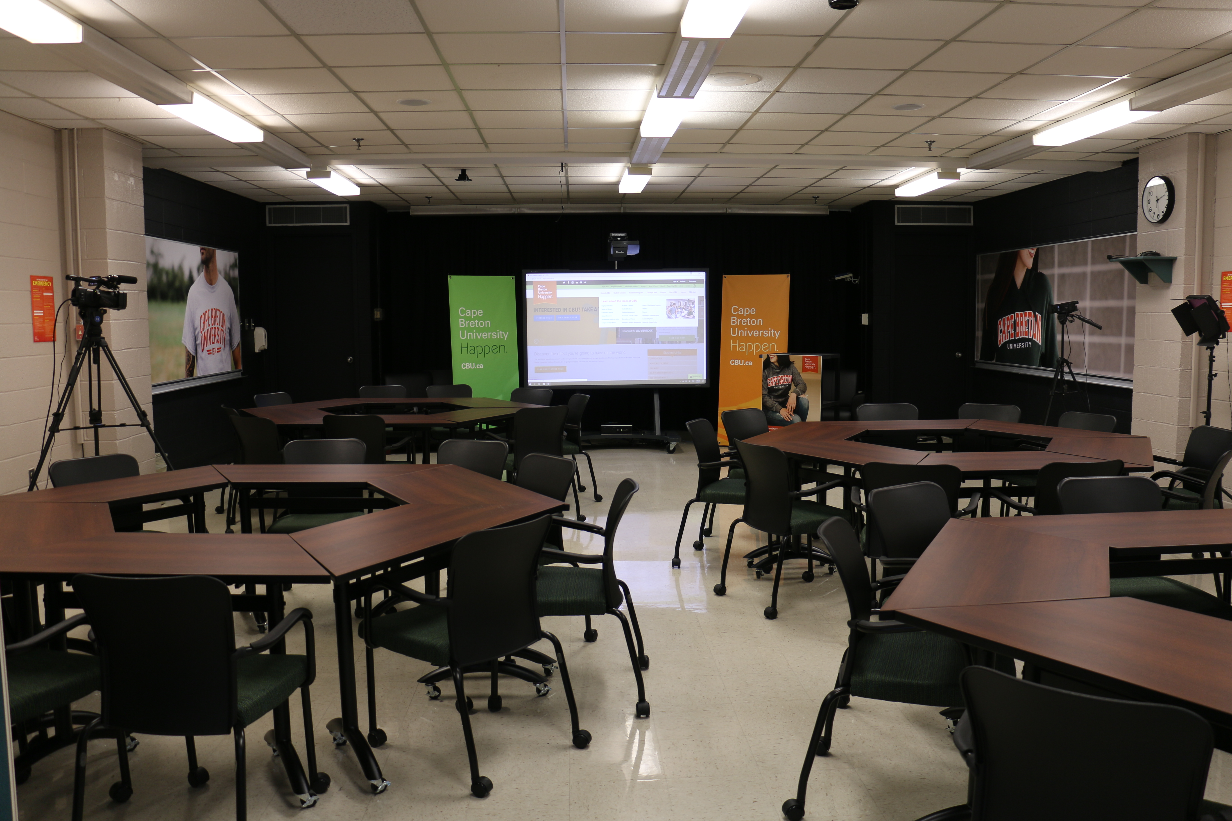
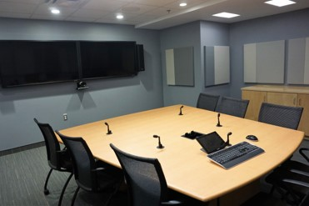
Support
Investment in Teaching Spaces
Telepresence Rooms
Dedicated Blended Learning Classroom

Slide 12
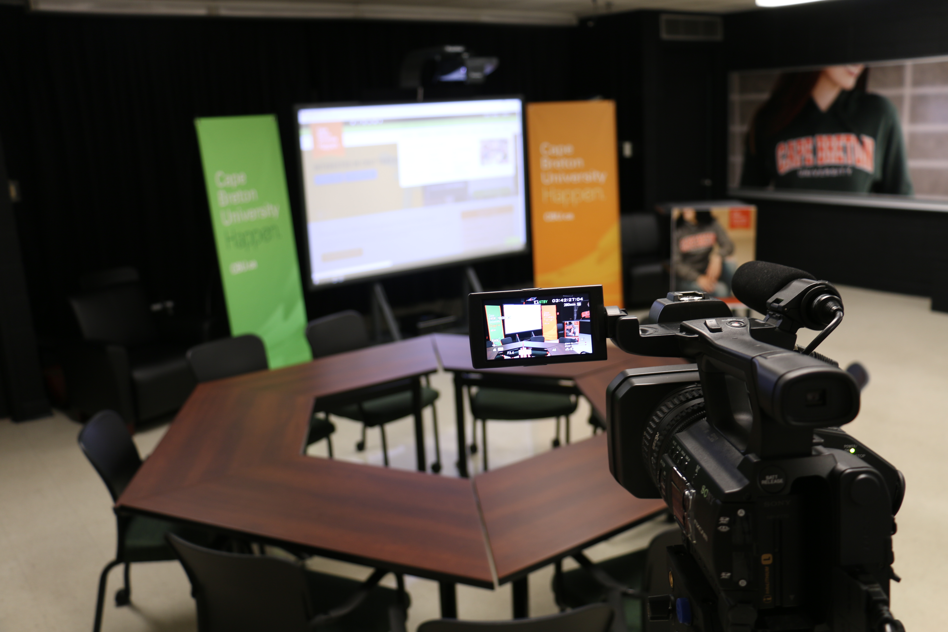
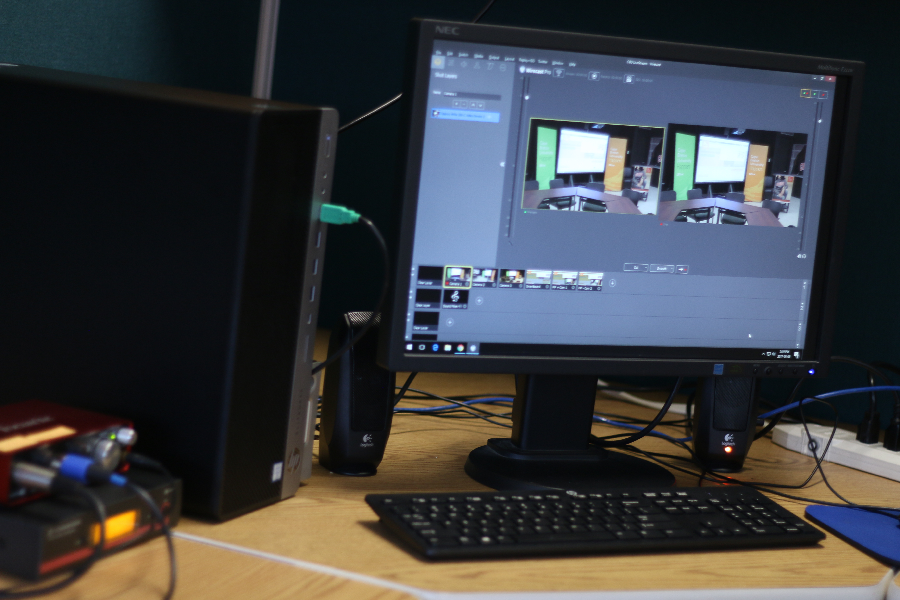
CC-261 - “The Room”
Before
After
Lights, Camera, & Action!
Lights
Cameras
Sound
The Encoder

Slide 13
Recent Offerings:
Faces of Battle
Sustainable Happiness
Shakespeare
Intercultural Communication
Psychology Research Practicum
Critical Approaches to Outdoor Studies
3 Live Events from Viola Desmond’s Canada
Nature of Entrepreneurship

Slide 14
Over 1700+ students have registered for Curiosity and Certificates in the 10 courses offered since January 2017.

Slide 15
Questions for Discussion
What are the challenges faced in your institution around supporting and delivering open courses? How have you resolved them?
Some argue that dual mode (or multi-modal) course offerings disadvantage students who are not face-to-face would you agree- how would you justify dual mode?
Small universities, by nature have collapsed or overlapping organization of roles- this made collaboration for us easier-would the model hold for a later institution?

