Slide 1
Open Educators Factory : building openness capacity building for HE educators
Daniel Burgos, Fabio Nascimbeni
UNIR iTED

Slide 2
Rationale: why the OEF research
The victory of Open Education (Weller 2014)
Policy: EC, ICDE, UNESCO all agree that OE is the way to go
Institutions: open initiatives in more and more universities
>350 institutions offering MOOCs
vs
The power of the Status Quo
Frontal teaching is often still the norm
OER are in an eternal “experimentation phase”
The MOOCs hype is settling down

Slide 3
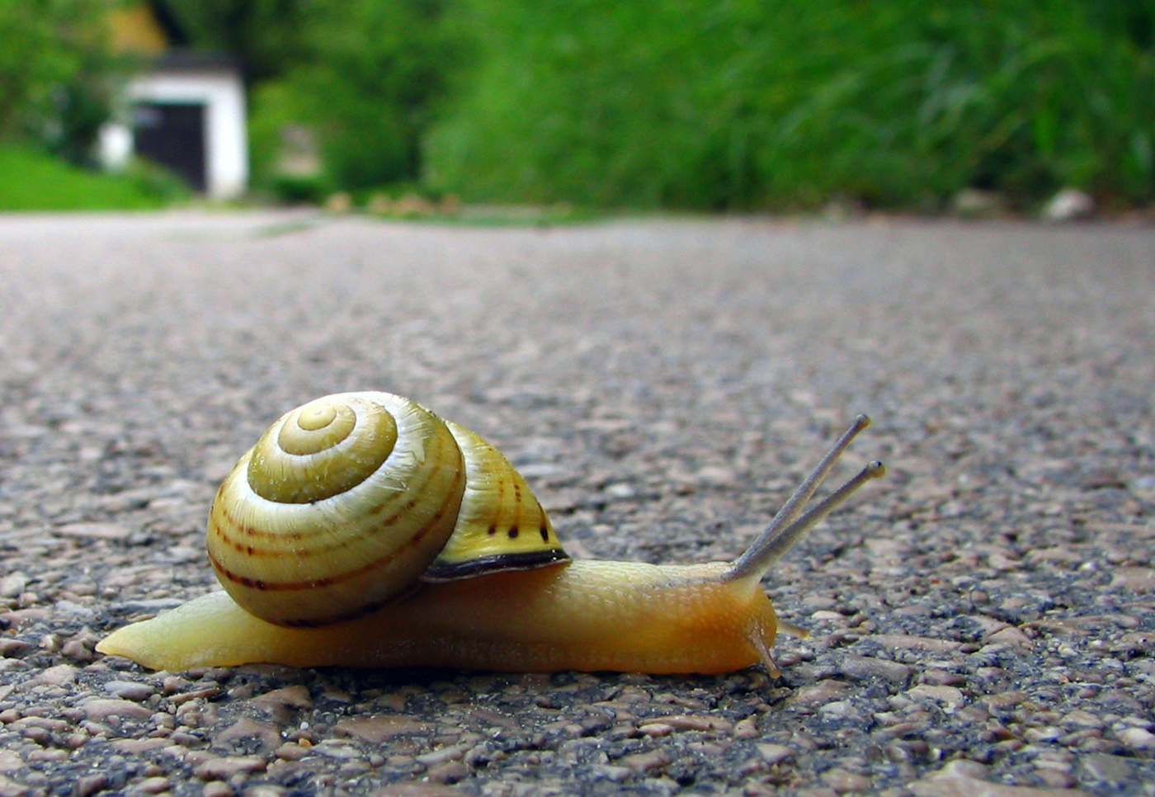
http://www.freakingnews.com/Snail-Pictures--1603.asp
Why change is so slow? What do we need?

Slide 4
We need a peaceful army of Open Educators
Educators (professors, tutors, lecturers) are the ones who should drive the change towards openness, they must must transform from agents of resistance into agents of change.
https://it.pinterest.com/pin/545780048568142339/
Notes:
This means re-imagining their role from the owners of knowledge to critical friends, co-travellers, mediators, facilitators.

Slide 5
Starting questions
What does it mean to be an open educator today?
How to build openness capacity
beyond OER
in a full institutional perspective
in a sustainable perspective
Can we map openness capacity across a university?
Can we build openness capacity starting from this map?

Slide 6
Definition of Open Educator
An Open Educator choses to use open approaches, when possible and appropriate, with the aim to remove all unnecessary barriers to learning.
He/she works through an open online identity and relies on online social networking to enrich and implement her work, understanding that collaboration bears a responsibility towards the work of others.

Slide 7
The OEF framework
Design | Content | Teaching | Assessment
Open designer | OER specialist | Open teacher | Open evaluator
OPENNESS
Collaborative designer | OER user | Engaging teacher | Innovative evaluator
Individual designer | New to OER | Traditional teacher | Traditional evaluator
Nascimbeni, Burgos (2016). In search for the Open Educator, IRRODL, 17 (6)

Slide 8
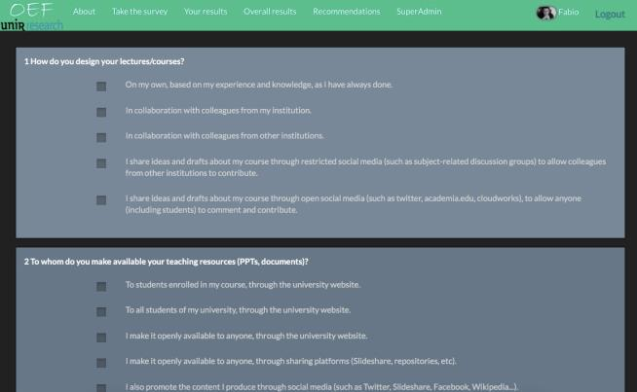
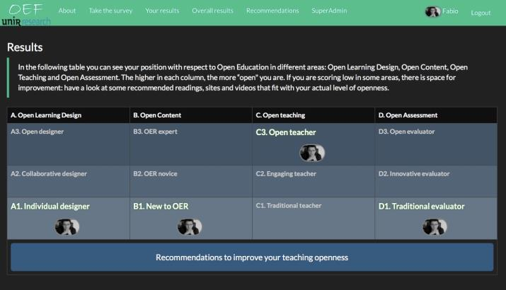
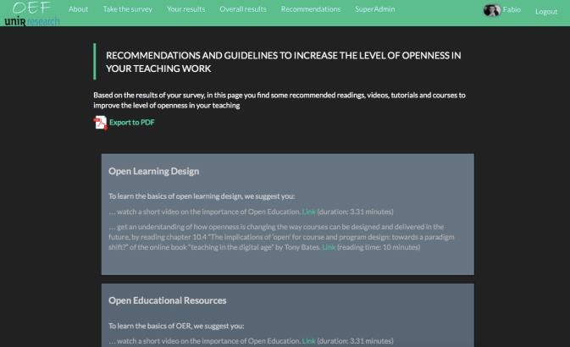
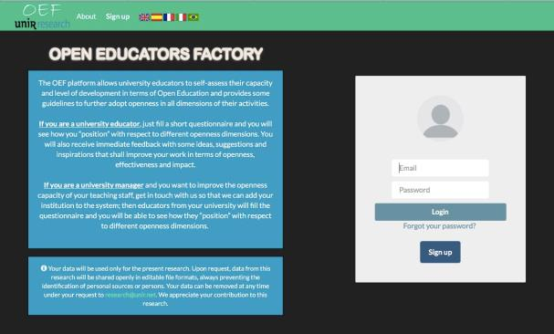
The OEF platform
By filling a short questionnaire…
…the teacher is “positioned” in the different columns…
…receives tailored guidelines…
…and can go back to check his/her progresses.

Slide 9
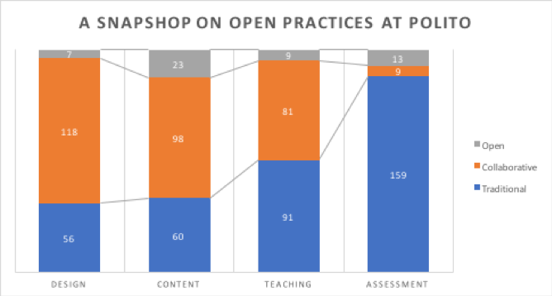
Pilot: openness capacity in Politecnico di Torino
181 replies in total, data available through the OEF platform
Nascimbeni, Burgos, Campbell, Tabacco, Mapping openness capacities beyond OER: a ase study (under publication)

Slide 10
Use of OER and licenses

Slide 11
Open pedagogies

Slide 12
Open assessment

Slide 13
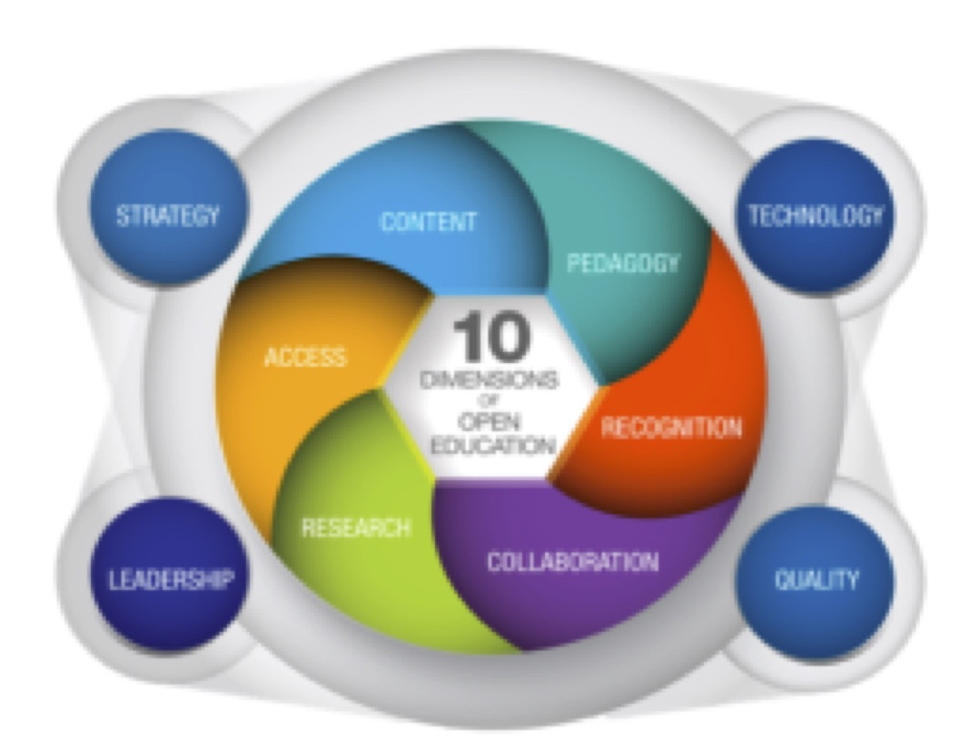
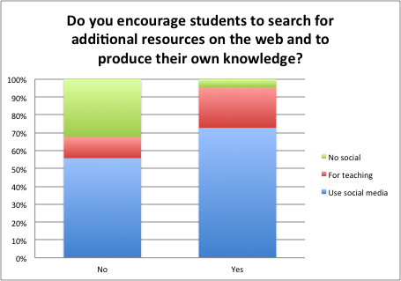
Two main findings
Openness has many “entry points”
The relation between
Openness and Collaboration
is clear
JRC, 2016

Slide 14
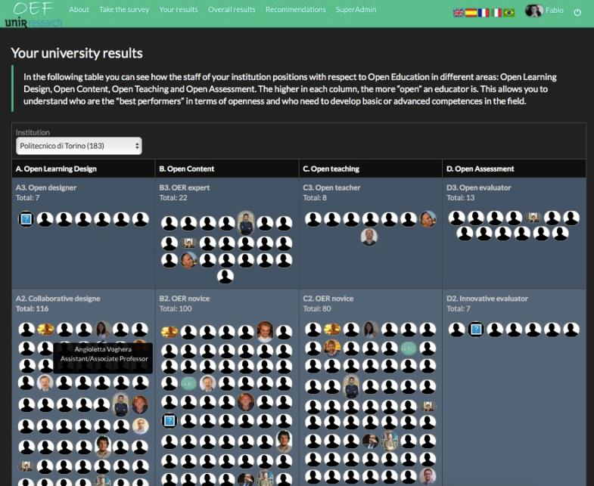
Building openness capacity from within

Slide 15
Future of the project
Foster the use the OEF platform: the more data we get, the more useful the tool will be for the community
Translate the platform into other languages (RU, CH)
Next phase: qualitative research on relation between Openness and Collaboration, investigating the impact of Open Culture (sharing) on teaching practices: “If you cannot convince teachers to be open, teach them how to network”

Slide 16
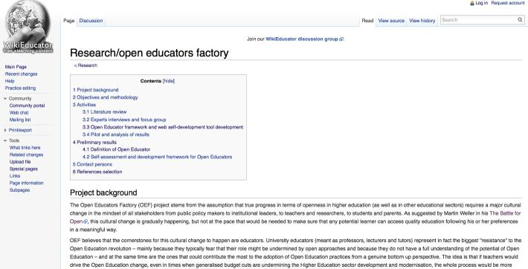
This is an open research project
http://wikieducator.org/Research/open_educators_factory
http://rd.unir.net/pub/oef
fabio.nascimbeni@unir.net

