Slide 1
Breaking Barriers in Home Study Science
Home Labs and Science Distance Education
Martin Connors & Farook Al-Shamali
Athabasca University, Alberta, Canada
CIDER Sessions Season 2017-18
March 21, 2018

Slide 2
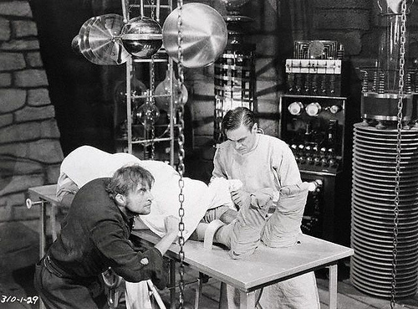
Opening the Doors of the Laboratory:
Distance Education Science
Martin Connors
Farook Al-Shamali
Thanks to ..
Rafael Hakobyan
Elaine Goth-Birkigt

Slide 3
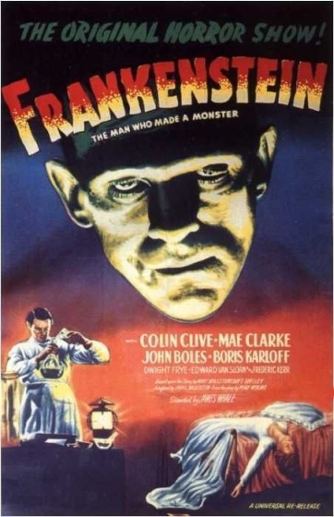
The monster in the room:
How can an online course have labs?
How about virtual reality?
No, Science is real reality!
Less “tongue in cheek”, accepting institutions do not want something so different.
A real experiment has to happen with modern technology this can be:
At home
online
Frankenstein (1931) copyright expired

Slide 4
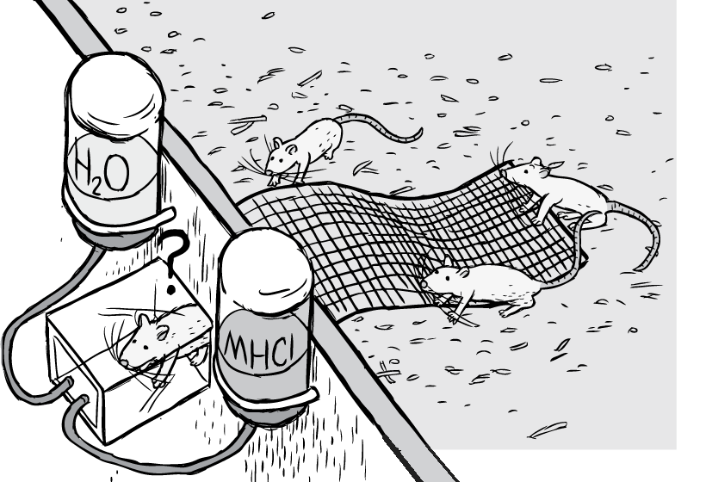
What is an Experiment?
Tests a hypothesis
Gets data
I can ace the labs and get into med school
boring
Cool, rats are so smart!
Artist: Stuart McMillen, http://www.stuartmcmillen.com/blog/cartoon-blog/bustle-cagerow-making-rat-park/

Slide 5
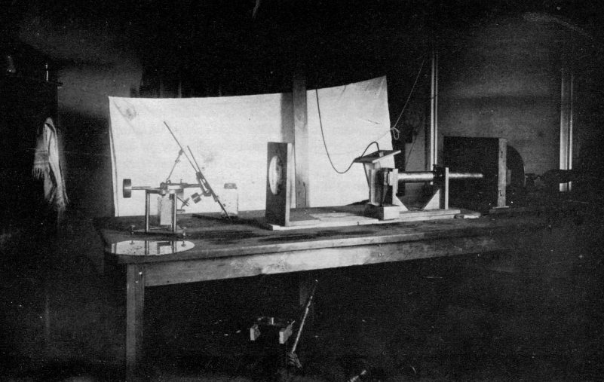

Why make students do experiments?
Connect the curriculum to the real world
Learn about uncertainty and how to test
Practical experience with equipment
Testing (weed out klutzes from surgery)
Everybody else does it
In many cases, freshman labs are straight out of the 17th, 18th, or 19th century!
US Library of Congress (1884) Public Domain

Slide 6
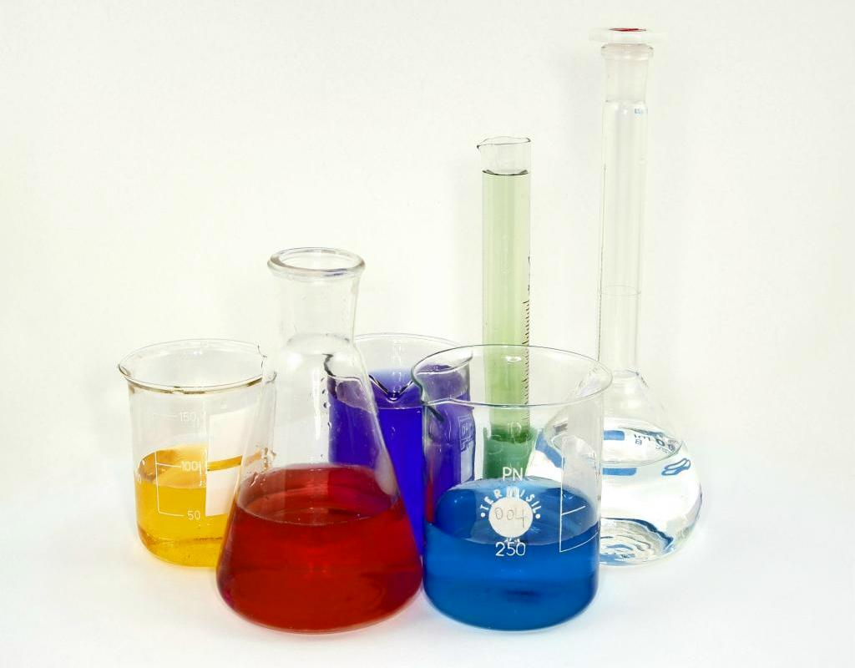
The Solution
"Lab glassware" by Tweenk - Own work. Licensed under CC BY 3.0 via Commons - https://commons.wikimedia.org/wiki/File:Lab_glassware.jpg#/media/File:Lab_glassware.jpg

Slide 7
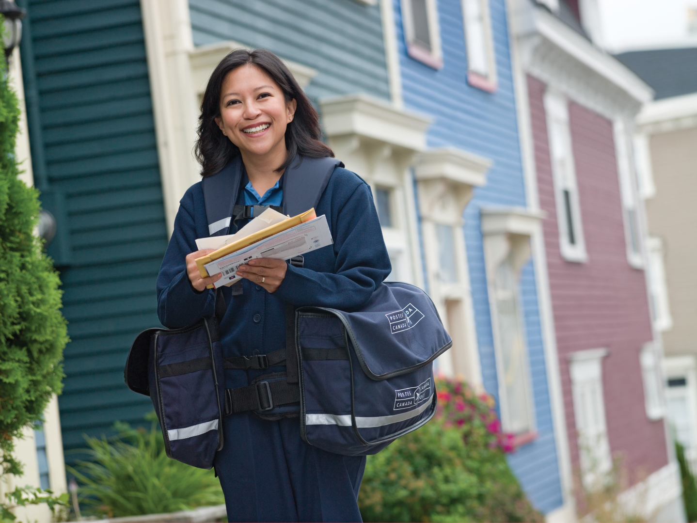
Distance Education Motivation
Students enroll in distance education because they do not want to come to campus!
So why bring them to the lab when you can bring the lab to them? “Home lab”
Canada Post – unaltered in accordance with usage rules

Slide 8
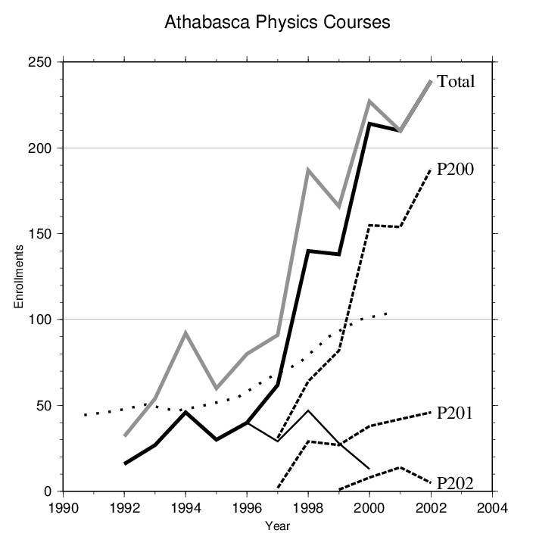
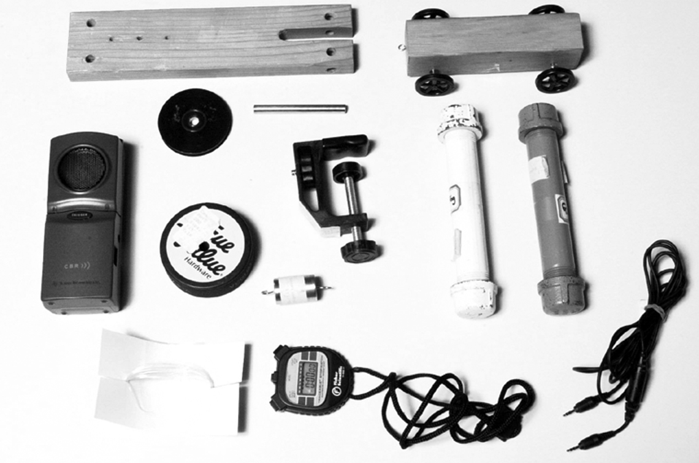
If you build it they won’t come…
First Physics Home Lab Kit (1997) brought about a large enrollment increase!
Now about 500 physics students per year

Slide 9
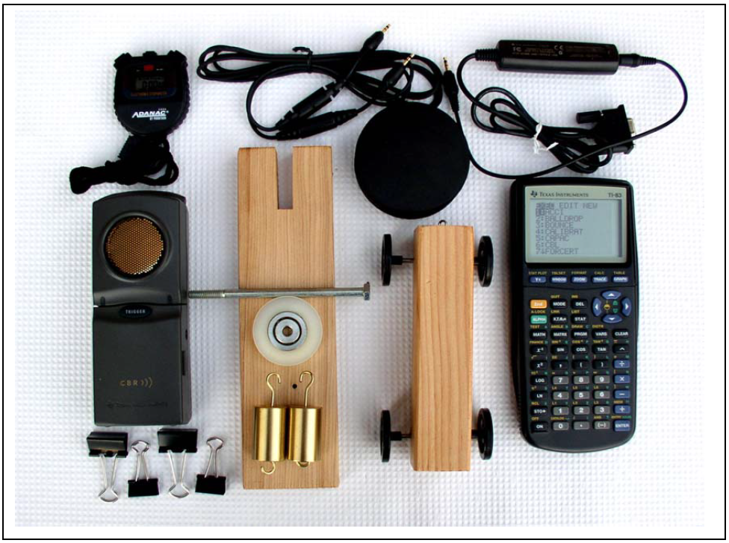
Blast from the Past
We could send Calculator-Based Labs from Texas Instruments in a small package.
The calculator could make data graphs on its screen.
This was 1997!
When PCs became universal, could transfer over data.

Slide 10
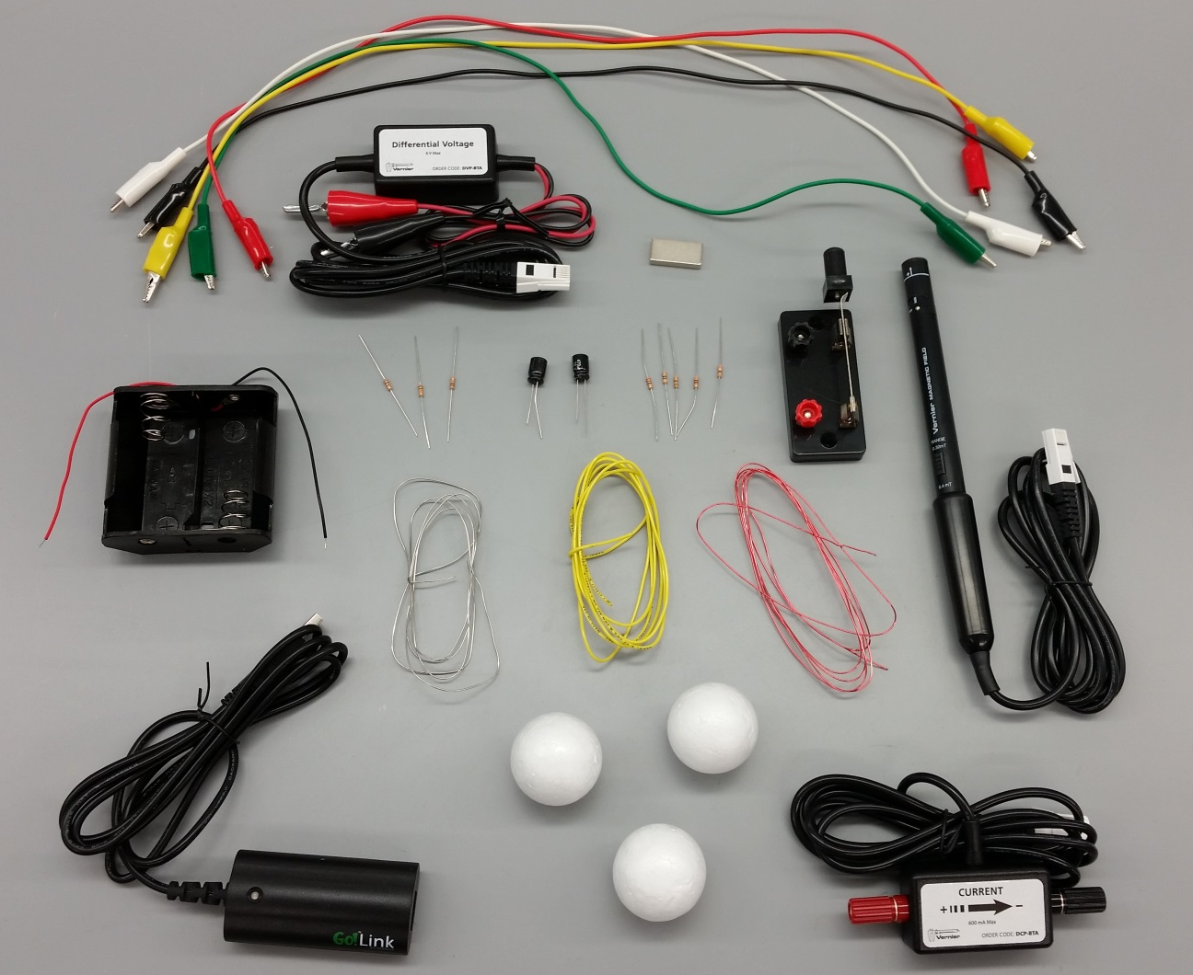
Modern Lab Kits
Calculators are now a thing of the past (for labs at least).
Modern sensors plug into the computer with USB link.
“Graphical Analysis” software shows data as it is collected and allows fits to data.
(Electricity and Magnetism Lab kit shown)
Link
Electric Current Sensor

Slide 11
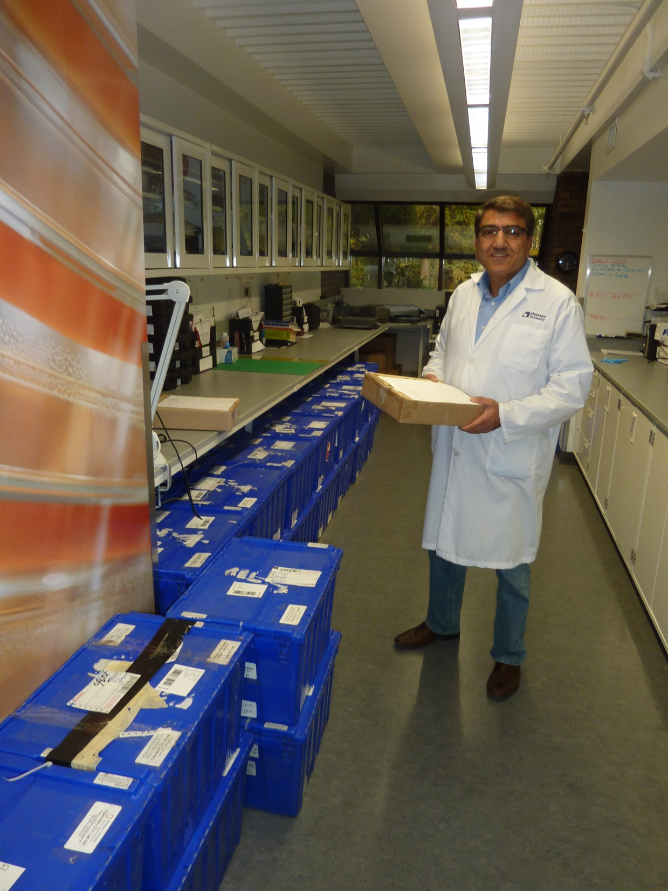
Business end of success
Lab kits are refurbushed in our lab, loaned by library or us directly, sent out by post or courier
These are CHEM kits: now used in PHYS, BIOL, GEOL, CHEM
Photo: 2015 Sue and Derrick Rowlandson Memorial Award for Service Excellence winner Rafael Hakobyan
Over 1000 kits per year loaned to students

Slide 12
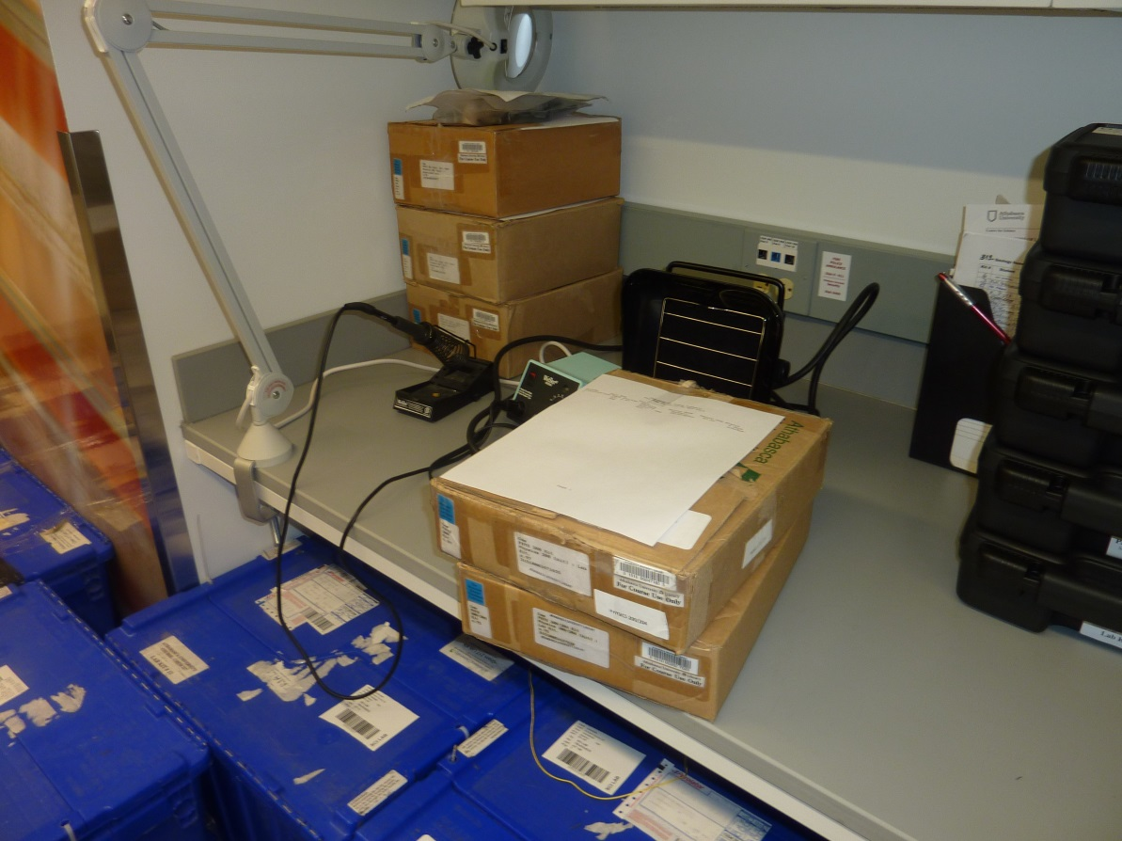
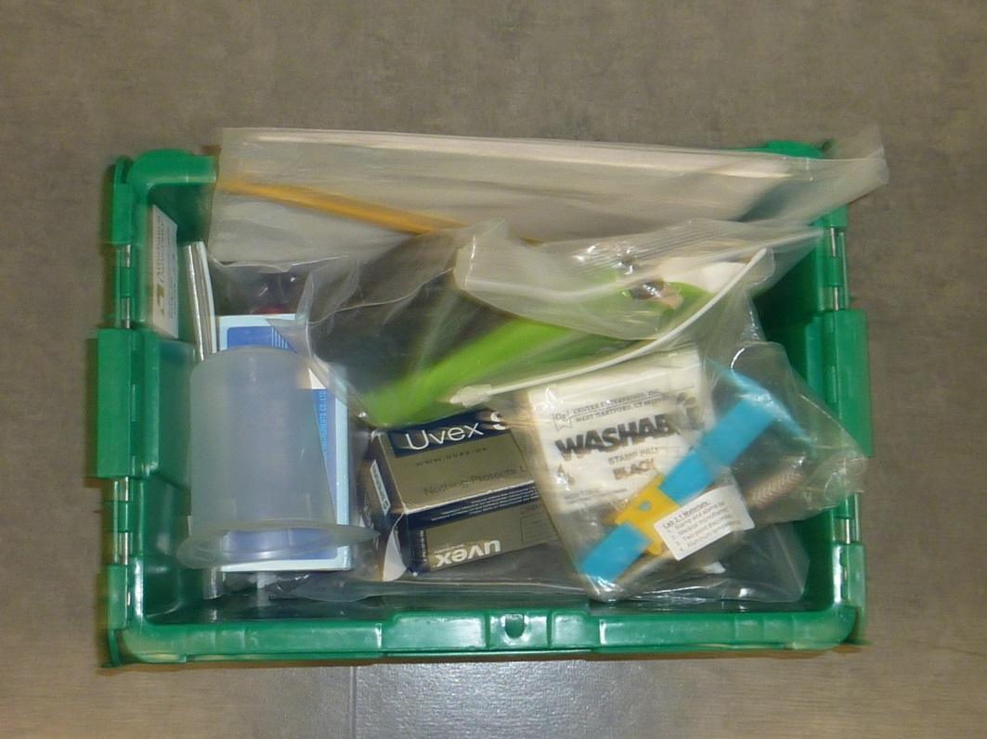
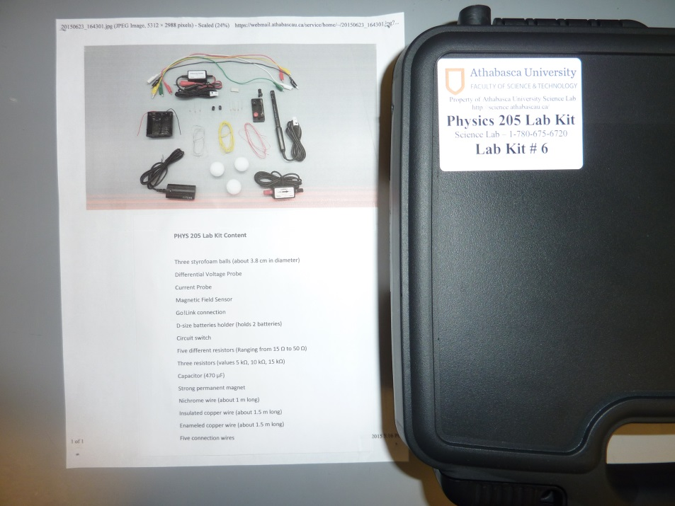
Old style physics kits
Biology kit
New style physics kit with packing list

Slide 13
Now for something completely different:
Remote Labs
Philosophy: a lab should still take place, but remotely controlled online by the student
In a real lab, errors take place, and the student must use judgement in taking data and analyzing it
Visual feedback is also essential for a real experience
Further, by doing the lab, the student gets a feeling of ownership of the data

Slide 14
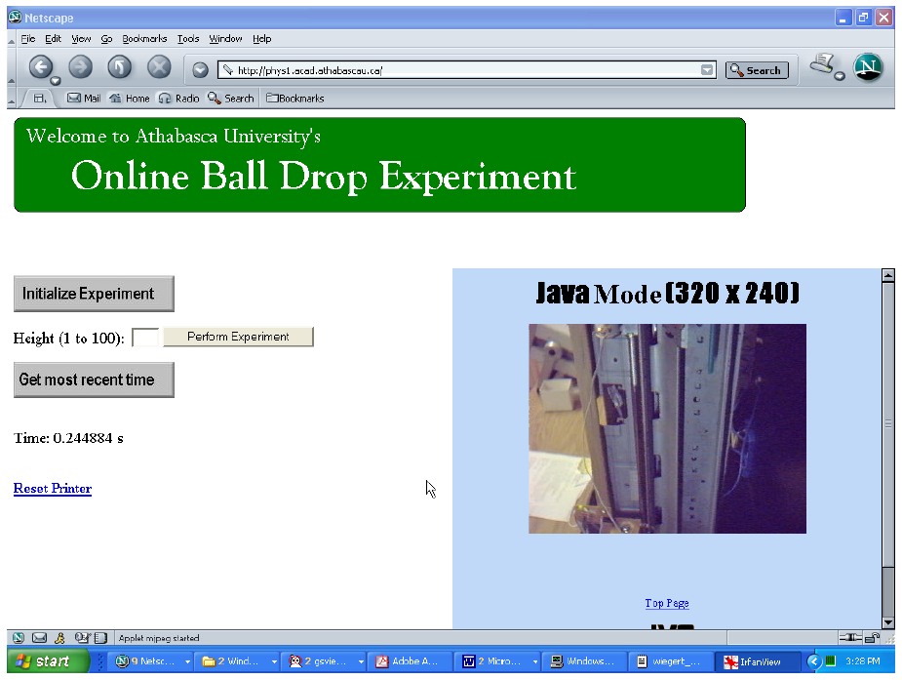
Historic Rube Goldberg Attempt at Online Labs (2002)
What students saw:
web page with one variable (height) and one output (time to drop)
Also a webcam picture to show that they were doing a real experiment

Slide 15
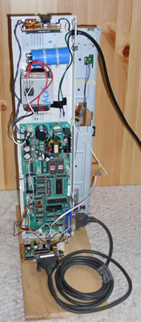
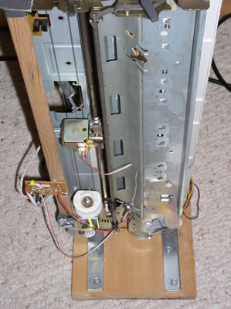
Anybody been to the Computer Museum?
There used to be a thing called a dot matrix printer! If you tip one on its side and tell it to print, it can pick up a metal ball with a solenoid, then time the fall, all under control of a Microchip PIC, hooked to the Internet with a “SitePlayer”. (Webcam not shown).

Slide 16
But, pretty good results!
If you drop something from higher up, how long it takes to fall is longer.
This device could measure that with microsecond precision.
A classic Physics undergraduate lab, done online!

Slide 17

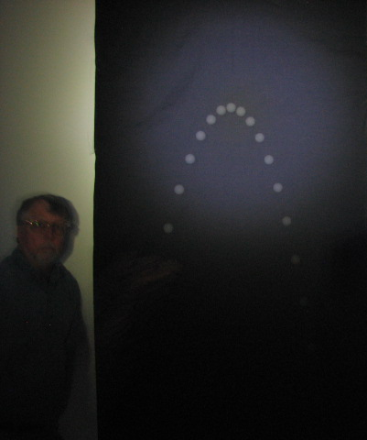
Return of telepresence with modern technology
Demonstrating 2-d motion of a ball using a computer-controlled online strobe light and camera
Next step: computerized ball launcher
United Artists (1958) copyright expired

Slide 18
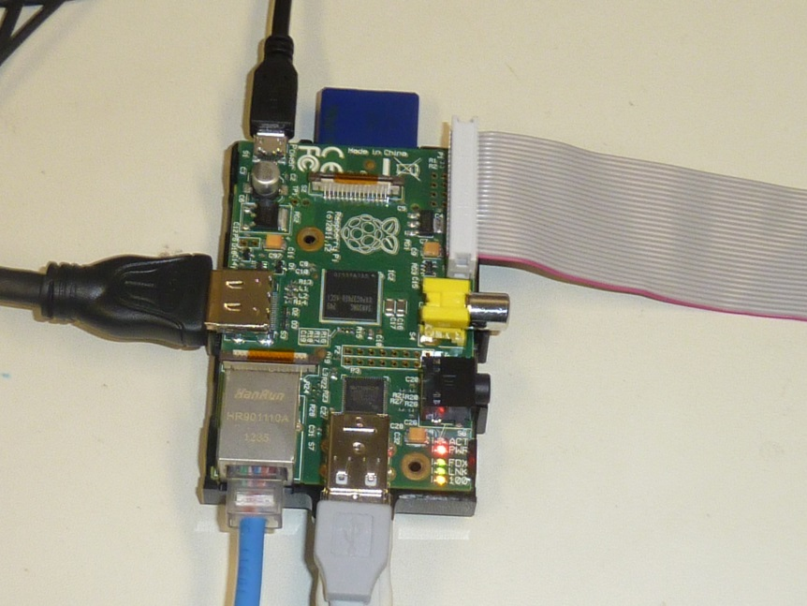
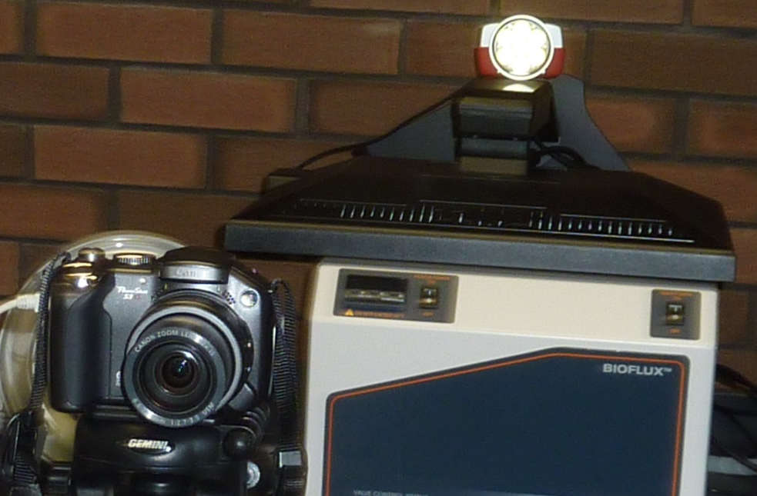
Science experiments in the World of Things
$35 now gets you a linux system (Raspberry Pi) to go online, develop code, run headless to run the experiment
An inexpensive camera is controlled by “gphoto2”. The expensive part is the $1000 programmable flash generator

Slide 19
Instruction in Transition
Conventional practices being challenged
Open Educational Resources growing
Multimedia production getting easier
Interactivity & mobility now expected
Research-based instructional methods/design
Goal: Increased learning efficiency
Goal: Reduced cost to University and student

Slide 20
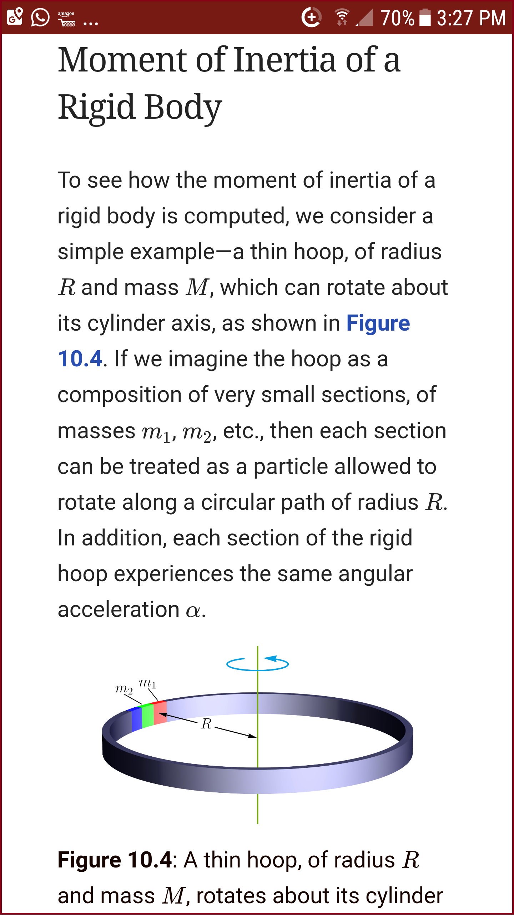
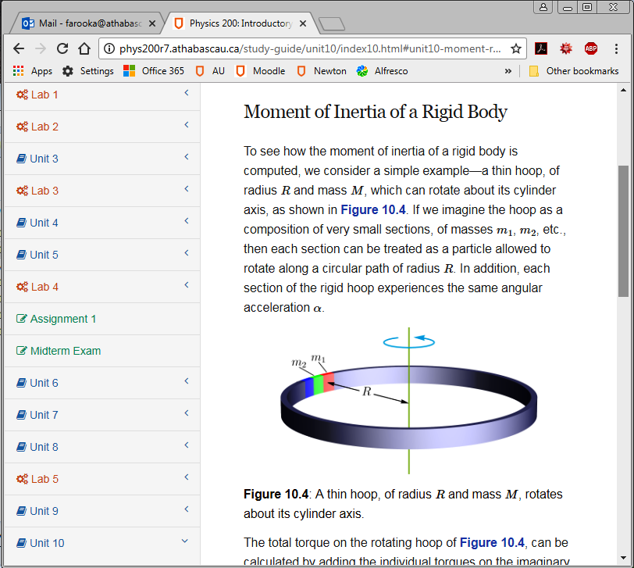


Teaching Online - PHYS 200
Introductory Physics I (classical mechanics)
Algebra-based
Locally developed study guide
Mandatory lab component
Mobile friendly
OER textbook
OER software

Slide 21
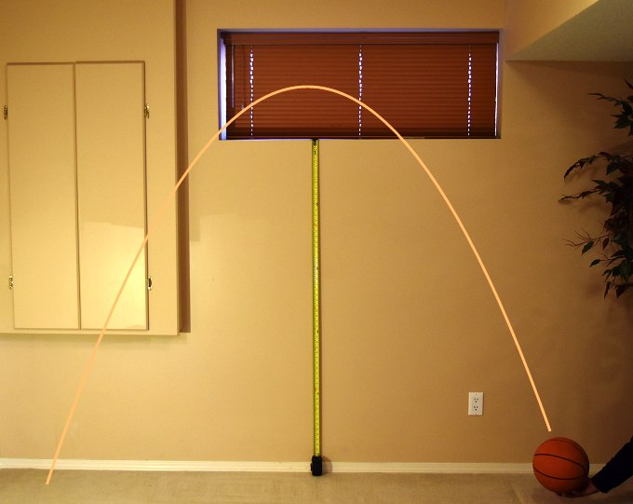
Physics Home Lab
Done anywhere
Quality hands-on experiments
Independent preparation of setup
Full data analysis
Detailed lab reports submitted

Slide 22
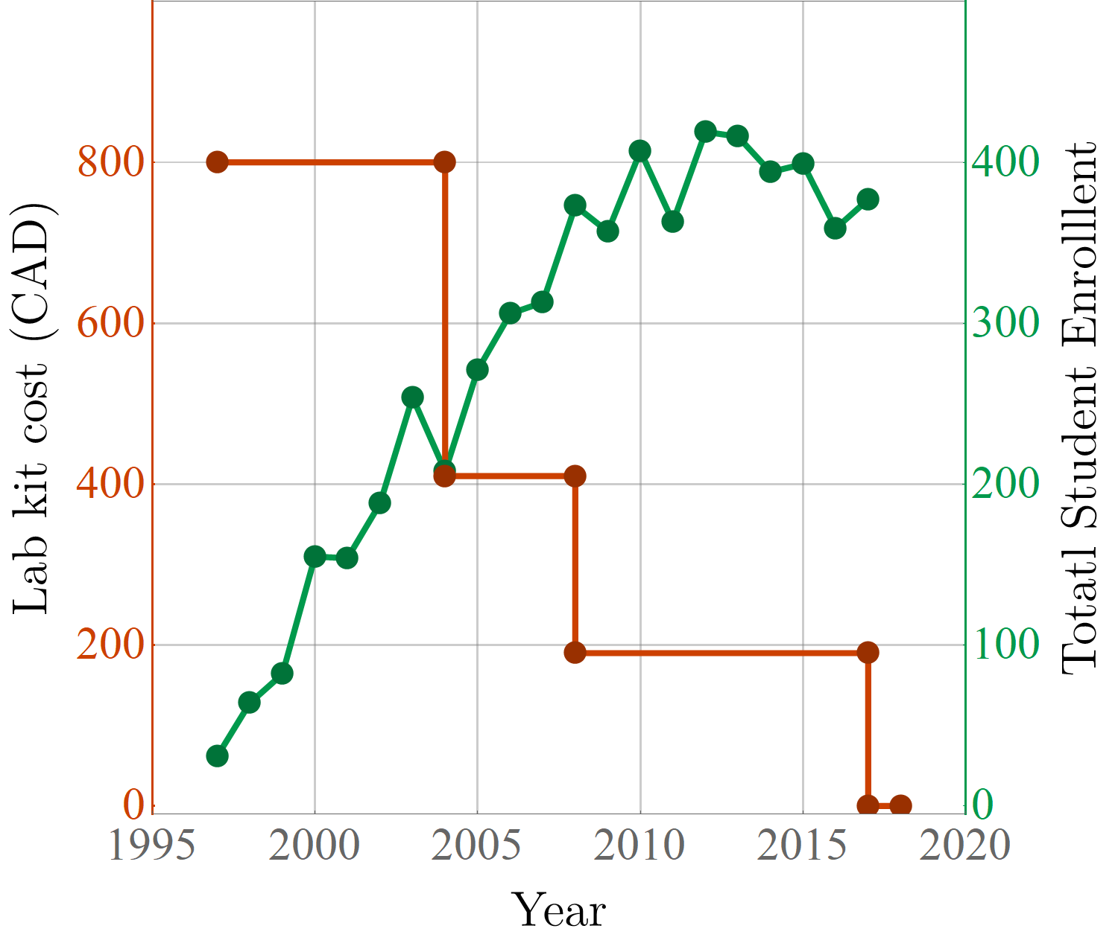
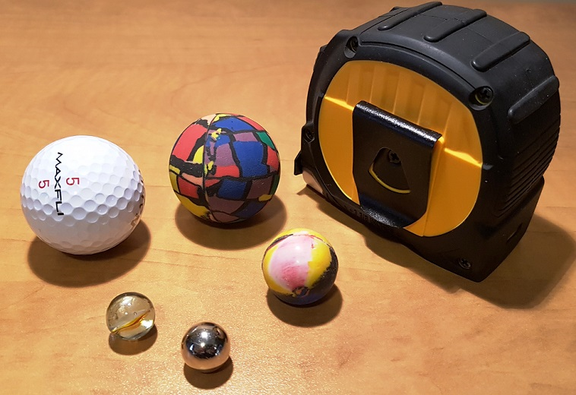
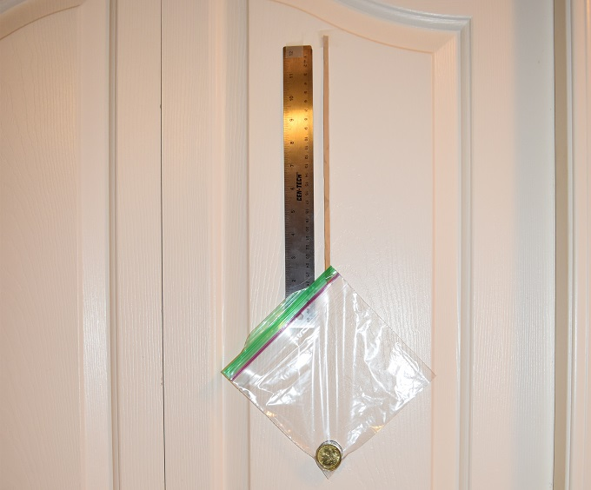
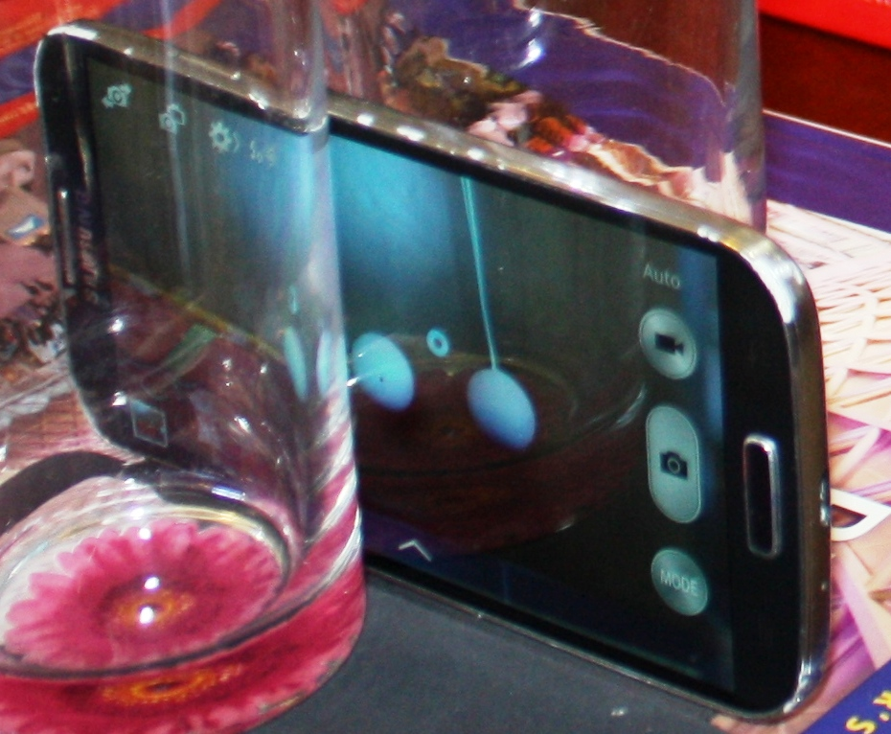
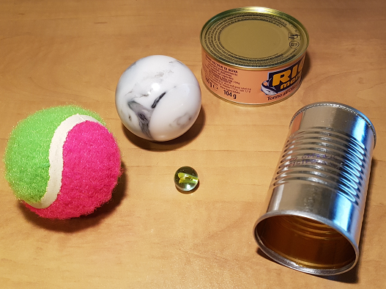
The Lab Kit Evolution - PHYS 200

Slide 23
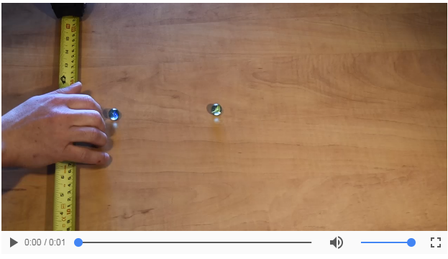
Kit-Free Advantage - PHYS 200
Financial savings (equipment, shipping, infrastructure)
No kit shipment issues (especially out of country)
No waiting list
No borrowing limitations
Enhanced lab quality

Slide 24
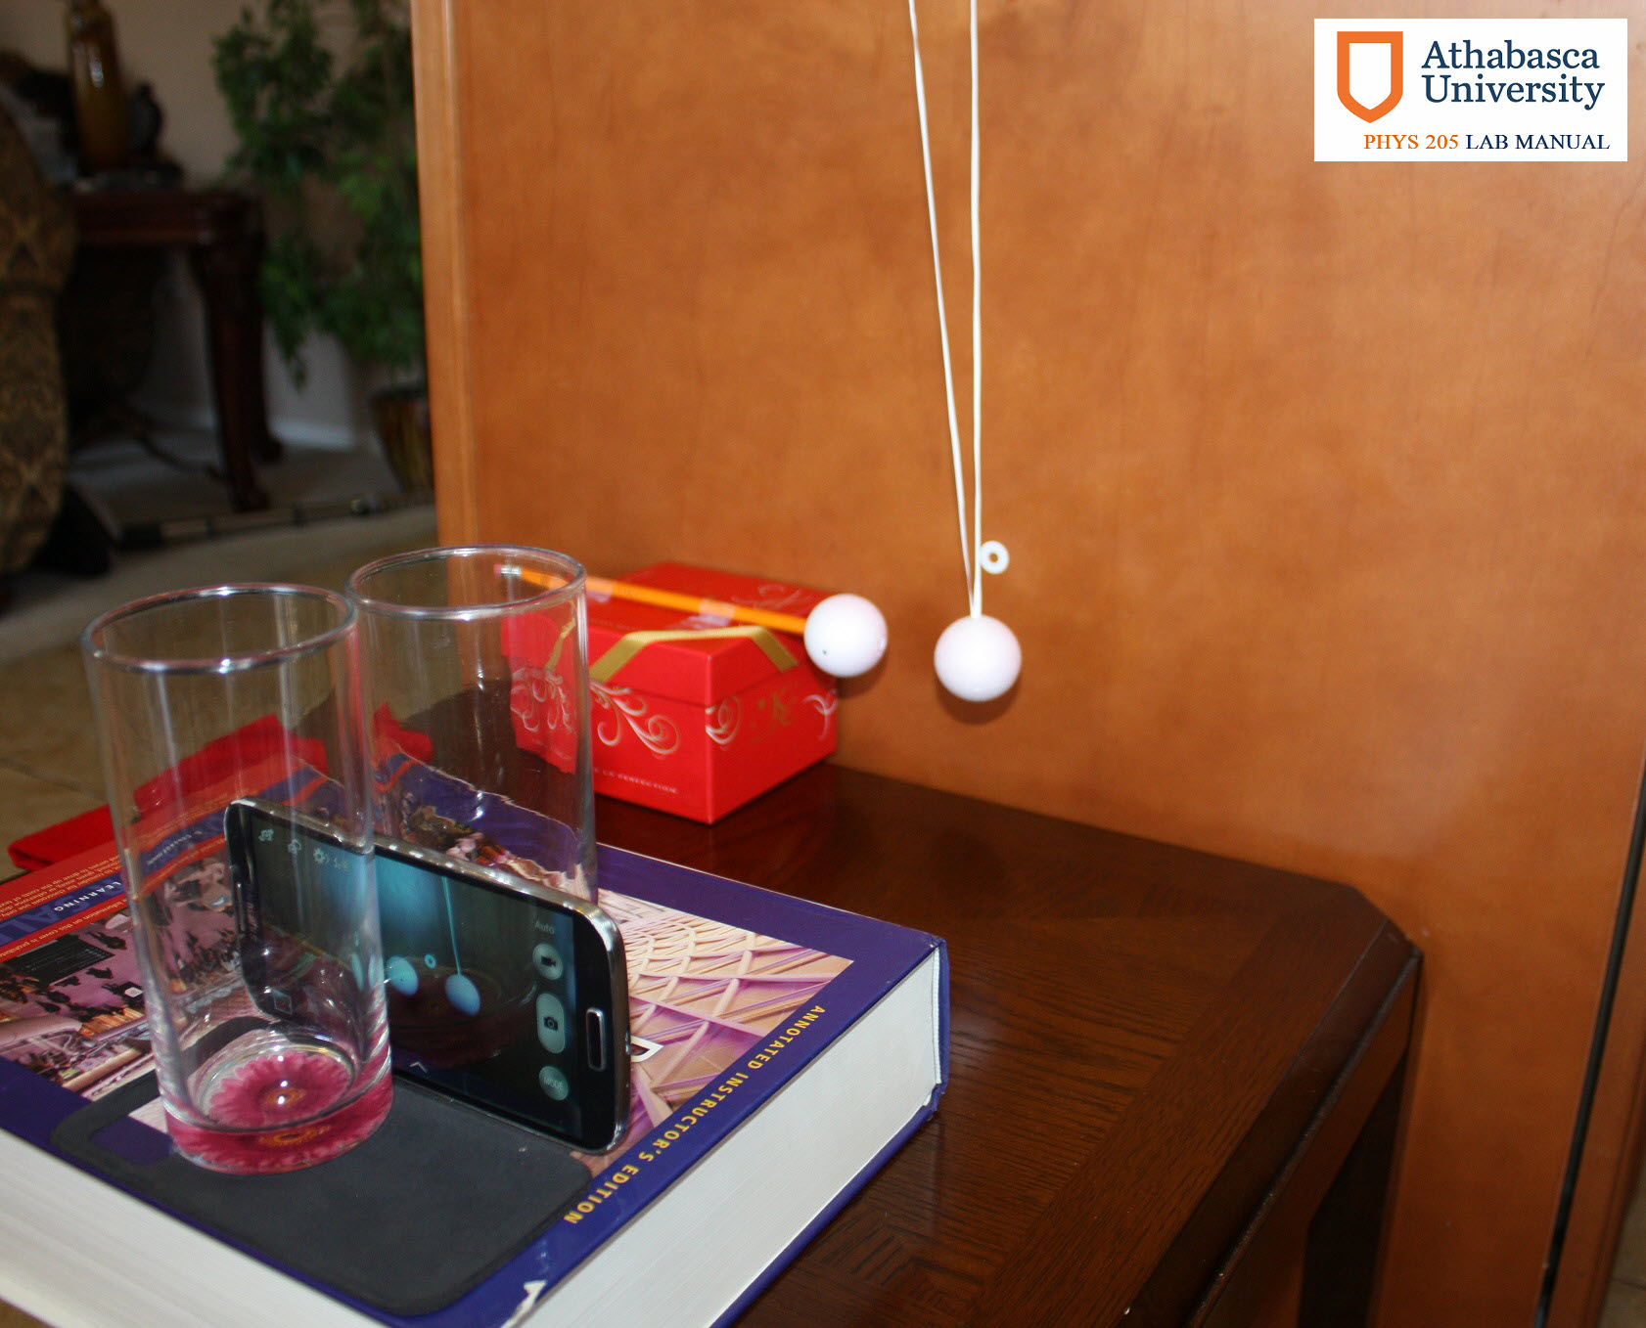
Smartphone Advantage
Each student has one
High-tech Device
More apps are developed
HD camera

Slide 25
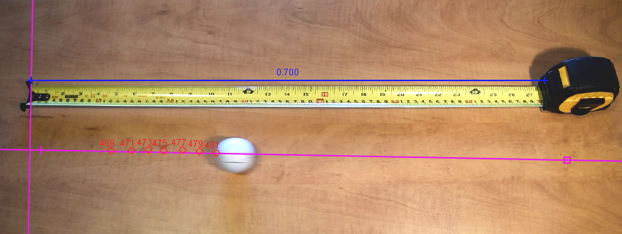
Video Analysis
Straightforward with OER software
Allows motion analysis in 2D
Accurate

Slide 26
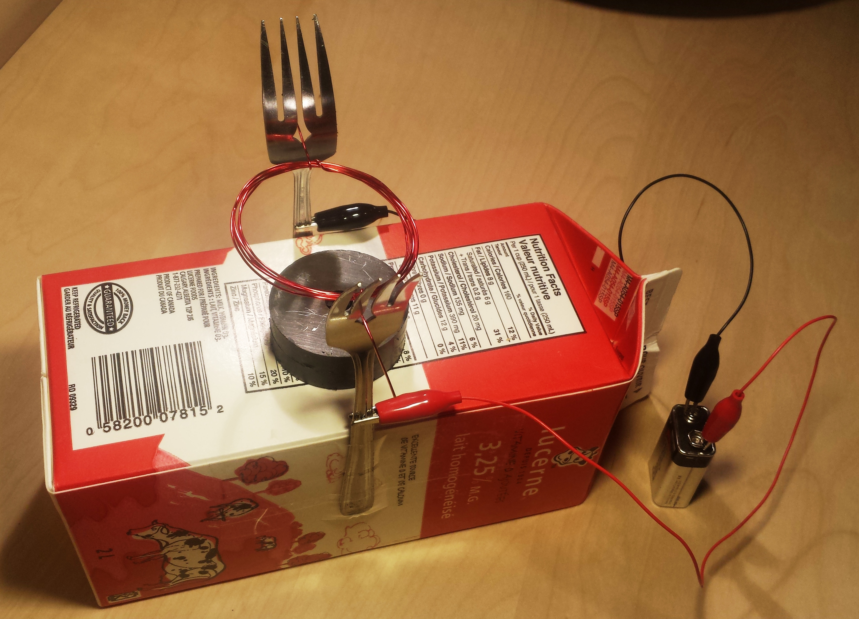
Lab Flexibility - PHYS 205
Investigative approach (less strict procedure)
Lab project (e.g. the electric motor)
Open lab project (new ideas)
The video report option

Slide 27
What we have learned?
Home labs can be incredibly cost effective (compared to the capital cost of on-campus laboratory buildings)
Sending stuff out in the “mail” is a viable part of online business models (like Amazon/Fedex)
Learning outcomes are accepted for transfer credit
High tech is a real part of the sensors in the kits but not all labs need high tech
Telepresence can make “real” labs available online

Slide 28
Mobile devices are currently common house items
Devices are increasingly sophisticated and more user friendly
Students are getting more tech savvy
Should adapt to the YouTube generation
The video report is a viable option

Slide 29
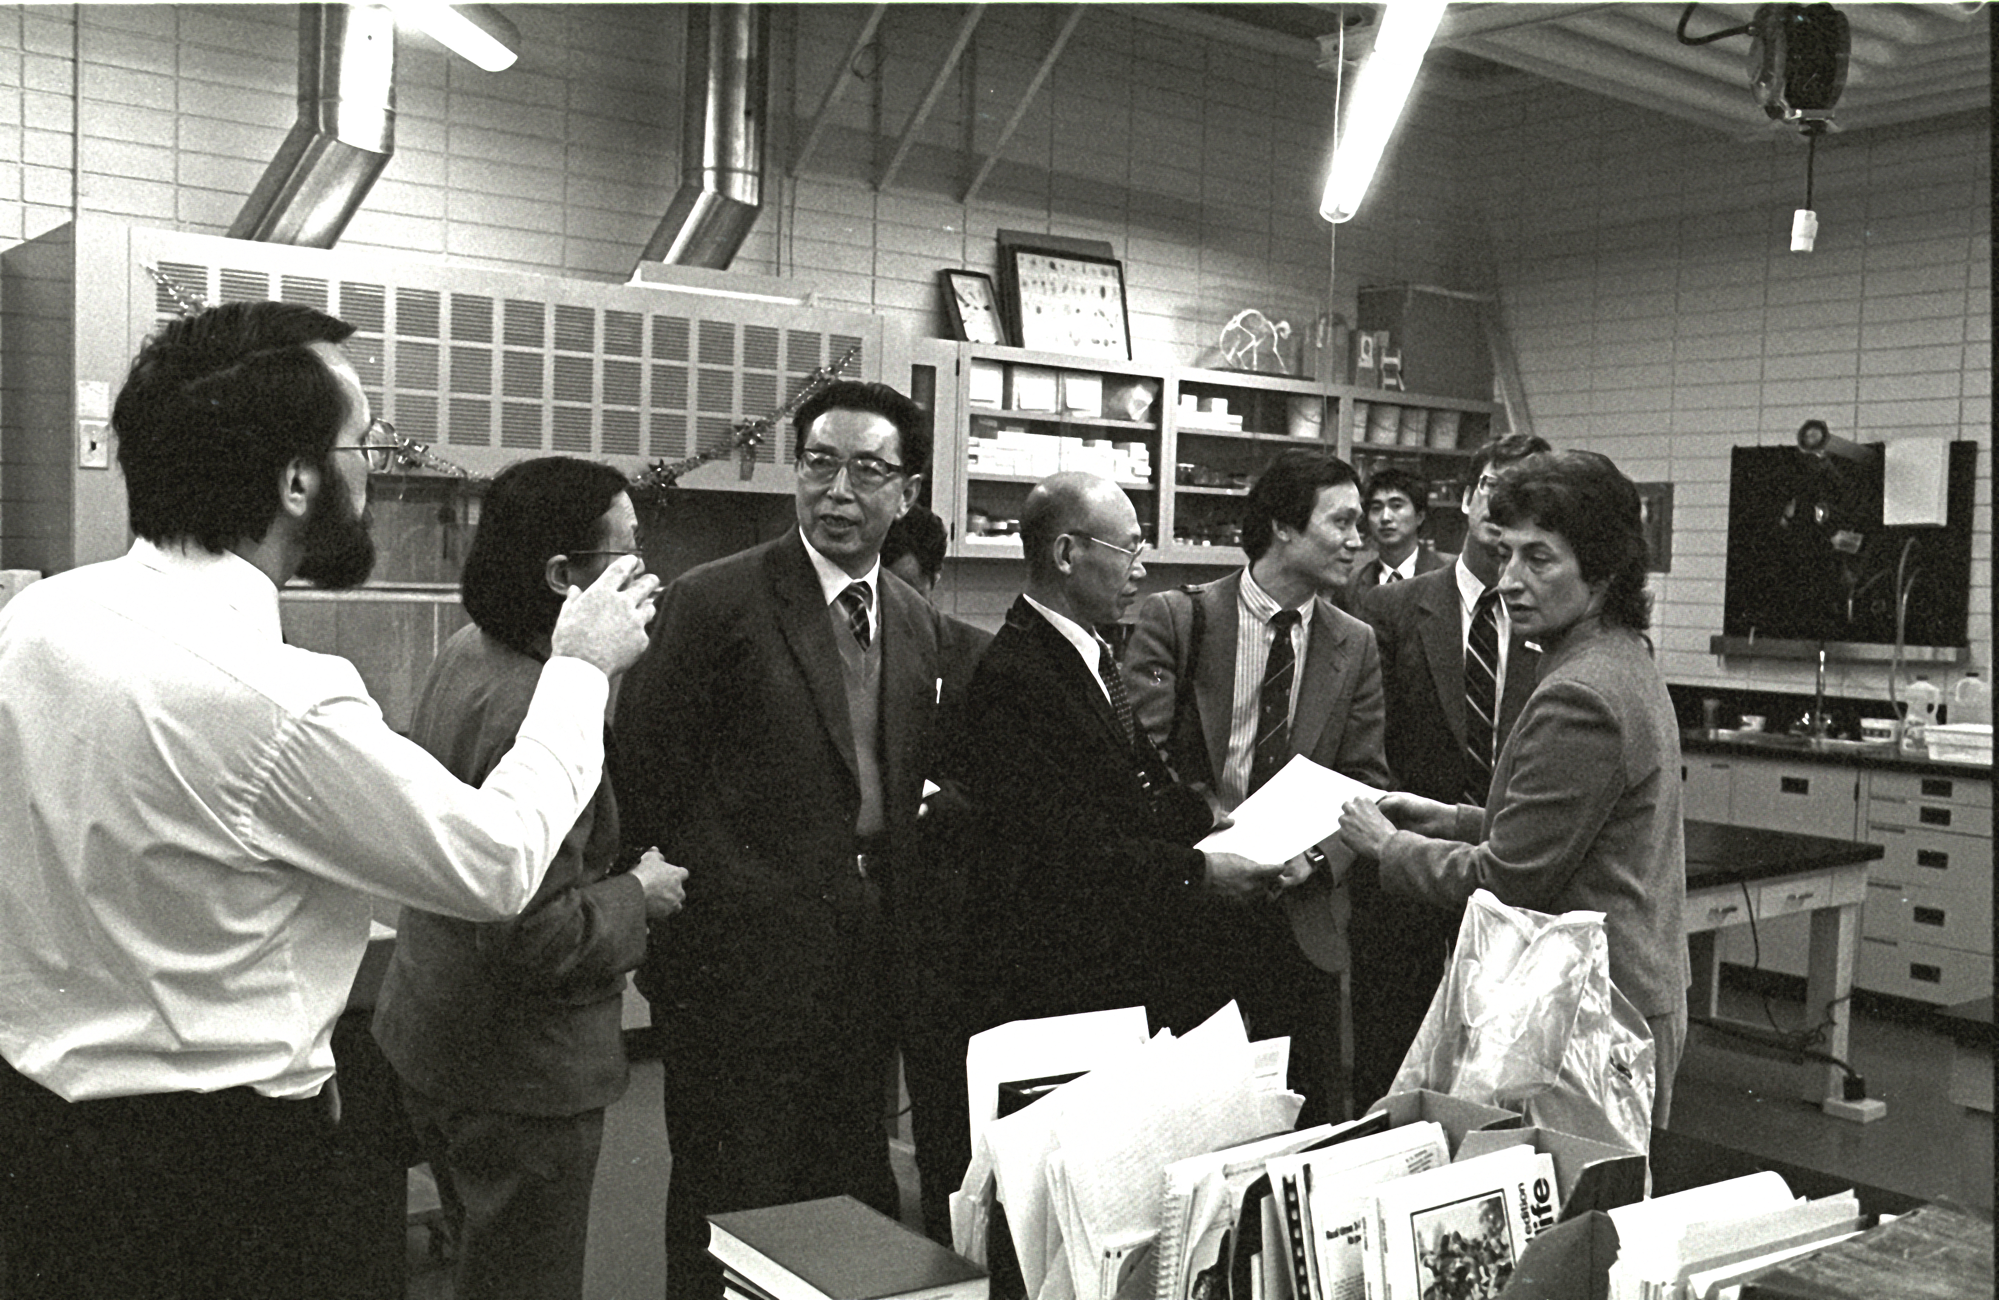
Thank You
Athabasca University Science: pioneering instruction since the 1980s.
A leader for AU 2.0!

