Slide 1
Implementation of UDL in Online Learning at AB PSI’s
April 4, 2018
Notes:
Polls
Linda and Kasey free at 2:45 pm to 3:45 pm on Thursday send invitation.
Knowledge about UDL
Number of courses that are online at your institution
Do you facilitate an online course? Would modules on UDL help you to design more effective online experience?
Do you have policy around UDL at your institution?
Where does the UDL initiative rest in student services or your teaching and learning centres or combination of both?

Slide 2
Agenda
UDL Refresher
Poll
History of Project
Implementation Process
NAIT, Red Deer College, Keyano College, Athabasca University, Lethbridge College, and Grand Prairie Regional College (GPRC)
User Experience
Poll
Next Steps
Contact Information
Notes:
eCampus operations committee asked who wanted to host the site and GPRC was interested because they had a background hosting some of the eCampus AB OERs
Contact Anna Gillis to ask for such a video clip

Slide 3
UDL Refresher
UDL is a framework to improve and optimize teaching and learning for all people based on neuro- and learning science evidence about how people learn.
There are three principles:
Multiple means of engagement.
Multiple means of action and expression.
Multiple means of representation.
UDL acknowledges variability in learner populations and provides a system to address that variability through the design of learning outcomes, materials, methods and assessments as well as institutional policies and practices.

Slide 4
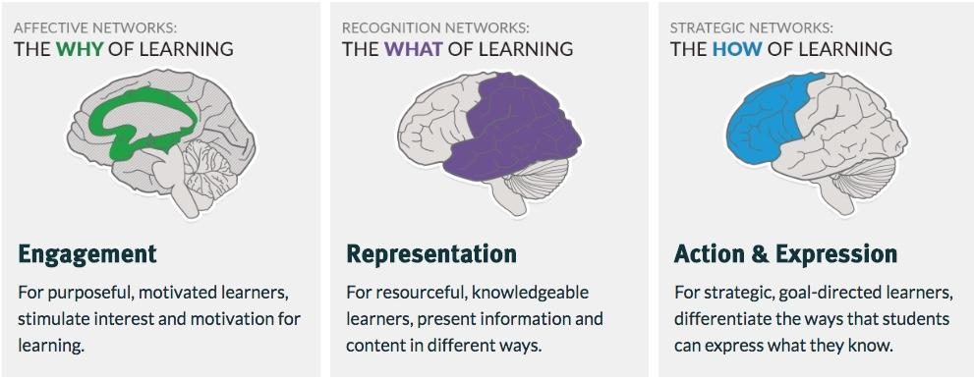
UDL Learning Guidelines

Slide 5
Poll
Which of the following statements best characterises UDL based on your current understanding?
☐ UDL is good for all learners
☐ UDL is for a targeted group of learners

Slide 6
History of Project
The UDL Advisory Committee was part of eCampus Alberta initiative and its work began in the fall of 2013.
A proposal outlining a project to develop a set of UDL modules was written and submitted to the eCampus Alberta Operations Committee on June 4, 2015.
The proposal was approved for funding by the eCampus AB Chair and Lethbridge College was asked to develop the course.
In January of 2016 a meeting between Lethbridge College (LC) and the UDL Committee was held to review the LC course outline and outcomes.
Notes:
Lethbridge College summary - incorporate elements here as appropriate.

Slide 7
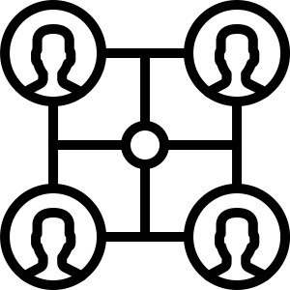
UDL Module Creation Process
eCampus AB and UDL Advisory Committee approached LC to complete the UDL Project. A project plan was created to set vision for the UDL modules.
Content was researched, written, compiled, and developed online within the Canvas LMS at Lethbridge College.
Process was iterative with the UDL Advisory Committee providing feedback at every step and LC making any required changes.
Modules were packaged in Canvas, Moodle, and common cartridge forms to be compatible with any LMS environment.
Modules were distributed back to eCampus AB and the UDL Advisory Committee to implement at member institutions.
LC Staff Julie Deimert (Manager, Accessibility Services) acted as Subject Matter Expert/Writer and Erin Howard as Instructional Designer working with the advisory committee to ...

Slide 8
Tour of the UDL Website
GPRC UDL Course
Notes:
Main page
Layout of modules
Example of content
Example of assessment
Explanation as to why there are few forums (asynchronous, unmoderated)

Slide 9
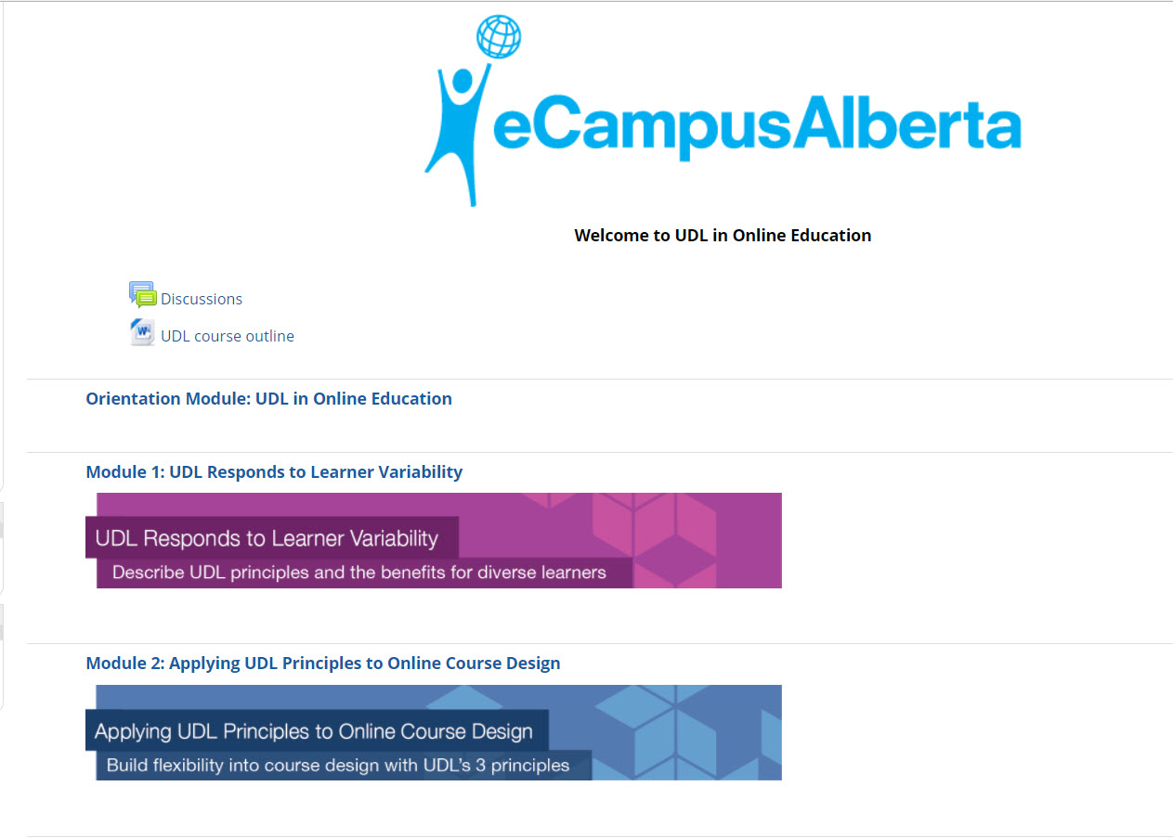
Main Page
Notes:
Complete list of the five modules.

Slide 10
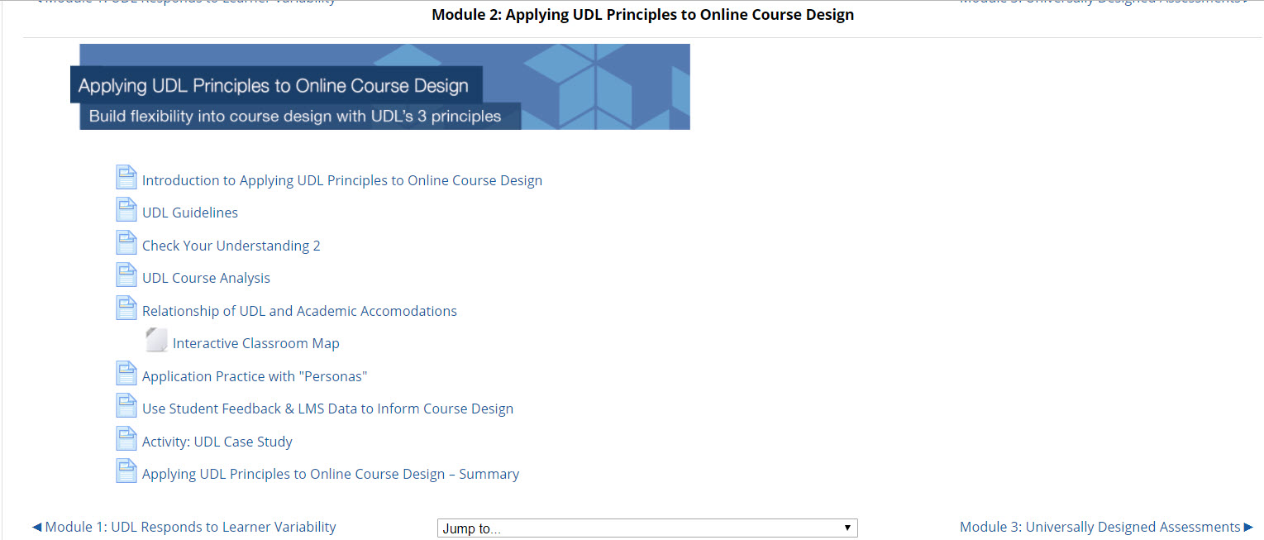
Module Layout
Notes:
Introduction to the concepts that will be discussed
Learning activities
Assessments
Resources including videos, images, worksheets, etc.
Reviews

Slide 11
Example of Content
Notes:
Personas in this example providing an interactive classroom map which details student variability

Slide 12
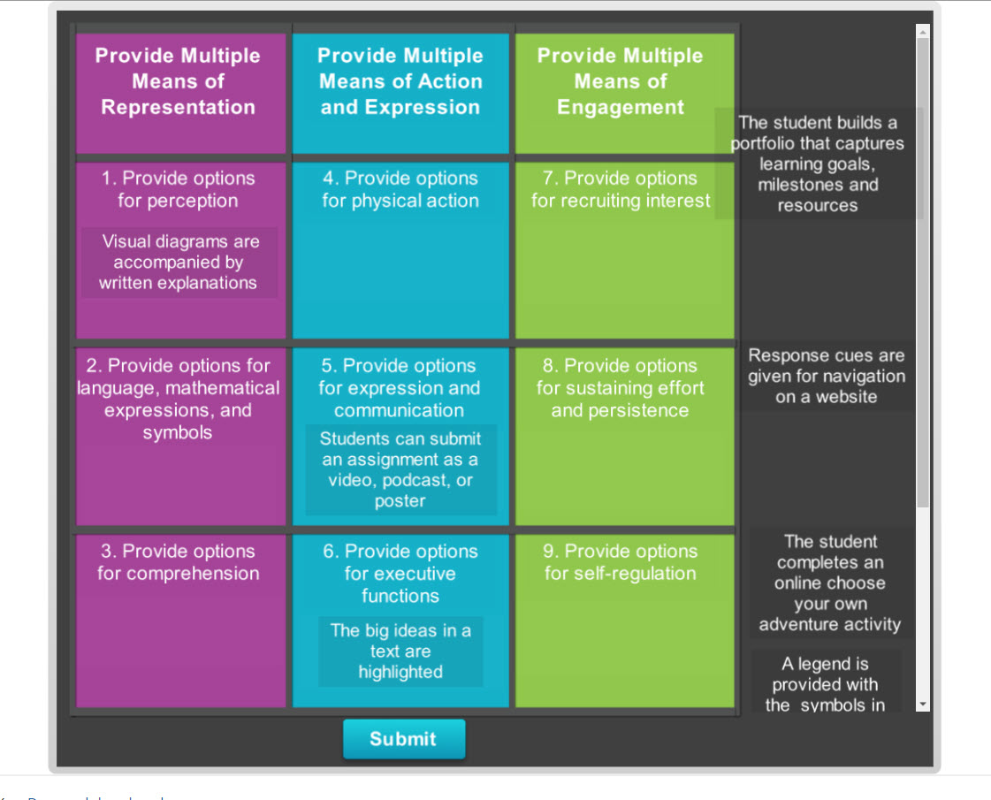
Example of Assessment
Notes:
Matching quiz one of three assessments in the modules

Slide 13
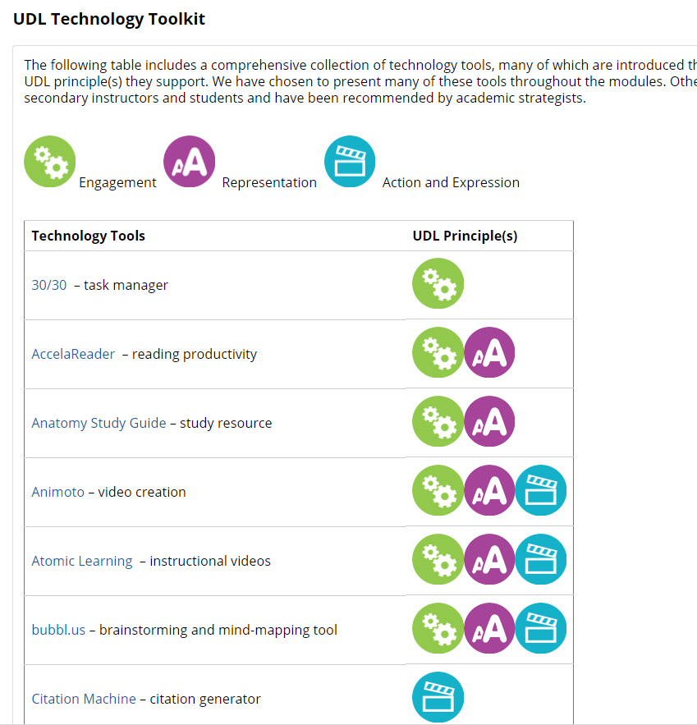
Toolkit

Slide 14
Decision to Exclude Forums
Course was intended to be a standalone course that could be downloaded and viewed by visitors to the site.
Course on GPRC is not monitored daily so it wasn’t considered prudent to include live discussion forums though there are placeholders for those institutions that do what to include this feature.
Each institution was expected to customize the course to meet its own needs which included determining whether they wanted to include forums and collaboration tools.
Notes:
GPRC course is intended mainly to act as a link to original course and a place where people and organizations could download the course in its entirety.

Slide 15
NAIT - Promoting UDL - Our Journey
Phases of the Journey
Explore - UDL identified as a principle in the NAIT Online Learning framework. Benefits of UDL model for online and face to face learning recognized.
Prepare - Began to create a climate for the benefits of UDL. Mapped out UDL resources. Developed initial stages of an informal UDL strategy. Submitted a proposal for a UDL policy.
Integrate - Began to create structures. Develop expertise. Foster collaboration. e.g. incorporated UDL principles into Quality Curriculum and Instruction policy and procedures.
Notes:
Add NAIT logo
Explore - 2010 chose UDL as model to build awareness within NAIT
Prepare - Mapped out resources (GAANT chart). Developed initial stages of an informal strategy. Submitted proposal for UDL policy (2013)
Integrate - UDL incorporated into policy and procedures for Quality of Instruction and Quality of Curriculum. Developed expertise -Focused on UDL for my MEd studies, dev. Expertise among staff through PD sessions (UDL 101), intranet UDL website, UDL monthly tips,
Q & A. Foster collaboration - informal team of three from ConEd, Teaching and Learning and SSD. Incorporated UDL into new instructor
training. UDL module into BMI-2,
Scale - Develop UDL resources to support UDL standard in Quality of Instruction and Quality of Curriculum policy and procedure. Incorporated in all new instructor training. Incorporated in CAP training, piloted UDL online course small focus group.
Optimize - Continue to enhance through UDL online Moodle course, Embed in processes - incorporated into QCQR (?), Predict and prepare - gather User feedback from UDL course

Slide 16
NAIT - Promoting UDL - Our Journey
Phases of the Journey
Scale - Promote growth and expand practices, e.g. incorporated UDL into level 1 & 2 of NAIT’s Being a Master Instructor course and into Championing Academic Practice (CAP) training for faculty leadership. Embedded UDL principles into our curriculum quality review processes.
Optimize - Continue to enhance UDL practices through implementation of the UDL online Moodle course and professional development. In curriculum, use of Maple TA and digital learning objects, etc. Gather feedback.

Slide 17
Red Deer College - Our Story
Why: “With over 150 Online Courses being offered at Red Deer College, incorporating UDL principles within our online course design and delivery must be a key consideration and practice.” -Jennifer Thomas Learning Designer
How: RDC Redeveloped our Excellence in Online Teaching and Learning Faculty Development Program to include the UDL in Online Education course opportunity.
What: Audit and Certified Track Options
When: Piloting February-May 2018
Who: 10 participants
Notes:
Why UDL Online Education Modules are important to RDC
Redeveloped the RDC Excellence in Online and Teaching and Learning Program in 2018 (8 separate courses)
Included in the course offering is the UDL in Online Education Modules
Format Options: Audit or Certified Track
Certified Track includes a Project- Participants must submit project and meet with a the assigned UDL in Online Education module facilitator for discussion, feedback, reflection. Meeting approx 30min-45min
Piloting February - May of 2018
10 Participants

Slide 18
Notes:
Collaboration with Student Academic Success Services
Online launch in the spring of 2018
Working group - hosted 1 hour workshops on making course content accessible
Follow-up - roll out online version as a resource for everyone at the college

Slide 19
LC Integration of Modules
LC now offers the UDL Modules as PD offering at Lethbridge College
Instructors can take course through Canvas LMS
They have inspired us to create our own online course development standards for LC that include a number of UDL standards
Adapted from previous eCampus standards and eCampus course review rubric

Slide 20
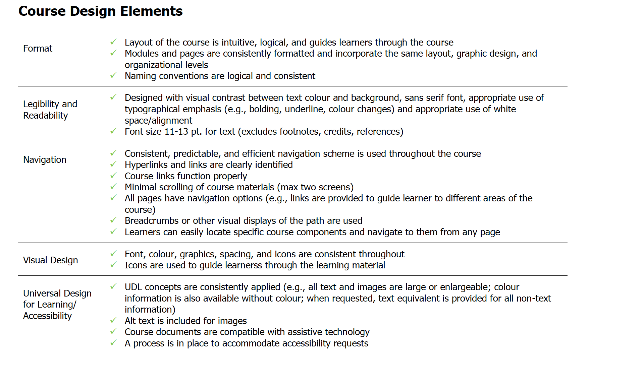
Sample page from LC Course Design Standards (based on eCampus Standards)

Slide 21
Athabasca University
A Moodle 2.6 version of the UDL modules were uploaded to the AU OCW site in the early 2017.
Discussions around UDL occur in context of Community of Learning Design (CLD).
Webinars have been delivered to faculty and staff about how to implement UDL principles in practice.
UDL principles have been implemented in small ways through assignments and learning activities rather than whole courses.
Notes:
Multiple Means of Representation/Alt formats.

Slide 22
Grand Prairie Regional College Video
Play video

Slide 23
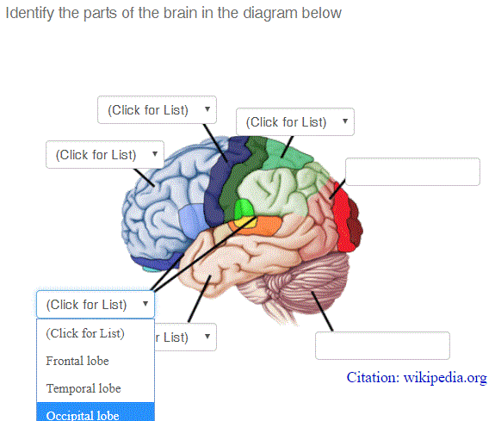
NAIT User Experience
Create content in a WYSIWYG environment.
Compliance with support software and assignment printing.
Share content with other instructors and other institutes.
Notes:
RDC has participants but no data. Won’t have data to use for the presentation. Information may be available at the end of June.
Mark Schneider is going to provide user experience for NAIT. eg. Maple TA, Articulate, assessments.
Inexpensive, cloud is open source (share content, easy for users to build questions) Computer Algebra System (CAS) - not just mathematics specific, 250 faculty have used Maple TA since December 2017. 75% are trades, not math focused (including culinary arts).
Assess through simulation, built-in mastery learning assessment feature. Hints feature can be included in assessments. Student with anxiety are helped with hints Performative feedback. Overlay text directly onto images, e.g. identify parts of human bodies (embed questions directly on top of image). HTML 5 so it is mobile friendly, upload videos directly into questions, reason why people are using it. In LMS things are not user friendly, Maple TA is user friendly.
Can print out online assessment (text is selectable and highlightable HTML 5), can change font colours, renders a print that is not just a PDF (image). Works with assistive technology, software. Struggled with MyLab printed pixelated graphic of actual text and not convertible to Braille because of ability to render character by character.
Student experience as well (NAIT) - quote from a student’s perspective.

Slide 24
NAIT User Experience (cont’d)
Feedback from instructors
New platform that allows instructors to share questions and exemplars of UDL in practice as well as allow instructors to see what others have created. Plan to do a lot more of Maple TA
LMS integrated but doesn’t depend on the LMS (can share assessment questions). Can cross share among institutions, all institutions could share questions. Maple TA was initially a STEM platform but used in other disciplines as well. Ease of use and allows for placement of design elements.
Notes:
RDC has participants but no data. Won’t have data to use for the presentation. Information may be available at the end of June.
Mark Schneider is going to provide user experience for NAIT. eg. Maple TA, Articulate, assessments.
Inexpensive, cloud is open source (share content, easy for users to build questions) Computer Algebra System (CAS) - not just mathematics specific, 250 faculty have used Maple TA since December 2017. 75% are trades, not math focused (including culinary arts).
Assess through simulation, built-in mastery learning assessment feature. Hints feature can be included in assessments. Student with anxiety are helped with hints Performative feedback. Overlay text directly onto images, e.g. identify parts of human bodies (embed questions directly on top of image). HTML 5 so it is mobile friendly, upload videos directly into questions, reason why people are using it. In LMS things are not user friendly, Maple TA is user friendly.
Can print out online assessment (text is selectable and highlightable HTML 5), can change font colours, renders a print that is not just a PDF (image). Works with assistive technology, software. Struggled with MyLab printed pixelated graphic of actual text and not convertible to Braille because of ability to render character by character.
Student experience as well (NAIT) - quote from a student’s perspective.

Slide 25
Poll
What do you need to move forward with UDL at your own post-secondary institution?

Slide 26
Next Steps
Are you interested in joining a community of practice hosted on Google Drive? - Alberta COP Google Form.
Topics we might cover in the community include design thinking in context of UDL.
View the modules on the GPRC Collaboration Tools website.
Notes:
Google Form: Name, email institution

Slide 27
Contact Information
Linda Raymond
Linda.Raymond@Keyano.ca
Kasey Fulton
Kasey.Fulton@rdc.ab.ca
Wendy Marusin - wendym@nait.ca Mark Schneider mschneider@nait.ca
Sandra Law
slaw@athabascau.ca

