Slide 1
Social Presence in Online Learning: A Scoping Study
David Mykota, Ph. D
College of Education
Canadian Initiative for Distance Education Research
Funded by the Social Sciences and Humanities Research Council of Canada
Insight Development Grant Program

Slide 2
Social Presence: A Scoping Study
Importance of Social Presence
How people interact socially in an online learning environment is described as social presence.
Social presence is considered the critical affective (e.g. social and interpersonal) component to communication in an online learning environment.
One of the more important concepts used to determine the level of interaction and effectiveness of online learning (Borup, West, & Graham, 2012; Kim, Kwon, & Chow, 2011; Richardson & Swan, 2003).
Has been shown to aid in the engagement of higher order thinking (Garrison, Anderson, & Archer, 2000; Garrison, Cleveland-Innes, & Fung, 2010).

Slide 3
Social Presence: A Scoping Study
Why a Scoping Review of Social Presence?
The understanding of what comprises effective affective communication (e.g. social presence) has become a more complex multi-faceted phenomenon.
Because the construct has been characterized by multidisciplinary research in the fields of higher education, social psychology, educational psychology, information technology, and computer science.
Social presence lacks clarity making it difficult to establish what is or is not working, socially and interpersonally, in online higher education.
There has only been one study that undertook a systematic approach. The review, however, was limited to studies up until 2013. Since then number of studies pertaining to social presence has doubled.( see Chen, Fang, & Lockee, 2015)

Slide 4
Social Presence: A Scoping Study
What is a Scoping Study?
Scoping studies:
are considered more rapid reviews of the literature,
ask broad questions,
can have post hoc inclusion/exclusion criteria,
do not assess for bias, and
examine a wide range of evidence (Levac et al., 2010).

Slide 5
Social Presence: A Scoping Study
Purpose
The focused purpose of the study is to report the findings of a scoping review of the construct social presence.
The overarching questions to be answered are:
What elements, either technological or social, bring about the development of effective affective communication (e.g. social presence)?
What are the outcomes of social presence?
How is the construct social presence defined?

Slide 6
Social Presence: A Scoping Study
Methods
Five stages to the conducting of the scoping review included:
identifying relevant studies;
screening and selecting studies;
charting the data;
collating and summarizing; and
reporting the results.
The scoping review followed the design advocated by Arksey and O’Malley (2005) with enhancements by Levac, et al. (2010) and Peters et al. (2015).

Slide 7
Social Presence: A Scoping Study
Methods ( cont’d.)
Working in conjunction with the research librarians a series of search terms were then constructed representative of social presence to facilitate the searching of the ERIC, PsychINFO, ProQuest, and JSTOR databases.
In building the search terms, key concepts were combined using the Boolean operators “and” and “or” so that relevant articles from 1996 to 2016 were extracted and imported into Endnote.

Slide 8
Social Presence: A Scoping Study

Slide 9
Social Presence: A Scoping Study
Methods (cont’d.)
A two-stage screening process was employed.
First Stage
Initial title, abstract, and keyword screen for inclusion was conducted by two reviewers with discrepancies resolved needed, involvement of a third reviewer.
Studies in which social presence was not the focus were excluded or designated as uncertain for inclusion.
Second Stage
To ascertain if material identified as uncertain from the initial title and abstract screen were suitable for inclusion required reading of the full text by the reviewers with consensus reached on relevancy for final inclusion (e.g. focus of the study being social presence).
The reference lists of those studies identified for inclusion were then searched for additional studies not included in the database search.

Slide 10
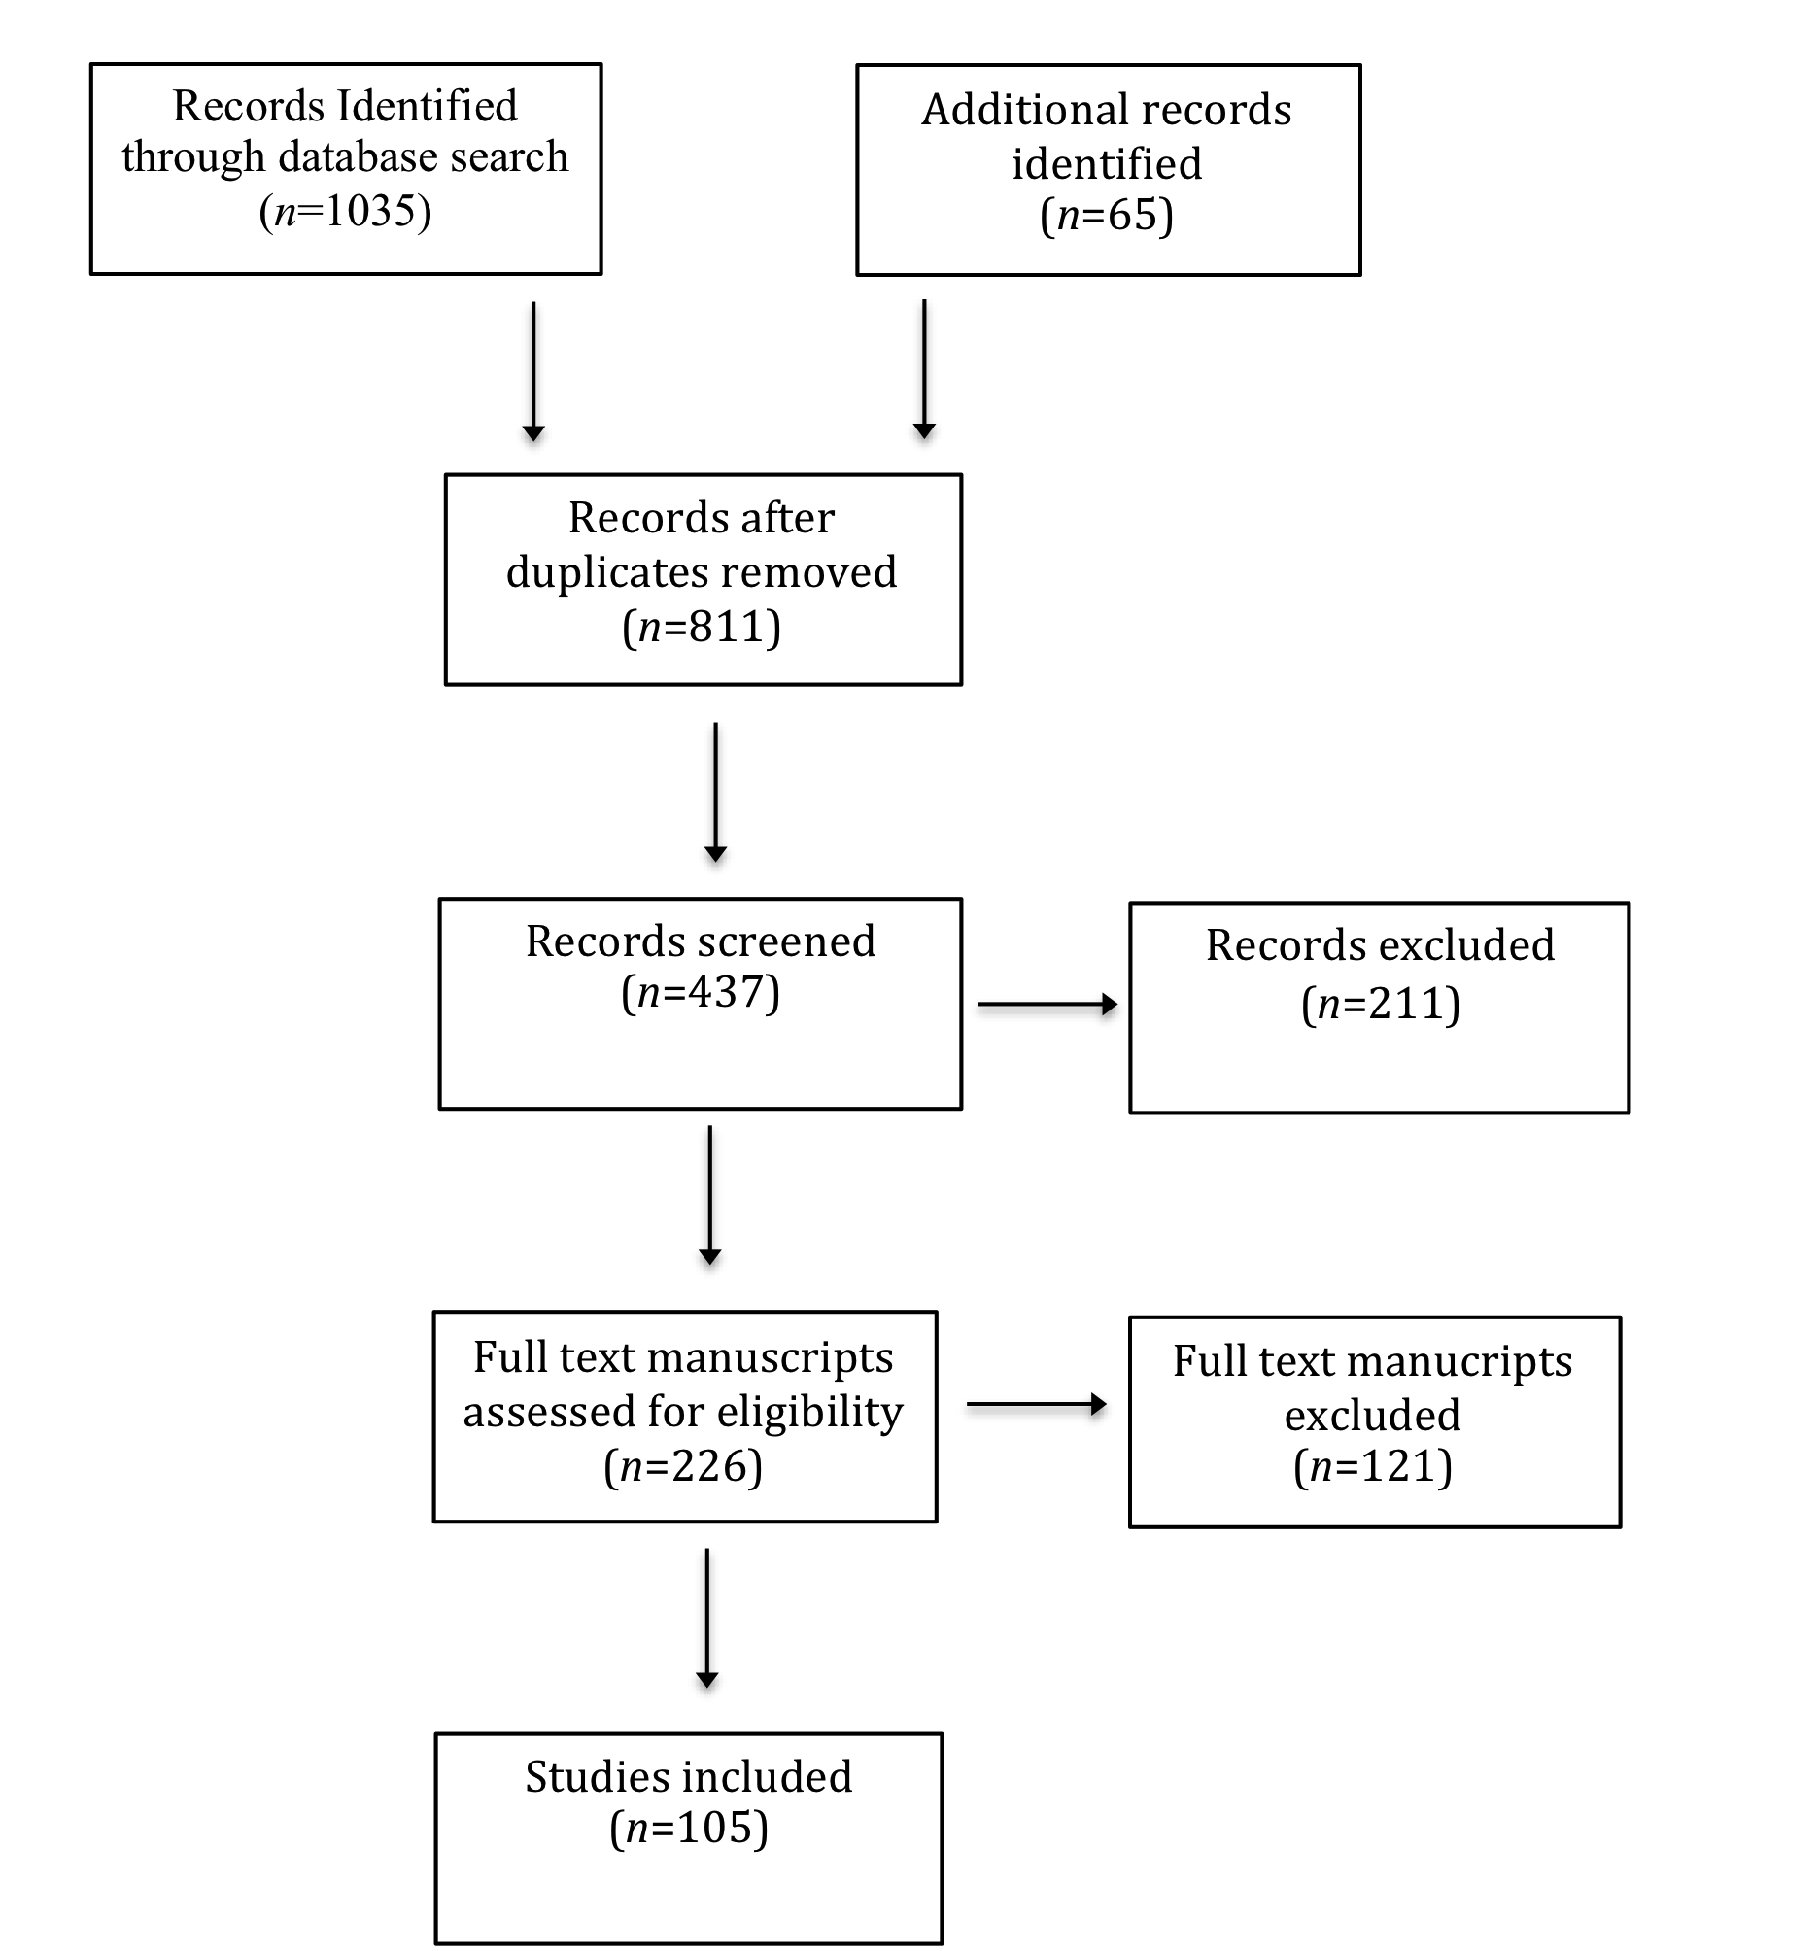
Social Presence: A Scoping Study
Agenda item one
Subtitle
Fig. 1 Flow Chart of Decision Making Process for Social Presence Scoping Review

Slide 11
Social Presence: A Scoping Study
Data Analysis
Data was extracted using a data extraction form modeled after Peters et al.’s (2015) recommendations for systematic scoping reviews.
The form was then piloted with modification occurring until there was an 80% agreement between reviewers.
The data was then entered into word files with a content analysis (Hsieh & Shannon, 2005) pertinent to the objectives outlined conducted.
Descriptive characteristics of the social presence scoping review were obtained through a numerical analysis of the data extracted and charted.

Slide 12
Social Presence: A Scoping Study
Results
Numerical Analysis Results
The descriptive statistics of the scoping review presented as percentage of studies (n=105) include:
Year of Publication
Study Location
Type of Online Learning Environ
Study Design

Slide 13
Social Presence: A Scoping Study
Fig. 2 Social Presence Studies by Year of Publication (n=105)

Slide 14
Social Presence: A Scoping Study
Fig. 3 Social Presence Studies by Geographical Area (n=105)

Slide 15
Social Presence: A Scoping Study
Fig. 4 Social Presence Studies by Type of Online Learning Environment (n=105)

Slide 16
Social Presence: A Scoping Study
Fig. 5 Social Presence Studies by Study Design (n=105)

Slide 17
Social Presence: A Scoping Study
Results (cont’d)
Content Analysis Results
RQ1: Social and Technological Elements
Three overarching conceptual maps emerged representative of the practices and guidelines for:
Establishing Social Presence
Introducing Social Presence
Sustaining Social Presence
Although the conceptual maps are reported as distinct, they are interwoven and interrelated across categories.

Slide 18
Social Presence: A Scoping Study
RQ1: Social and Technological Elements
Establishing Social Presence
The Establishing Social Presence conceptual map attends to foundational instructional design and pre-course activities.
The conceptual map is composed of the following three categories, their descriptors, and the studies extracted (see Table 2).
Design a Balance of Course Activities
Provide Course Information/Expectations
Creating a Safe Online Environment
This conceptual map also represents how instructors and course designers choose ways for students to enter and navigate a course, access evaluation materials, and what strategies instructors can employ to establish social presence in online environs.

Slide 19
Social Presence: A Scoping Study

Slide 20
Social Presence: A Scoping Study
RQ1: Social and Technological Elements
Introducing Social Presence
The Introducing Social Presence conceptual map attends to facilitation type behaviors that are essential to establish instructor-to-learner and learner-to-learner connections.
The conceptual map is composed of the following three categories, their descriptors, and the studies extracted (see Table 3).
Welcoming Activities
Initiating Instructor Communication Patterns
Student Engagement in Content
This conceptual map also describes those instructor communication patterns that need be introduced, learned, and modeled by the instructor so as to establish effective affective communication patterns thereby enabling course participants to form a community of learners and establish norms for interaction and participation.

Slide 21
Social Presence: A Scoping Study

Slide 22
Social Presence: A Scoping Study
RQ1: Social and Technological Elements
Sustaining Social Presence
The Sustaining Social Presence conceptual map refers to specific behaviors instructors and students can embody to enhance affective communication, increase intimacy, engage in immediacy and interactivity behaviors, thereby ensuring the maintenance of social presence as the course progresses.
The conceptual map is composed of the following three categories, their descriptors, and the studies extracted (see Table 4).
Discussions Forums
Assignment Feedback
Synchronous Meeting

Slide 23
Social Presence: A Scoping Study

Slide 24
Social Presence: A Scoping Study
RQ2: Outcomes of Social Presence
Outcomes of Social Presence were organized into one overarching conceptual map representative of the outcomes of social presence in online learning environs.
The four categories embedded within the Outcomes of Social Presence conceptual map are specific to research outcomes from the literature on social presence (see Table 5).
Group and Community Cohesion
Satisfaction
Participation
Knowledge Gain

Slide 25
Social Presence: A Scoping Study

Slide 26
Social Presence: A Scoping Study
RQ3: Social Presence Definitions
Definitions of Social Presence were mapped and presented chronologically representative of the evolution of the social presence construct.
By way of background, presence research is thought of comprising three dimensions that include telepresence, co-presence and social presence (Biocca, Harms, & Burgoon, 2003; Kehrwald, 2010).
Biocca et al. (2003) described three classification schemes that include:
Co-presence or mutual awareness (Goffman, 1959)
Psychological involvement (Short, Williams & Christie, 1976)
Behavioral engagement as applied to virtual reality (Palmer, 1995)

Slide 27
Social Presence: A Scoping Study

Slide 28
Social Presence: A Scoping Study
Discussion
Social presence research is gaining traction internationally.
Frequency of publications increasing on a year-to-year basis having almost doubled over the last four years.
Vast majority of research into the construct involves asynchronous learning.
Growing body of research involving blended learning, synchronous learning environments, and more recently MOOCs, and virtual 3D environments.
Study designs reflect both quantitative and increasingly qualitative methods, involving rating scales, surveys, content analysis, and interviews.

Slide 29
Social Presence: A Scoping Study
Discussion (cont’d)
Social presence has evolved from a two dimensional psychological state (e.g. immediacy and intimacy) to one that is both multidimensional and subjective in nature.
Not one consistent definition for the construct and it has not been operationalized uniformly, which muddles comparative analysis across learning environments (e.g. asynchronous, synchronous, blended, MOOC, virtual environments, etc.)
Confounding definitions of social presence, is the understanding of it
as a psychological/phenomenal state of individual users;
an interactive relational pattern of performable behaviors;
a property of the medium; or
an overarching critical literacy as suggested by Whiteside (2017).

Slide 30
Social Presence: A Scoping Study
Discussion (cont’d)
Students and instructors can be cultured to leverage social presence through the use of low-tech affective elements.
Lowenthal (2010) describes these low tech behaviors as human qualities established through personal sharing and assist in creating initial connections between the instructor and students.
Low tech elements: photos with biographical information ; digital stories, welcome messages (audio/video), screencasts, email etc.

Slide 31
Social Presence: A Scoping Study
Discussion (cont’d.)
As the technological sophistication of the medium developed, the effectiveness of asynchronous video communication; synchronous video communication; and social media (e.g. Twitter, Facebook, Cloud computing, LinkedIn) as a means to augment the development of social presence became more evident.
Even though a variety of technologies exist for use in a higher education online learning environment, their successful implementation is dependent on the degree to which those involved (e.g. instructors and students) embrace innovation and novelty.
Although positive benefits to the use of asynchronous video are reported (e.g. digital storytelling, screencasts, & announcements) the effectiveness of the practice is dependent on how asynchronous video is used to replace text.

Slide 32
Social Presence: A Scoping Study
Discussion (cont’d)
Affordances offered through synchronous web video conferencing tools did not augment social presence and lead to better student performance (as measured by grades) or more satisfied learners.
Possible explanations are offered by the degree to which synchronous video conferencing inhibits accessibility (e.g. anytime and anywhere) and, students overall acceptance/success in using new technologies.
Mixed results are reported for social networking as means to increase social presence. Intensity of student use of social networking sites (e.g. Facebook, LinkedIn, & Twitter) did not significantly impact social presence (Lim and Richardson, 2016).

Slide 33
Social Presence: A Scoping Study
Discussion (cont’d)
Findings related to the outcomes and effects of social presence are limited by their dependence on student perceptions and surveys as subjective measures of social presence (Biocca, et al., 2003; Chen et al., 2015).
Empirically grounded research that considers the inclusion of more objective measures of social presence that takes into account measurable outcomes such as academic performance, is advocated.

Slide 34
Social Presence: A Scoping Study
Conclusion
The study is limited by the data extracted and the manuscripts screened for inclusion, as it is specific to the parameters of the scoping review and therefore may not be exhaustive in nature.
Although positive outcomes have been reported for social presence, a comparative analysis is somewhat complicated by the various definitions proposed and the numerous technological advances that have come to characterize the medium and impact social presence.
Future research that advances a better understanding of the nomological network that links both the theoretical and empirical frameworks that validate social presence across a variety of learning environs is advocated.

Slide 35
Social Presence: A Scoping Study
Acknowledgements
Funding for this study was made available through the Social Sciences and Humanities Research Council of Canada Insight Development Grant Program.
A special thanks to the Social Sciences Research Laboratory at the University of Saskatchewan for their assistance in the analysis phase of the study.

