Slide 1
Michael K Barbour
Touro University California
Randy LaBonte
Canadian eLearning Network

Slide 3
Methodology

Slide 4
Individual Program Survey

Slide 5
Nature of K-12 E-Learning Regulation

Slide 6
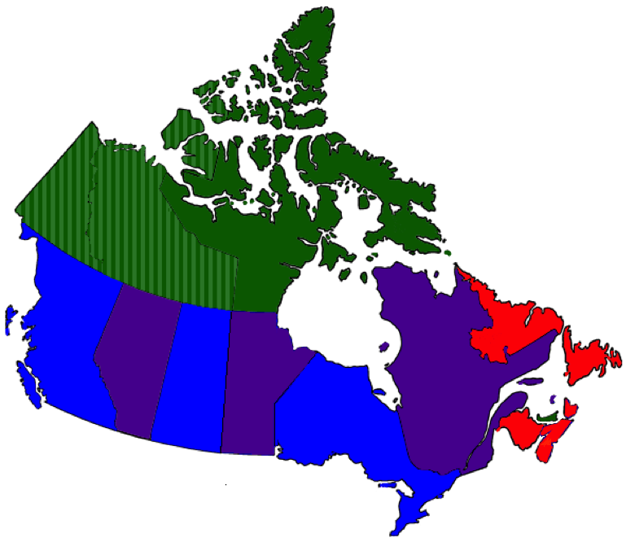
Nature of Activity
Single provincial program
Primarily district-based programs
Combination of provincial and district-based programs
Use online learning programs from other provinces

Slide 7
Level of K-12 E-Learning Activity

Slide 8
K-12 Distance/Online Learning Activity

Slide 9
K-12 Distance/Online Learning Activity
* (Canadian Teachers Federation, 2000)

Slide 10
K-12 Blended Learning Activity

Slide 11
K-12 Blended Learning Activity
* Estimate based on learning management system data
** Data provided by Ministry
*** Unable to estimate level of activity
**** Data extracted from individual program survey response

Slide 12
2017 Annual Study
Report
1-2 brief issue papers
7 vignettes
Website
moving discussion of the trends from report to individual blog posts
French language version

Slide 14
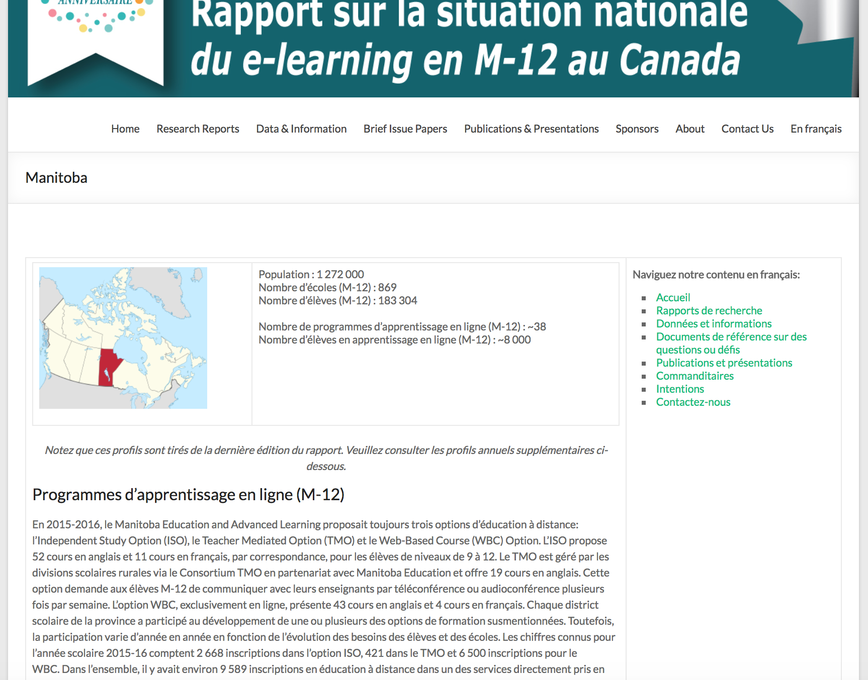

Slide 15
http://k12sotn.ca

Slide 16
Cross Canada Observations

Slide 17
Trending…
Blended and online practices are blurring – it is more about learning within flexible structures
Transition from online to blended more difficult than from classroom
Personalization and flexibility critical drivers in Canada
Competency-based emerging in new curriculum
Research focus on better data and exploring pockets of innovation
BC: Navigate/NIDES, @KOOL/AVS embedded teachers, consortia/BCLN & AB
AB: Argyll/Palliser sync, ADLC partnerships, Moodle Hub sharing
ON: Centralized resources/tech and support, consortia & sharing
QC: LEARN shifting sync to async & gamification
NS/MB/NL: Centralized approaches, local partnerships
Online Blended Classroom
Personalized Blurred Partnerships

Slide 18
Education in Canada

Slide 19
Resources for online programs
Ministry of Education produced?
NL, NS, NB – provincial program
YT, NT, NU – provincial program
MB, SK – mixed provincial/district
QC – mixed provincial/district
ON – mixed provincial/district
AB – mixed provincial/district
BC – no provincial program

Slide 20
Nature of Activity
BC
AB
ON QC
Single provincial program
Primarily district-based programs
Combination of provincial and district-based programs
Use online learning programs from other provinces

Slide 21
LEARN (QC) http://www.learnquebec.ca/home

Slide 22
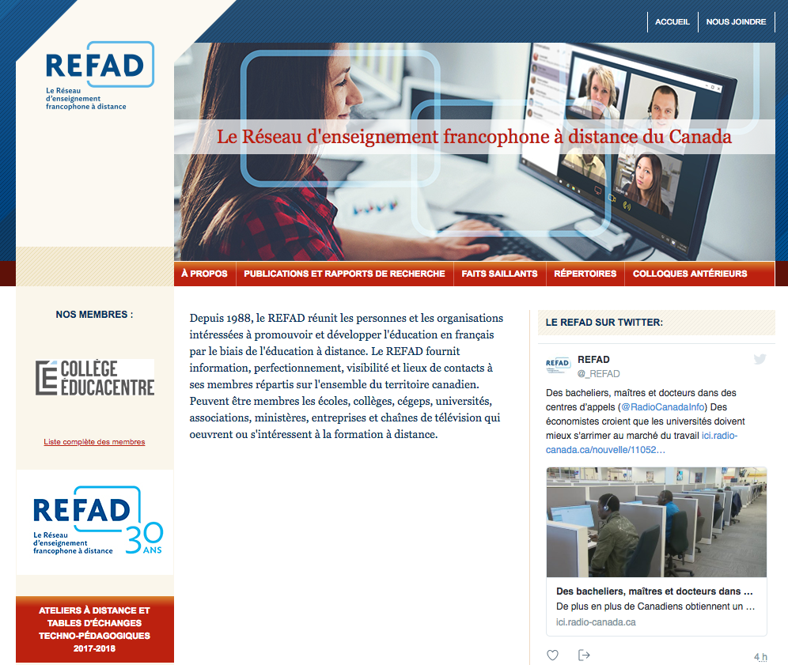
REFAD - http://www.refad.ca/

Slide 23
E-Learning Ontario Resources http://www.edu.gov.on.ca/elearning/bank.html

Slide 24
CFORP (ON) http://www.cforp.ca/

Slide 25
http://www.edu.gov.on.ca/elearning/strategy.html

Slide 26
Resources for online programs?
Ministries of Education
Rest of Canada
AB
BC

Slide 27
https://www.adlc.ca/

Slide 28
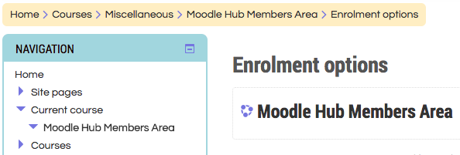
Alberta Moodle Hub http://hub.rockyview.ab.ca/

Slide 29
BC Learning Network https://bclearningnetwork.com/

Slide 30
BC Western Canada Learning Network https://bclearningnetwork.com/

Slide 31
BlendED Alberta http://www.blendedalberta.ca/

Slide 32
BlendEd BC - https://blendedbc.com/

Slide 33
Trending…
Blended and online practices are blurring – it is more about learning within flexible structures
Transition from online to blended more difficult than from classroom
Personalization and flexibility critical drivers in Canada
Competency-based emerging in new curriculum
Research focus on better data and exploring innovation
Online Blended Classroom
Personalized Blurred Partnerships

Slide 34
Your Questions and Comments

Slide 35
State of the Nation: K-12 E-Learning in Canada
http://k12sotn.ca/
Associate Professor of Instructional Design
Touro University California
mkbarbour@gmail.com
http://www.michaelbarbour.com
Randy LaBonte
CEO -- CANeLearn
Canadian eLearning Network
rlabonte@CANeLearn.net
http://CANeLearn.net

