Slide 1
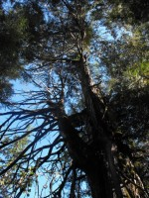
Academic Blogging Circles
Glenn Groulx
November 2010

Slide 2
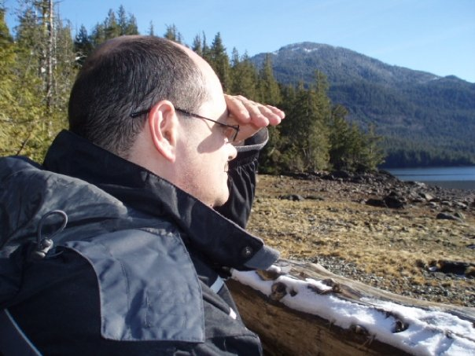
Background
Completed MDE program
Completed 4 courses using Me2U and AU Landing
Completed e-portfolio
Research Assistant
Blogging in academic setting since for more than 2 years
Exploring/expanding on my own shifting role as lifelong autonomous learner
Adult Literacy Instructor at NWCC
(English and Computers)
Interested in delivering remote learning (blended F2F and online support) for learners in remote communities

Slide 3
About the Academic Blogging Circle
Provides a space for participants to discuss “special interest” topics related to edublogging
Open membership – anyone can join
some content has limited access to group; some is public
Not connected with any course or program
Has 20 members
Set up Summer 2010
Membership made up of a mix of faculty members, alumni, administrators, and students from different academic programs and different disciplines

Slide 4
“Academic Blogging Circle”

Slide 9
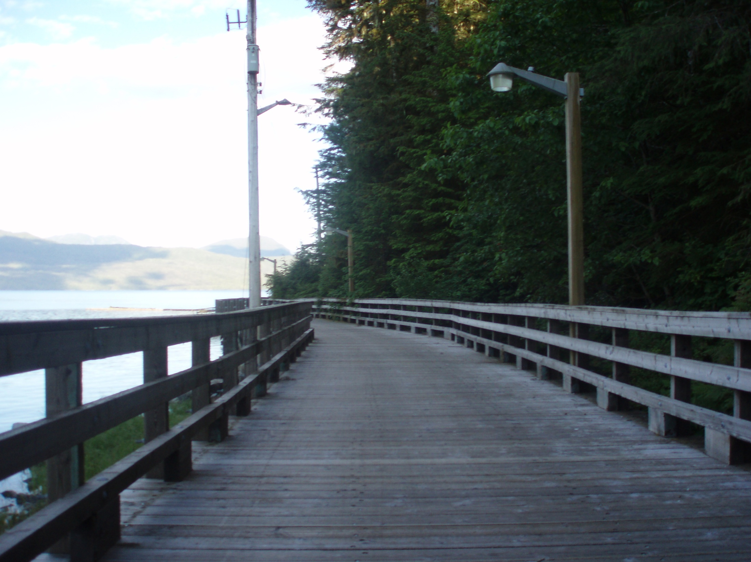
Benefits of the Blogging Circle
Bridges the skills gap for learners between cohort learning and autonomous lifelong learning
Encourages interdisciplinary collaboration
Encourages open participation from different types of learners in non-formal setting
Facilitates learning from seminars to independent study to auto-didaxy

Slide 10
The Road Ahead
Opens up potential for sustained self-assessment
Analytics for autonomous learners
PLAR
Counseling and advising support
E-mentoring
Personalized mini-courses
Increased independent study
E-portfolios (formative and summative)
Group projects
Non-formal research groups
Unanticipated collaborations (papers, presentations)

Slide 11
Questions and Discussion
Glenn Groulx, B Ed., MDE
E-mail: ggroulx@nwcc.bc.ca
Twitter: @ggroulx
EduBlog: https://landing.athabascau.ca/pg/blog/glenngr4
Academic Blogging Circle:
https://landing.athabascau.ca/pg/groups/9775/academic-blogging-circle/

