Slide 1
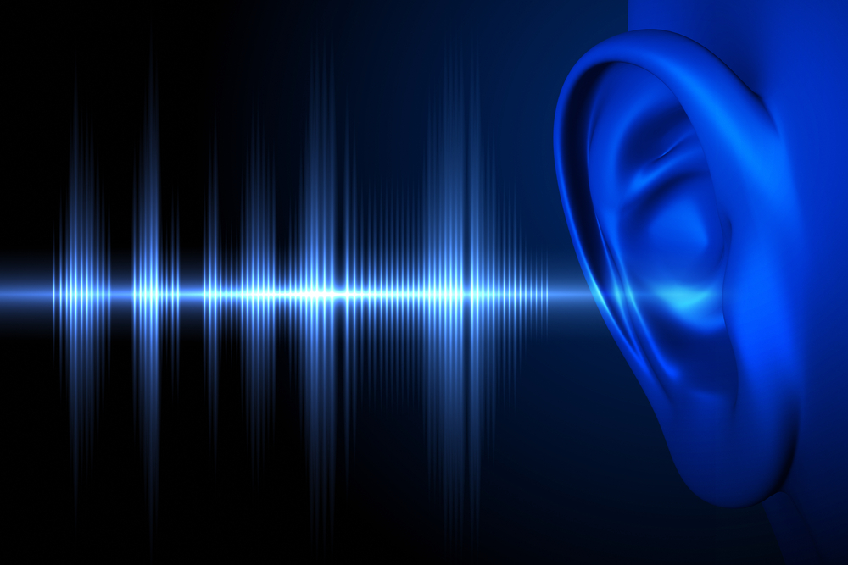
Hearables for Online Learning
Rory McGreal
Athabasca University
Image:Forma MDD

Slide 2
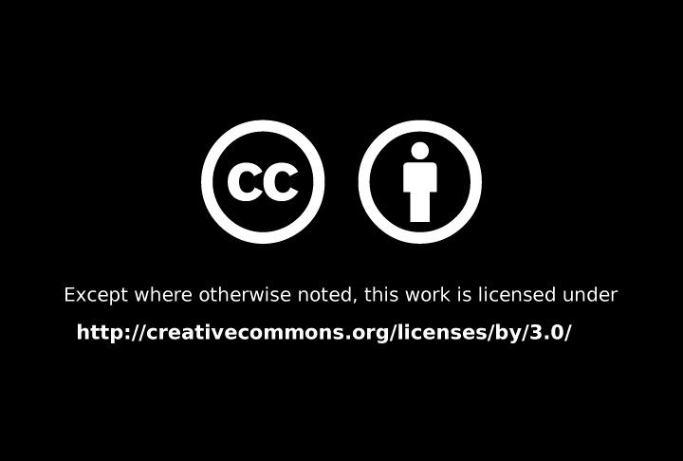
https://creativecommons.org/licenses/by/4.0/
Some images fair dealing or fair use

Slide 3
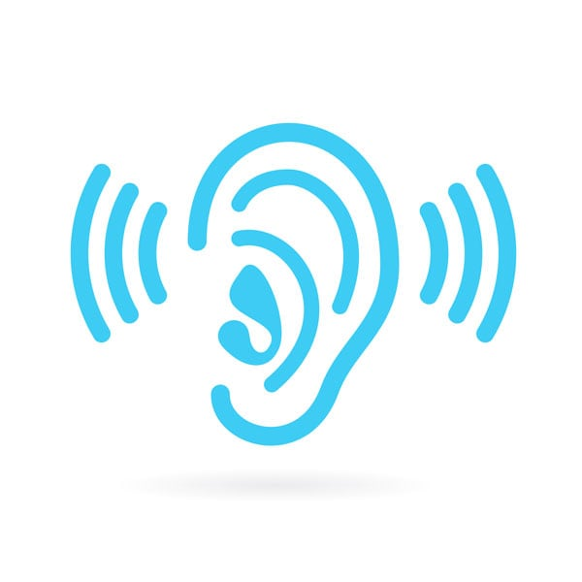
What are hearables?
wireless smart micro-computers (Bluetooth)
artificial intelligence
speakers & microphones
fit in the ears
connect to Internet & other devices
designed to be worn daily
(Hunn, 2014)

Slide 4
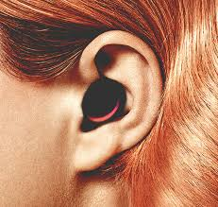
.
Hearable Features
* tiny, nearly weightless
* perfect fit in ear canal
* comfortable over time
* sufficient battery power
* strong antenna
* microphone
* micro-processor
Photo: Nicolas Sadoc

Slide 5
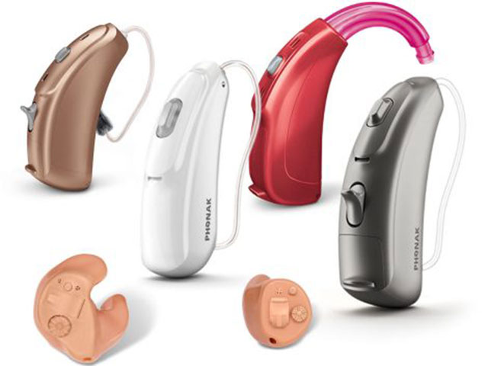
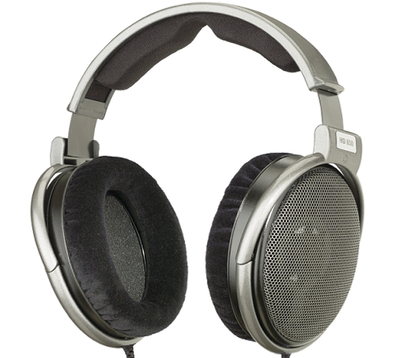
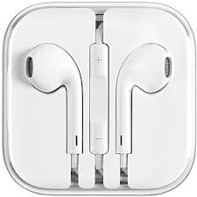
E
Headphones
PSAPs: Personal Sound Amplifiers
Hearing aids
Earbuds

Slide 6
E
Headphones
PSAPs: Personal Sound Amplifiers
Hearing aids
Photo Phonak
Notes:
https://5.imimg.com/data5/WC/EF/MY-42689130/apple-iphone-earphones-500x500.jpg
https://www.pbtech.co.nz/fileslib/_20171025115654_OverEar650.png

Slide 7

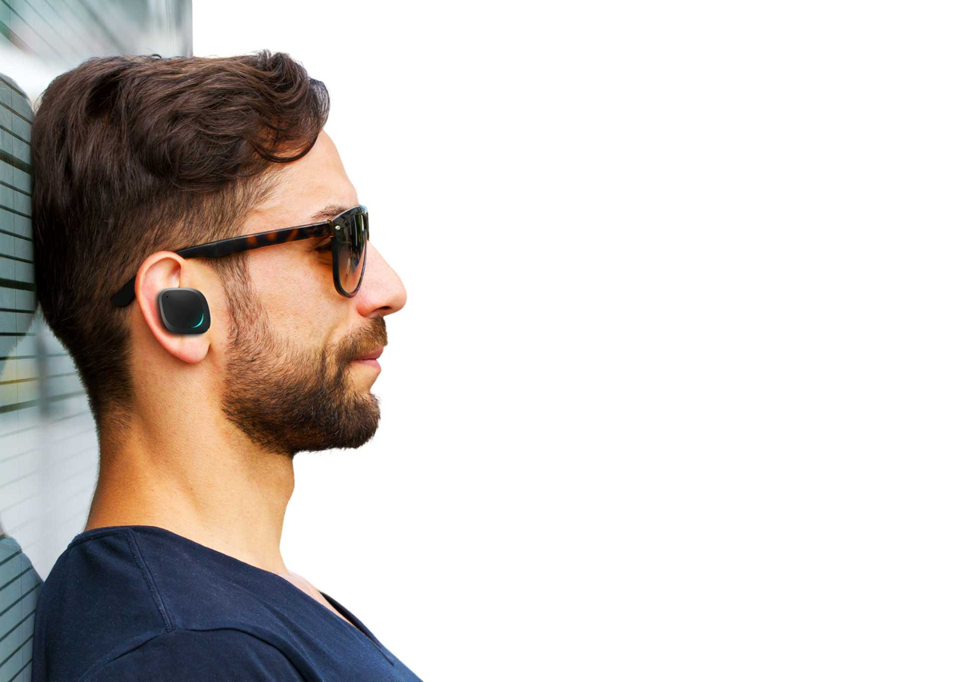
Approval no longer required
No longer considered medical devices
(Over the Counter Hearing Aid Act, 2017)
Photo: Znattta Blog

Slide 8
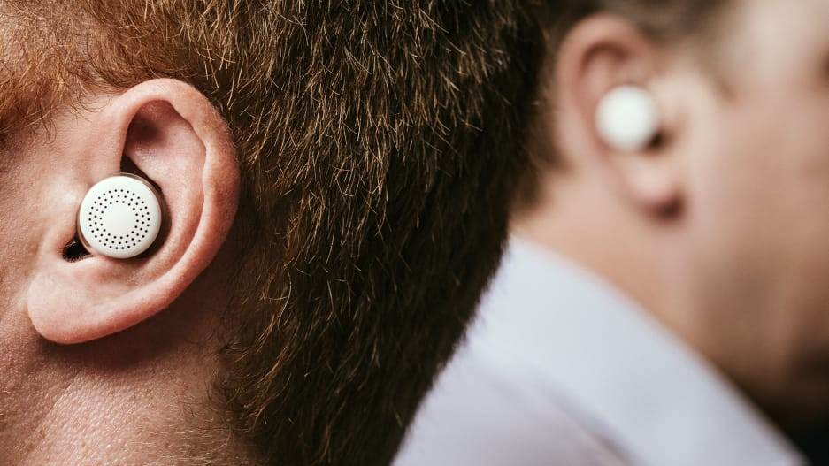
\
\
* cancels out unwanted background noise,
* amplifies voice of a particular person
* converse in another language.

Slide 9
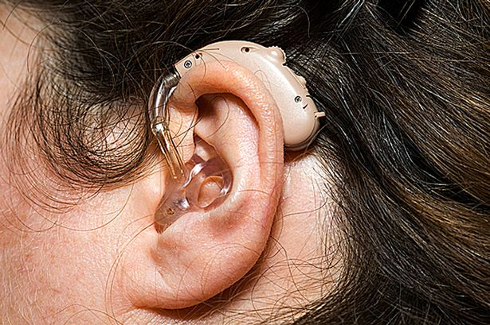
Stigma
Photo: IPFNZ

Slide 10
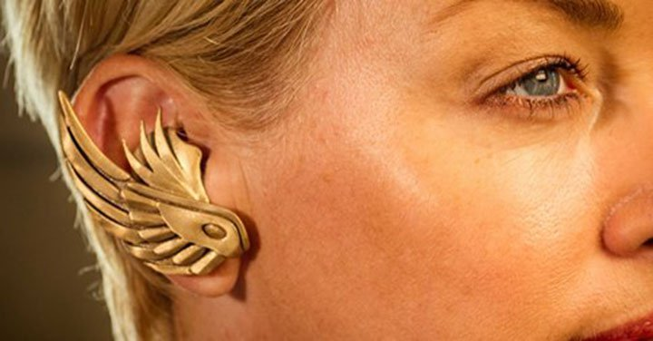

Slide 11
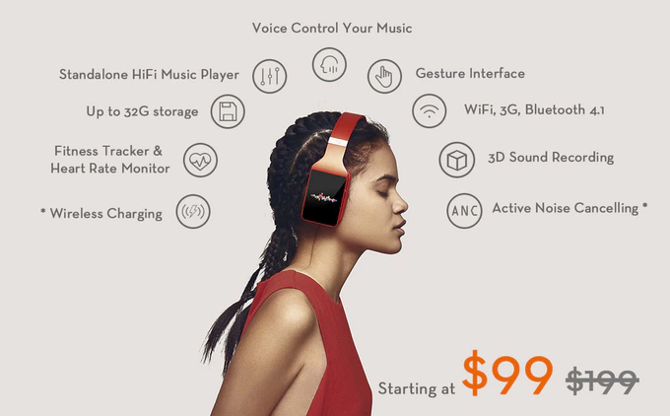

Vinci
Notes:
https://ksr-ugc.imgix.net/assets/014/656/754/7af7e2fce82aaed30afae8b2117e80a6_original.jpg?w=680&fit=max&v=1480045847&auto=format&q=92&s=c2fe7be80983e65e7bec0a6b75c5c88a

Slide 12
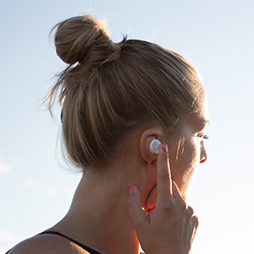



Slide 13
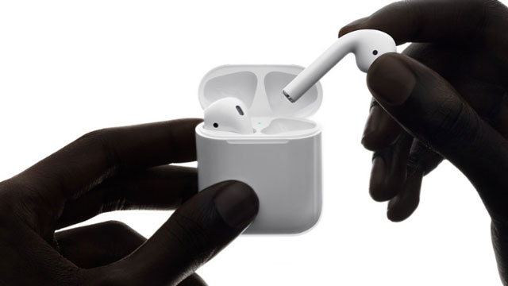

Bone conduction

Slide 14
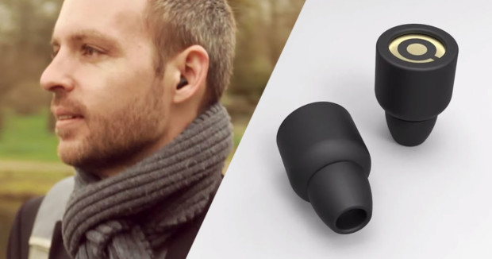
Earin
Music listening only
Notes:
https://cdn.shopify.com/s/files/1/2350/4809/files/1_900x_f1153dbf-4ba9-488d-ae7c-23b65adb918f_540x.png?v=1512989829

Slide 15

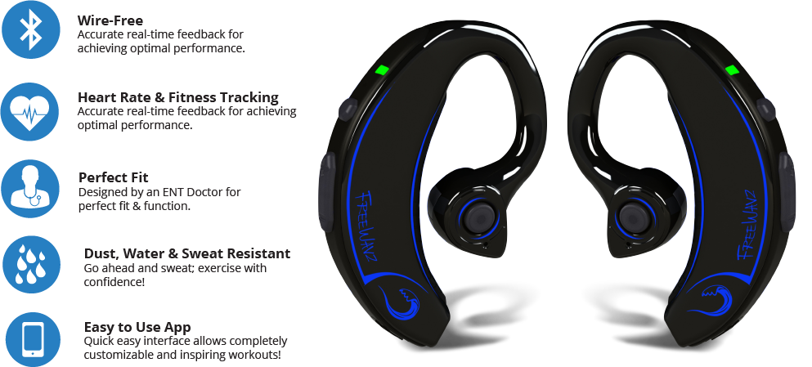
http://www.freewavz.com/

Slide 16
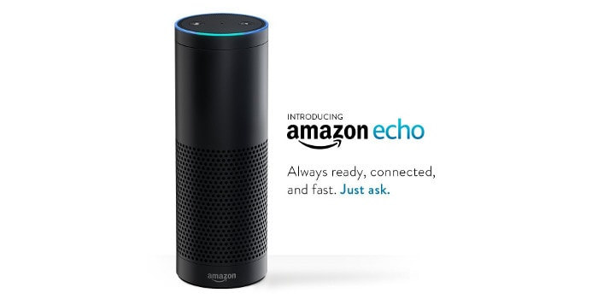
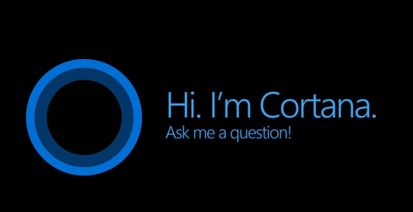

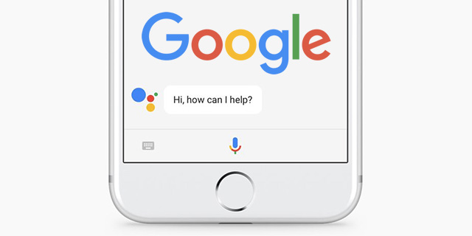

Audibles
An interface revolution? Knightlab
Assistant
In +63% of US homes by 2023

Slide 17
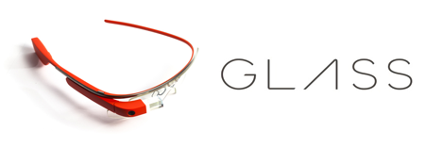
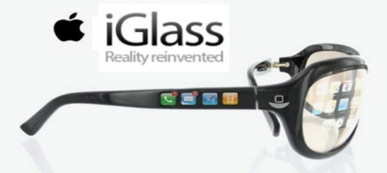
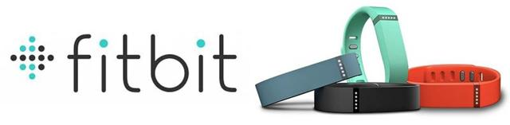
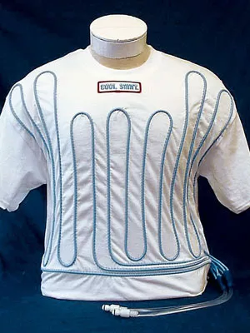
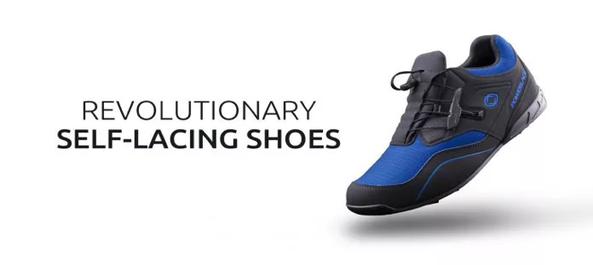
Wearables
CoolShirt

Slide 18
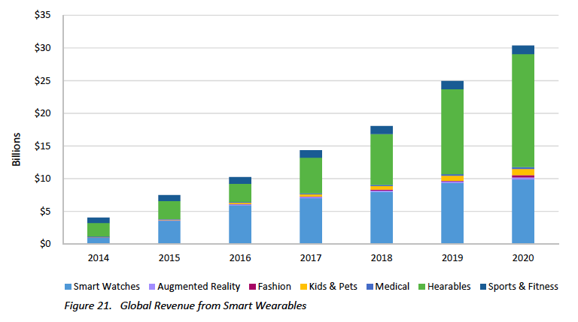
Graph Nick Hunn

Slide 19
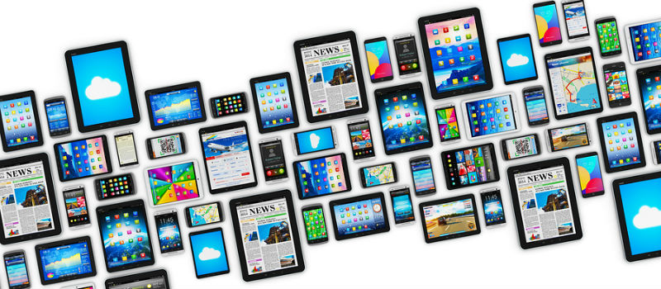
Mobile devices
Photo: Solutions Review

Slide 20

Wireless Access
Mobile Learning
Notes:
20

Slide 21
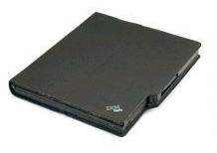
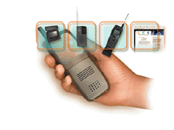

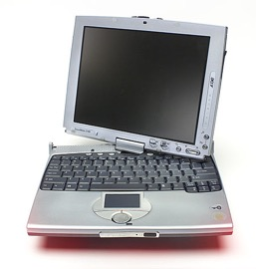
OPENNESS
Nokia
5510
Digital convergence:
Handy 21 Oxygen project MIT
Electronic book
Radio
Camera
Telephone
WWW
Computer
PDA
Email
Pervasive computing
Game player
Clock
TV
Fax
Notes:
21
Computers on paper and electronic books represent different aspects of a the phenomenon known as pervasive computing, where microchips are being imbedded into common objects. Your refrigerator will be able to talk to your stove. God forbid that they don’t gossip about us. Can you imagine your fridge whispering to your stove: “Oh God! Here comes the fat man again?”
Digital convergence is another trend where your cell phone will also house a personal digital assistant, a computer, a calculator, a clock, a fax, an Internet connection for email and web browsing, an electronic book, and even a television. These devices already exist.

Slide 22

51% of the world’s population
+3.7 billion Internet connexions
World population: +7.4 billion
http://www.soil-net.com/album/Places_Objects/slides/Globe%20Planet%20Earth%20NASA.jpg

Slide 23
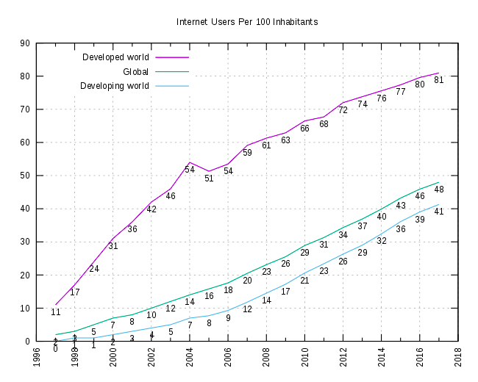
Graph: ITU

Slide 24
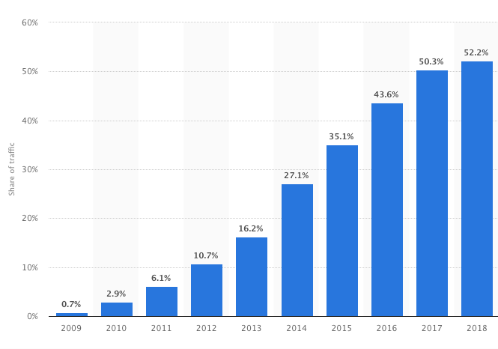
Percentage of all global web pages served to mobile phones
from 2009 to 2018
52.2%
Graph: Statista

Slide 25


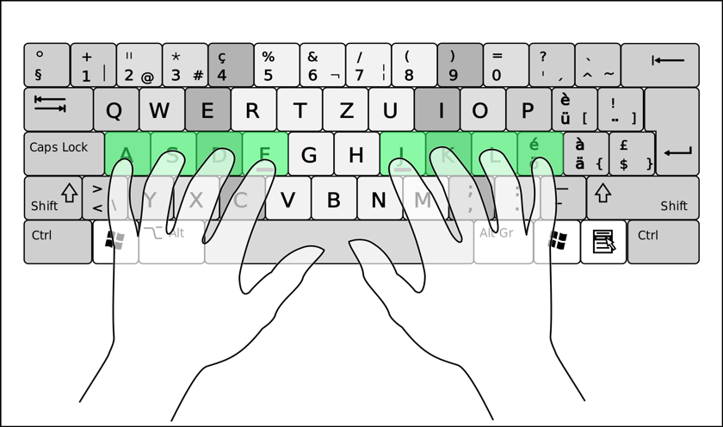


Speak or type 2023?
Searches
Image:NounProject
Image: Wikimedia

Slide 26
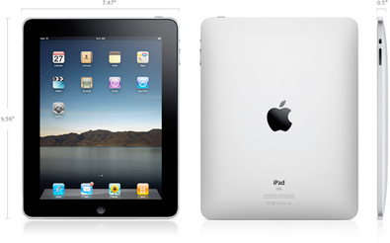
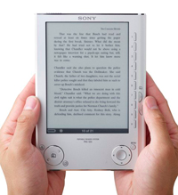

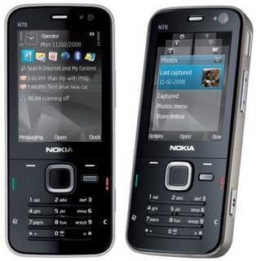
The world is going mobile
Mobile Learning

Slide 27
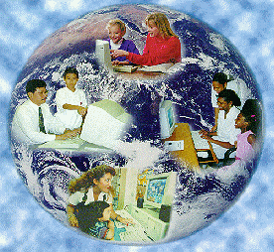
Internet is the biggest commons
Public domain is a priceless, shared heritage

Slide 28

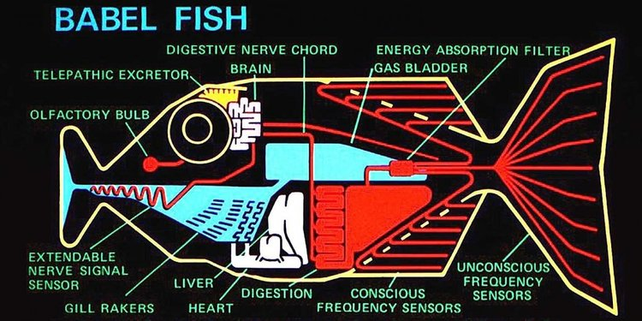
Image: Business Insider

Slide 29
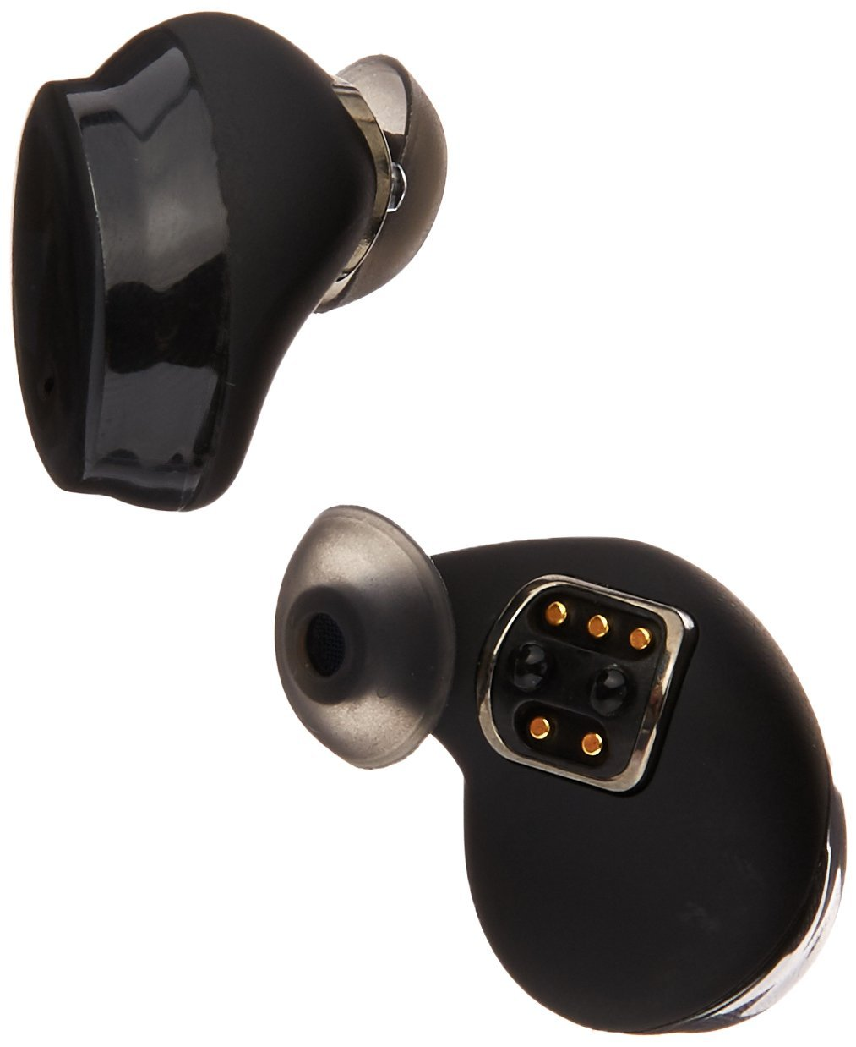

Bragi Dash
Notes:
https://images-na.ssl-images-amazon.com/images/I/61i5E9Dq4NL._SL1238_.jpg

Slide 30
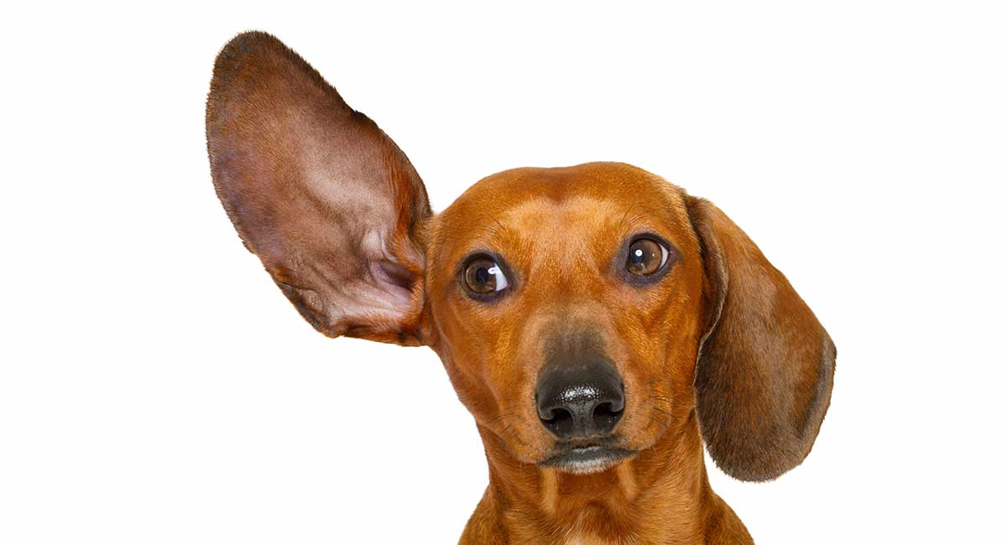
Photo: Happy Puppy

Slide 31
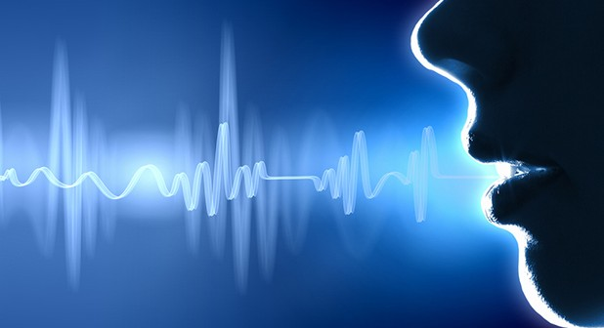
Intelligent Voice
Recognition (IVR)
Intelligent Virtual
Assistant (IVA)
Photo: BougieBlackBrother

Slide 32
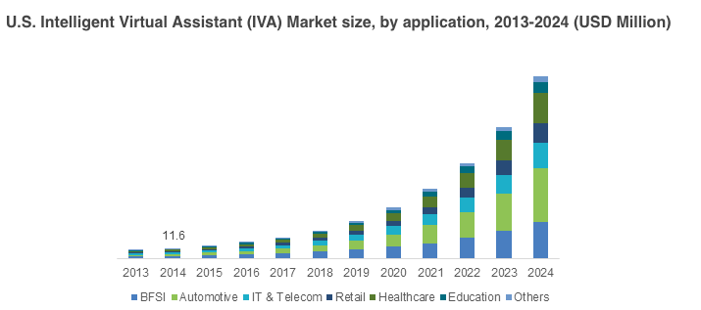
Intelligent Virtual Assistant Market
Fomal & Informal Learning
Graph: Global Market Insights

Slide 33
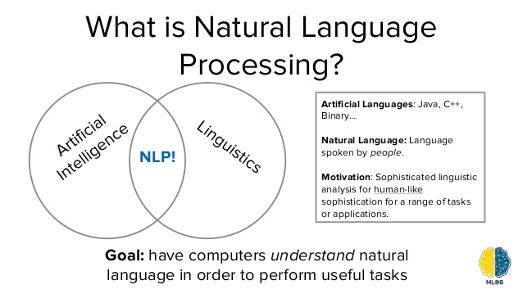
Natural Language Understanding (NLU)
Graph: Ted Xiao

Slide 34
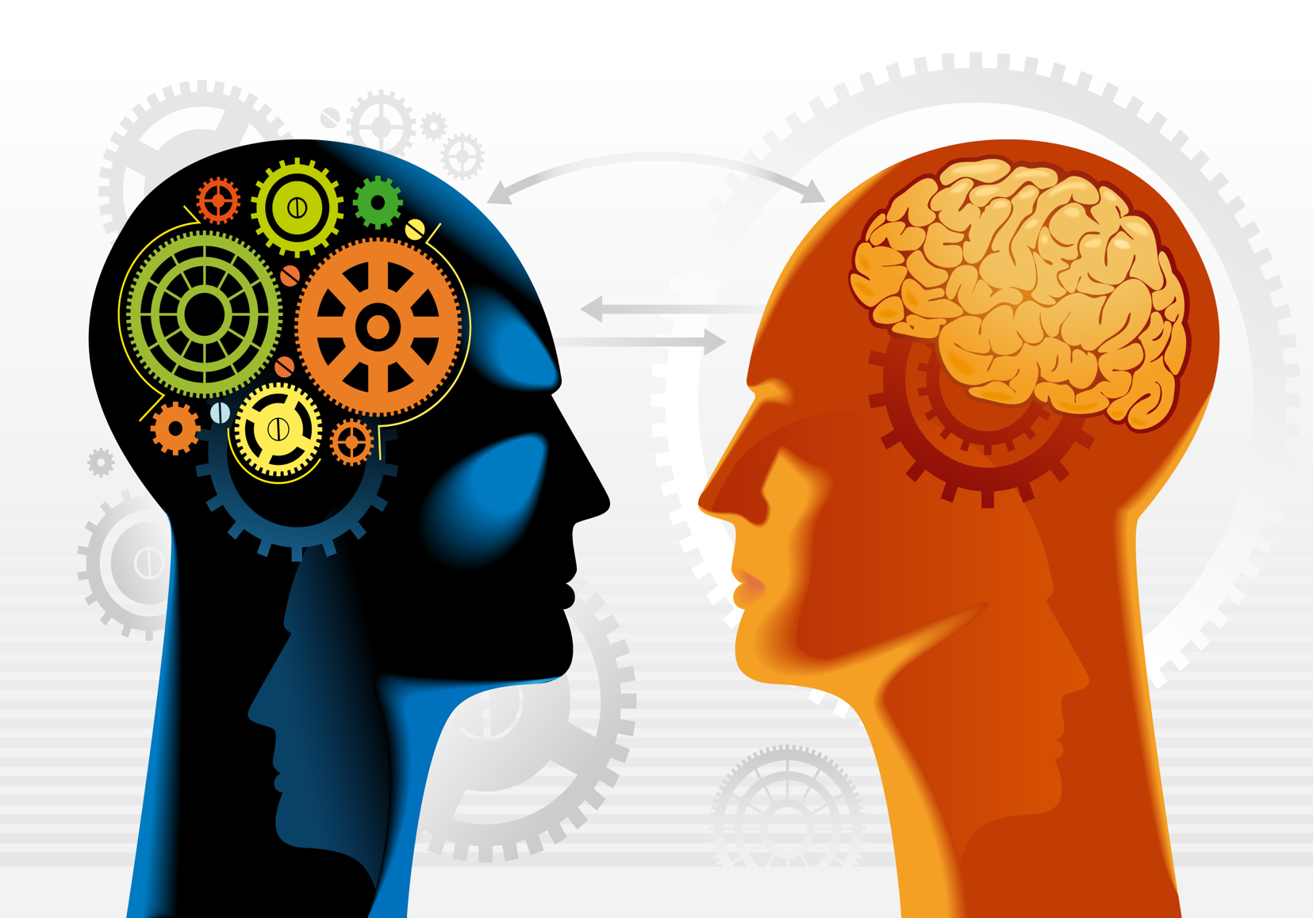
IVA & NLU for Education
Diagram: AIHR Raja Sengupta

Slide 35
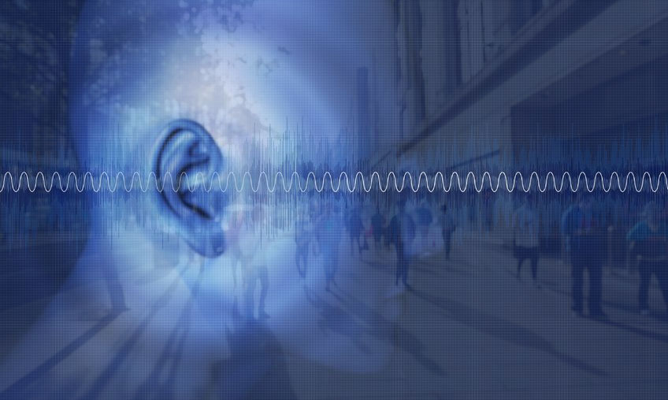
Hearables for Education
Private & personal
Super hearing
Focused hearing
Selected sounds
Blend physical & digital
Instant access
Hands-free
Photo: Nuheara

Slide 36
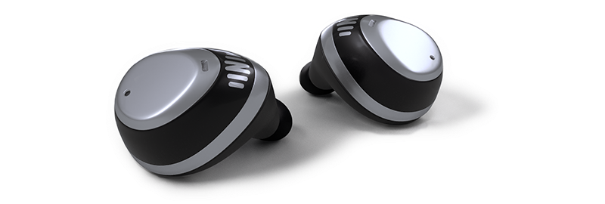
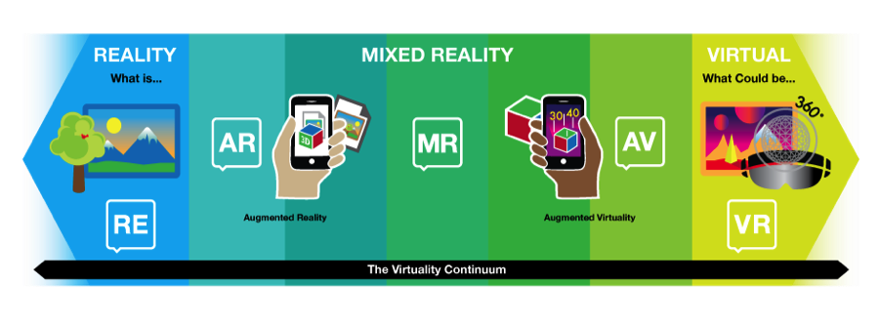
VR & AR Learning
Diagram: MJ Anderson
Photo: Nuheara

Slide 37
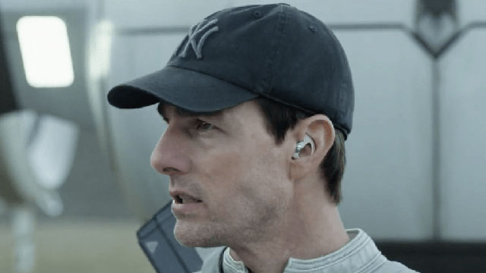
Personal Digital Assistant
Photo EverydayHearing

Slide 38


Hearables: Technical Challenges
Power usage
Battery life
Connectivity (HBw)
Cloud processing
Computing power
Memory
Not there yet!

Slide 39
Hearables: Benefits
Portable (anywhere/any time)
Easy to use
Connectivity (HBw)
Highly personalizable
Accessible
Integrated in normal life

Slide 40
Hearables: Benefits for Learning
Elearn/Mlearn/Hlearn
Control/ownership
Fun
In-context learning
Contact -interactive
Links

Slide 41
Hearables: Benefits for Learning
As one aide to learning – not standalone
Blended learning
Podcast lectures
Text-to-Speech
Accessible on the move

Slide 42

Just-in-Time Learning
Training wherever/whenever
Integrated into workday
Continuous learning
Instruction on fixing problems
Access to manufacturer
Hands-free
Image: ICD International

Slide 43
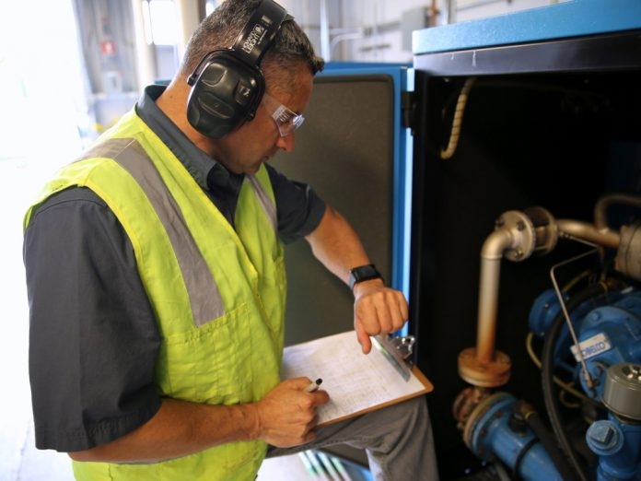
Just-in-Time
Photo: Crunchwear

Slide 44
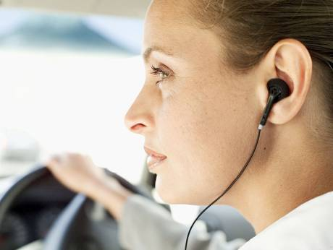
Salesperson Learning on the Job
Photo: Gulf News

Slide 45
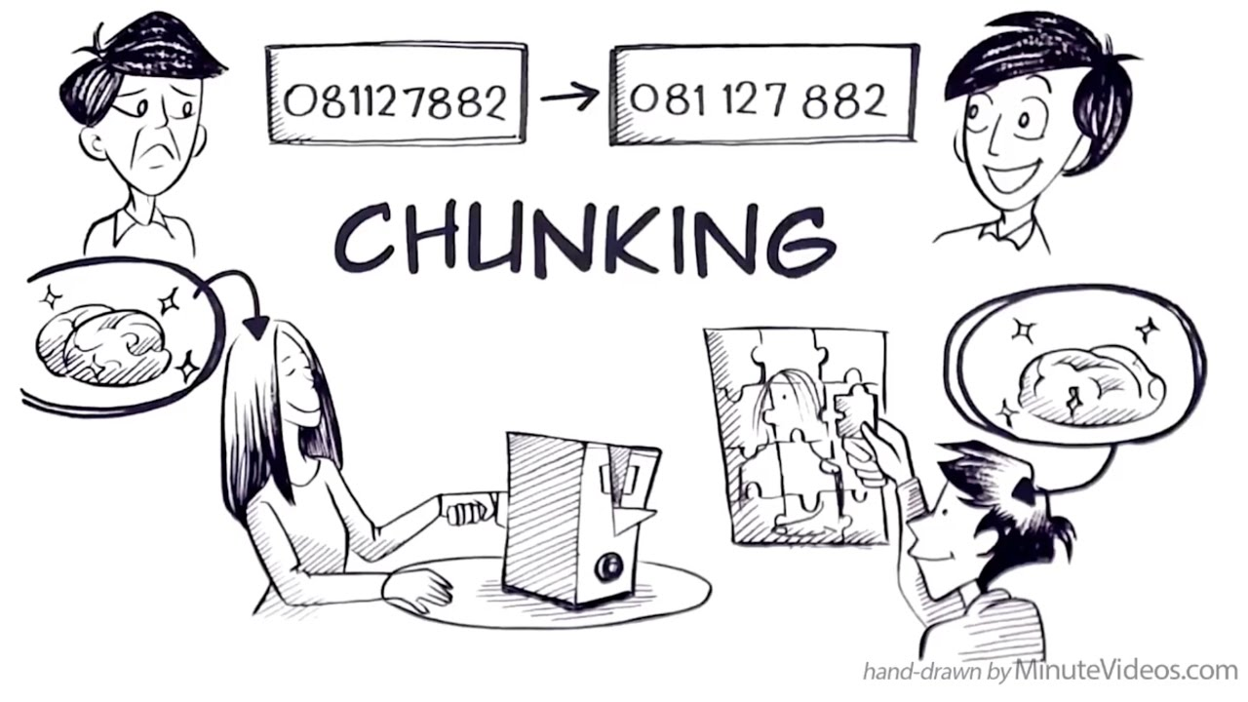
Bite-sized content (3 – 5 minutes)
Cartoon: MinuteVideos

Slide 46


Self-Directed Learning
Diagram: Extreme Learner

Slide 47

Personal Learning/ Connectivism
Context-aware
Adaptive
Individualised
Personal Learning networks
Image: Flickr

Slide 48

The microphone is always on
Photo: Blue Diamond Gallery

Slide 49

Will it know what you are thinking?
AI-enhanced hearables in the future will be able to understand more than the words we speak
Photo: Max Pixel

Slide 50

Text while driving
Photo: US Air Force

Slide 51


Hearing Loss
1.1 billion children and young adults at risk of hearing loss, with earphones blasting away at point-blank range.
Photo: TextEd

Slide 52

Hearables
"Maybe instead of people staring at their screens, they are going to be staring off into the distance. What's it called? The thousand-yard stare" (Glazer, 2014)
Image: Deviant Art

Slide 53

Memento Homo
Photo: Cambridge University Press

