Slide 1
Where are we at with Online Education Research? A CIDER Workshop
Terry Anderson
Athabasca University

Slide 3
Method
AU PRESS
Setting the scene: a framework of research areas in online distance education Olaf Zawacki-Richter and Terry Anderson

Slide 4
Zawacki-Richter (2009) carried out an international Delphi study
patterns in distance education research published in scholarly journals (Zawacki-Richter, Bäcker & Vogt, 2009).

Slide 5
Macro level: Distance education systems and theories
Access, equity and ethics
Globalization of education and cross-cultural aspects
Distance teaching systems and institutions
Theories and models
Research methods in distance education and knowledge transfer

Slide 6
Meso level: Management, organization and technology
Management and organization
Costs and benefits
Educational technology
Innovation and change
Professional development and faculty support
Learner support services
Quality assurance
Drop Out

Slide 7
Micro level: Teaching and learning in distance education
Instructional or learning design
Interaction and communication in learning communities
Learner characteristics

Slide 8
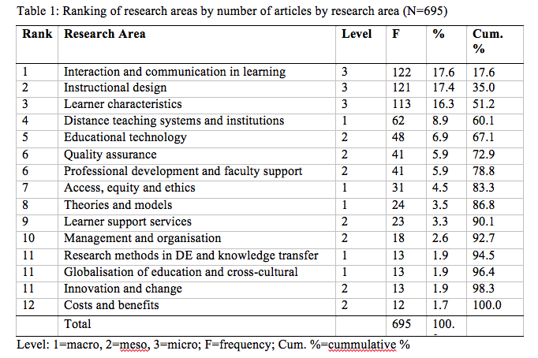

Slide 10
OVER TO YOU
Connect will automatically place you in a group of 5.
Your task:
Introduce Yourselves
Produce a list of 5 most pressing online Learning questions/issues you would like to see DE research focus on.
Report of any issue you are currently doing formal research on
Report back in 10 minutes

Slide 11
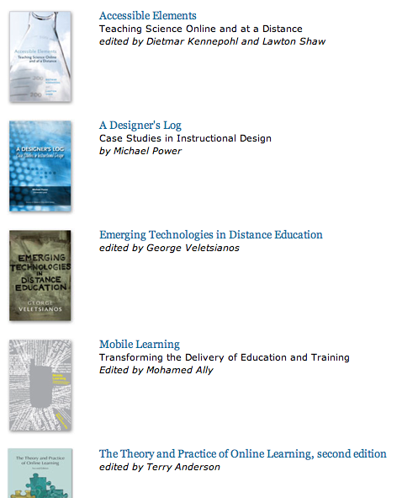
Shameless Plug Issues in Distance Education Series http://aupress.ca 8 Free books

Slide 12
Available this fall
Athabasca University Press

Slide 13
Your comments &
questions
most welcomed!
Terry Anderson terrya@athabascau.ca
Blog: terrya.edublogs.org

