Slide 1

State of the Nation:
K-12 E-Learning in Canada
Michael K. Barbour
Touro University California
Randy LaBonte
Canadian eLearning Network

Slide 2




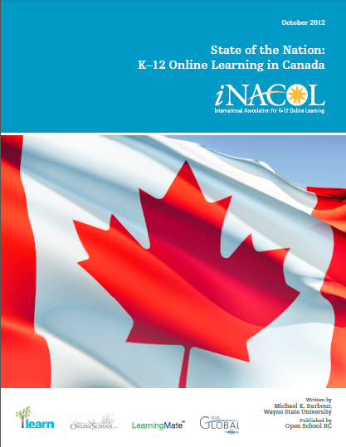
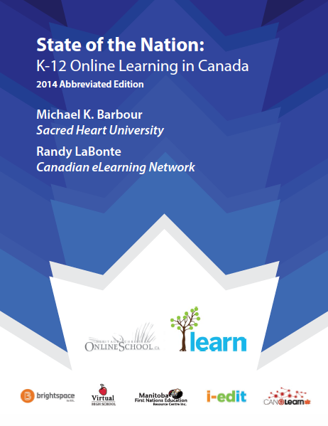


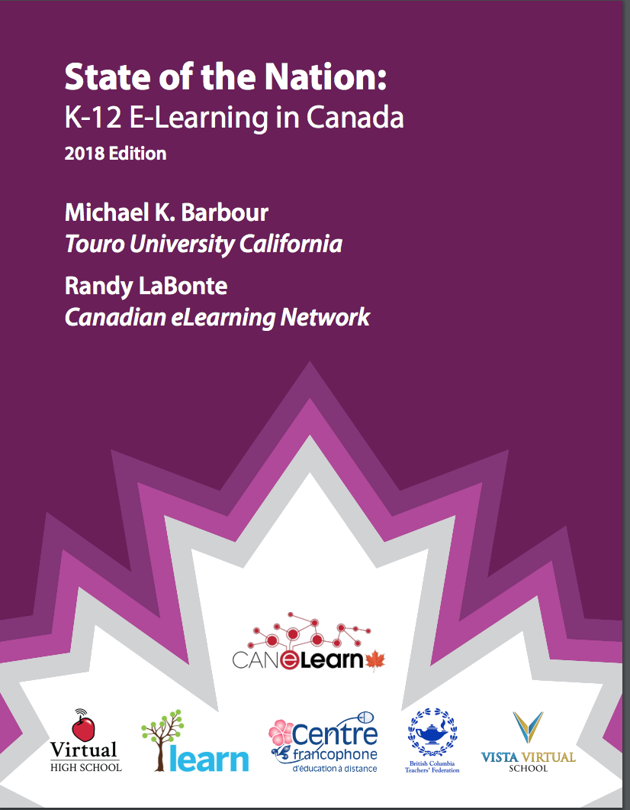


Slide 3









Slide 4
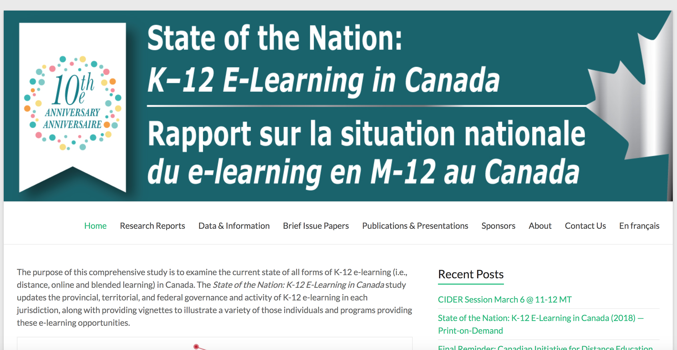
http://k12sotn.ca

Slide 5
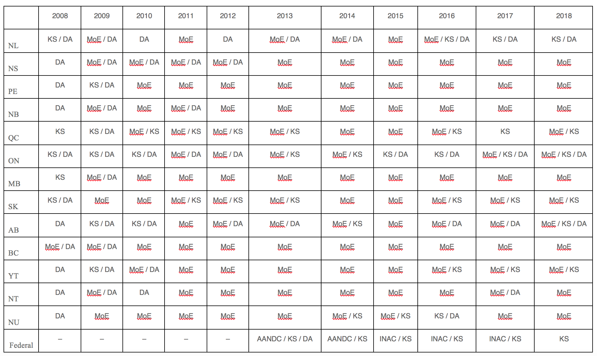
Methodology

Slide 6
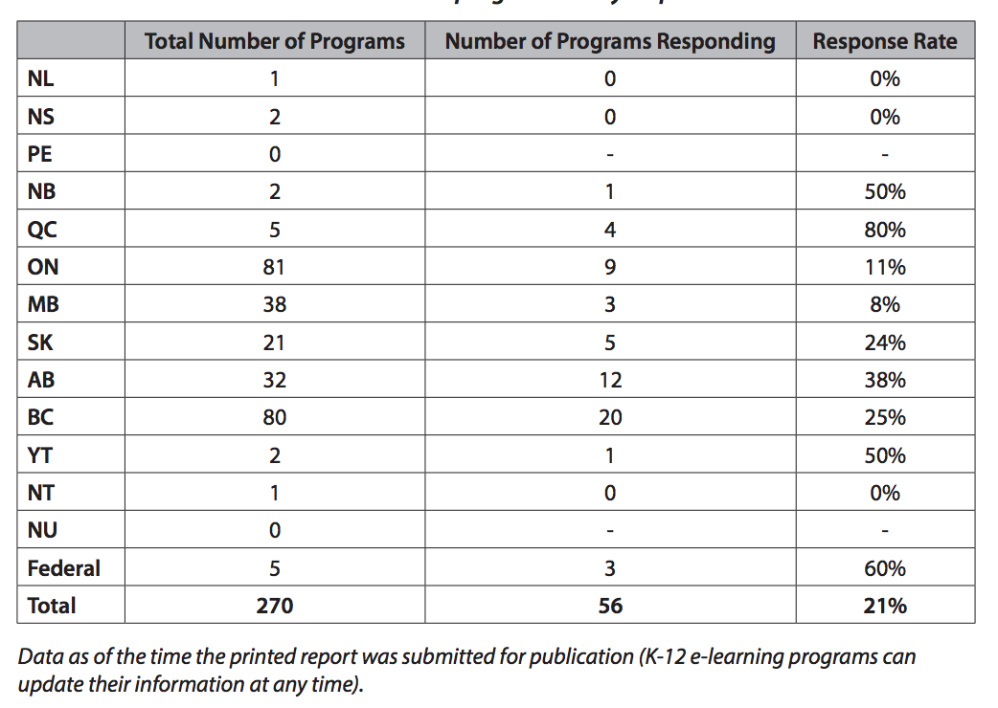
Methodology

Slide 7
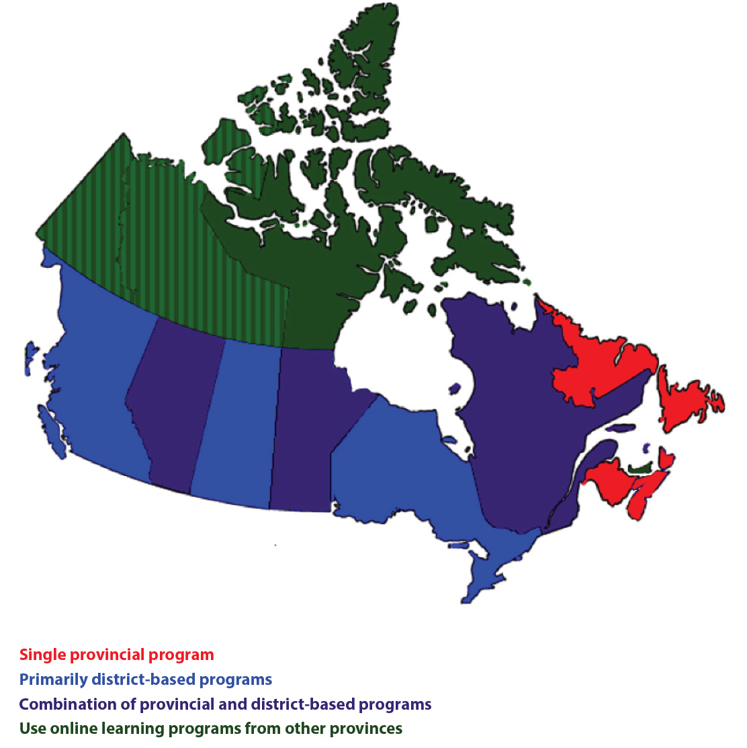
National Overview

Slide 8
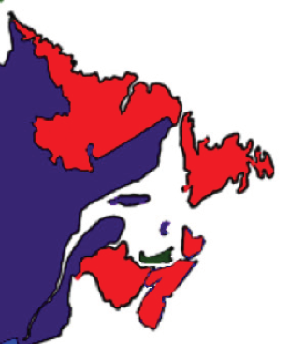
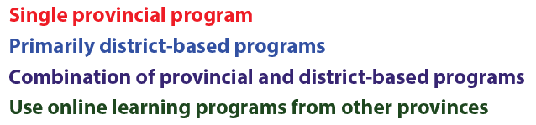
Atlantic Canada

Slide 9
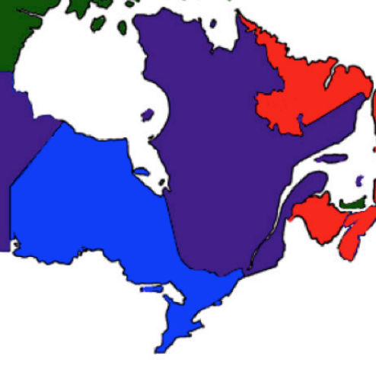
Central Canada

Slide 10
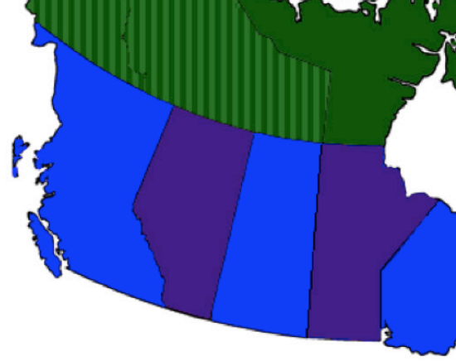
Western Canada

Slide 11
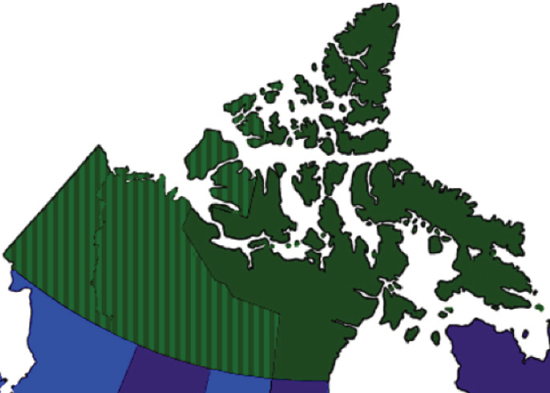
Northern Canada

Slide 12
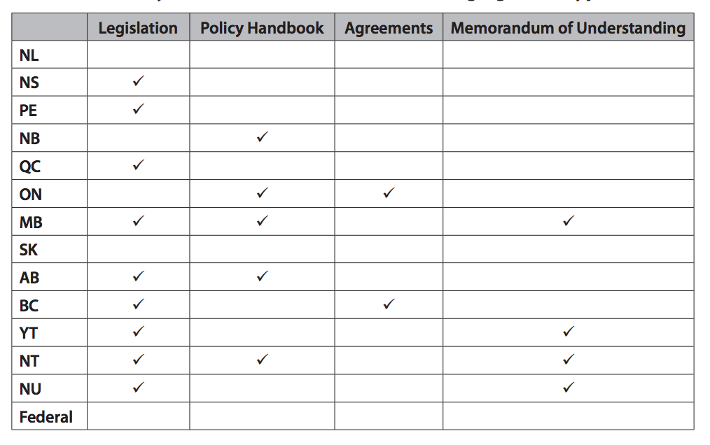
Regulation

Slide 13
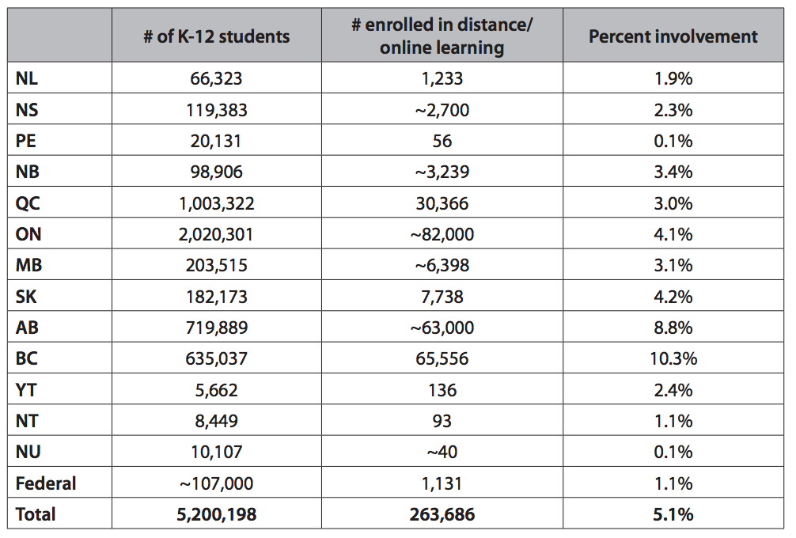
Activity: Distance & Online Learning

Slide 14
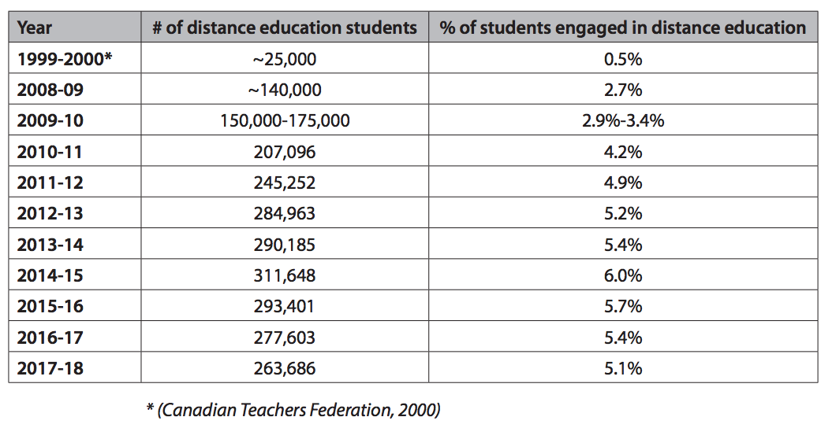
Activity: Distance & Online Learning

Slide 15
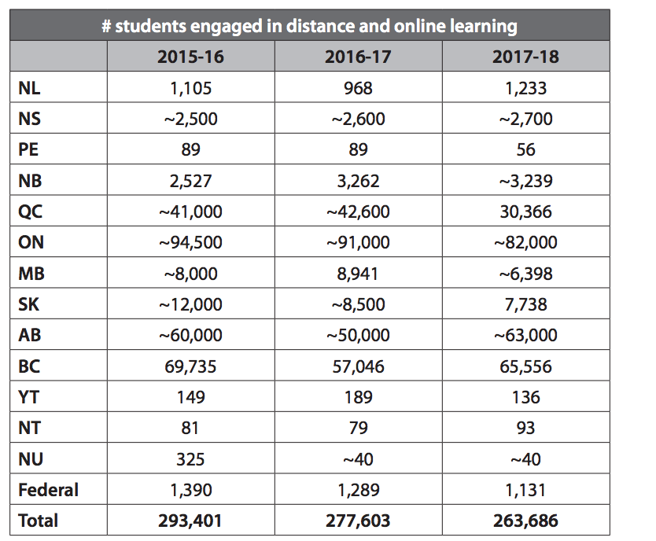
Activity: Distance & Online Learning

Slide 16
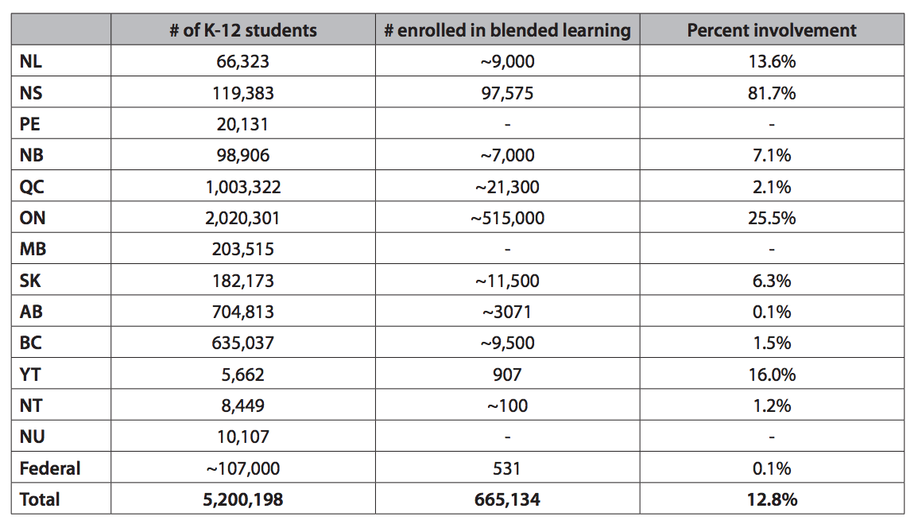
Activity: Blended Learning

Slide 17
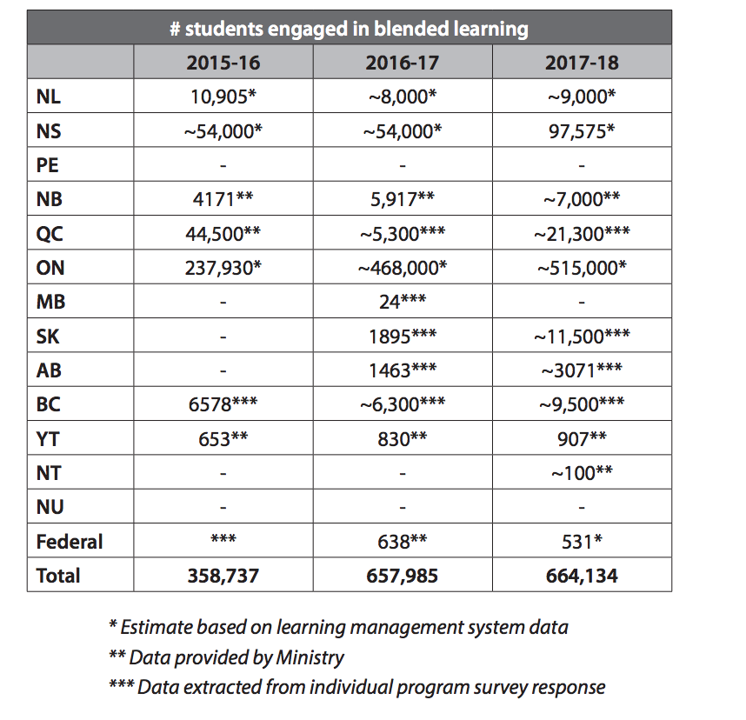
Activity: Blended Learning

Slide 18
http://k12sotn.ca

Slide 19

Your Questions and Comments

Slide 20

Associate Professor of Instructional Design
Touro University, California
  mkbarbour@gmail.com
  http://www.michaelbarbour.com

