Slide 1
Introduction to LCS(2)- Application Scenarios,Ongoing Exploration and Demo
Pengfei Wu
PhD Student in BNU
Email:wupengfei_2000@163.com
Ema@gmail.com
Modern Educational Technology Research Institute
School of Educational Technology，Faculty of Education，
The Joint Laboratory for Mobile Learning，Ministry of Education- China Mobile Communications Corporation
Beijing Normal University
Notes:
Good morning .professor anderson.Welcome to our Lab.My name is wupengfei.I am a PhD student .My supervisor is Prof. Yu Shengquan.
Now I am very glad to introduce the application scenarios of LCS and give you a demo.
I take the course of “New Development of Educational Technology” for example.
scenarios
英 [sɪ'nɑ:ri:əʊz] 美 [sɪ'nɑ:ri:oʊz]

Slide 2
Application Scenarios
1. Construction of Digital Resource Library
In a school, school-based resource library can be built by teachers.
In a company, HR department can make staff engage in the collaborative construction of enterprise resources for training.

Slide 3
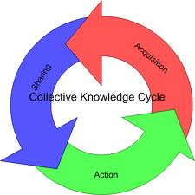
2. Knowledge Management
Application Scenarios
For individual consumer
Build personal knowledge base
Build personal knowledge network
Weave your interpersonal network for learning
For organizational consumer
Encourage your staff to create learning cells with their practical experiences
Transfer and share these knowledge represented by learning cell in the organization
Promote Tacit knowledge and explicit knowledge conversion to each other
Improve organization performance

Slide 4
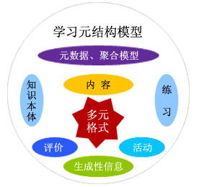
3. Organizational Learning
Application Scenarios
LCS is not only a CMS, but also provide functions of LMS
Learning community can help to aggregate contacts and organization wisdom and promote communications among staff
Online assessment based on the learning procedural information can drive employees online learning
Build learning organization
We are using LCS to build a learning research team.
Notes:
LCS is not only a CMS, but also provide functions of LMS
Besides continuously emerging resources, there are also abundant learning activities and kinds of personal gadgets for learning
Learning community can help to aggregate contacts and organization wisdom, promote communications among staff
Online assessment based on the learning procedural information can drive employees online learning

Slide 5
4. Project Management
Application Scenarios
It can be used as a platform of project management
Learning Community provides functions of announcement, BBS, resource sharing, membership management, task management and activity management.
Task allocation and program monitoring

Slide 6
5. Regional Study of Teaching
Application Scenarios
Sharing and collaborative editing of teaching plans
Teachers in different schools can co-design a common teaching plan when they will have the same class in the near future.
Teachers can also set up research group using learning community freely to solve specific discipline problem.

Slide 7
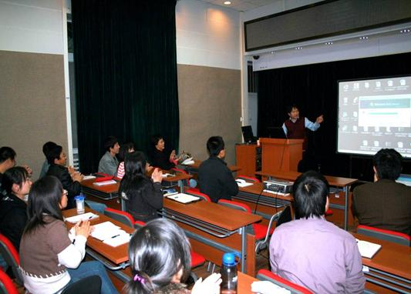
6. College Teaching and Learning
Application Scenarios
Unlike traditional LMS, such as BB, Moodle, Sakai…
LCS has much web2.0 features and pays more attention to the construction of social learning network.
It can also undertake tasks of college teaching.
A doctoral course named new developments of educational technology instructed by Prof. Shengquan YU
15 participants, one semester
Notes:
All the above are the application scenarios.Next I will introduce ongoing exploration of learning cell.

Slide 8
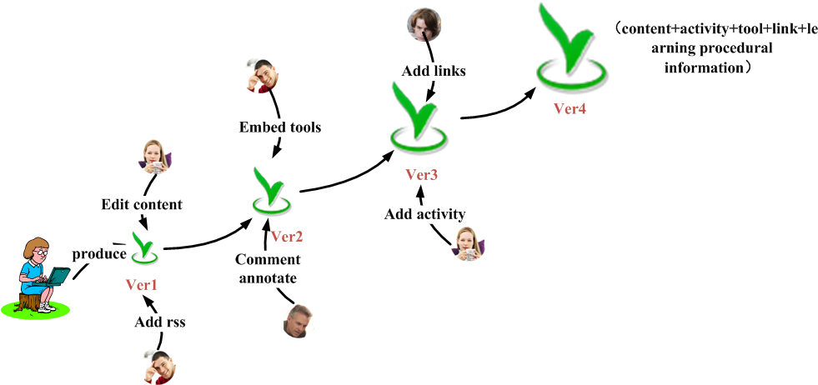
Ongoing Exploration
1. Orderly Evolution of Learning Resource in U-Learning Environment
Research Goal
Consider learning resource as an organism from the ecological perspective, combining semantic gene and social trust model technologies to automatically control the orderly evolution of learning resource in an open ecological system

Slide 9
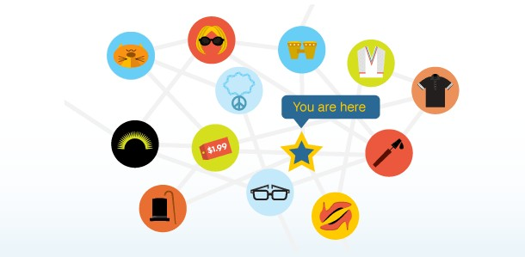
2. Personalized Recommendation of Learning Resource in U-Learning Environment
Ongoing Exploration
Research Goal
Design a Personalized Recommendation Model of Content (PRMC) in u-Learning environment and realize the personalized recommendation of LC based on this model.

Slide 10
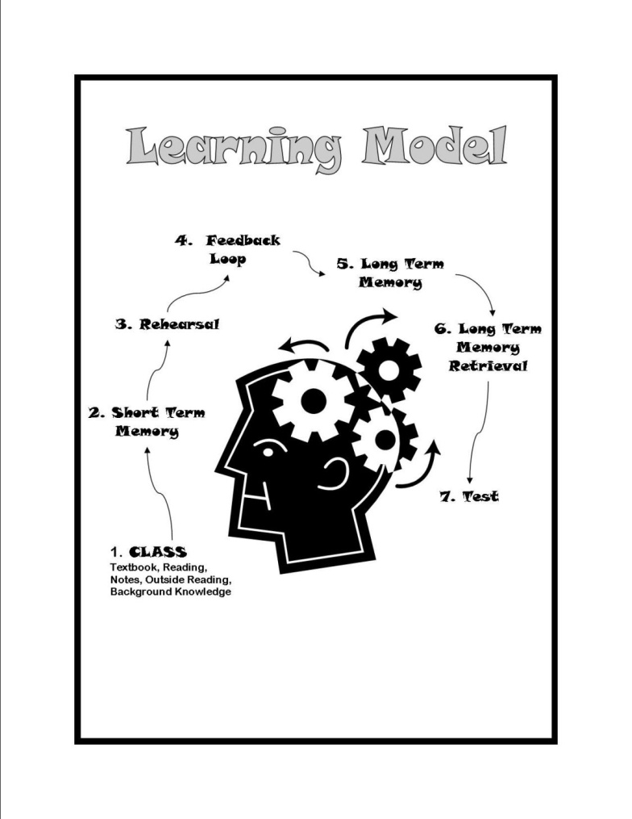
3. Learning Model Design for U-Learning Based on LC
Ongoing Exploration
Research Goal
Design an effective multidimensional learning model based on learning cell and validate the effect

Slide 11
4. Automatic Construction of Visual Social and Knowledge Network
Ongoing Exploration
Research Goal
Automatically construct social and knowledge network through mining kinds of learning procedural information (comment, create, annotation, invitation, add friends, questions and answer, test…)
Contribute
Lc
Contribute
Lc
relateTo
Lc
relateTo
OWN
Subscribe
View
Contribute
Lc
Collect
Create
Friend
Friend
relateTo
Friend
Friend
Lc
relateTo
Lc
Create

Slide 12
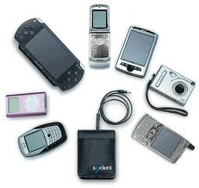
5. Adaptive Presentation of Learning Content on Multi-Devices
Ongoing Exploration
Research Goal
Explore an adaptive presentation technology to implement the self-adaption adjustment of learning cell on different learning devices

Slide 13
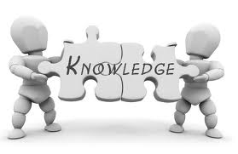
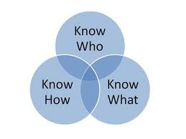
6. Design of Structured Knowledge Template
Ongoing Exploration
Research Goal
Design various resource templates for different types of knowledge based on multimedia learning theories
Help users to create high-quality learning cells quickly

Slide 14
Demo Multiple Learning Models based on LCS
Learning by reading/ learning by listening/ learning by watching
Learning by doing/ acting
Learning by connecting
Learning by re-organizing
Learning by reflection
Learning by communicating
Learning by teaching
Learning by creating
Learning by comparing
Notes:
Now let us look at a demo of multiple learning models based on LCS . The multiple learning models include learning by reading…

Slide 15
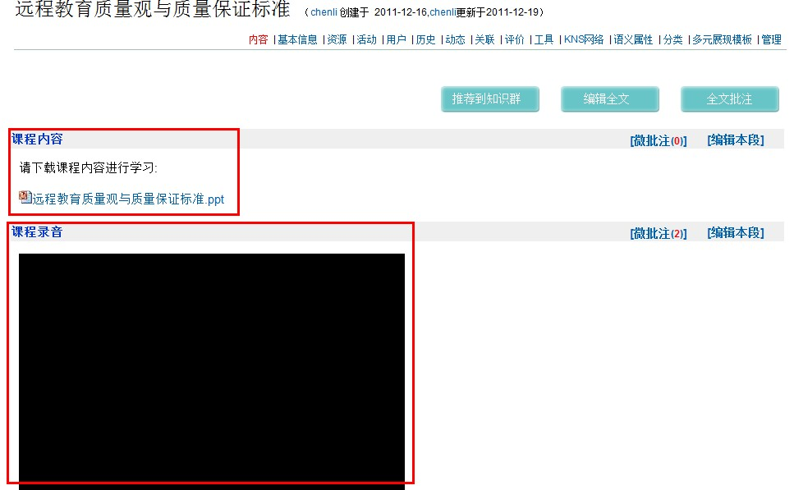
Demo .
Learning by reading/ learning by listening/ learning by watching

Slide 16
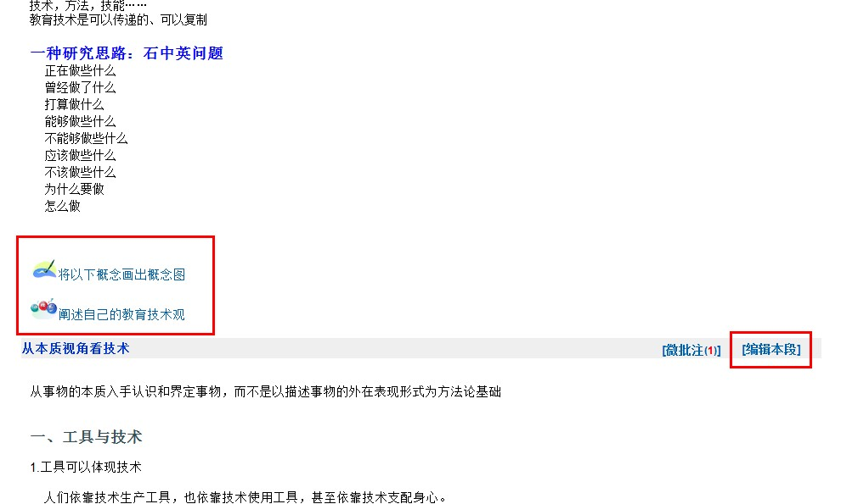
Demo .
Learning by doing/ acting

Slide 17
Demo .
Learning by reading/ learning by listening/ learning by watching (Learning pattern based on learning object )
Learning by doing/ acting (Learning pattern based on learning activities )
Learning Cell has reconciled the two ways through integrating the content, activities and resources. Therefore, students can naturally enter in the closely related learning activities and achieve better learning experience.

Slide 18
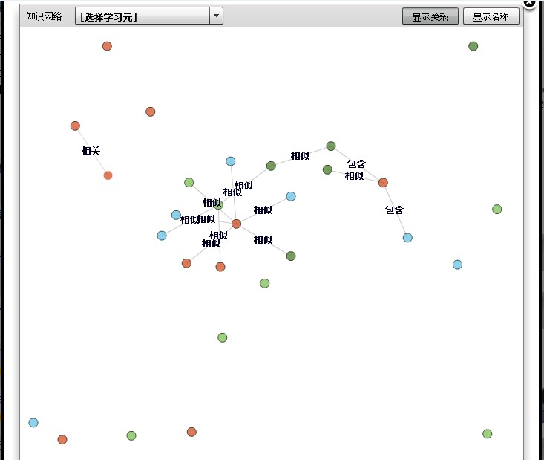
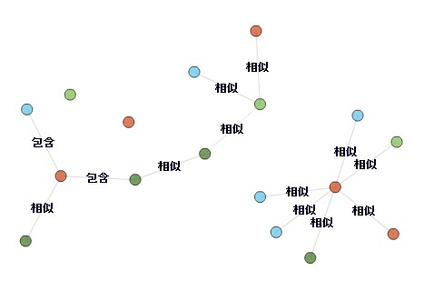
Demo .
Learning by connecting

Slide 19
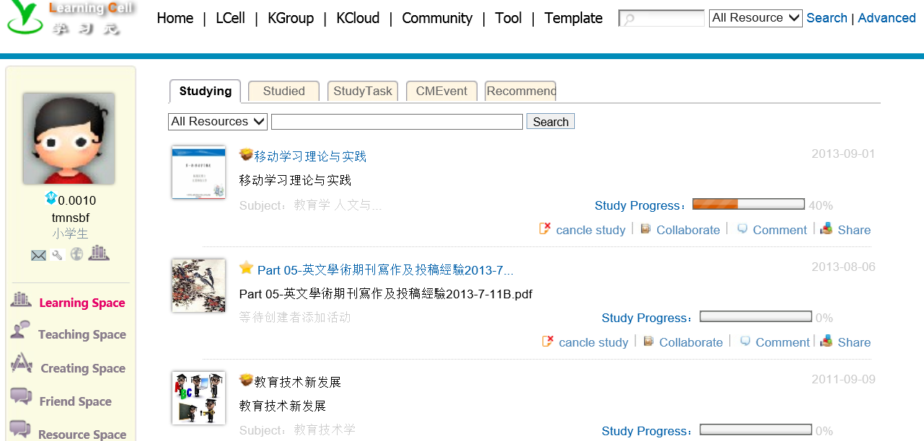
Demo .
Learning by re-organizing

Slide 20
Demo .
Learning by connecting
Since semantic relatedness and visual navigation has provided the connection of knowledge, we can better understand the knowledge structure from the overall perspective. Also thinking from multiple perspective is helpful to deepen the understanding of knowledge, inspire us and promote innovation.
Learning by re-organizing
Through the polymerization tools of learning cell, learners can freely organize and manage numerous small units of knowledge, construct their own knowledge system which has definitely promoted the learners 'knowledge management.
Notes:
polymerization[英][ˌpɔliməraiˈzeiʃən] [美][pəˌlɪmərɪˈzeʃən, ˈpɑləmə-]

Slide 21
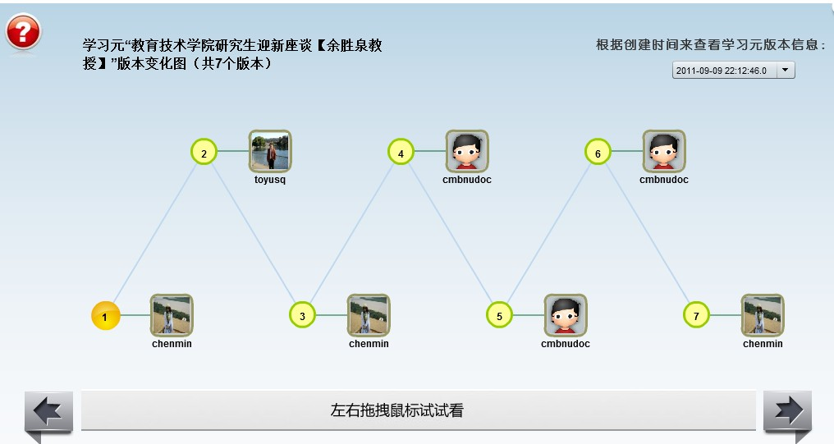
Demo .
Learning by reflection

Slide 22
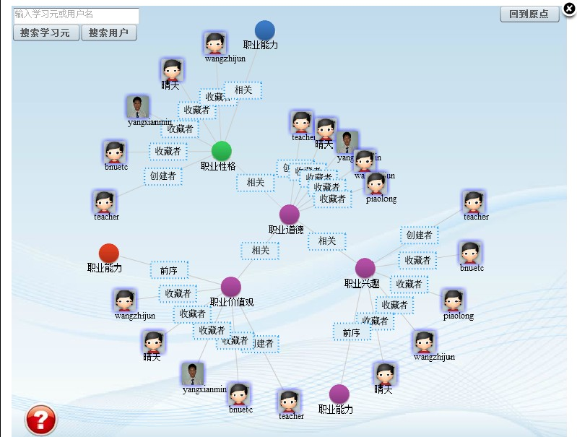
Demo .
Learning by communicating

Slide 23
Demo .
Learning by reflection
The learners can not only learn the content, but also see the growth and construction history of a knowledge unit and during this process of situation, learners can reflect the knowledge logic.The environment of LC retains the detailed record for the learners and provides training and evaluation so that learners can reflect their own learning in the learning process.
Learning by communicating
Acquiring knowledge not only through physical learning object， but also from experts， learners related by the learning object， learners can construct social cognition network closely related to learning content and fully absorb the wisdom of others through communication.
Notes:
cognition[英][kɔɡˈniʃən]

Slide 24
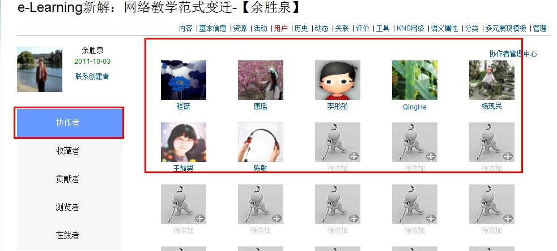
Demo .
Learning by teaching

Slide 25
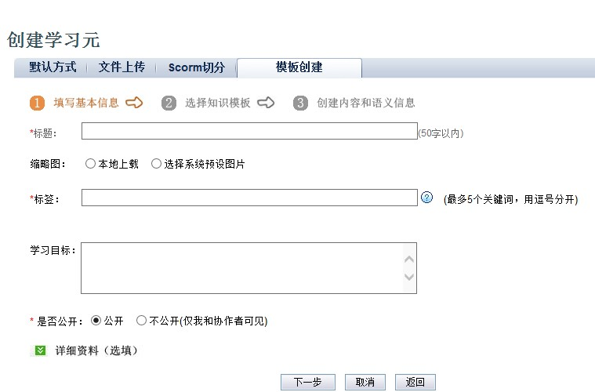
Demo .
Learning by creating

Slide 26
Demo .
Learning by teaching
Learners often switch the “teaching”and “learning”role during the communication and collaborative editing process. And many studies have shown that, in the “teaching” process, learners can often better memorize and understand the teaching content.
Learning by creating
The LC learners not only accept the knowledge passively, but also construct expression, contribute wisdom actively, create new knowledge in the basis of comprehension, recombination and reflection.

Slide 27
Demo .
The Learning environment of LCS provides open creative atmosphere , convenient tools and the binding mechanism of knowledge ontology, voting and verification to ensure the content growth direction people create collaboratively.
Therefore, LCS provides an ideal platform for combination of learning and creation.

Slide 28
Thanks for Your Attention
LEARNING CELL
欢迎访问学习元平台：http://lcell.bnu.edu.cn

