Slide 1

State of the Nation Study: K-12 Online Learning in Canada
Michael K. Barbour
Wayne State University

Slide 2
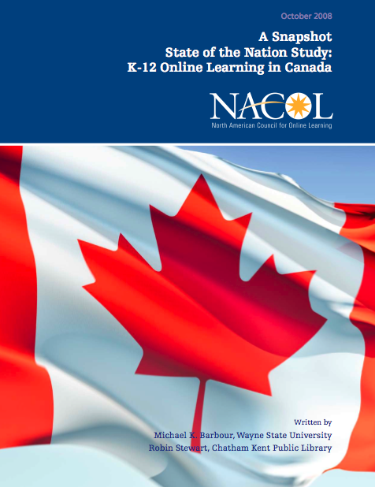
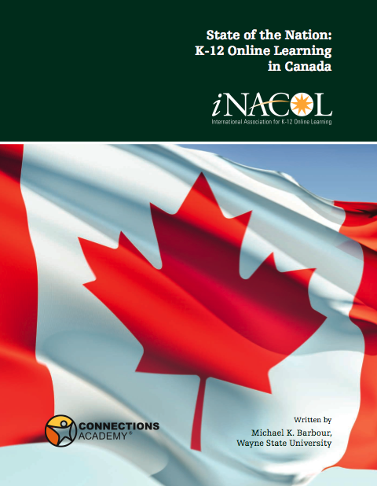
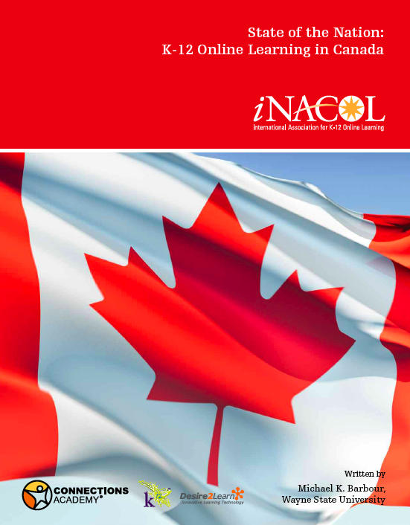
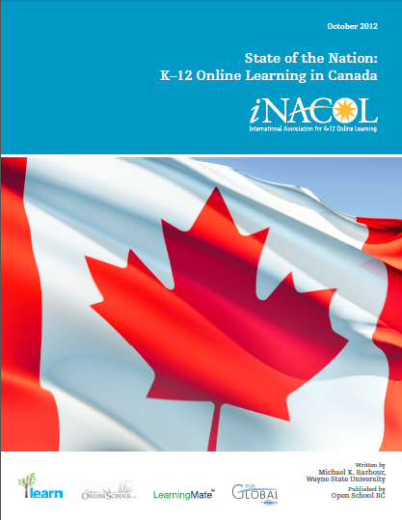

Slide 3




Slide 4
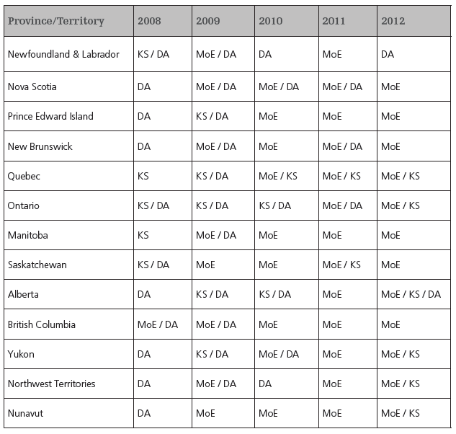
Methodology

Slide 5
National Trends
K–12 distance education continues to grow
Correspondence education continues to be prevalent
Blended learning is seen as effective ICT
Unions remain cautiously supportive
Several jurisdictions have made dramatic changes over the past five years

Slide 6
National Trends: Regulation
Many provinces and territories have some reference to distance education in the Education Act or Schools Act
  This is changing!
regulation of K–12 distance education is the use of contracts with MoE or policy handbooks
British Columbia and Nova Scotia are major exceptions

Slide 7
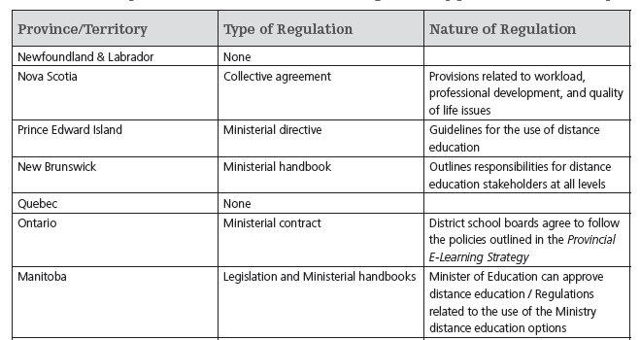
National Overview - Regulations

Slide 8
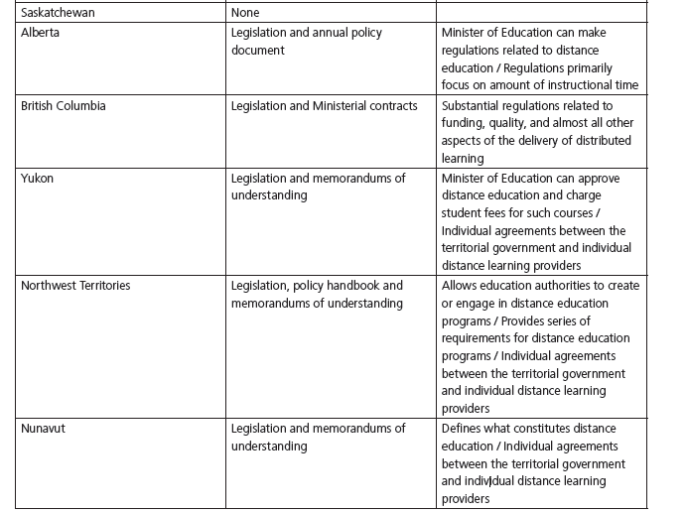
National Overview - Regulations

Slide 9
National Trends: Activity
Growth of K-12 distance education is quite uneven
  Reported growth in some jurisdictions may be due to better accounting
Participation in blended learning is not counted in most instances

Slide 10
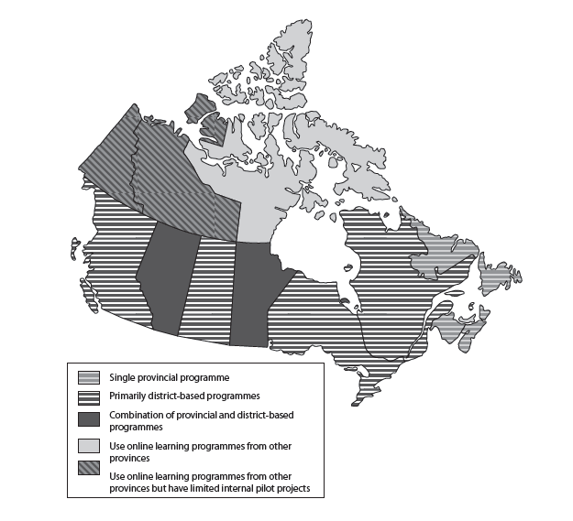
National Overview - Activity

Slide 11
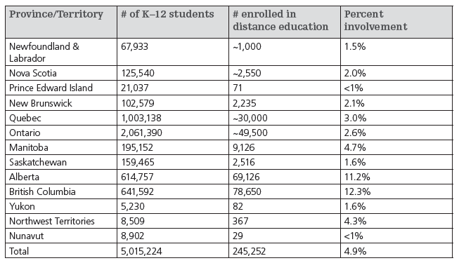
National Overview - Activity

Slide 12
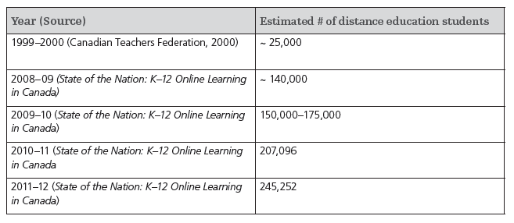
National Overview - Activity

Slide 13
Conclusions / Take-Aways
Regulatory behaviour varies considerably from no to extensive regulations
Level of activity is increasing nationally, but to what level we just can’t tell definitively

Slide 14

http://virtualschool.wikispaces.com/canada/

Slide 16

Your Questions and Comments

Slide 17

Assistant Professor
Wayne State University, USA
  mkbarbour@gmail.com
  http://www.michaelbarbour.com

