Slide 1
Copyright in Canada
Creative Commons Attribution 3.0 License
(some images fair dealing)
Pentalogy & Bill C-11
Rory McGreal
September 2012

Slide 2
I am not a lawyer
X
Notes:
http://www.myfreedomfoundation.com/Uploads/lawyer_cartoon.gif

Slide 3
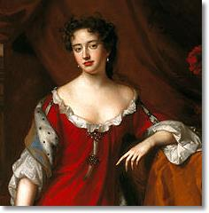
Myth 1. Copyright was instituted to protect the rights of the copyright owner
An Act for the Encouragement of Learning
Statute of Queen Anne 1710
Notes:
http://www.yay-today.com/wp-content/uploads/2010/09/queen_ann_portrait.jpg
Copyright was instituted to protect the rights of the copyright owner.
Copyright isn't on a par with the right to life, liberty, fraternity and equality before the law. It's a privilege extended to us by our fellow citizens because they recognise the value they get out of our efforts.

Slide 4
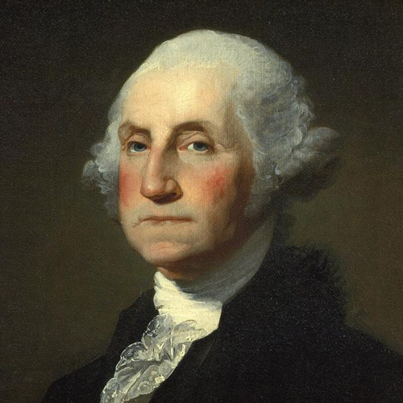
USA: Copyright Act 1790:
An Act to Promote the Progress of Science and the Useful Arts
George Washington
Notes:
http://cinemaknifefight.files.wordpress.com/2012/06/washington.png

Slide 5
Myth 2. Copyrighted materials are intellectual “property”
“Inventions cannot be a subject of property”
President Thomas Jefferson
Notes:
http://files.libertyfund.org/img/ThomasJefferson250.jpg
Thomas Jefferson was zealous in his opposition to making copyright a property law.

Slide 6
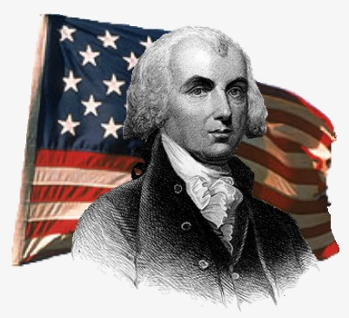
“incentive NOT property or natural law is the foundational justification for American copyright - It is a privileged monopoly.”
President James Madison
Notes:
http://1.bp.blogspot.com/-zga__mt4wbE/T1sz0YUnrXI/AAAAAAAAETU/QQYB5IDL-wk/s1600/34.jpg

Slide 7
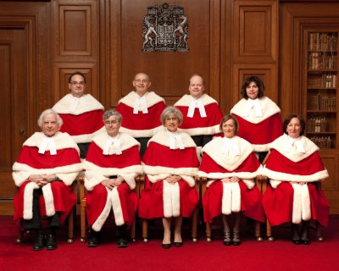
Canadian Supreme Court
Pentalogy, July, 2012
Notes:
http://www.scc-csc.gc.ca/images_scc/popup/pi_16.jpg

Slide 8
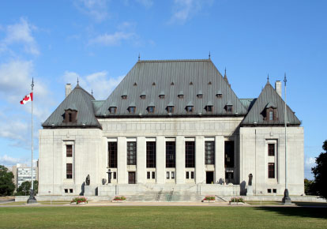
5 Court cases
Entertainment Software Association, et al. v. Society of Composers, Authors and Music Publishers of Canada
Rogers Communications Inc., Rogers Wireless Partnership and Shaw Cablesystems G.P., Bell Canada and Telus Communications Company and Respondent SOCAN can be found here:
Re:Sound v. Motion Picture Theatre Associations of Canada, et al.
Society of Composers, Authors and Music Publishers of Canada, et al. v. Bell Canada, et al.
Province of Alberta as represented by the Minister of Education;, et al. v. Canadian Copyright Licensing Agency Operating as "Access Copyright"

Slide 9
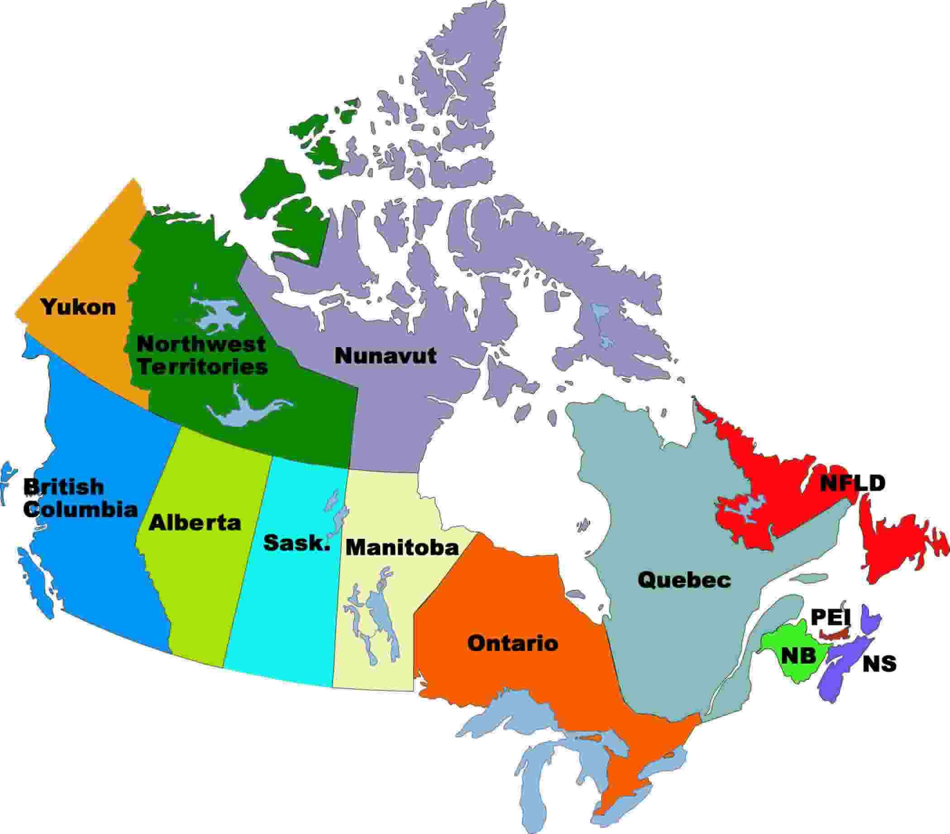
Fair Dealing
All anglophone provinces vs. Access Copyright
SC strongly restated fair dealing as a RIGHT
Copy portions without permission for research AND
Education NOT separate from research
Vs
X
Notes:
http://www.revenuecanada666.com/uploads/5/2/1/1/5211185/2450474_orig.jpg
http://drawn.ca/wordpress/wp-content/uploads/2009/10/AccessCopyrightLogo1.jpg
http://www.campusaccess.com/images/map-canada.jpg

Slide 10
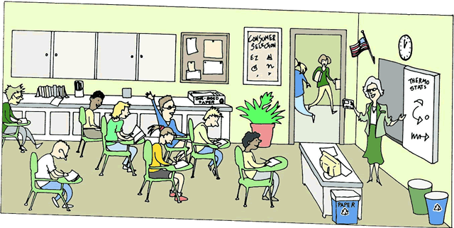
Fair Dealing
WRONG RIGHT
NO Class copies
Class copies are ok
✗
✔
Notes:
http://srhabay.wikispaces.com/file/view/classroom.gif/39167168/classroom.gif

Slide 11
Fair Dealing
WRONG RIGHT
NOT when required for a course
Class copies are ok when required, optional or supplementary
Notes:
http://sustainability.utoronto.ca/Assets/Sustainability+Digital+Assets/Projects/rewire/Rewire+-+Resources+-+Supplementary.gifhttp://sustainability.utoronto.ca/Assets/Sustainability+Digital+Assets/Projects/rewire/Rewire+-+Resources+-+Supplementary.gif
http://www.running-advice.com/images/onlineStoreIcons/required_reading.jpg

Slide 12
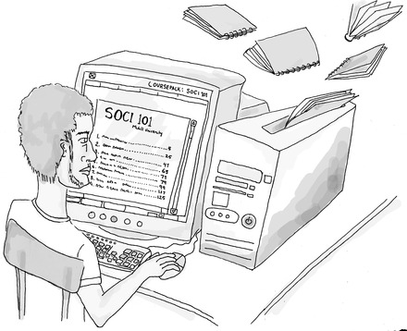
Fair Dealing
WRONG RIGHT
NO course packs
Course packs are ok
Notes:
http://www.mcgilldaily.com/wp-content/uploads/2008/03/graphicsashaplotnikovacoursepacks_medium-4982.jpg

Slide 13
Fair Dealing
WRONG RIGHT
ONLY one copy in library reserve
Library reserve ok with multiple copies
Notes:
http://english.illinoisstate.edu/graphics/digitalReserve.jpg

Slide 14
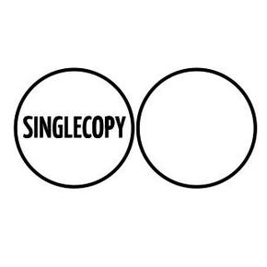
Fair Dealing
WRONG RIGHT
Single copies only for personal use
Class copies are allowed
Notes:
http://freemusicarchive.org/file/images/albums/Single_Copy_-_Survivors_-_2012041660516468.jpg?method=crop&width=290&height=290
http://www.blogcdn.com/www.tuaw.com/media/2009/10/db_thl.jpg

Slide 15
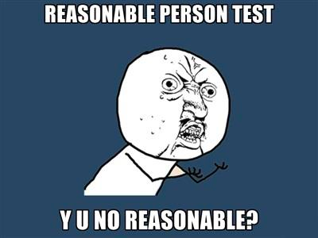
Fair Dealing
WRONG RIGHT
A “reasonable amount” can be copied with a liberal interpretation
10% limit or even 5%
Notes:
http://www.sd83.bc.ca/~rcadden/S00902ED1.6/Image_Percent.gif
http://lawiscool.com/wp-content/uploads/2012/05/reasonable-person-test.jpg

Slide 16
Fair Dealing
WRONG RIGHT
Only for published works
Applies to ALL works
Notes:
http://bookishpublishers.files.wordpress.com/2012/02/online-china-writing.jpg
http://www.robgreydesign.com/img/Publications/Publication-group.jpg

Slide 17
Fair Dealing
WRONG RIGHT
Digital “book burning” is necessary
Destroying copies has little relevance if any
Notes:
http://www.paulvwalters.com/wp-content/uploads/2011/09/burning-books-thumb1997486.jpg

Slide 18
Fair Dealing
WRONG RIGHT
Different rules for paper & digital
Technologically neutral
Notes:
http://discovermagazine.com/misc/images/digital.jpg
http://www.cbc.ca/books/canadareads/bookstack-175.jpg

Slide 19
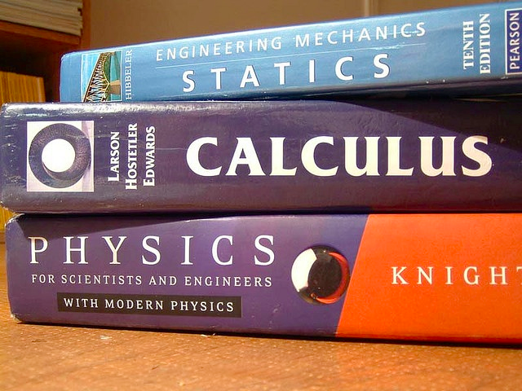
Fair Dealing
WRONG RIGHT
Digital reserve cannot substitute for buying whole book
Using a portion of a work should NOT force the institution to buy the whole book
Notes:
http://5.mshcdn.com/wp-content/uploads/2012/08/textbooks.jpg

Slide 20
Fair Dealing
WRONG RIGHT
Overly restrictive & unnecessary requirements
Liberal interpretation
Notes:
http://activerain.com/image_store/uploads/6/9/0/5/8/ar125631040985096.jpg
http://us.123rf.com/400wm/400/400/jesterarts/jesterarts1205/jesterarts120500042/13799191-3d-orange-man-pulling-a-giant-globe--a-general-and-vague-concept-open-to-interpretation.jpg

Slide 21
Fair Dealing
WRONG RIGHT
Course content is only fair dealing until the end of a course after which the copy must be destroyed
Not necessarily limited by time
Notes:
http://us.cdn2.123rf.com/168nwm/dvarg/dvarg1208/dvarg120800089/15019440-twenty-ninth-december-in-calendar-burning-icon-on-black-background.jpg

Slide 22
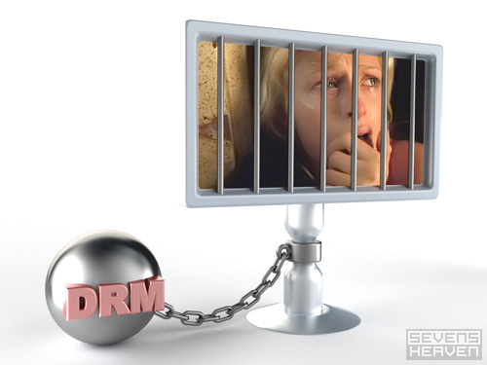
Technological
Protection
Measures
Notes:
http://www.thewavingcat.com/wp-content/uploads/2006/05/illustration-illustratie_drm-prison%5B1%5D.jpg

Slide 23
Includes EDUCATION in Fair Dealing
Expands the pentalogy conditions even further
Fear of being sued is reduced:
MUST prove financial harm
$5K limit on fines for non-commercial infringements
Notes:
http://www.adpostuae.com/wp-content/uploads/2012/03/99308.education_logo.png

Slide 24
AUCC Silence
The “Pentalogy” and Alberta v. AC vindicate the principled decision to oppose the AUCC’s recommendation for a fair dealing policy and opt out of the AUCC-Access Copyright model license -- Mark McCutcheon
Notes:
http://4.bp.blogspot.com/-Kz_tIs5xzkM/T7lCfhHiYlI/AAAAAAAAAUk/S68j8CfT84k/s1600/silence1jpg-468x.jpg

Slide 25
Copyright Board
Access Copyright’s “enforcer”
SC decision is referred back to them
AUCC is not on our side
A “copyright grab” by AC is possible – compulsory tariff
Notes:
http://www.brocku.ca/webfm_send/15672

Slide 26
Support for Authors
Universities and students buy texts
Universities license works
This supports authors
This is not a copyright free-for-all
Notes:
http://www.delizonpublishers.com/images/authors.jpg

Slide 27
I am not a lawyer
X
Notes:
http://www.myfreedomfoundation.com/Uploads/lawyer_cartoon.gif

Slide 28
rory@athabascau.ca
Notes:
http://people-equation.com/wp-content/uploads/Thank-you.jpg

