Slide 1
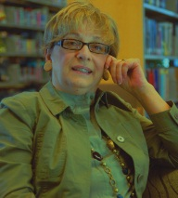
Experiencing contiguous teaching
and the student impact:
Describing the blended teacher as bricoleur.
M. Cleveland-Innes, Ph.D.

Slide 2
The complexity of blends
More than multiple colors…..
“the organic integration of thoughtfully selected and complementary face-to-face and online approaches” (p.148)
and
“a complex weaving of the face-to-face and online communities so that participants move between them in a seamless manner—each with its complementary strengths” (p. 27)
Garrison & Vaughan, 2008

Slide 3
Faculty role change
"...... teaching and course materials (have become) more sophisticated and complex in ways that translate into new forms of faculty work. ..... such new forms are not replacing old ones, but instead are layered on top of them, making for more work." (Rhoades, 2000, p, 38)
New ways of teaching will make it more difficult for faculty to be exemplars of research and teaching (Fairweather, 2002).
The individualization of communications,
and the role of instructor as a facilitator of student participation and learning, add to instructor workload when teaching online (Davidson-Shivers, 2009).

Slide 4
The Argument
Teaching in online or blended environments constitutes a new role for the teacher.
In this new role, support for learner independence and interdependence will be mixed with the most innovative and creative delivery options.
The complex role of a blended/online teacher will take a dynamic, flexible quality in the nature of bricoleur – using all that is available to create learning.
Notes:
Despite its continuing growth, the use of social software in education is still in its infancy and there is little empirical research exploring the adoption of social software by students in blended or online learning environments.
While social software may be used by students to promote personal interests, it is unclear how learners can embrace this new learning platform for educational purposes.
The purpose of this study was to develop a grounded theory regarding the adoption of social software applications among students in blended and online learning environments.
Central Research Question:
What factors promote or hinder the adoption of social software applications among students in blended and online learning environments?
Sub -Questions:
What role, if any, does the instructor play in supporting the adoption of social software among students in blended and online learning environments?
Can social software encourage meaningful interactions and learning among students in blended and online learning environments, and if so, how might it occur?

Slide 5
The approach
Autoethnography is where “the investigator creates an ethnographic description and analysis of his/her own behavior, attempting to develop an objective understanding of the behaviors and work context under consideration by casting the investigator as both the informant 'insider' and the analyst 'outsider‘ ” (Cunningham & Jones, 2005, abstract).
Cunningham, S.J., Jones, M. 2005. Autoethnography: a tool for practice and education. Proc. of the 6th New Zealand Int. Conf. on Computer-Human Interaction, 1-8.
Create research focus
Document personal reflection data
Document self-observation data
Document personal memory data
Compare to external data
Chang, H. 2008. Autoethnography as method. Walnut Creek, CA: Left Coast Press.
COHERE 2011
Christie, Cleveland-Innes, Gauvreau

Slide 6
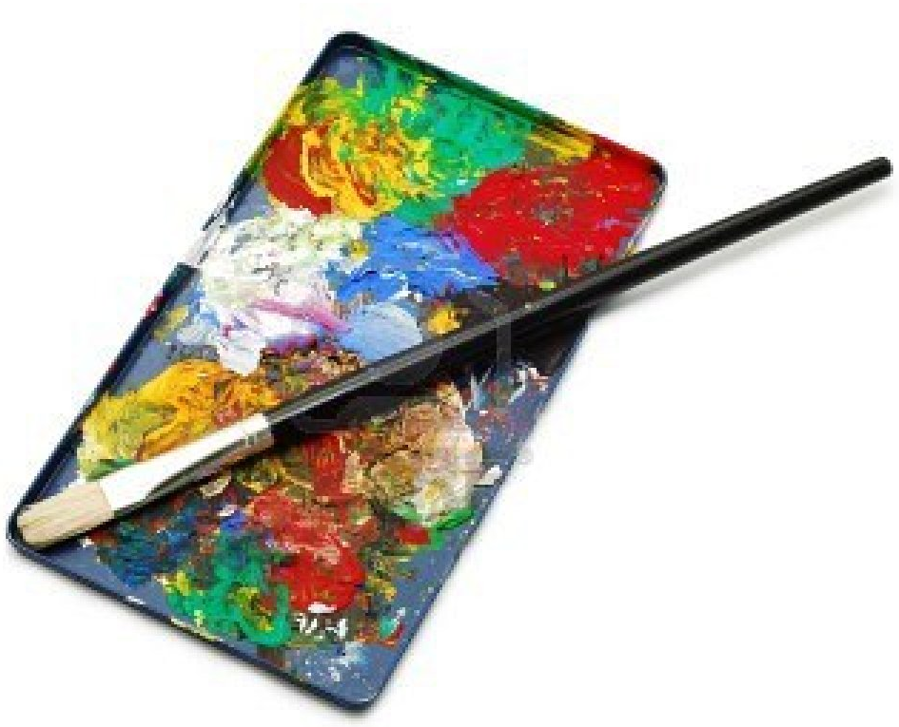
The application of a blended CoI “ “ensuring students have time to reflect on meaning and engage in discourse to share understanding”
 | Face-to-face | Virtual
Teaching presence | Design Facilitation Direct instruction | Design Facilitation Direct instruction
Social presence | Open communication Affective expression Group cohesion | Open communication Affective expression Group cohesion
Cognitive presence | Triggering event Exploration Integration Resolution | Triggering event Exploration Integration Resolution

Slide 7
Blended teacher as bricoleur
A bricoleur is one who creates or crafts from a diverse range of materials and tools which happen to be available.
The teacher as bricoleur makes a series of professional judgments about what and how to teach.
Honan, 2004
The blended teacher as bricoleur makes a series of professional judgments about what and how to teach using the diverse range of material and tools available….
Honan, E. (2004) Teachers as bricoleurs: producing
plausible readings of curriculum documents,
English Teaching: Practice and Critique, 3(2), 99–112.
Available online at: http://education.
waikato.ac.nz/research/files/2004v3n2art6.pdf

Slide 8
Student response
LEARNING ENVIRONMENT | 4.88/5
INSTRUCTOR SUPPORT | 4.78/5
EVALUATION | 4.33/5
FACILITATION | 4.14/5
DIRECT INSTRUCTION | 4.16/5

Slide 9
THANK YOU
full marks

