Slide 1
State of the Nation Study: K-12 Online Learning in Canada
Michael K. Barbour
Wayne State University

Slide 2
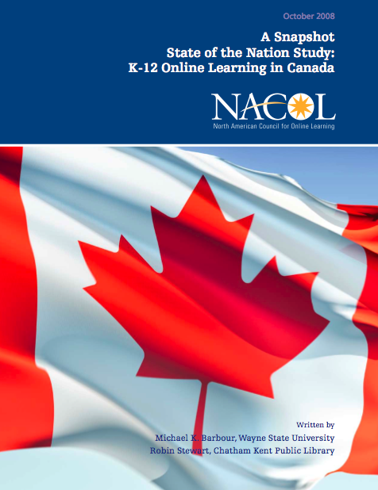
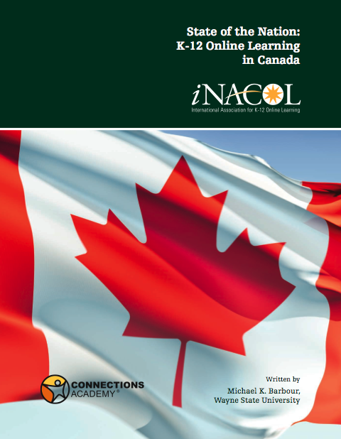
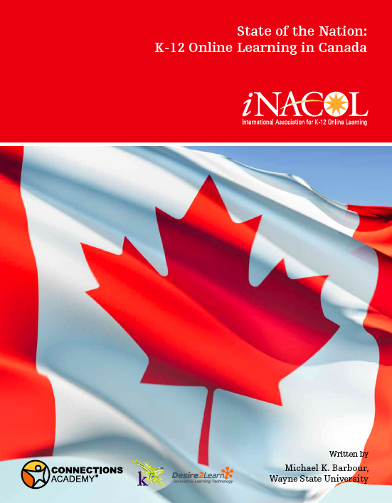

Slide 4
Methodology
Province/Territory | 2008 | 2009 | 2010 | 2011
Newfoundland & Labrador | KS / DA | MoE / DA | DA | MoE
Nova Scotia | DA | MoE / DA | MoE / DA | MoE / DA
Prince Edward Island | DA | KS / DA | MoE | MoE
New Brunswick | DA | MoE / DA | MoE | MoE / DA
Quebec | KS | KS / DA | MoE / KS | MoE / KS
Ontario | KS / DA | KS / DA | KS / DA | MoE / DA
Manitoba | KS | MoE / DA | MoE | MoE
Saskatchewan | KS / DA | MoE | MoE | MoE / KS
Alberta | DA | KS / DA | KS / DA | MoE
British Columbia | MoE / DA | MoE / DA | MoE | MoE
Yukon | DA | KS / DA | MoE / DA | MoE
Northwest Territories | DA | MoE / DA | DA | MoE
Nunavut | DA | MoE | MoE | MoE

Slide 5
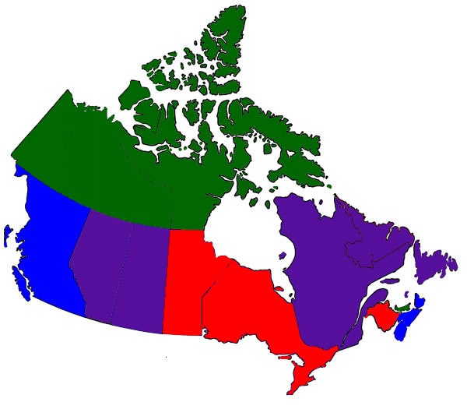
National Overview - Regulations
Legislative regime
Policy regulations
No real regulations
Memorandums of Understanding with other provinces

Slide 6
National Trends
Regulations varied significantly
Method of delivery is still print-based in many instances
Greater reliance upon synchronous tools than elsewhere
~210,000 K-12 students took one or more DE courses

Slide 7
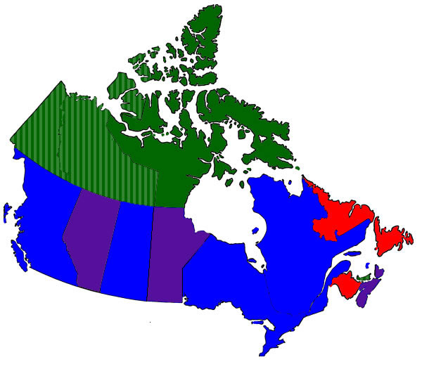
National Overview - Activity
Single provincial programme
Primarily district-based programmes
Combination of provincial and district-based programmes
Use programmes from other provinces

Slide 8
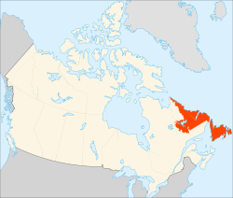
Newfoundland and Labrador
Online learning began in mid-1990s with district-based programmes
Single province-wide programme since 2001
No specific policies for online learning, but provincial programme is housed within MOE
Between 1,500 – 1,800 enrolments & 1,000 students annually

Slide 9
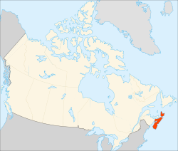
Nova Scotia
Online learning began in 2003
Creation of a single province-wide programme
11 provisions included in the agreement between the Government & teachers union
Between ~2,500 students annually

Slide 10
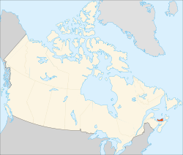
Prince Edward Island
Small video conferencing programme & uses online learning programme in New Brunswick
MOE has issued two directives since 2001 containing guidelines for the use of distance education in K-12 environment
Approximately ~65 students annually

Slide 11
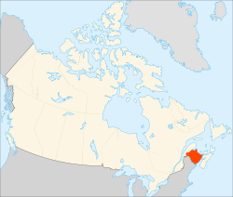
New Brunswick
Online learning began in 1998
Single province-wide programme
used frequently by face-to-face teachers too
No specific policies for online learning, but provincial programme is housed within MOE
~1,800 students annually in both programmes

Slide 12
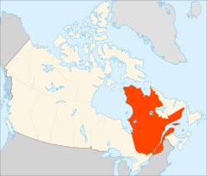
Quebec
MOE devolved distance education
Société de formation à distance des commissions scolaires du Québec (SOFAD)
Approximately 27,000 enrolments
Learn Quebec
Approximately 300 enrolments*
Écoles éloignées en réseau or Remote Networked Schools
Connects schools, but no distance education

Slide 13
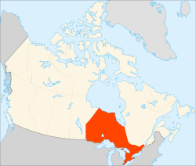
Ontario
Online learning began in 1994
Primarily district-based programmes using the provincial CMS and course content
Cooperation between boards through consortiums
Approximately 25,000 students
Three private schools
Approximately 5,000 students
Independent Learning Centre
Approximately 20,000 students

Slide 14
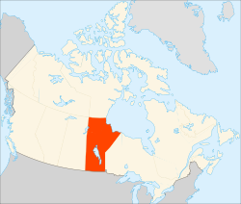
Manitoba
Province offers three forms
MOE manages correspondence and audio teleconference systems
2,500 enrolments for correspondence, approximately 400 for teleconference
districts manage their own web-based programme using MOE content
approximately 6,000 students
All districts appear to participate in web-based option to some extent

Slide 15
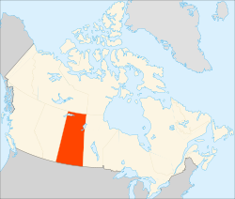
Saskatchewan
Province devolved responsibility to districts
Most districts have their own capacity
Sixteen districts provided space to external students through the Saskatchewan Distance Learning Course Repository
Approximately 4,500 enrolments from3,300 students

Slide 16
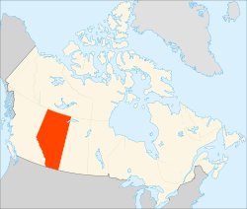
Alberta
Online learning began in 1994-95
Numerous district-based, several private, and a province-wide programme
MOE has no specific online learning policies
Release Inspiring Action on Education in June 2011
Approximately 21,000 students

Slide 17
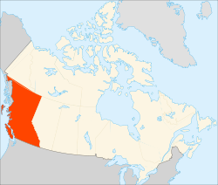
British Columbia
First online learning programmes (1993)
Fifty-four public & 14 private programmes
Most extensive distributed learning regulations
Funding follows student
Over 88,000 students enroled

Slide 18
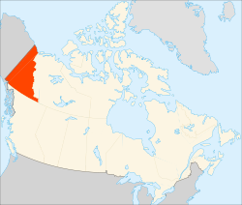
Yukon
Several MOE programmes and also utilizes programmes from British Columbia & Alberta
Primarily regulated by Ministry or through inter-provincial agreements
Fifteen students enroled in video conferencing programme
Approximately 80 students enroled British Columbia & Alberta programmes

Slide 19
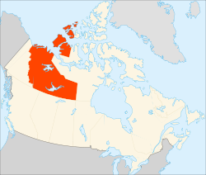
Northwest Territories
Primarily utilizes programmes from Alberta, beginning to create internal capacity
Beaufort Delta Education Council
MOE active in this provincial-territorial agreement
Less then 50 students enroled

Slide 20
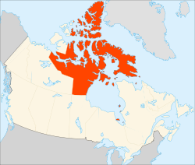
Nunavut
Utilizes programmes from Alberta & British Columbia
A belief that southern distance education courses rarely meet the needs of students in context, cultural, relevance, and pedagogy.
Trying to build internal capacity
Building on other existing programs, including adult programs like “Together @ a Distance”

Slide 21
National/Comparative Take-aways
Seen as a substitute when face-to-face learning is not feasible or economic
Unions are cautious supporters
Has not become a political issue
Several jurisdictions have made dramatic changes over the past five years

Slide 22
http://www.inacol.org/research/docs/iNACOL_CanadaStudy10-finalweb.pdf

Slide 23
Your Questions and Comments

Slide 24
Michael K. Barbour, Assistant Professor
Jason Siko, Doctoral Student
Wayne State University, USA
mkbarbour@gmail.com
http://www.michaelbarbour.com

