Slide 1
More is Different: sensemaking and wayfinding in complex information environments
George Siemens
April 4, 2012
Presented to:

Slide 2
Can learners be trusted to account for their own learning?

Slide 3
Because the internet and social media make managing/owning/directing your own learning possible. Intermediary agents need not apply.

Slide 4
What is self-organization?
“Processes of self-organization literally create order out of disorder”
Francis Heylighen

Slide 5
“Individuals, groups, and communities all form symbiotic relationships for a wide variety of reasons but the underlying impetus is resource sharing. Whether the resource is food, information, or support, individuals come together to share resources (Ribbands, 1953).
Erin Brewer, 2003

Slide 6
Online Self-Organizing Social Systems (OSOSS) “structure allows large numbers of individuals to self-organize in a highly decentralized manner in order to solve problems and accomplish other goals.”
Wiley & Edwards 2003

Slide 7
The internet is very good at fragmenting information and narratives

Slide 8
We haven’t developed skills and tools to weave fragmentation together into a coherent whole.

Slide 9
Adaptation
To avoid getting lost in the “mass of inconsequential”
(Bush, 1945)
We still need control, but the points are different than where the education system has assigned them in the past.

Slide 10
Complex systems:
“a set of diverse actors who dynamically interact with one another awash in a sea of feedbacks.”
Miller and Page, 2007

Slide 11
Complexity:
“disturbing traits of mess, of the inextricable, or disorder, of ambiguity, or uncertainty”
Morin, 2008

Slide 12
Coherence is the thing…

Slide 13
“meaning relations that connect discourse segments”
Kamalski et al. 2008: 323

Slide 14
“an ancient urge to seek a comprehensive picture of the world⎯for the sake of understanding ourselves, for knowledge’s sake, and not the least for acting as best we can”
Cordero 2007

Slide 15
High-knowledge readers perform better with reduced coherence.
McNamara et al. 1996: 35

Slide 16
More is different
P.W. Anderson (1972)

Slide 17
Complex systems:
“a set of diverse actors who dynamically interact with one another awash in a sea of feedbacks.”
Miller and Page, 2007

Slide 18
Enter the MOOC

Slide 19
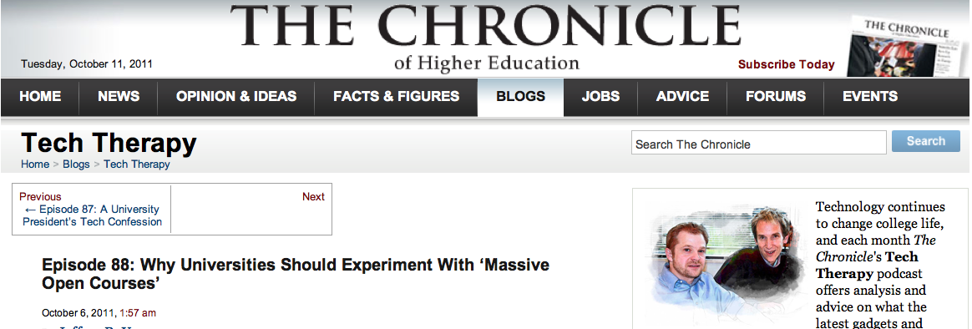
“For all intents and purposes I am sitting in the middle of a massive coffee-shop…in the middle of hundreds of half-baked, uninformed conversations…not grounded in scholarship and since the tendency is for the bloggers and tweaters to flit from conversation to conversation I have no sense of any substantial engagement”

Slide 20
“Too many disconnected , unconnected things going on to have a good sense that one is making reasonable, thoughtful choices.”

Slide 21
Because we’ve been presented with coherent wholes most of our lives (at least in formal education)

Slide 22
The real question, then, is not IF coherence is important, but WHO creates it

Slide 23
Coherence formation has two components
Sensemaking
Wayfinding

Slide 24
Sensemaking
“Sensemaking is a motivated, continuous effort to understand connections . . . in order to anticipate their trajectories and act effectively”
(Klein et al. 2006)

Slide 25
or
“Sensemaking is about labeling and categorizing to stabilize the streaming of experience”
(Weick et al. 2005: 411)

Slide 26
Wayfinding
“the process that takes place when people orient themselves and navigate through space”
(Raubal and Winter 2002)

Slide 27
Or
“recognizing places and finding one’s way between places”
(Golledge 1992)

Slide 28
Sensemaking and wayfinding are personal
(even thought they are socially and communally enabled)

Slide 29
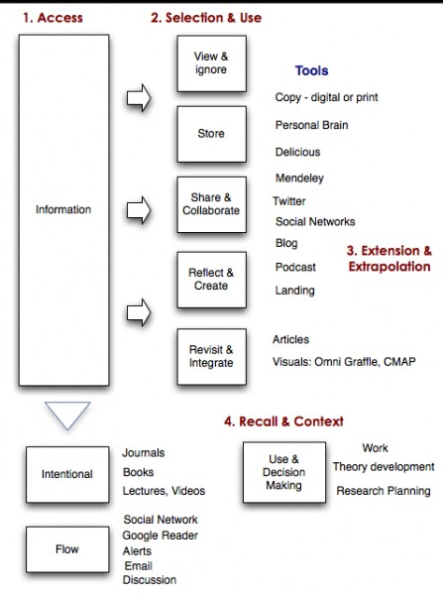
How I manage
information

Slide 30
Finding the ‘right’ data set: authentic complex information environments
2008, 2009, 2011

Slide 31
The data set
Connectivism and Connective Knowledge 2008
(CCK08)

Slide 32
The methods
1. Social network and participation analysis
2. Corbin & Strauss’ (1990) version of grounded theory

Slide 33
SNA & Participation Habits

Slide 34
CCK08 Weekly Forum Posts

Slide 35
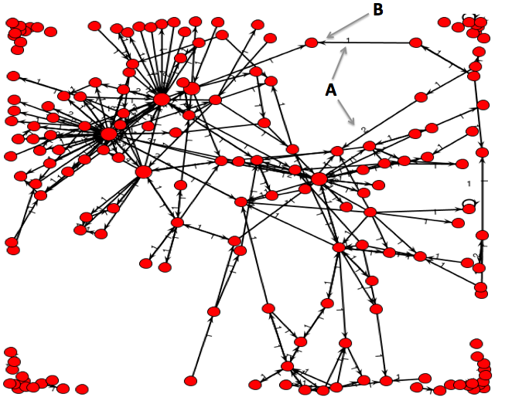
CCK08: Introduction forum
Limited interaction. Most are isolated

Slide 36
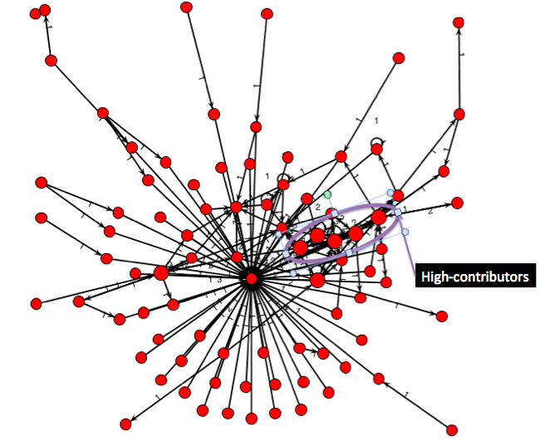
Downes auto-subscribes learners in CCK08

Slide 37
Dramatic participation variance
Of the top ten posters in Week 1, only three were in the top ten in Week 12.

Slide 38
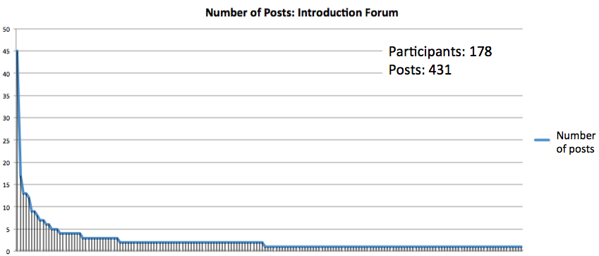
Introduction forum posts: CCK08
Dialogue limited:
Group too large?

Slide 39
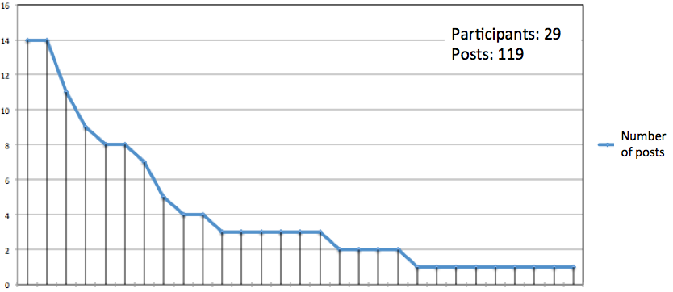
Week 12 forum posts: CCK08
More equitable distribution?
Due to smaller #’s of participants?

Slide 40
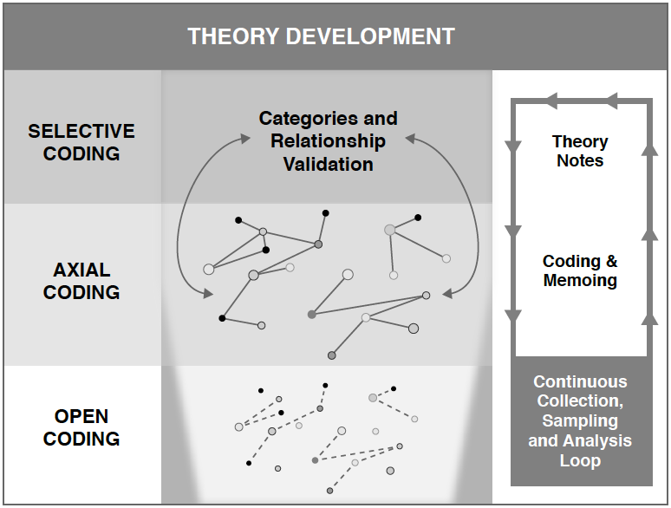

Slide 41
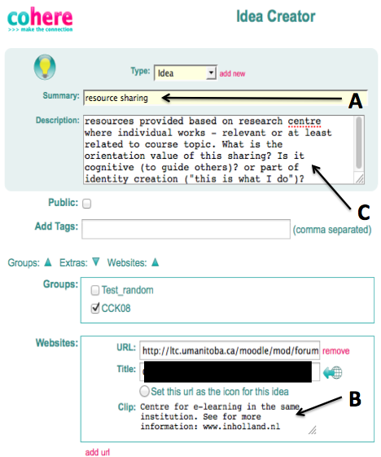
Open coding using Cohere
http://cohere.open.ac.uk

Slide 42
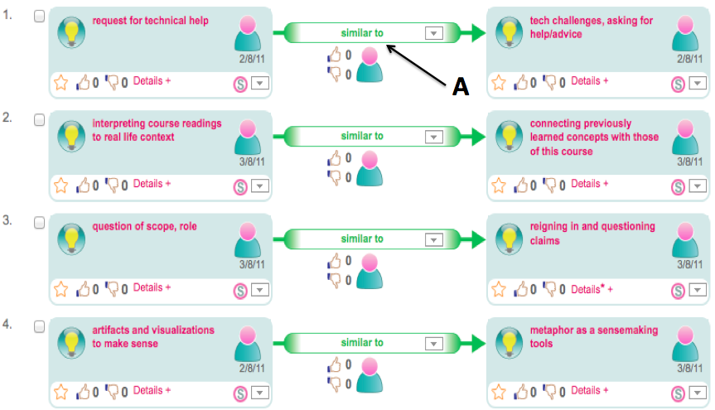
Axial Coding

Slide 43
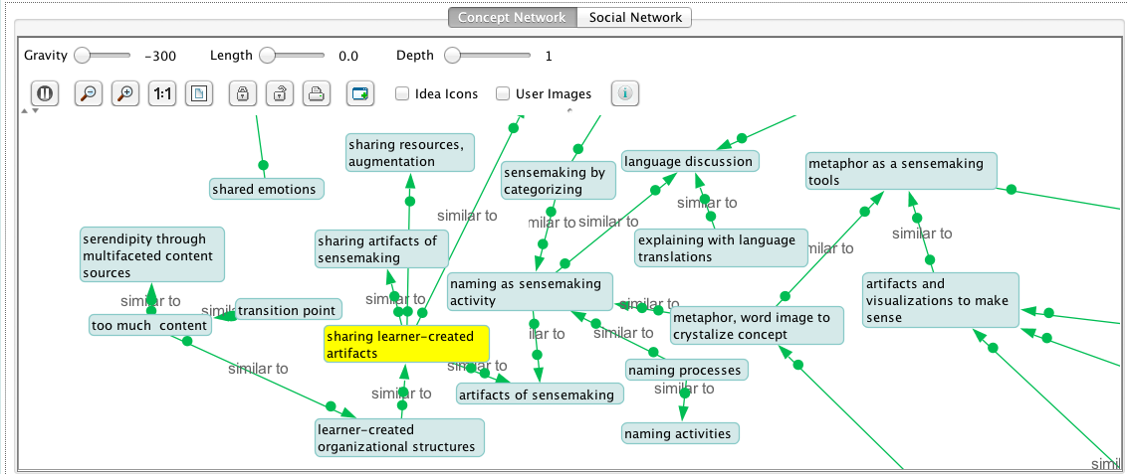

Slide 44
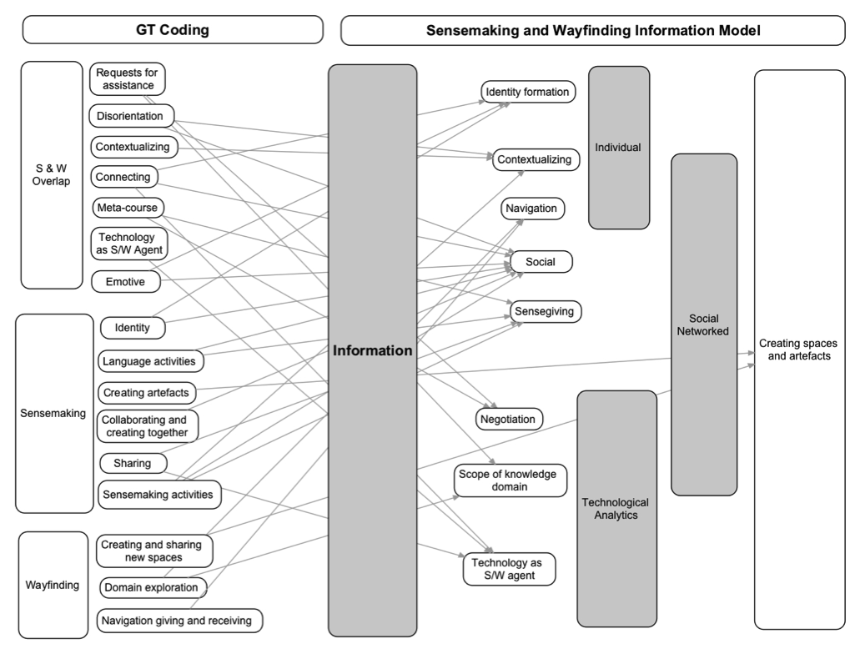

Slide 45
SWIM in Open Online Courses

Slide 46
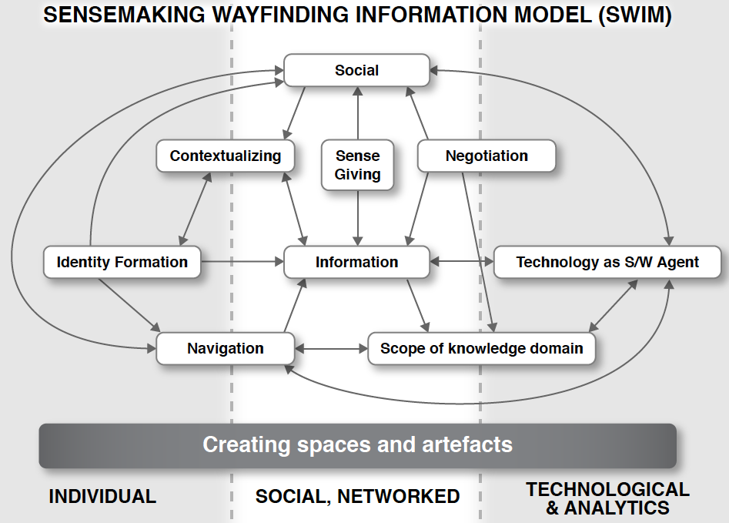

Slide 48
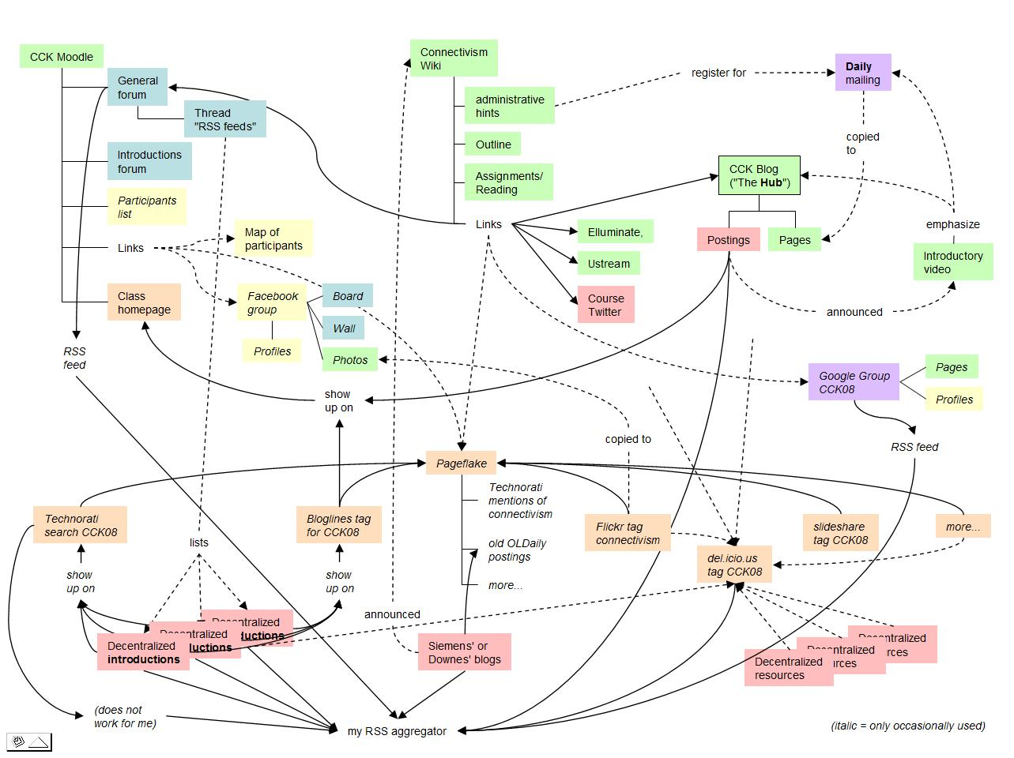
Sensemaking artefacts

Slide 53
Self-organization and sub-networks
Sensegiving through artefact creation and sharing
Sensemaking/giving through language games
Knowledge domain expansion
Wayfinding cues, symbols
Social organization through creating sharing

Slide 54
Twitter: gsiemens
www.elearnspace.org/blog

