Slide 1
profiling
best on line high school students

Slide 2
exploratory study to profile high achieving students.
Notes:
This inter-institutional project is an exploration of the characteristics of students with different levels of academic performance in three Mexican fully online high school programs. The three participating schools are public and have offered their online programs for less than five years, although they have extensive experience in face to face education in the high school level.

Slide 3
Notes:
These three higher education institutions offering online programs are members of the Mexican Public Universities Network of Distance High Schools of ECOESAD consortium that funded the study. A sample of three students per institution (9 students in all) was selected using the following criteria: one in each institution had to correspond to percentile 95 or over according to the GPA and was classified as a high performing learner; another had to correspond to percentile 45 to 55 (average performing learner) and the other to percentile 1 to 5 (low performing learner).

Slide 4
IPN and UNAM
Notes:
At UNAM and IPN the sample was taken from the first class of a program called Prepárate that served teenage students who had been invited by Mexico’s Ministry of Education to participate in an evaluation of online learning among 14 to 17 year olds. These students received a lap top, Internet connection at home and a monthly scholarship (about 50 US dollars) to promote their commitment towards the program.

Slide 5
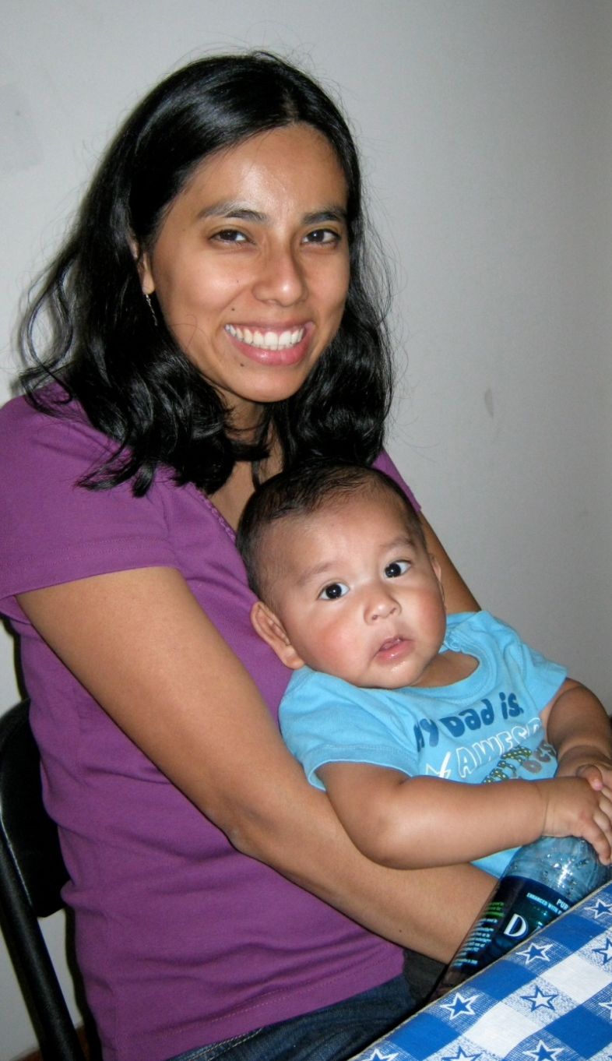
adults
at UAEM, without those benefits
Notes:
UAEM did not participate in the Ministry’s evaluation protocol. Its students were adult learners (some were full time workers, others were housewives).

Slide 6
95 +
1 - 5
45 - 55
Notes:
Three participants were students who fly high into the skies of success. Other three were more or less comfortable with their performance. Finally, three students were at risk of meeting a dead end.

Slide 7
 | IPN | UAEM | UNAM
high | ②18 | ②34 | ① 17
average | ① 17 | ① 37 | ① 17
low | ① 17 | ① 21 | ① 16
achievement
age and gender
Notes:
Each program coordinator decided the specific participant to be interviewed in an effort to select the most representative learner of the corresponding academic performance level. Fig. 1 shows the gender and age of each participant:

Slide 8
method
developing and piloting of questionnaire
interviews, transcriptions, qualitative analysis: Tesch (1990)
Notes:
A selection of 61 questions was developed in order to cover the following areas of information we wanted to explore: learning strategies and habits, socializing strategies with peers, opinions both on the tutoring and the counselling experiences, acknowledgement of academic progress by learners, subjective opinion on Math materials and learning process, opinions on their online learning experience and comparison between distance and face to face learning.
The questionnaire was validated by two judges and was used in a pilot study with three UNAM students who would not be part of the final sample. Some questions were rephrased to maximize understanding.
The final version was then used by the local interviewer of each institution (who was also the program coordinator). Interviews were taped and transcriptions were handed to a researcher, Dr. Cynthia Klingler, who used the method provided by Tesch (1990 in Creswell, 2009) for a qualitative analysis. This method includes the following steps:
Reading of all transcriptions
Search for meanings
Creation and organization of categories of information
Conduction of discourse analysis searching for causes, consequences and meanings of answers
Organization of answers in categories that were analyzed in order to find connections and patterns
The researcher provided the research team with a text document that included a recollection of findings. The team then reviewed this document and incorporated quantitative information from the transcriptions and finally made a summary of findings by level of academic performance and category.

Slide 9
findings

Slide 10
categories | diferences
study strategy | yes
time on line | yes
support | yes
social contact | yes
tutoring | yes
perceived gains | yes
math | yes
on line learning | yes
DE vs F2F | yes
when in doubt | no
counseling | no
least preferred course / area | no
Notes:
Fig. 2 summarizes the categories that were found. The last column indicates if differences among the answers of low, average and high performance students were observed.

Slide 11
strategies
Notes:
Important differences were found among learners of different level of achievement. Low performing students concentrate only on graded activities (thus avoiding text, explanations and exercises that do not contribute to the final grade). One of them said that she identifies the specific issues that each learning unit contains and then she looks them up in the Internet (she does not review the online materials). Another learner only studies her notes for the final exam. Medium performing students mentioned only looking for information in the Internet and a pre-selection of learning activities according to how hard they seem. Finally, high performing students used highly organized studying materials they actively prepared throughout the course and two mentioned that they establish a time limit days before the official closing of the course, so they can manage any difficulty they find.

Slide 12
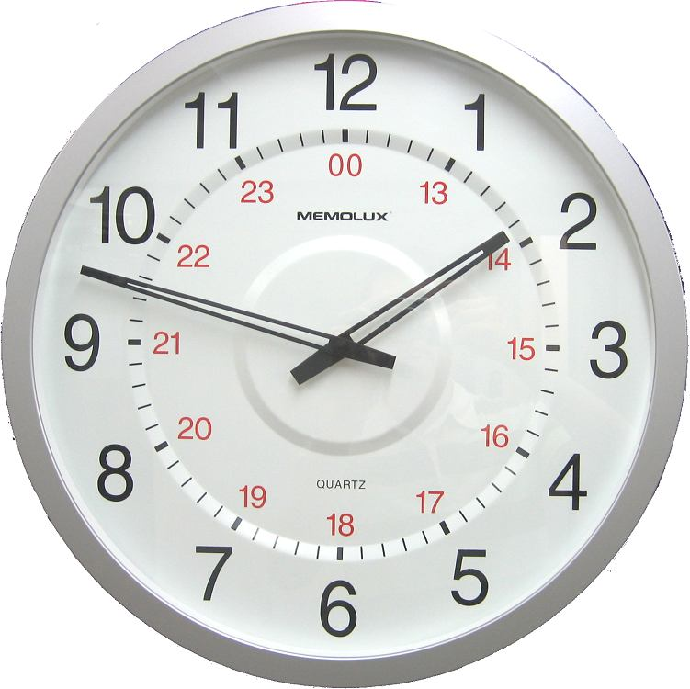
time commitment
Notes:
There were also differences in terms of the time allotted to study each day. Low performers averaged 3.7 hours a day; percentile 45-55 students committed a mean of 3.3 hours per day and the best students dedicated 5.2 which makes a big difference in the long run.

Slide 13
support
Notes:
Results show a continuum that begins in a total lack of resources to the use of books, Internet and quizzes. Low performing students tend to do no effort to understand and remember information while learners in percentile 95 and over use printed and online materials as well as self-applied quizzes to test their learning.

Slide 14
social contact
Notes:
A clear relationship between opportunities to socialize and academic success can be observed. Two of the low performing students reported they did not have any extracurricular activities and one said her social needs were covered in her working setting. Two students in the intermediate performance level said they had extracurricular activities and the three students in the high level said they had friends: one through extracurricular activities, one in his working place and the other said he has a consolidated social group.

Slide 15
tutors
Notes:
Differences among students of different levels were found concerning their perspective on the tutors’ role in distance education. While low performing students believe tutors are responsible for students motivation to learn (thus showing an external locus of control), successful learners focus on the importance of tutors having good communication skills and criteria in for them to be flexible and better serve different types of students.

Slide 16
perceived gains
Notes:
While learners in percentile 1-5 identified two to three areas in which they feel the program has had a positive effect, intermediate performing students identified three to four and high performing students identified four to eight areas. Students from all levels included information management skills. Both in the intermediate and the high levels writing skills were mentioned.

Slide 17
math
Notes:
One student in the low level of performance and one in the intermediate level identified small improvements in their understanding of Math. On the contrary, the three successful learners respectively said they had had improvement, lots of improvement and meaningful learning in this area.

Slide 18
online learning
Notes:
When asked about their opinions on distance learning, low performing students could only think of negative effects: lack of opportunities to socialize, difficulties while reading from the screen and the need for more attention to cope with the learning process. Intermediate performance learners could identify three pros and two cons. They considered the development of personal responsibility as the most important positive effect. High performing learners also focused on responsibility and were able to identify three pros and three cons, thus embracing a more balanced view of this mode of delivery.

Slide 19
vs F2F
Notes:
Low performing students have the following opinions: one says DE is better, one that it requires more effort and one that they are both the same. Two average students believe DE is better and one has no opinion. All the high performing learners say DE is better.

Slide 20
when in doubt…
Notes:
One of the students of percentile 1-5 did not answer. The other looks for information in the Internet and the other reviews chats. Two of the students of percentile 45-55 look for meaning in the programs glossary, another one looks for help and the other one searches the Internet and studies during the weekend. The high performing students study the online materials, two look for meanings in the glossary and in the list of word roots and one reviews the learning activities provided in the online materials.

Slide 21
counselors
Notes:
All students consider counsellors to be an important actor of the online learning process.

Slide 22
least preferred area
Notes:
In each level, two learners said Math was their least preferred subject.

Slide 23
conclusions

Slide 24
successful S:
appreciates accomplishments and DE
has internal locus of control
identifies increasing cognitive growth and development of skills
is proactive
Notes:
Successful students acknowledge their own achievements, are happy with the mode of delivery and identify positive effects of the online program on basic and cognitive skills. They tend to exhibit an internal locus of control and seem proactive.

Slide 25
average level:
uses fewer strategies & LMS
Notes:
Students of percentile 45-55 tend to use fewer strategies and they use less the online materials that the program provides.

Slide 26
low performance:
longs for F2F
lacks social contact
has external locus of control
uses other materials
Notes:
Low performing students miss face to face education, have scarce social encounters and thus feel lonely, exhibit an external locus of control and look for information in sources other than their online course materials.

Slide 27
must do...

Slide 28
systematic
extracurricular activity
Notes:
Two important factors were identified for a successful experience: an extracurricular activity that provides students with a social group experience and...

Slide 29
super-counselor
Notes:
An extra-good counsellor.

Slide 30
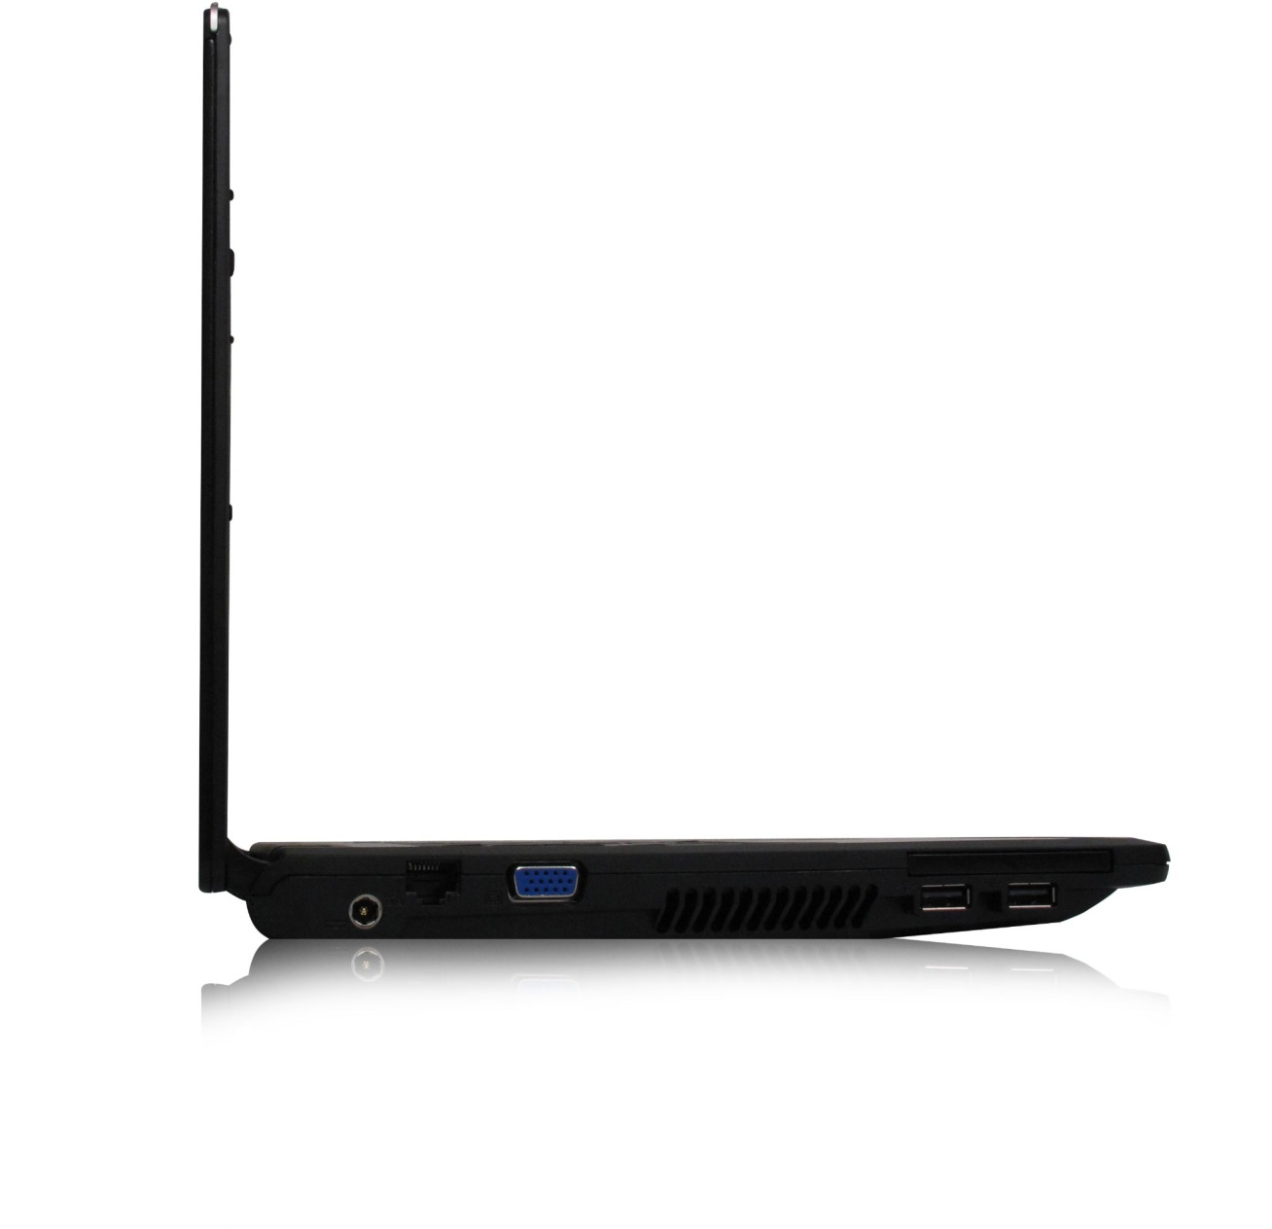
DE is not distant at all!
Notes:
Limitations of this study are related to its qualitative nature: findings cannot be generalized to other populations. However, interesting differences were found that we will explore in future research projects. In all, we see that distant education need not be distant at all!

Slide 31
thank you!

