Slide 1
Learning Analytics:
Passing fad or game-changer for higher education?
Leah P. Macfadyen, PhD.
Program Director,
Evaluation and Learning Analytics
UBC Faculty of Arts
leah.macfadyen@ubc.ca

Slide 2
What do we mean by ‘learning analytics’?
Learning analytics has been defined as
  the process of developing actionable insights through problem definition and the application of statistical models and analysis against existing and/or simulated future data
(Cooper, 2012)

Slide 3
The Society for Learning Analytics Research (SOLAR) defines the core activities of learning analytics as
  the measurement, collection, analysis and reporting of data about learners and their contexts for purposes of understanding and optimizing learning and the environments in which learning occurs.
http://www.solaresearch.org

Slide 4
On the shoulders of giants
LA draws from, and is closely tied to, a series of other fields of study including
  Business intelligence
  Web analytics
  Academic analytics
  Educational data mining
  Action analytics
Elias, T. (2011). Learning Analytics: Definitions, Processes and Potential. http://learninganalytics.net/LearningAnalyticsDefinitionsProcessesPotential.pdf
Notes:
BI – business decision makers use IT and strategic thinking to use large volumes of data for decision-making
Web analytics – collection, analysis and reporting of website usage to try to better understand impact/effectiveness (trends, testing, changes); personalization; trends and predictions
Academic analytics – Goldstein and Katz 2005 – application of BI to academia. Focus on ‘student success’ but with a focus on institutional metrics relating to recruitment, admissions, retention and graduation rates
EDM – focus on identifying patterns in data to allow predictive modelling for decision making
Action analytics (Norris et al) – focus on deployment – using academic analytics to produce actionable intelligence, architectures, services, models for course/curriculum redesign, changes to faculty practice to “improve services and reduce costs”

Slide 5
Factors driving the emergence of LA
The underpinnings:
  Socio-political factors
  Educational factors
  Technological factors
Ferguson, R. (2012). Learning analytics: drivers, developments and challenges. International Journal of Technology Enhanced Learning, 4(5/6) pp. 304–317.

Slide 6
New developments….
Converging developments in data availability and educational data science
  Even bigger “big data”
  Increasing volumes of teaching- and learning-related
  More, and more accessible, data
  Parallel developments in educational data science
    Data mining algorithms and approaches
    Approaches to network analysis
    Approaches to text mining and discourse analysis at scale
    Increasingly user-friendly software

Slide 7
Moving beyond number crunching
  EDM laid groundwork of computation and modelling
  Recognition that learning cannot simply be understood by algorithms, and that social and pedagogical theory, approaches and insights must also be brought to bear.
  Technological, ideological, and methodological orientations of the field of learning analytics differentiate it from EDM
      “…technical, pedagogical, and social domains must be brought into dialogue with each other to ensure that interventions and organizational systems serve the needs of all stakeholders.”
  Siemens, G., & Baker, R. S. J. d (2012). Learning Analytics and Educational Data Mining: Towards Communication and Collaboration.
  Paper presented at the Learning Analytics and Knowledge, Banff, AB, Canada.

Slide 10
Interdisciplinary collaboration
  technical/analytic
    statistics
    data visualization and visual analytics
    educational data mining
    computer science
    machine learning
    natural language processing
    human-computer interaction
    and others….

Slide 11
social/pedagogical
  social sciences
  education
  (educational) psychology
  psychometrics
  educational technology
  art and design
  and others…

Slide 12
The rise of systems thinking
  systems of information-feedback control are fundamental to all life and human endeavor…everything we do as individuals, as an industry or as a society is done in the context of an information feedback system
(Forrester, 1961)

Slide 15
LA investigates these information flows and feedbacks in an education system to
  Identify which data may carry meaningful or actionable information about teaching and learning
  Allow development of approaches and tools that make more and better information about teaching- and learning-related activities more easily available to the members of the system (teachers, learners…)

Slide 16
Who are the stakeholders?
Learners…but also…
Instructors and faculty members
Parents
The wider community
Administrators
  Department Heads/Program Directors
  Deans
  Institutional administrators
Governments and policy makers

Slide 17
Different LA purposes for different stakeholders?

Slide 19
Where to start?
Clarifying purpose and goals
Identifying stakeholders
Planning for institutional buy-in
Establishing/confirming data governance policy and tools
Selecting your technologies
Thinking about the data
Notes:
Clarifying Purpose. Beyond believing that it's a 'good thing', what is your goal for Learning Analytics? Which challenges and opportunities do you hope it might help you meet? This question underpins everything else. (Are the key goals, for example, real-time tracking of student study strategies to perhaps identify, early, students at risk of failure? Or, perhaps your interests are at a higher level: more meaningful reporting on students or achievement to inform curriculum planning or future strategy?
Identifying stakeholders: This is tightly related to #1, of course. Who do you see as the key 'end users' of LA efforts? Are you more interested in tools for educators, to allow them to monitor students? Tools for students to track their own progress? Tools for administrators to inform strategy? All of this? Who has priority?
Establishing data governance policy and tools: Even before you get into working with the data, this is worth getting to work on. Ethics policies, policies on information privacy and how to engage the learners about this, policy on data security.
Carefully selecting your technologies: Much LA work is focussed on the LMS and on data that LMSs gather (though it's worth noting that other data sources are valuable, too). Most LMS companies now claim that they 'do learning analytics', but believe me, not all LMSs are created equal in this arena, and I'd advise having people with good critical knowledge advise on choices. At present, Desire to Learn seems to be pulling ahead, having bought up a new plugin tool that permits some adaptive design.
Thinking about the data: This task is a beast, and will doubtless occupy a lot of time. What data exists? Where is it? How can it be harvested and joined to other relevant data? What other data might you need to collect to achieve your institutional goals?
Planning for institutional buy-in: As with the eLearning strategy outline in my 2004 report, you can't start this too early. What a fantastic opportunity to start early by engaging not only senior admin but also educators and even learners in the potential for LA (or..heaven forbid!?actually asking them what would be valuable or useful?:-)

Slide 20
Prepare to discuss ethical questions…
Relating to research
  Ethical questions about purpose: Why is data being collected? To what end? (Financial? Educational?)
  Ownership of data
  Collection and analysis of data on students and learning
  Informed consent, privacy, de-identification
  Student and data privacy…how will data be handled and protected? Who should have access to it?
  Ethics of surveillance - Foucault's panopticon - power imbalance between educators/institution and learners
  …but in parallel with changing attitudes to privacy and self-disclosure

Slide 21
Relating to deployment of LA tools and systems…
  Is there an obligation to act on new knowledge?
  How do we find the balance between potential “individual harms" and greater scientific knowledge
  Questions about the ethics of intervention…does this approach treat students as passive objects?
  To what degree should we act upon findings from interpretation of incomplete data sets?
  Use of collected data beyond educational purposes (e.g. fundraising)
  Data management and governance – diff. types need diff levels of protection?

Slide 22
Principles for Learning Analytics
LA as a moral practice
Students as agents (and collaborators), not just recipients
Recognition that student identity and performance (and thus labels and categories) are temporal constructs
Student success is complex and multidimensional - recognition of the incompleteness and biases of our data
Transparency of purpose
The necessity of using the data
Slade, S. & Prinsloo, P. (2013).
Learning Analytics: Ethical Issues and Dilemmas.
American Behavioral Scientist 57(10), 1510–1529.

Slide 23
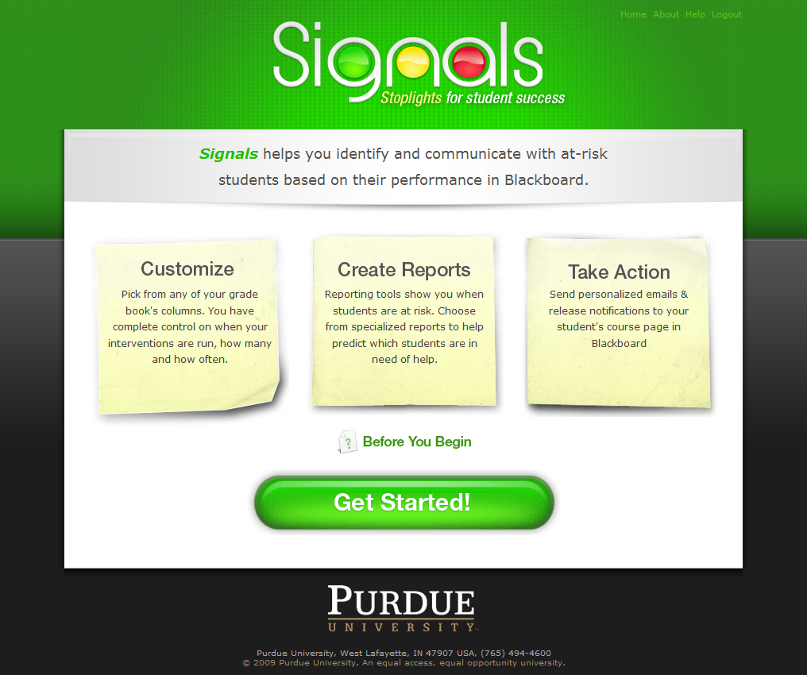
The Purdue Signals Project http://www.itap.purdue.edu/studio//signals/

Slide 24
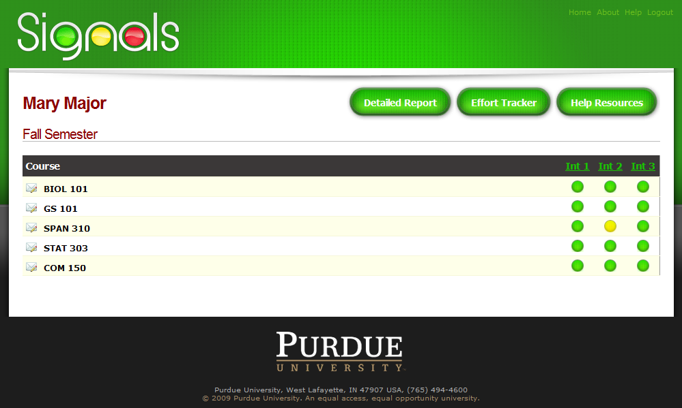

Slide 25
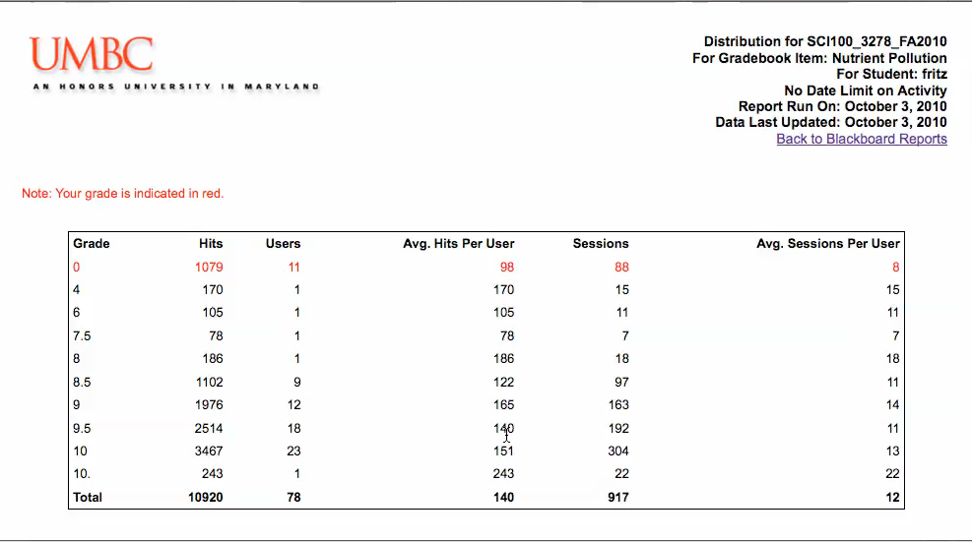
UMBC’s ‘Check My Activity’ tool http://www.educause.edu/ero/article/video-demo-umbcs-check-my-activity-tool-students

Slide 26
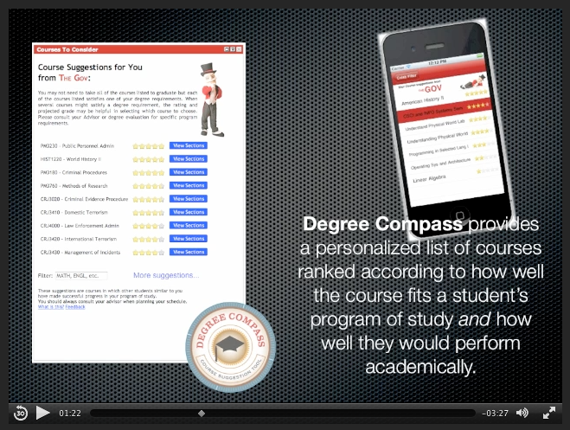
Austin Peay University’s ‘Degree Compass’ tool http://www.apsu.edu/academic-affairs/degree-compass-and-my-future

Slide 27
More enterprise-level LA tools
Civitas Learning: http://www.civitaslearning.com
    Another recommender system that makes use of data from learning management systems, student information systems, and other sources, then builds school-specific predictive models that discover hidden connections and identify key decision points that affect student success.
Desire2Learn’s Insight Student Success System: http://www.desire2learn.com/products/insights/features/
    Designed to let instructors visualize and compare key learning and engagement factors – from course content access, to social learning patterns, to grades achievement.
Knewton’s Adaptive Learning System: http://www.knewton.com/platform/
    A combination learner tracking, course recommender and learning strategy advice system.
Blackboard Analytics: http://www.blackboard.com/Platforms/Analytics/Products/Blackboard-Analytics-for-Learn.aspx

Slide 28
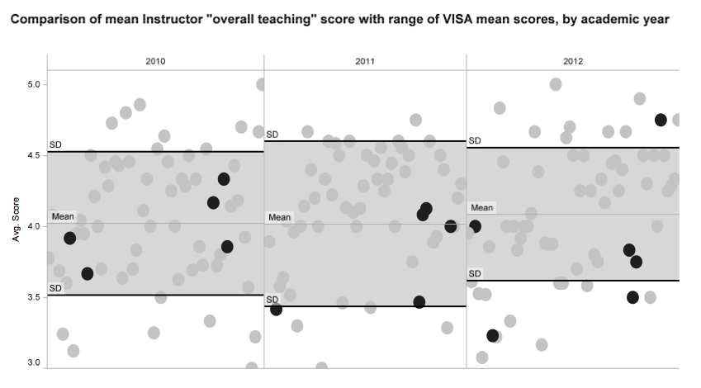
Finer-grained tailored LA implementations in the
UBC Faculty of Arts
Visual analytics tools allow easier exploration and representation of student evaluation of teaching data
  For instructor reports (merit, tenure and promotion,
  For departmental reviews
  For planning instructional development offerings

Slide 29
Better understanding of our students

Slide 30
Using the SNAPP tool to investigate student networks and engagement
“[Social networks are the] single most potent source of influence”
(Astin, 1993)
  Perseverance
  Development
  Academic success
(Tinto,1993; Light, 2001; Brown, 2008)

Slide 31
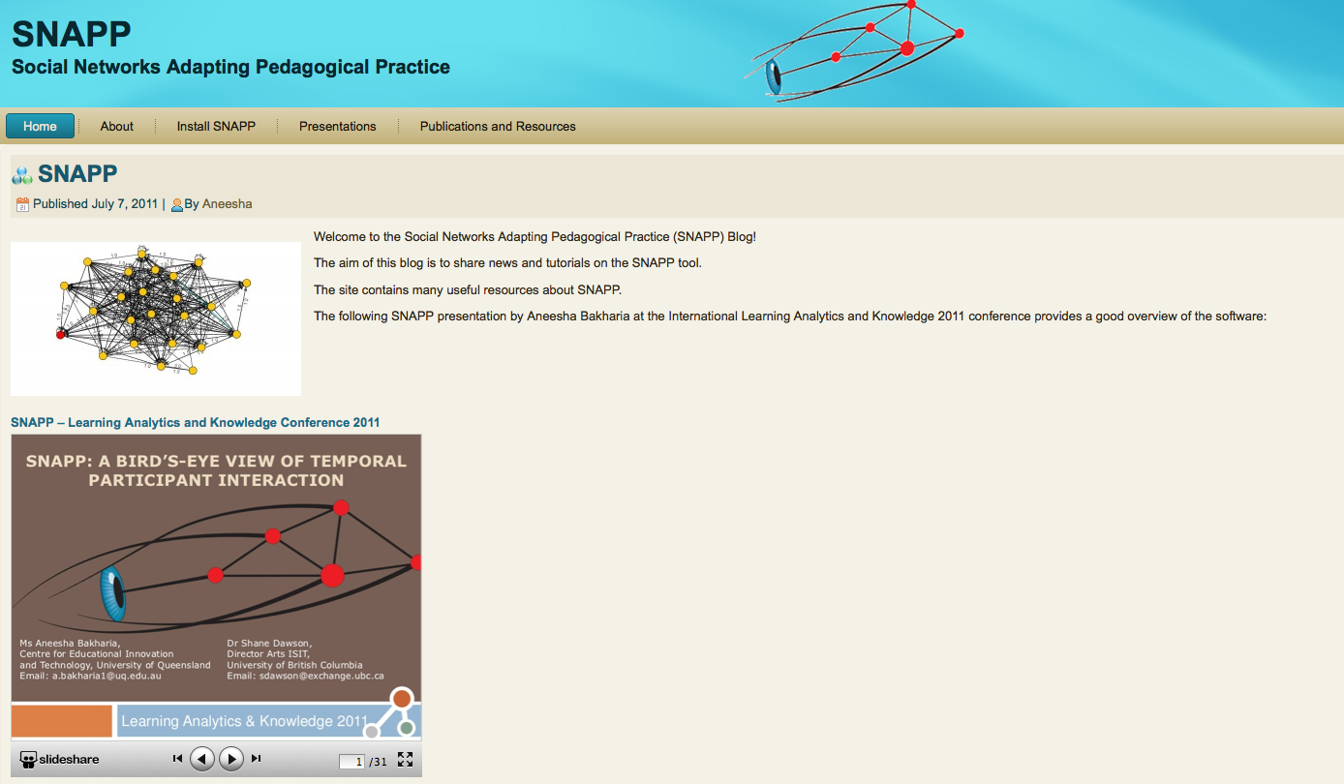
Social Networks Adapting Pedagogical Practice (SNAPP)http://www.snappvis.org

Slide 32
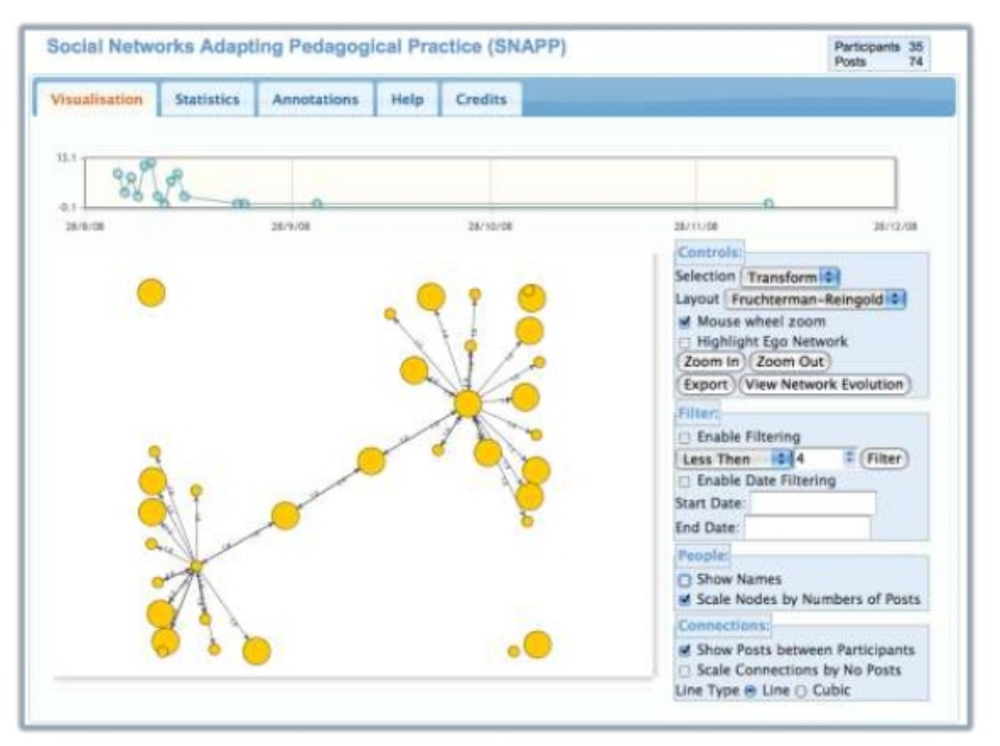

Slide 33
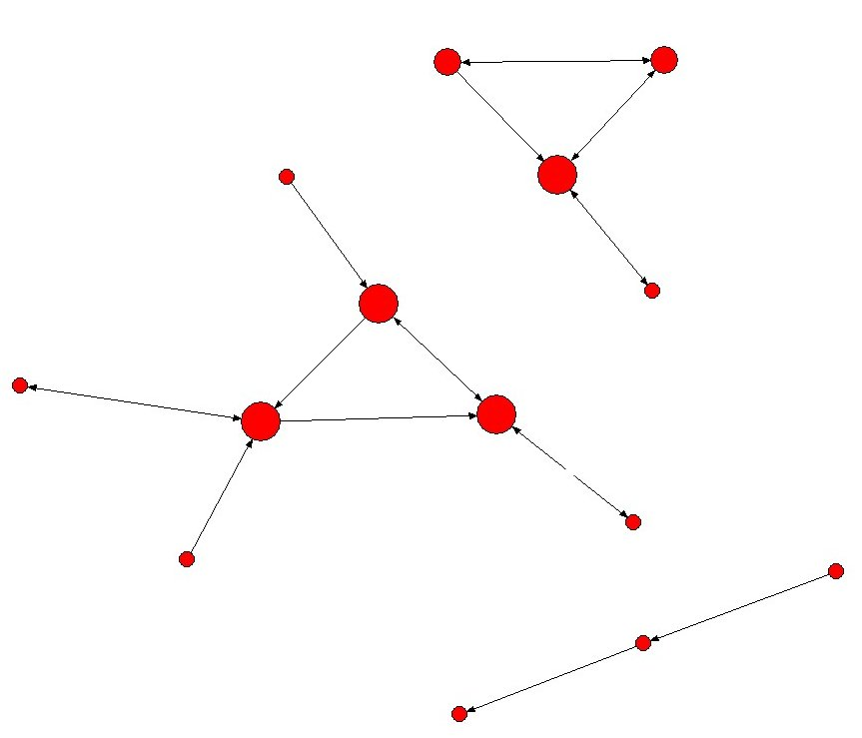
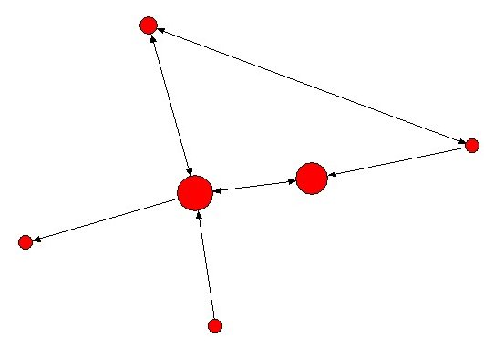
Seeing networks in action
Power of
visualizations
Forum 1
Forum 2

Slide 34
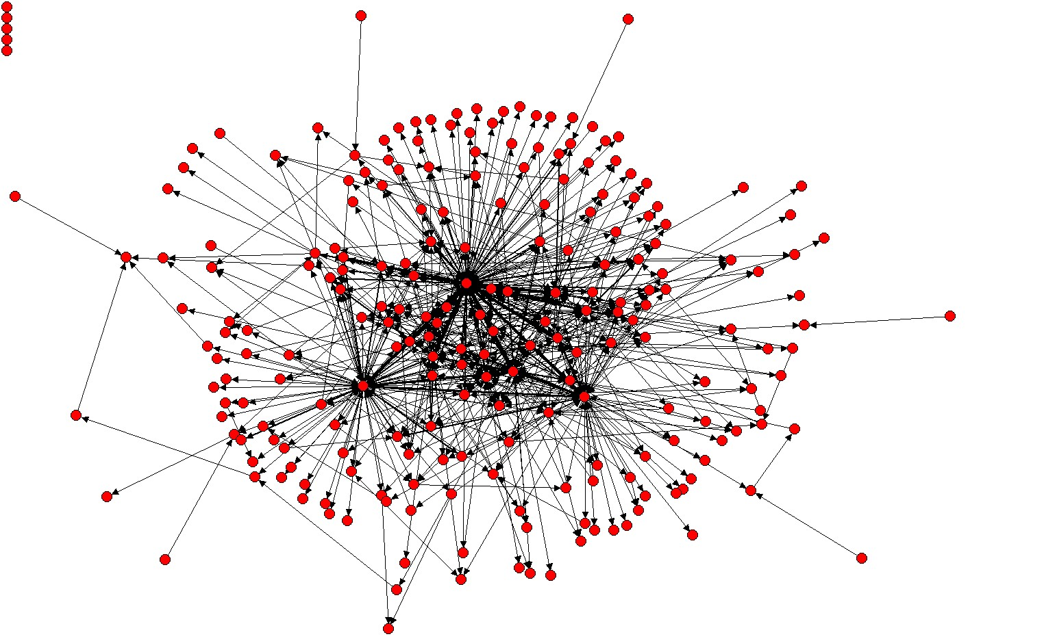
Development of Learning Networks
network density
disconnected students

Slide 35
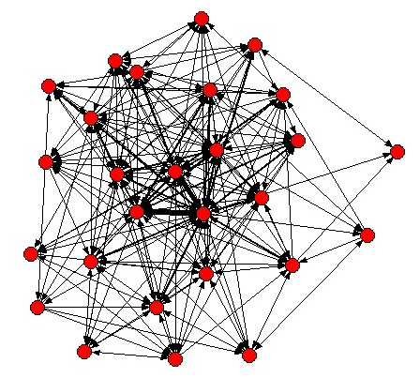
BIOL200

Slide 36
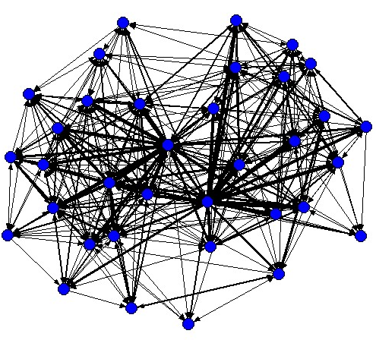
SOCI430

Slide 37
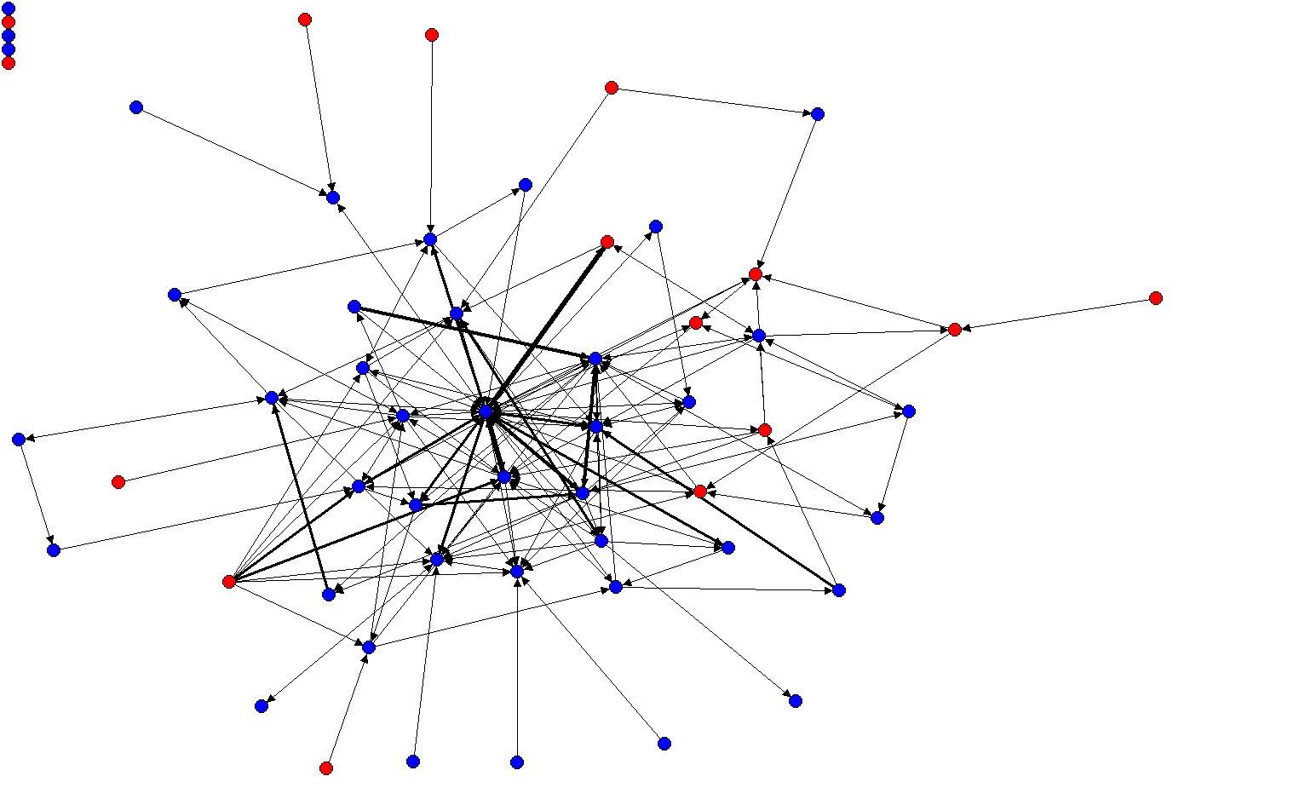
Cross-group communications

Slide 38
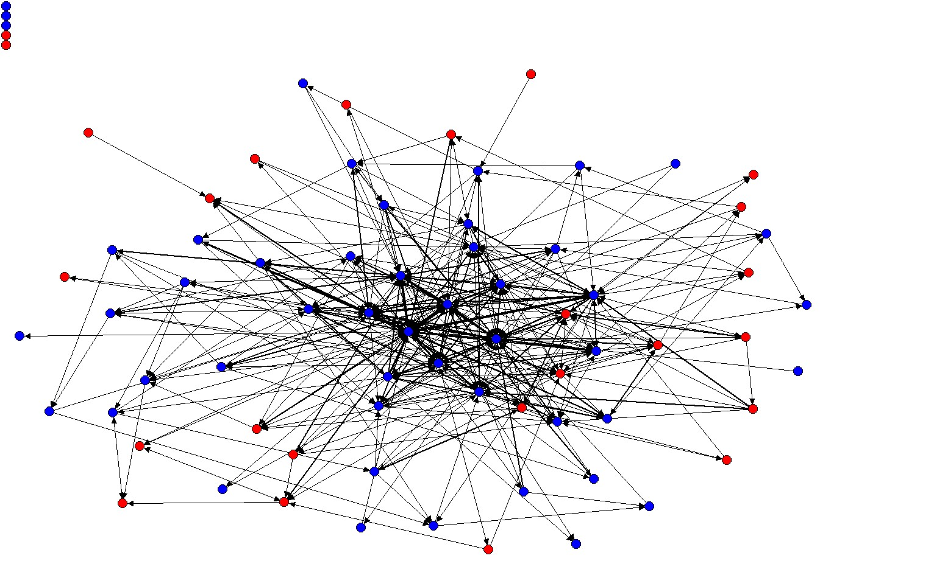
Cross-group communications

Slide 39
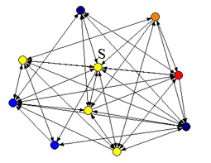
“Ego network” of a BIOL200 low-performer
Red = A; Orange = B; Yellow = C; Blue/black = D or Fail.

Slide 40
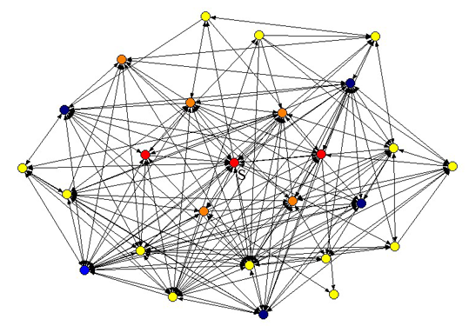
“Ego network” of a BIOL200 high-performer
Red = A; Orange = B; Yellow = C; Blue/black = D or Fail.

Slide 41
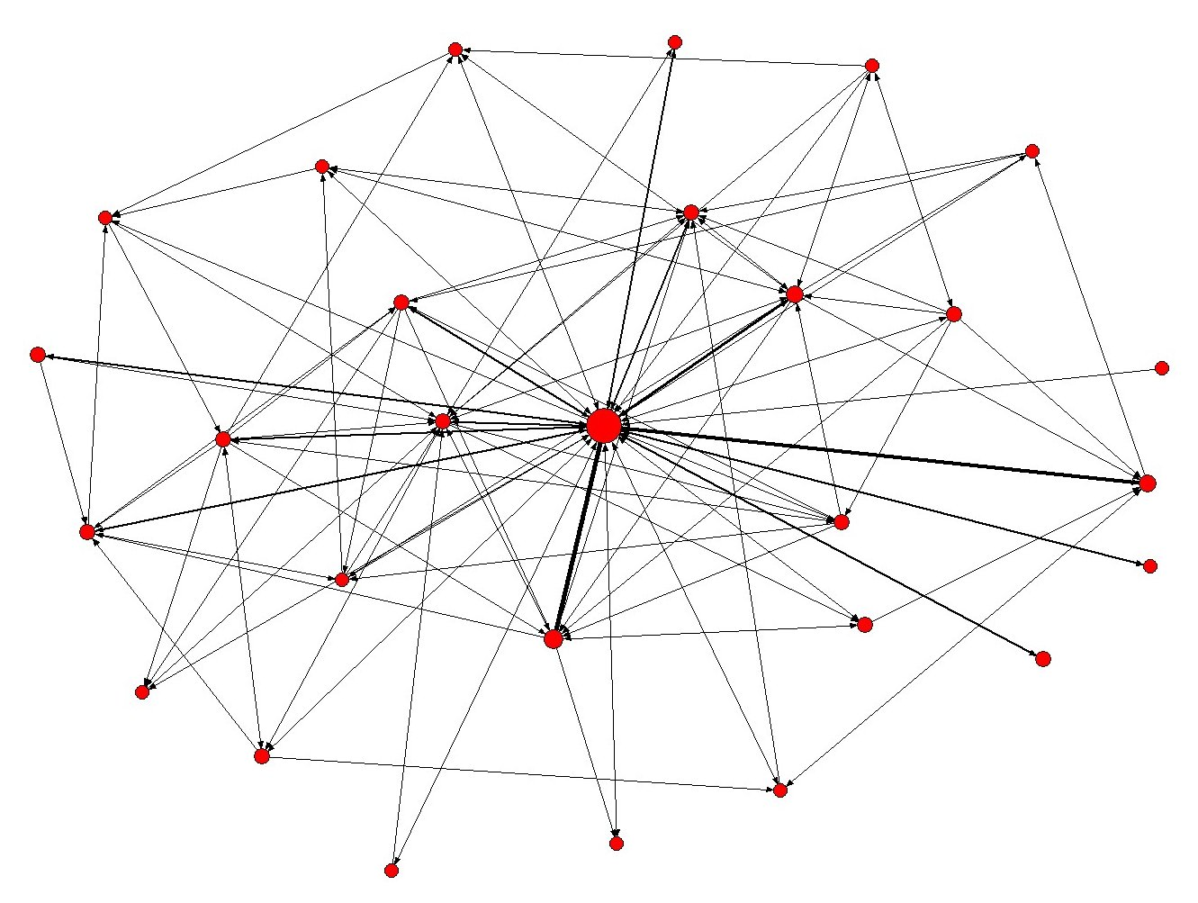
Visualising Instructor Activity

