Slide 1
Sense of Irony or Perfect Timing: Examining the Research Supporting Proposed e-Learning Changes in Ontario
Michael K. Barbour
Associate Professor of Instructional Design
Touro University California
Randy LaBonte
Chief Executive Officer
Canadian eLearning Network

Slide 2
Oh the irony...
AERA annual meeting in Toronto (April 5-9, 2019)
Leveraging Education Research in a “Post-Truth” Era: Multimodal Narratives to Democratize Evidence
“relating to or denoting circumstances in which objective facts are less influential in shaping public opinion than appeals to emotion and personal belief.”

Slide 3
Oh the irony...
AERA annual meeting in San Francisco (April 17-21, 2020)
The Power and Possibilities for the Public Good When Researchers and Organizational Stakeholders Collaborate
“in 2020 let us harness possibilities and choose as a body of scholars to reconnect with organizational leaders to examine collaboratively continuing educational problems. By reconnecting… we do mean programmatically engaging with educational organizations”

Slide 4
E-Learning Announcements in ON
15 March announcement
centralize the e-learning system
require 4 courses to graduate from secondary school
class size consultation
increase e-learning classes to 35 students (25% more than face-to-face courses)
21 November announcement
require 2 courses to graduate from secondary school

Slide 5
Ontario’s Existing E-Learning System

Slide 6
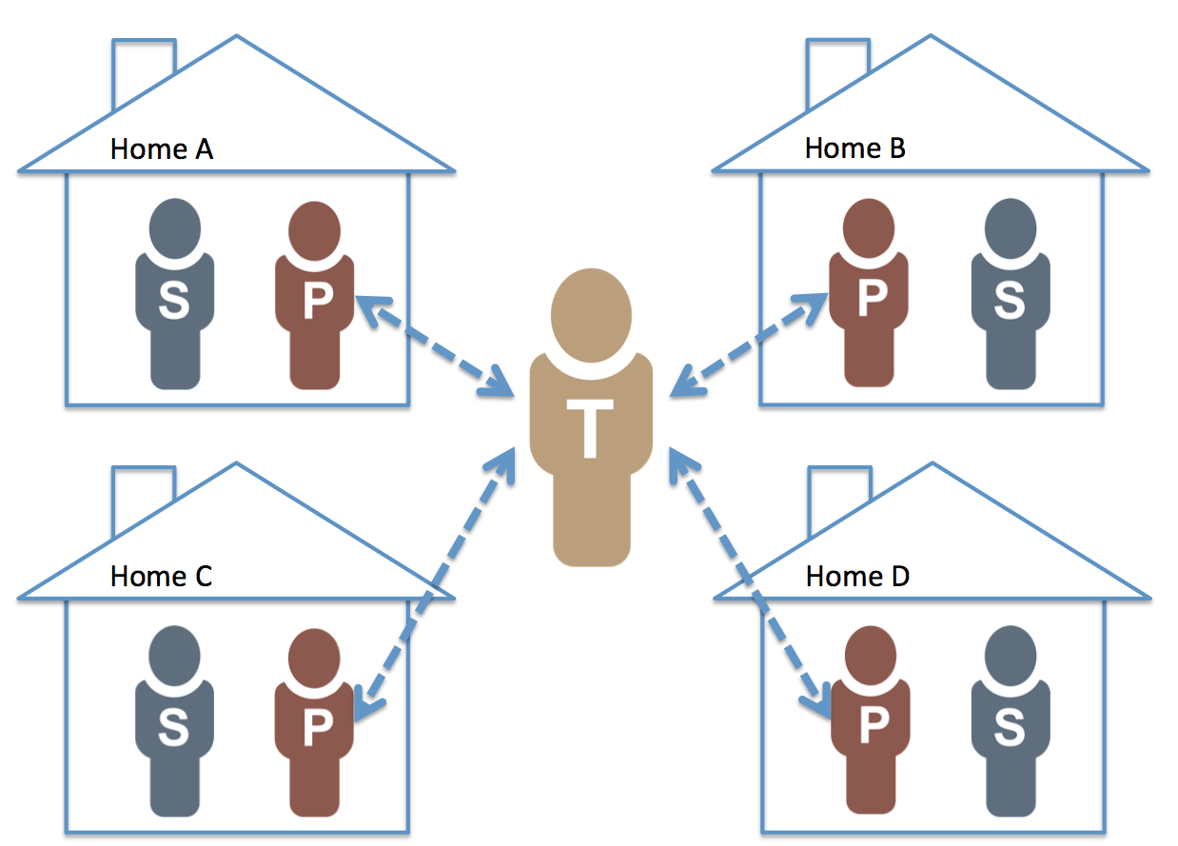
Ontario’s Existing E-Learning System
Borup (2015)

Slide 7
Ontario’s Existing E-Learning System

Slide 8
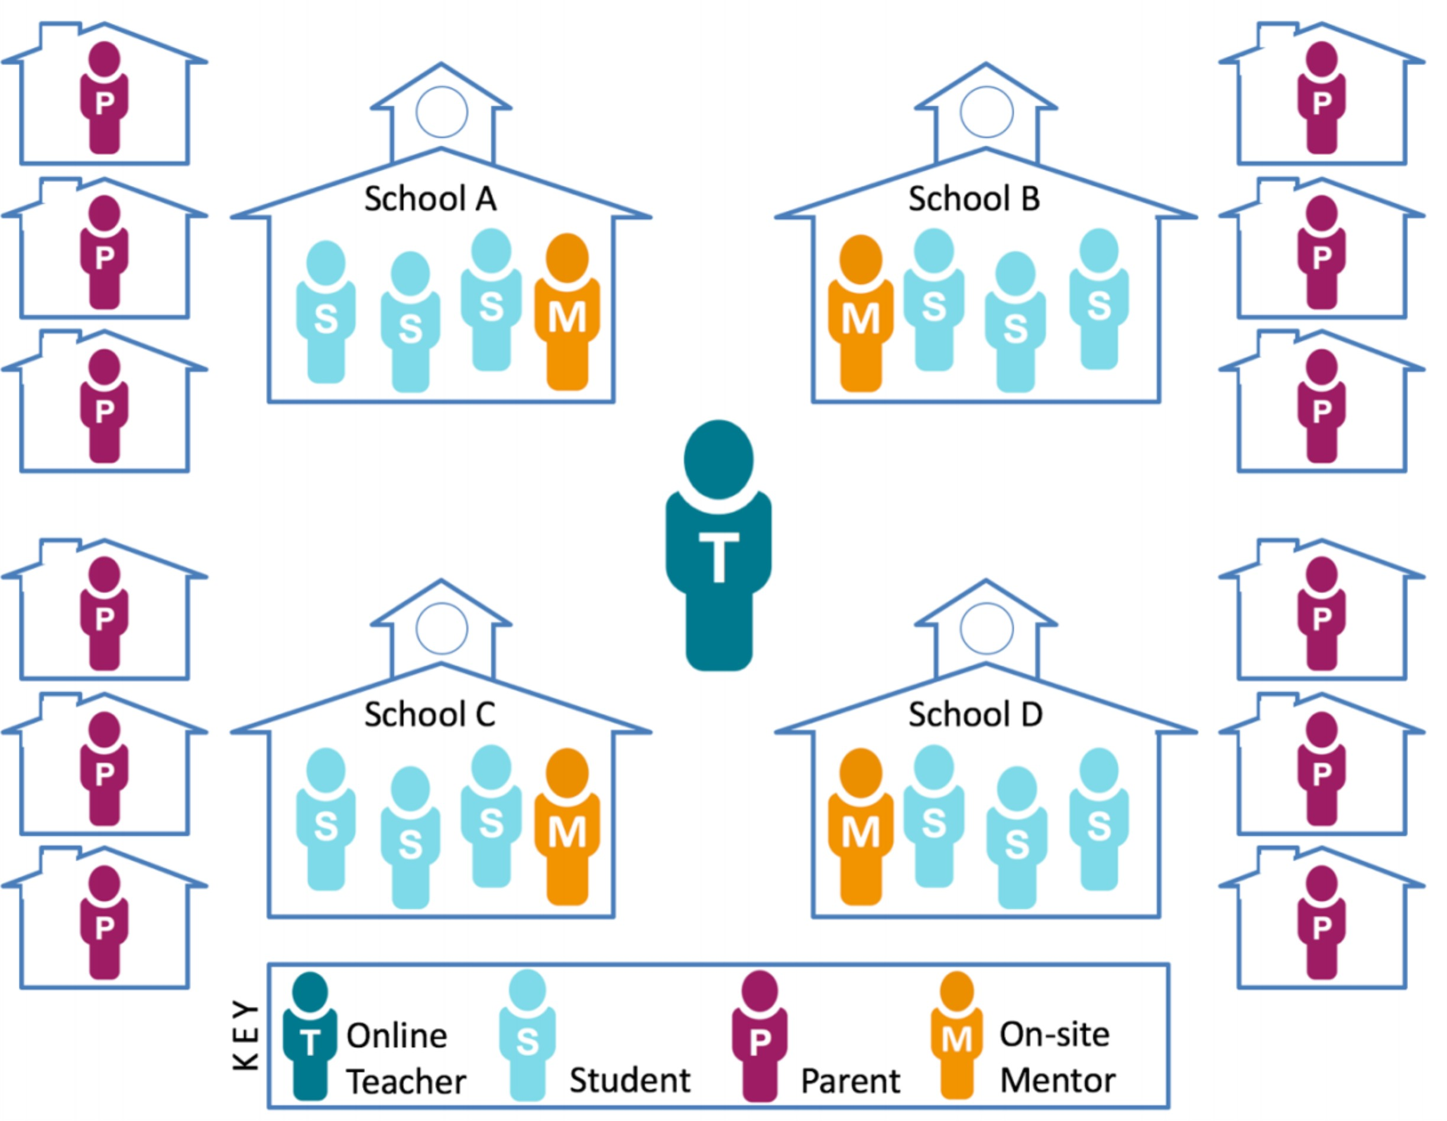
Ontario’s Existing E-Learning System
Borup, Chambers, & Stimson (2018)

Slide 9
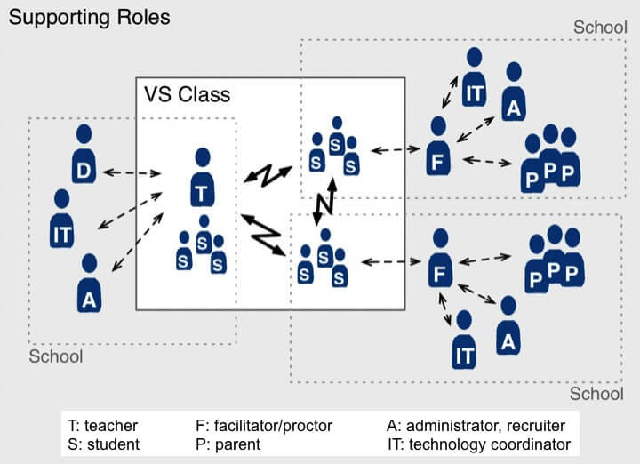
Ontario’s Existing E-Learning System
Davis & Niederhauser (2007)

Slide 10
E-Learning ON Master Agreement
assigning personnel for the delivery of the Provincial e-Learning Strategy, including a contact person who will be the liaison with the Ministry on matters pertaining to the strategy;
establishing class sizes and Pupil Teacher Ratios as outlined in provincial and school board policies and as specified in the applicable collective agreement;
ensuring e-learning and blended learning courses are part of the teacher’s “workload” as specified in the applicable collective agreement;
ensuring that day school students enrolled in day school e-learning courses are taught by day school grid teachers and placed on the day school funding register;
ensuring that all students, including those with special needs, have equitable access to appropriate e- learning opportunities and support within e-learning courses;
ensuring that students who enroll in a secondary school e-learning course are registered in the home school, as defined in enrolment register instructions;
ensuring adequate program support for all students, including those with special needs, and making the delivering school aware of these needs prior to enrolment in the course (e.g., orientation sessions);
providing a location and proctor for summative evaluations (e.g., final examination, culminating activity), if required, and ensuring the return of the completed examination to the e-learning teacher by a date pre-determined by the delivering teacher, in compliance with teacher workload;
providing an orientation program to students taking their e-learning courses to validate the student’s suitability for e-learning and to prepare them for this style of learning; and
ensuring that e-learning teachers make themselves available to students at scheduled times to support e-learning students. (pp. 7-10)
https://efis.fma.csc.gov.on.ca/faab/Memos/B2019/B09_attach1_EN.pdf

Slide 11
Centralize e-Learning System
“Since 2006, the Ontario e-Learning Strategy has guided the Ministry of Education to provide school boards with various supports necessary to provide students with online and blended learning opportunities. The Francophone version of the strategy, Apprentissage électronique Ontario, was released in 2007. Under this policy, the Ministry provides school boards with access to a learning management system and other tools for the delivery of e-learning, asynchronous course content and a variety of multimedia learning objects, and a variety of other technical and human resource supports (including a “Technology Enabled Learning and Teaching Contact” in each school board). School boards delivering either online or blended learning must sign a “Master User Agreement” to access all of these services.”
See ¶ 2 at https://k12sotn.ca/on/

Slide 12
Centralize e-Learning System
e-Learning Ontario
centrally provides all of the tools and content needed to deliver e-learning
even provides each school board with human resources to encourage the use of these services
school boards manage individual programs
determine which courses were offered
select individual teachers
undertake requirements of master agreement
many cooperate with other boards as a member of one or more consortiums to create efficiencies
The reality is that the existing system in Ontario is already highly centralized.

Slide 13
Centralize e-Learning System
Centralized
Newfoundland & Labrador
online students performed better than F2F (Barbour & Mulcahy, 2008)
successful completion rate of 86.8%, as compared to 80.9% for students enrolled in those same courses F2F (NLEDS)
Nova Scotia
online pass rate of 77% of students, while the second semester courses had a pass rate of 85% of students, which were also said to be consistent with classroom student achievement (Martell Consulting Services Ltd, 2014)
Decentralized
Newfoundland & Labrador
online students performed as well or better on the AP exam than their classroom-based counterparts (Barbour & Mulcahy, 2006)
British Columbia
following the expansion of distributed learning the course completion rates for online courses was initially lower, than about the same for a couple of years, then stronger than F2F courses (British Columbia Ministry of Education, 2014)

Slide 14
Centralize e-Learning System
Ontario
Consortium d’apprentissage virtuel de langue française de l’Ontario
had only a 4% failure rate during the 2009-10 school year (Barbour, 2010)
Ontario eLearning Consortium
consistently reported a 90%+ completion rate (CANeLearn, 2019)

Slide 15
Increase e-Learning Class Size
“for the life of the 2008-2012 collective agreement E-Learning courses will comply with class size maximums” (OSSTF)
“The maximum number of students permitted in a distributed learning course shall be twenty five (25)” (NSTU)
117 online learning students is equal to the full-time equivalent (ATA)

Slide 16
Increase e-Learning Class Size
“The nature of distance learning requires teachers to interact with students, often more frequently than in the face-to-face environment to ensure student understanding. In a traditional classroom a teacher has access to additional information, such as visual cues, to gauge student learning. Many of these cues are not available to the online teacher. By limiting the class size to 22, the instructor has a better chance of conferencing with each distance learner individually.”
(Barbour & Adelstein, 2013, p. 30)

Slide 17
Increase e-Learning Class Size
the research examining the impact of class size on e-learning student performance has consistently found when the e-learning class size increases, it has a negative impact on student performance in comparison to their face-to-face counterparts
(Gill et al., 2015; Miron & Gulosino, 2016; Miron, Shank, & Davidson, 2018; Miron & Urschel, 2012; Molnar et al., 2013, 2014, 2015, 2017, 2019; Woodworth et al., 2015)

Slide 18
Increase e-Learning Class Size
Borup, Chambers, & Stimson (2018)

Slide 19
Graduation Requirement
approximately 5% or 31,500 secondary school students were enrolled in one or more e-learning courses in Ontario (Kapoor, 2019)
65,000 students or approximately 10% were engaged in e-learning courses (Barbour & LaBonte, 2018)
Scaling up 10x to 20x the existing system – times two

Slide 20
Graduation Requirement
“During the 2017-18 school year (i.e., preliminary as of March 1, 2019), approximately 79,000 e-learning courses were completed by more than 57,000 students in online learning programs offered by English-language publicly-funded district school boards. The French-language school boards had between 2,500 and 3,000 students per school year taking courses through the CAVLFO.”
628,032 secondary students in ON
1,256,064 course enrollments required to meet mandate
314,016 course enrollments per year

Slide 21
Graduation Requirement
physical space
~1800 rooms of 35 students for 5 periods a day
connectivity
access drives project vs. project drives access
teachers
online – 4x number of course enrollments/year
F2F – if Master Agreement maintained, even with class size increase, need ~4,500 additional teachers
both have to be trained for their roles

Slide 22
Graduation Requirement

Slide 23
Graduation Requirement

Slide 24
Graduation Requirement
the existing e-learning system was developed to cater to specific populations of students
typically students that are more academically inclined, seeking more challenging courses or courses that have greater intrinsic interest
one of the main reasons there is such a difference between regular year student success and summer school success rates
Regardless of medium, if learning is designed, delivered, and supported to cater to one group of students, only that group of students will have success!

Slide 25
Graduation Requirement

Slide 26
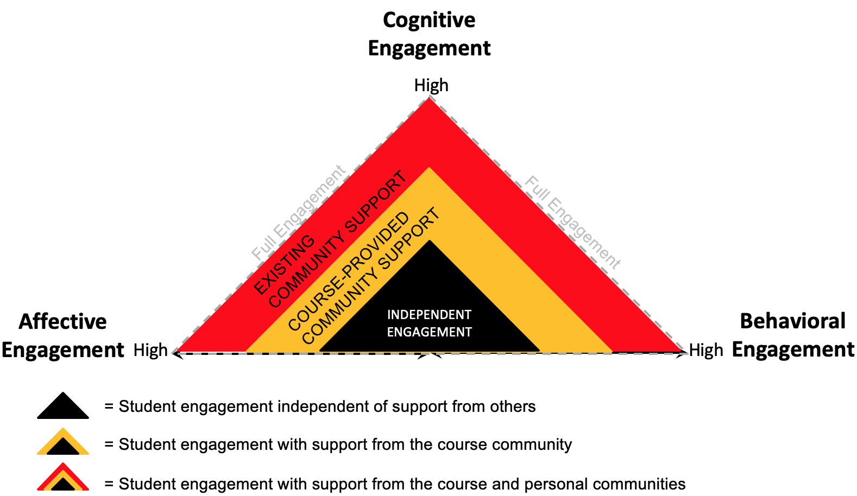
Graduation Requirement
The yellow triangle represents students' engagement with support from actors within the course community. The red triangle represents students' added engagement with support from actors within their personal support community.
Borup, Graham, & Archambault (2019)

Slide 27
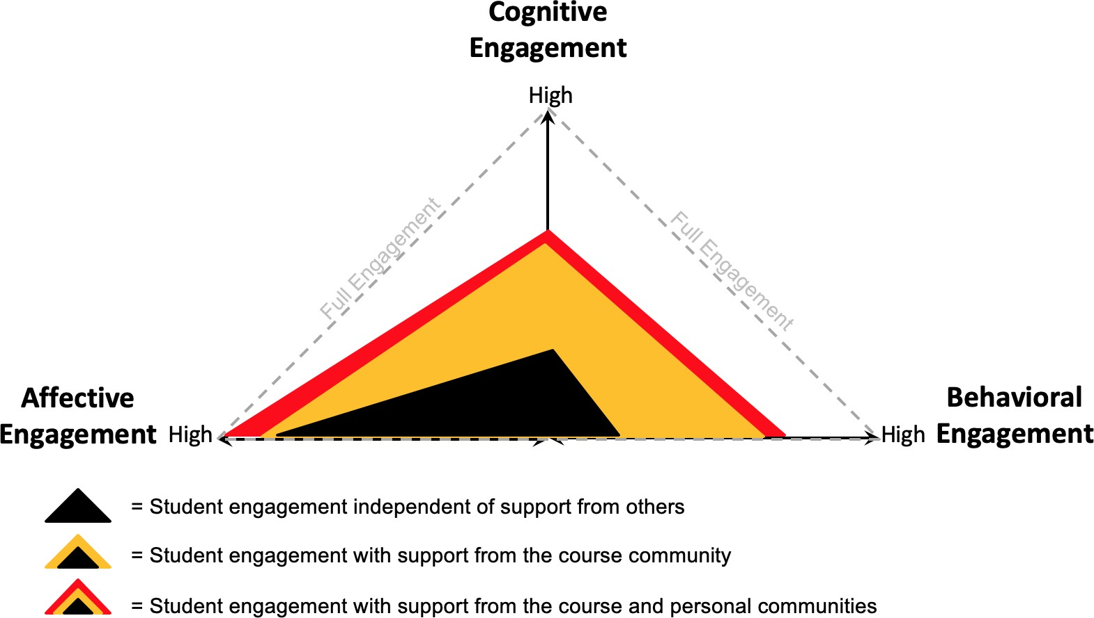
Graduation Requirement

Slide 28
Graduation Requirements
five states (AL, AR, FL, MI, & VA)
MI (2006): successfully completed at least one course or learning experience that is presented online
AL (2008): complete one online/technology enhanced course or experience, with an opt-out for students with IEPs
FL (2011): at least one online course
AR (2013): at least one digital learning course for credit
VA (2013): at least one online course

Slide 29
Graduation Requirements

Slide 30
Goals of E-Learning Announcement
“Today, Ontario's Government for the People announced its plan to modernize classrooms across the province.
To better prepare students for the demands of the future, the Province's plan modernizes classrooms in a number of innovative ways.
Digital skills are essential for everyone to be able to safely and effectively use technology. These skills are also needed as students advance in their education journey, and eventually enter the workplace.”
15 March 2019 Announcement

Slide 31
Goals of E-Learning Announcement
“The purpose of this study was to examine the impact that experience with online learning at the K–12 level had on students’ perceptions, attitudes, and habits in online learning at the postsecondary level.”
“These results indicated that when the high school distance learners were compared with the other university students who participated in the survey, there were no signiﬁcant differences between them on any of the measures.”
Kirby, Barbour, & Sharpe (2012)

Slide 32
Barbour, M. K., & LaBonte, R. (2019). Sense of irony or perfect timing: Examining the research supporting proposed e-learning changes in Ontario. International Journal of E-Learning & Distance Education, 34(2). Retrieved fromhttp://www.ijede.ca/index.php/jde/article/view/1137

Slide 33
Your Questions and Comments

Slide 34
Associate Professor of Instructional Design
Touro University, California
mkbarbour@gmail.com
http://www.michaelbarbour.com

