Slide 1
Writing a Research Proposal
Dr. M. Cleveland-Innes
Professor and Program Director
Centre for Distance Education

Slide 2
Agenda
Introductions
Becoming a writer
Writing an essay of argument
Finding your place in the relevant literature
Identifying the right question
Choosing the right research design

Slide 3


Slide 4
Introductions
http://cde.athabascau.ca/faculty/martic.php
Names and program of participants
Qualifiers
What but not how
Ceteris parabis* – proposal writing is somewhat discipline specific
Holy grail – clarity, argument, parsimonious questions, and detailed, appropriate design
*Latin phrase that translates approximately to "holding other things constant" and is usually rendered in English as "all other things being equal".
Read more: http://www.investopedia.com/terms/c/ceterisparibus.asp#ixzz1YWzcfm5v

Slide 5
Becoming a writer
"The most universal advice on writing a successful grant proposal is to present a well written, focused solution to a problem in a logical progression. This is much easier said than done, and finding the focus is often the most difficult piece of the puzzle. To find this focus, we suggest writing a "concept paper." A concept paper summarizes in two to three pages the entire project from beginning to end. The point is to take all of the ideas in your head and put them down on paper as concisely as possible. Writing a concept paper is a good exercise in defining your priorities and mission, and can be a useful tool in obtaining valuable feedback before "diving into" the full proposal." (cf. About page).
http://www.ryerson.ca/library/subjects/grants/proposal.html

Slide 6
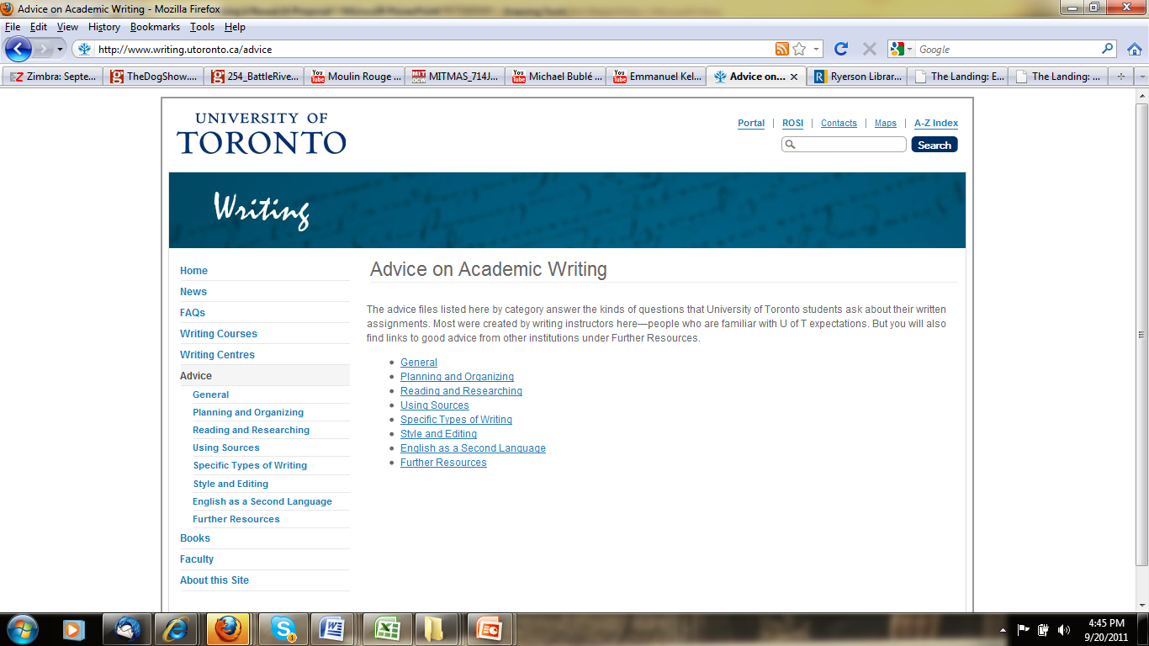
Becoming a writer
http://www.writing.utoronto.ca/advice

Slide 7
Becoming a writer
Less is more
Learn about tense, voice and verb agreement
Not writing but rewriting
“As you edit, concentrate on continuity: does each sentence and each paragraph lead into the next, or does the reader have to ask why you are suddenly talking about this? Writing requires meeting a reader’s expectations, but without becoming predictable and thus boring. Each paragraph should do what the reader expects, but do it in a way that is unexpected.” http://soci.ucalgary.ca/sites/soci.ucalgary.ca/files/courses/F11/SOCI631/sem1/SOCI631-F11-SEM1-outline.pdf

Slide 8
Writing an essay of argument
Statement of claim: “Emotion is present in online learning environments.”
Write at least three premises supporting your claim and cite the relevant literature.
Create a strong rationale for why your research is important: “Understanding the role of emotion will allow improved facilitation.”
Caution: don’t just describe relevant information and retell the stories from the literature.

Slide 9
Using the relevant literature
Choose a general topic
Find 5 articles on research in your field
Read and document
Choose 5 more articles
Read and document
What don’t we know?

Slide 10

Uncovering the dark spots

Slide 11
Identifying the research question
What problems exist in the practice of our field?
What don’t we know (looking for dark places)?
What interests you?
What expertise is available in your department or institution?
What can I accomplish in the time I have?
Don’t be presold! “Which, if any, human emotions are present in online learning environments.”

Slide 12
Choosing the right research design
The question determines the method–maybe ;-).
Practical and applied or abstract and theoretical?
Is there enough already known to help you formulate deductive notions and test the?
Is this an exploration of new relationships?
How or what questions that explore or describe – qualitative designs.
Testing and comparing relationships – quantitative designs.

Slide 13
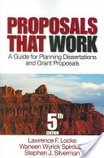
Resources
Locke, L., Spirduso, W., & Silverman, S. (Eds.). (2007). Proposals that work: A guide for planning dissertations and grants proposals. Thousand Oaks, California: Sage Publications, Inc.
Nair, A.S. (2007). On becoming a researcher. Retrieved from: http://www.scribd.com/doc/21202688/On-Becoming-A-Researcher

Slide 14
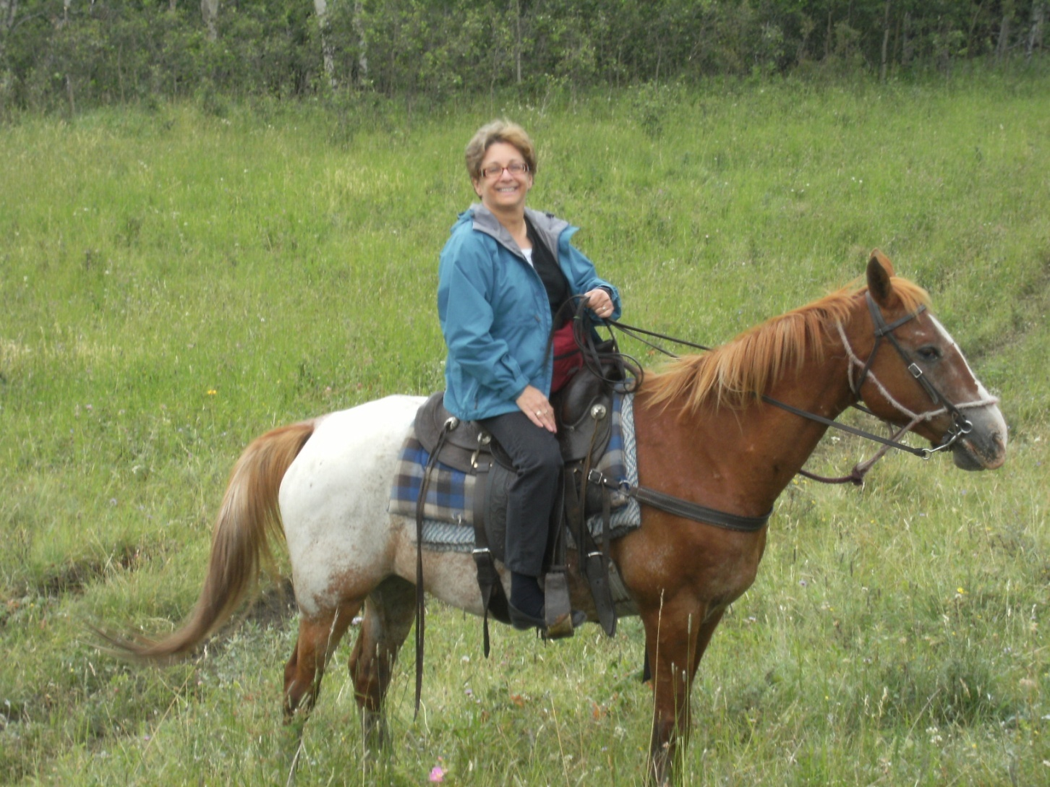
Happy Trails

